Slide 1
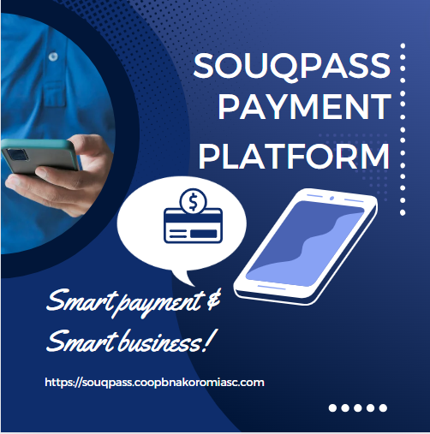



SOUQPASS PAYMENT PLATFORM
Exploring Souqpass.

Slide 2
Souqpass Payment
Souqpass ensures all payments, from any source, reach the cooperative account via one platform.
POS
The system also accepts cash transactions, but prompts for deposit if cash is not deposited.
02
Cards and Wallet
eCommerce
01
03
Allows to accept payment from any eCommerce sites with cards and other payment methods
It accepts local and international cards. It is integrated with wallets which makes great fit for seamless payment with fintech's.

Slide 3


Souqpass enables crowdfunding system collect funds easily from world wide
Crowdfunding
1
Equb
Our Digital Equb application also use SouqPass to disburse payment to member by reducing the perplex of payment.
2
SouqPass
Local and International Cards
3
Souqpass enables customers to commit payment from anywhere with their card
Loan
4
It have also functionality of loan repayment and disbursement feature.

Slide 4
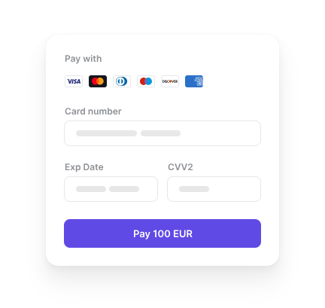
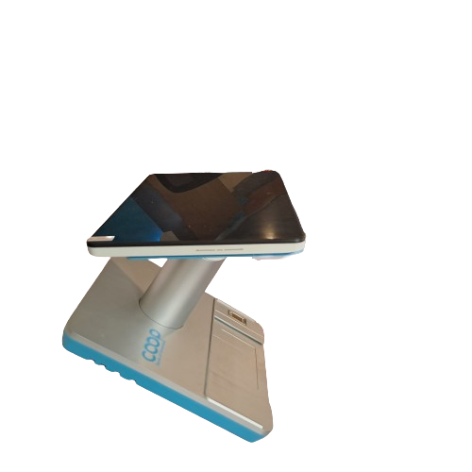

Souqpass Payment
Supports POS functionality:
Accepts card payments.
Accepts international cards.
Supports Card-Not-Present (CNP) transactions.
Wireless card payments.
SouqPass POS
02

Slide 5
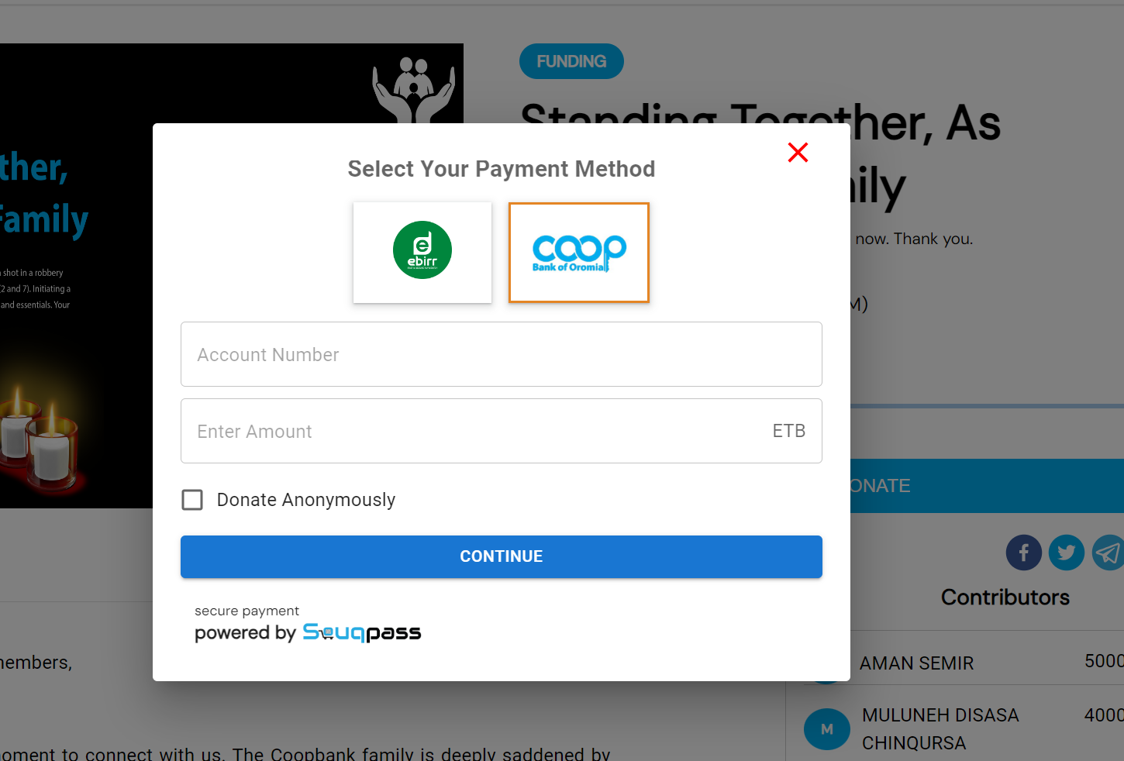
Souqpass Payment

Slide 6
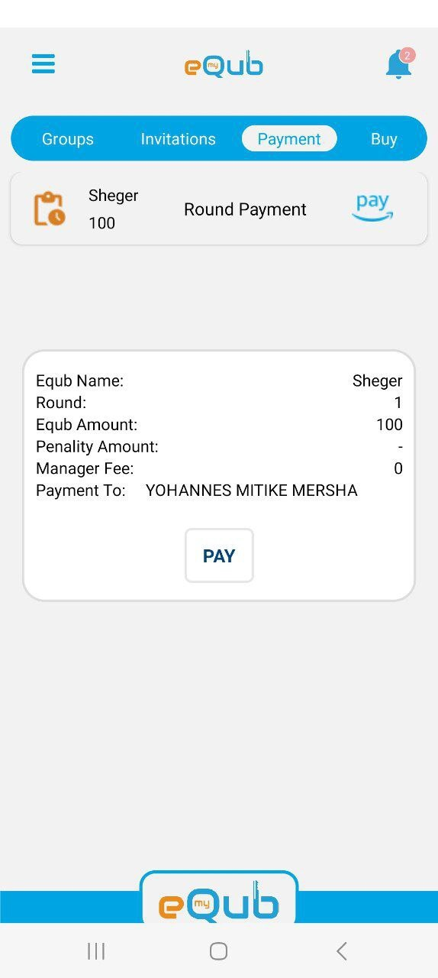
Souqpass Payment

