Slide 1
DengL
Breaking down language barriers
TUM.ai Makeathon 2023 Challenge | Bridge the Gap from Knowron
Team whAI | Felix Bastian, Lukas Mahr, You Sun Song, Felix Waiblinger

Slide 2
Where is the gap?
Germany needs 400,000 skilled immigrants each year
(Germany’s Federal employment Agency)
Most people who come
to Germany to work
leave after only
3~4 years
(Research institute Minor in Berlin)
The number of foreign workers worldwide has more than tripled in the last decade
(International Labor Organization)
Language Barrier
Multi-lingual communication
Administrative burden

Slide 3
Report Generation Tool with
Code-Mixed Translation
using
Neural Machine Learning Model
DengL

Slide 4
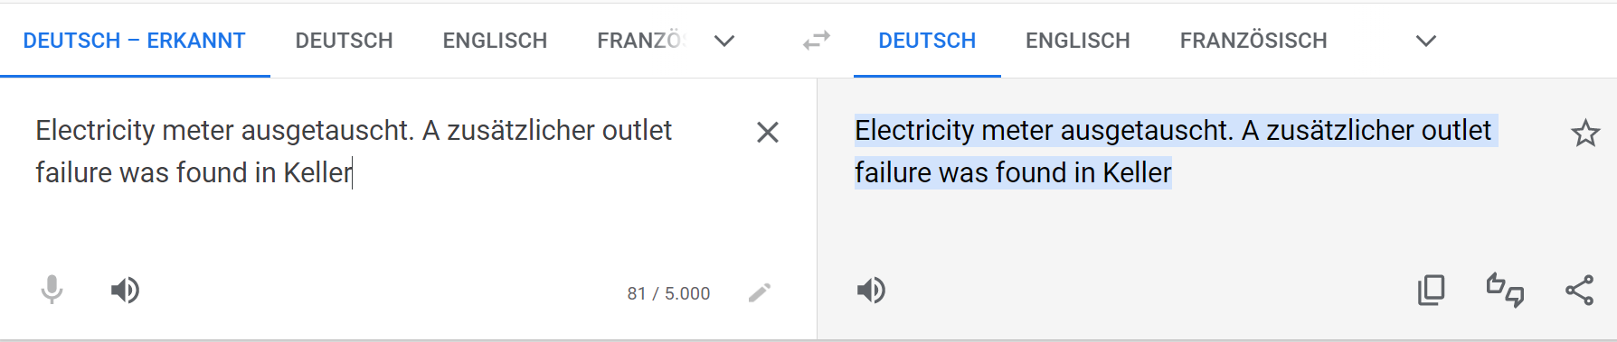
Why code-mixed translation?
code-mixed,
business domain corpus dataset
NMT model

Slide 5






Acceleration through AI
Microsoft Azure Platform
Modern interfaces
Speech-To-Text
Anywhere & Anytime
Language Detection
Custom Translator
Interactive & Responsive

Slide 6
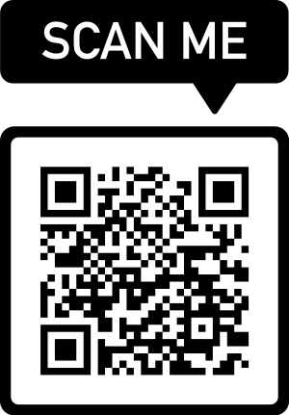
DengL

Slide 7
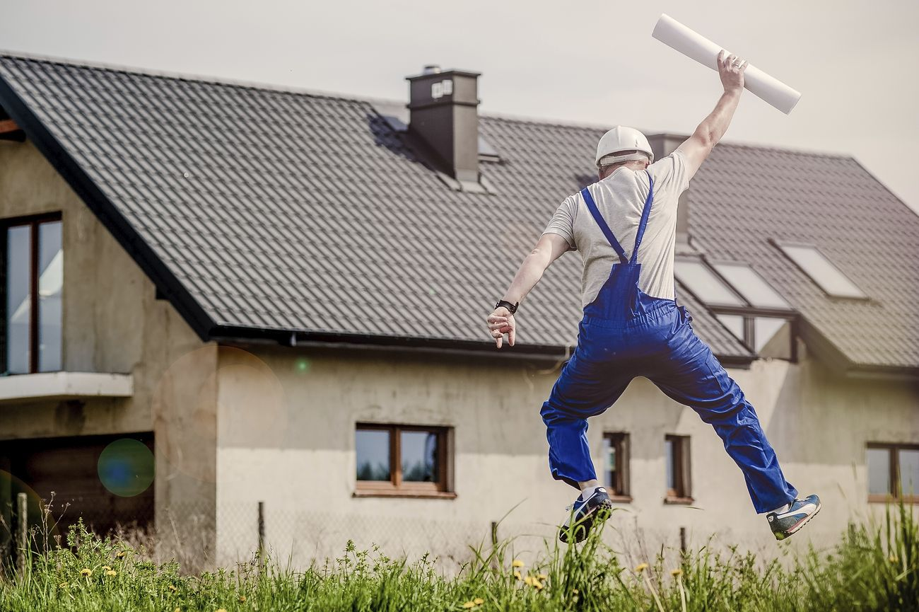
Shaping the Future
Lowering language hurdles
↓
Reducing bureaucratic efforts at work
Increase in skilled workers
↓
Economic growth

