Slide 1







Capstone Project
MUHLIS CM
19/04/2021

Slide 2



OUTLINE
Executive Summary
Introduction
Methodology
Results
Visualization – Charts
Dashboard
Discussion
Findings & Implications
Conclusion
Appendix

Slide 3

EXECUTIVE SUMMARY
Data Collection
Data Wrangling
Removing Duplicates
Find & Impute missing values
Normalizing Data
Explanatory Data Analysis (EDA)
Data Visualization
Building Dashboards

Slide 4

INTRODUCTION
It's a valuable effort to find the most populat programming language and database
Which country contibute more to survey
Best platform for technical works
Most used and desired webframe works
The participation of educated people in servey
Cortibution based on the gender

Slide 5

METHODOLOGY
Collecting data
Cleaning using python libraries
Visualization using python libraries
Creation of dashboard for various categeries
Top 10 count
Geography
Gender
Contribution by country
Contributers education status

Slide 6
RESULTS

Slide 7
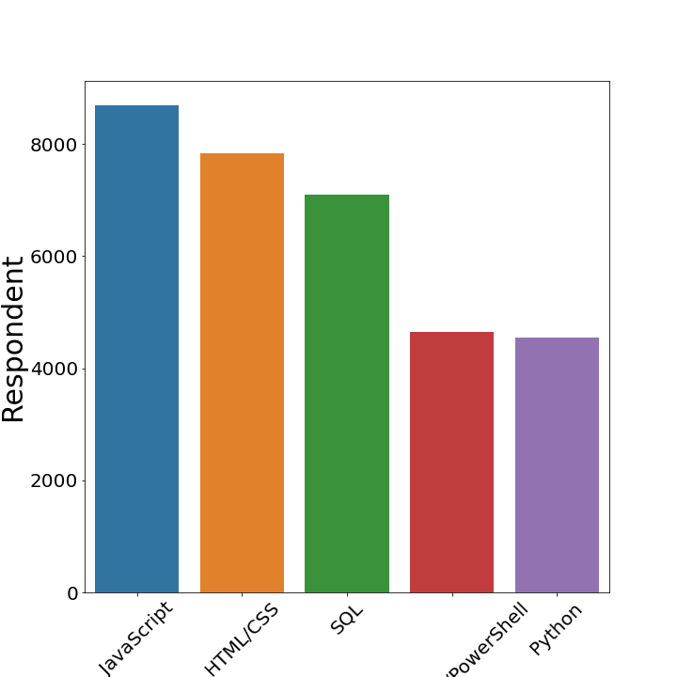
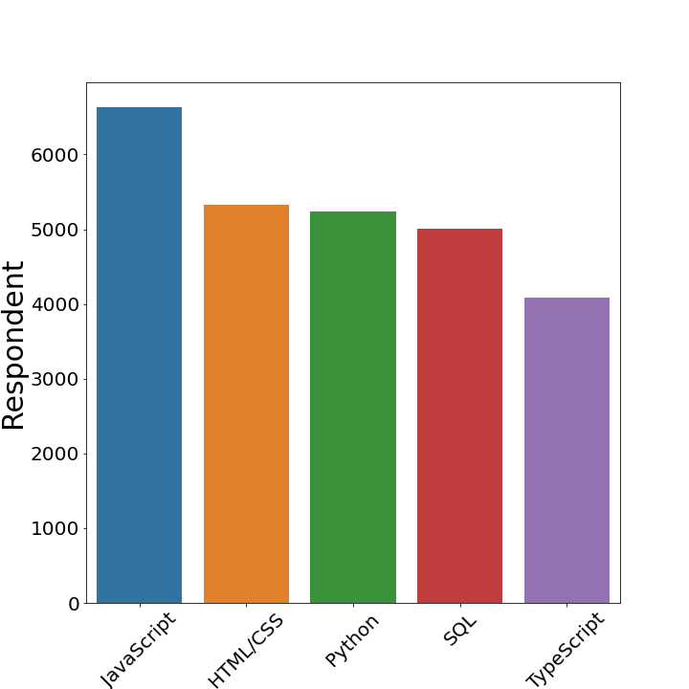
PROGRAMMING LANGUAGE TRENDS
Current Year
Next Year

Slide 8
PROGRAMMING LANGUAGE TRENDS - FINDINGS & IMPLICATIONS
Findings
Python improved rank
Sql lost 1 position
Java script and Html/ Css lead in two studies
Implications
Python jumped to 3 from 5
Type Script is more popular than c, java, C++
Python has potential to overcome other language in coming years

Slide 9
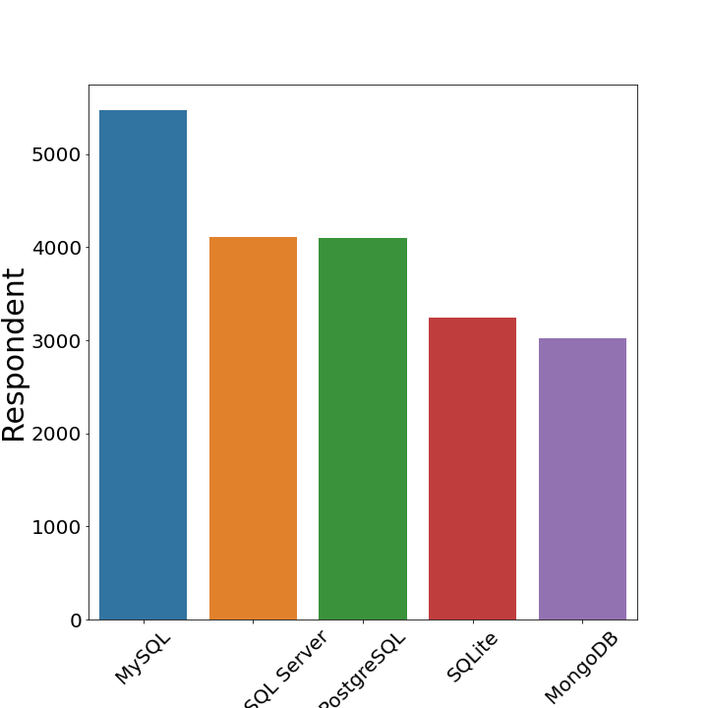
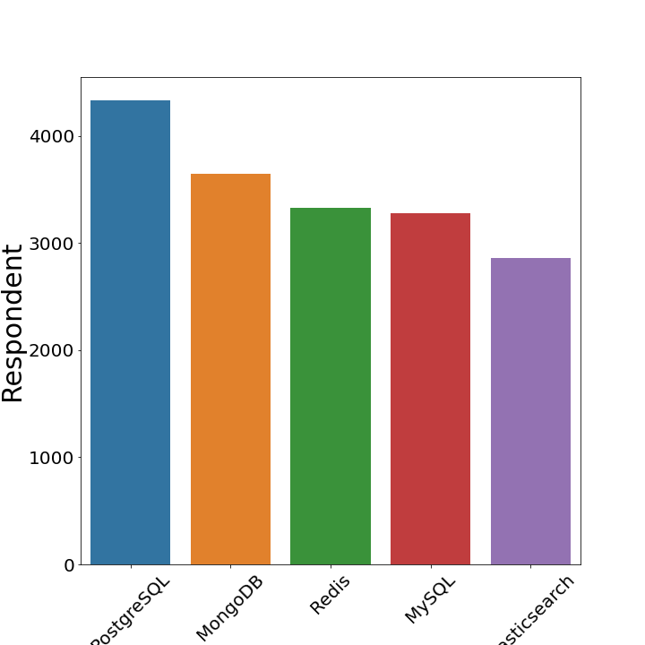
DATABASE TRENDS
Current Year
Next Year

Slide 10
DATABASE TRENDS - FINDINGS & IMPLICATIONS
Current Year
MySql is most sought after
SQL in 2nd and 3rd position
Sqllite and mangodb is in first 5
Future Trend
Postgrel sql is leading
MySql droped to 4
Mango db jumped to 2 and sqlite and Microsoft sql server are out of the top 5

Slide 11

DASHBOARD
https://eu-gb.dataplatform.cloud.ibm.com/dashboards/4dd8e585-435b-485f-86df-05ce0722f39c/view/4704f60e3ea008c468c8f6e4079e79057a35200eb2bbd20486817b495e647297f06a4690c82d4d5edd455361f2bd445cc1

Slide 12
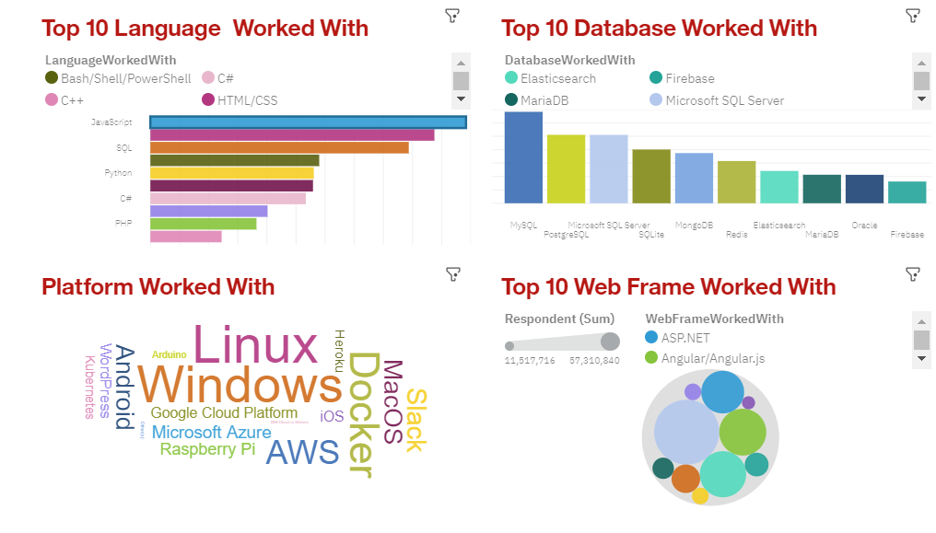
DASHBOARD TAB 1

Slide 13
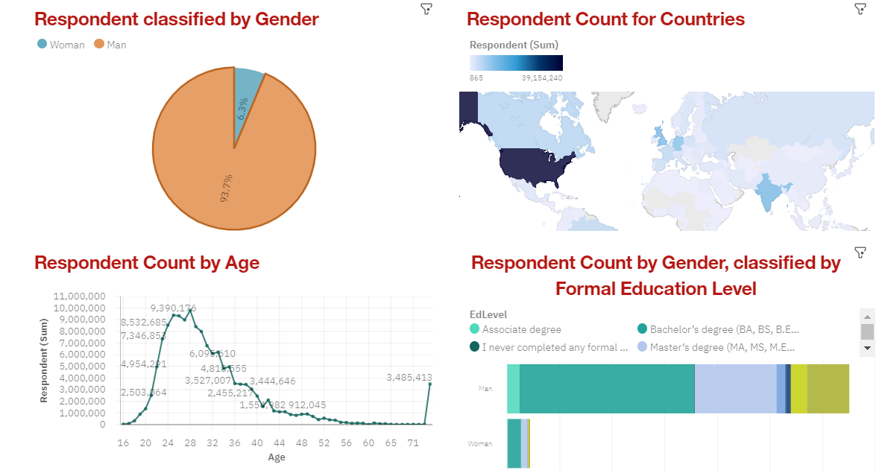
DASHBOARD TAB 3

Slide 14
DISCUSSION
In this project, intention is to find more popular language, data base, respondents age, country, favorite plate form , web frame work and cotribution by the gender of respondent, education deails, average age, the most desired programming language and data base in coming years

Slide 15
OVERALL FINDINGS & IMPLICATIONS
Findings
Java script is the most used and desired language
MySql is the most used data base
Postgrel sql in the data base which more people want to learn
Implications
Most of the Responders are Male
Averge age of the most responders lies between 20 and 40
United States are the major Cotributer to survey with 39,154,240 responders

Slide 16

CONCLUSION
Python become more popular in recent years, that's why more people want to
learn python
Contribution from females are less
USA cotributes more respondents, because of the large number of It companies the have
Linux is the most Sought after platform and people want to stick with it

Slide 17
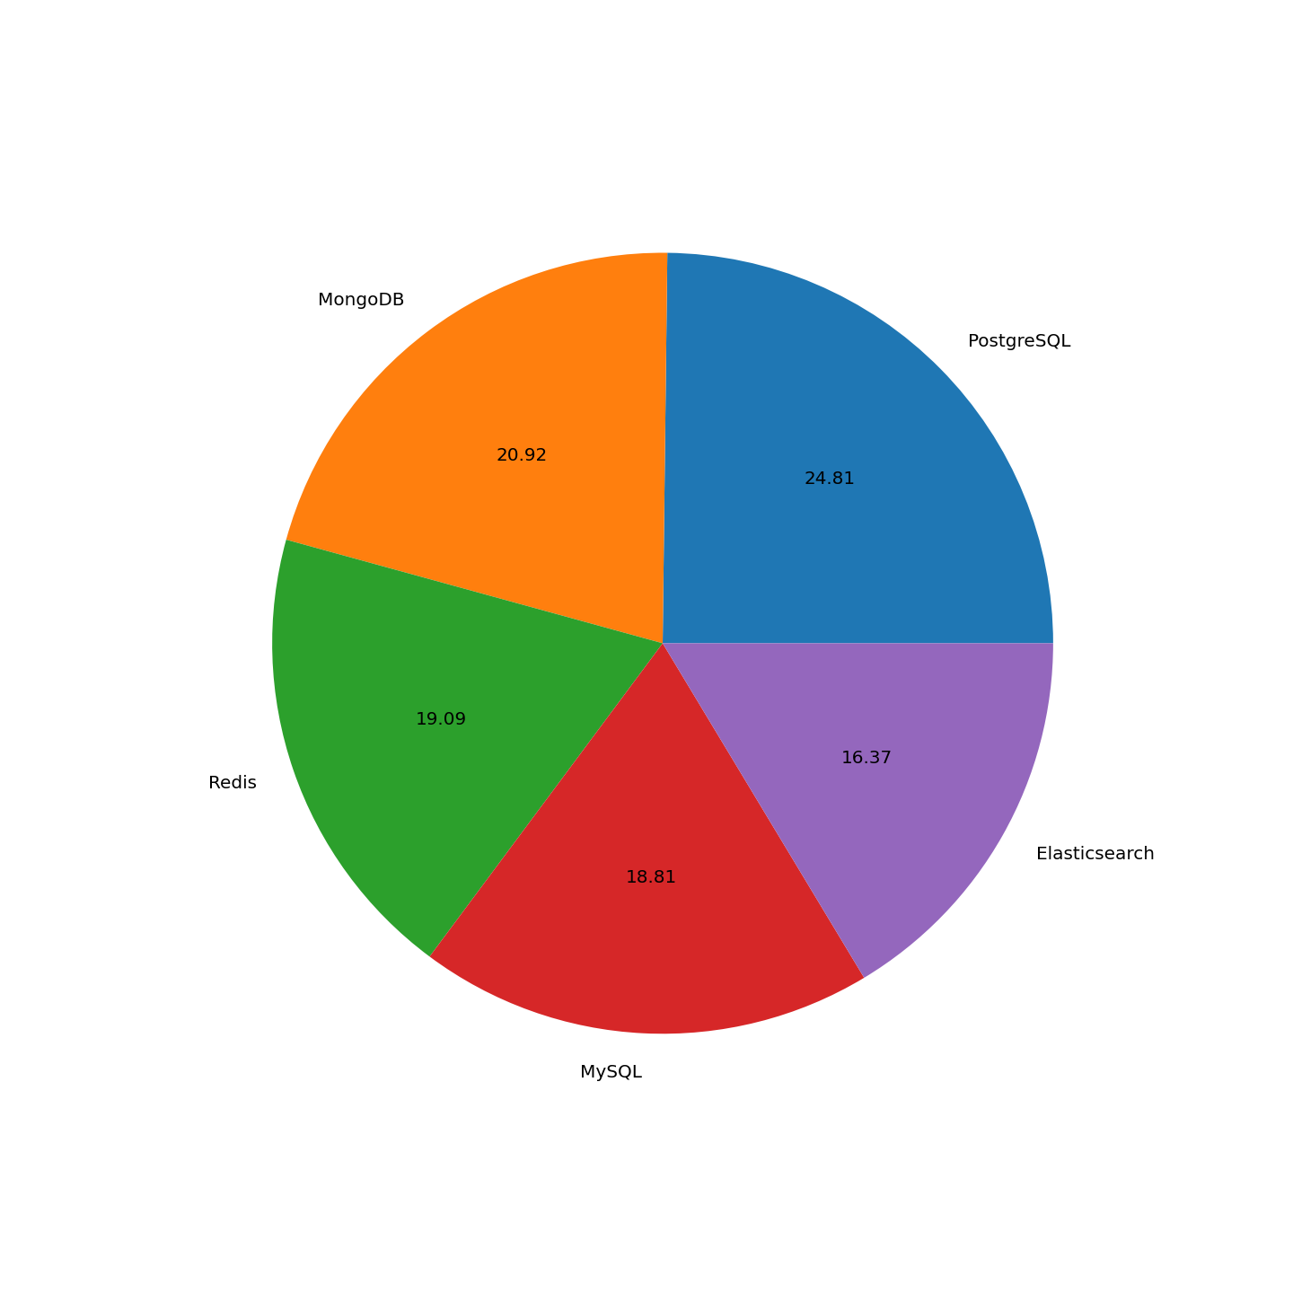
APPENDIX
Pie Chart for more desired Data bases.

Slide 18
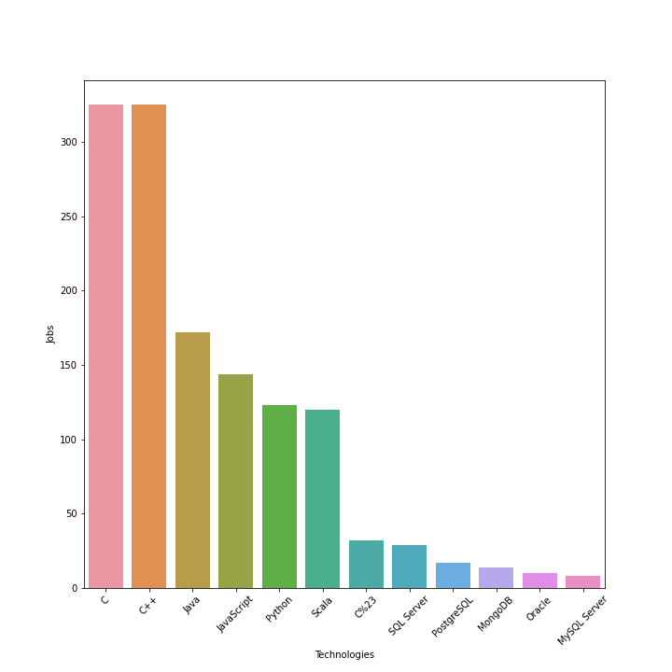
GITHUB JOB POSTINGS

Slide 19
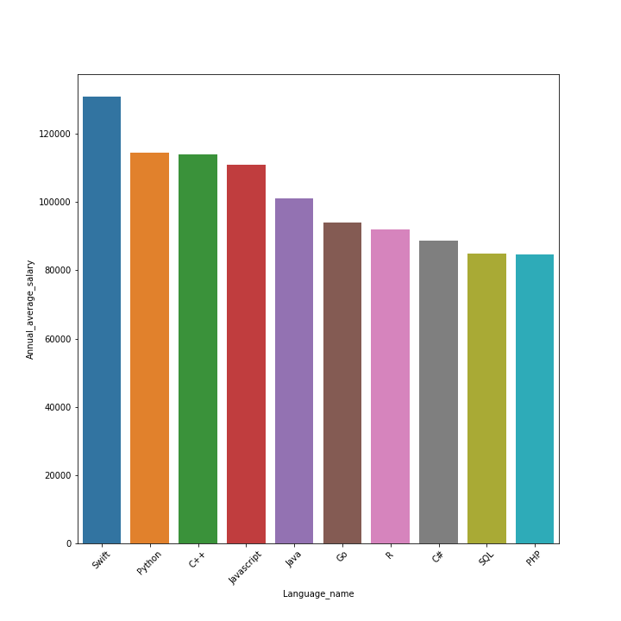
POPULAR LANGUAGES

