Slide 1
BSc APPLIED COMPUTING — DATA SCIENCE | THESIS DEFENCE
Analysing Surge Pricing Dynamics
in Nairobi's Ride-Hailing Industry
A mixed-methods, deployment-ready decision-support framework
Presented by
Course & Date
Muhsin Ahmed
Research Project
Student No. 665629
USIU-Africa | April 2026
Aligned with UN SDG 11.2 — Urban Mobility

Slide 2
1
Problem Statement
Nairobi's ride-hailing market has grown rapidly, but surge pricing remains opaque, contested, and under-studied. Drivers, passengers, and regulators see different sides of the same algorithm — and no one has the evidence base to reconcile them.
Opaque pricing
Affordability & accessibility
Drivers and passengers face sudden surge multipliers with no visibility into what triggers them — the single biggest grievance across all 35 interviews.
Nairobi households already spend up to 35% of income on transport. Surge during emergencies or late-night travel risks pricing out the people ride-hailing is supposed to serve.
No empirical Nairobi baseline
No decision-support tool
Prior work is North American or anecdotal; no large-scale, trip-level study has quantified where, when, and why surge fires across Nairobi's neighbourhoods.
Regulators and platforms currently have nothing between raw dashboards and proprietary algorithms — a public-interest gap this project sets out to fill.
Muhsin Ahmed | 665629 | DSA 4900VA | Nairobi Surge Analysis
2 / 6

Slide 3
2
Methodology
Convergent mixed-methods design — quantitative + qualitative, triangulated at interpretation.
STEP 1
STEP 2
STEP 3
STEP 4
STEP 5
Data
Clean
Engineer
Model
Deploy
3.7M trips
+ weather + 35 interviews
Schema, GPS, outliers,
missing-data fixes
47 features:
time, peak, spatial, weather
6 classifiers + 3 regressors
80/20 chrono split
Streamlit dashboard
(app/app.py)
Data sources
Analysis techniques
Validation
Trips — 3,703,406 records (Jan–Jul 2024)
Weather — Open-Meteo hourly archive
Interviews — 15 drivers + 15 passengers + 5 experts
Ethics — IRB-approved | Kenya DPA 2019 | NDA
EDA — Temporal, spatial, weather profiling
Stats — Mann–Whitney U, ANOVA (p<0.001)
Models — LogReg, Tree, RF, XGB, LGBM, MLP
Spatial — K-Means, DBSCAN, choropleth
Split — Chronological 80/20 + 5-fold TS-CV
Leakage — Audited — 4 target derivatives removed
Threshold — Sweep 0.3–0.6 for precision/recall trade
Qualitative — 35 interviews triangulated
Muhsin Ahmed | 665629 | DSA 4900VA | Nairobi Surge Analysis
3 / 6

Slide 4
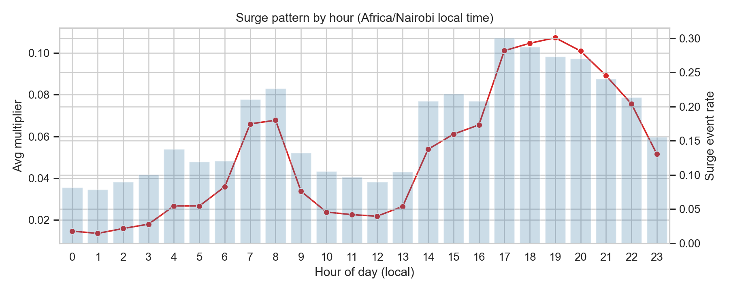
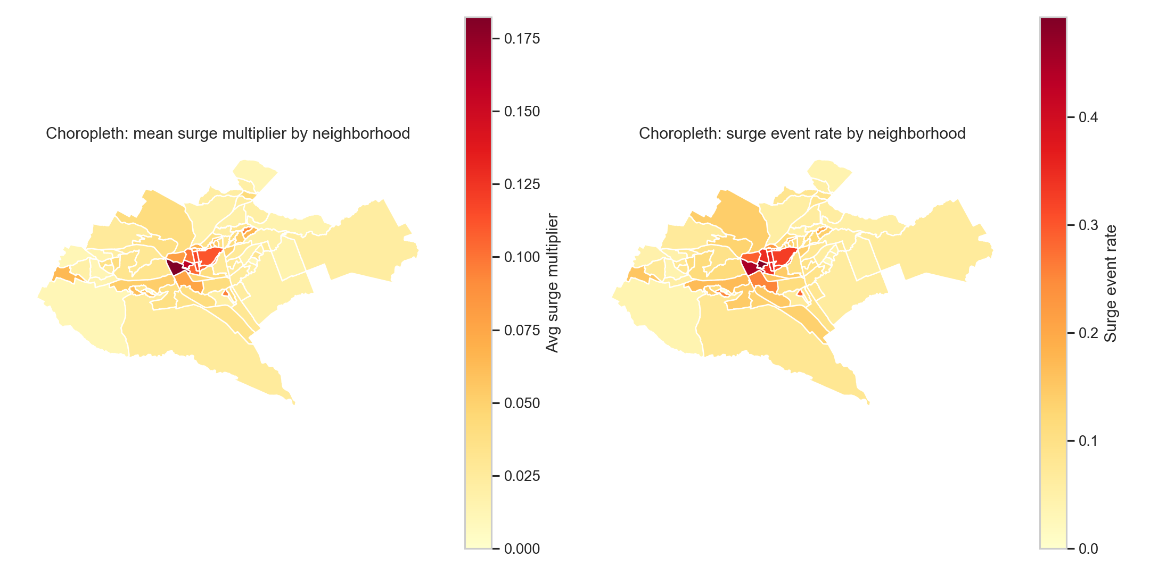
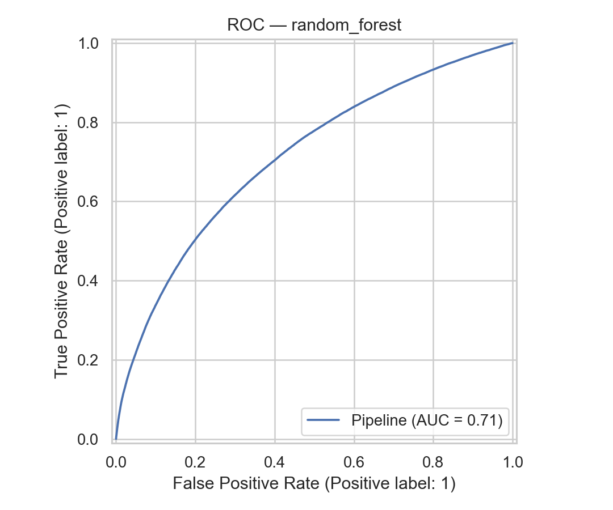
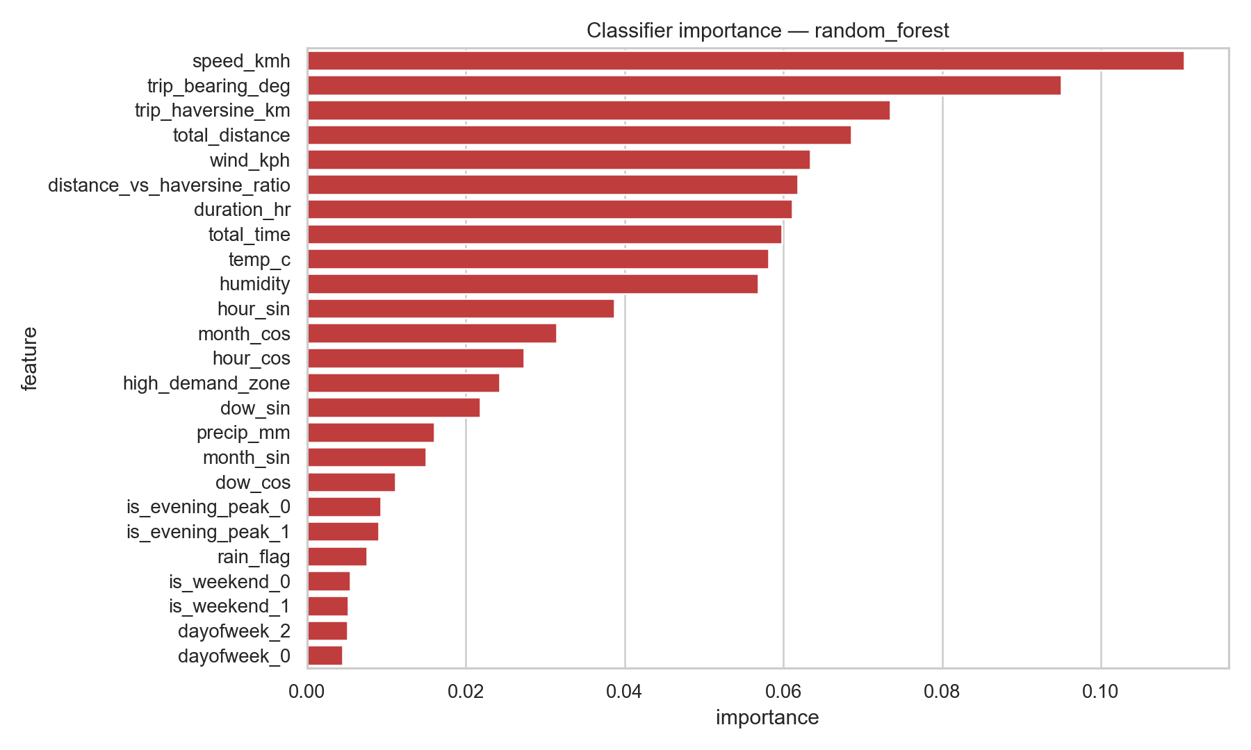
3
Results & Live Demo
0.713
0.133
46.4%
+70%
RF classifier ROC-AUC
XGBoost regressor RMSE
Karen — top-neighbourhood surge rate
Evening vs. morning peak surge
KEY FINDINGS
What the evidence shows
Surge is time-driven. Evening peaks run ~70% higher than morning; Fri/Sat evenings top the week.
Rain amplifies surge. ~1 in 4 trips hit rain; Mann–Whitney U confirms larger multipliers (p<0.001).
Spatially concentrated. Karen, Westlands, Kilimani, CBD surge at 2× the citywide rate of 19%.
Tree ensembles win. Random Forest beats LogReg / Tree / MLP; XGBoost leads regression.
Evening peak (17:00–20:00) dominates
CBD, Westlands, Karen, Kilimani top
Random Forest ROC-AUC = 0.713
Top drivers: hour, rain, neighbourhood
LIVE DEMO — Streamlit dashboard (app/app.py)
Muhsin Ahmed | 665629 | DSA 4900VA | Nairobi Surge Analysis
4 / 6

Slide 5
4
Challenges & Recommendations
CHALLENGES ENCOUNTERED
RECOMMENDATIONS & FUTURE WORK
What made this hard
Where this goes next
01
Platform opacity
01
Multi-platform, multi-year data
The provider never published its internal surge formula, so no ground-truth comparison was possible. R² sits in single digits because much of the variance is unobservable from outside the platform.
Extend the pipeline to Bolt, Little Cab, and Yango over 24+ months to capture long/short rains, festivals, and cross-platform variation in surge behaviour.
02
Target leakage risk
02
Real-time feeds & causal inference
Several candidate features (surge_event, surged, surge_multiplier) were direct derivatives of the target. A formal leakage audit was built and four columns were removed before any model training.
Add live weather, traffic, and event streams to lift the R² ceiling, and use diff-in-diff / IV designs around regulatory shocks to turn predictive results into causal estimates.
03
Class imbalance & calibration
03
Policy & platform interventions
Surge is a minority event. The default 0.5 threshold produced recall of only 0.234; a threshold sweep between 0.3–0.6 was needed to expose the precision-recall trade-off for operators.
Pilot transparency tiles, soft neighbourhood-level surge caps (e.g., ~40%), and driver-facing heat maps. Extend the framework to Kampala, Dar es Salaam, and Kigali for regional comparison.
Muhsin Ahmed | 665629 | DSA 4900A | Nairobi Surge Analysis
5 / 6

Slide 6
CONCLUSION | SLIDE 6 OF 6
A reusable baseline for Nairobi's surge economy.
This project produced the first large-scale, leakage-audited empirical account of surge pricing in Nairobi — combining 3.7 million anonymised trips, hourly weather, and 35 interviews into a reproducible mixed-methods pipeline. All four hypotheses were supported: surge is demand-sensitive, weather-reactive, spatially concentrated, and best modelled by tree ensembles. The Random Forest classifier (ROC-AUC 0.713) and XGBoost regressor (RMSE 0.133) met the predictive objectives, while the Streamlit dashboard operationalised the findings for regulators, platforms, drivers, and passengers. Together, the outputs form a public-interest prototype aligned with SDG 11.2 — a concrete step toward transparent, equitable urban mobility in Nairobi.
Evidence
Models
Delivery
3.7M trips + 35 interviews, triangulated
RF 0.713 AUC | XGBoost 0.133 RMSE
Streamlit dashboard — ready to demo
Thank you !!!

