Slide 1

Customer Personality Analysis Dashboard
Presented By
Muhsina Shehzad

Slide 2
About Data
Total Rows : 2240
Total Columns : 32
Customer Demographics Customer ID , Education , Marital Status , Income etc..
Customer Purchases & Spending Amount spend on Wine , Fish , Meat , Fruits etc..
Customer Purchase Channels Number of purchases made with discounts , through website , store, etc..
Marketing Campaigns 1 if the customer accepted the 1,2,3,4,5 campaign, 0 otherwise
Complaints 1 if the customer complained in the last 2 years, 0 otherwise

Slide 3
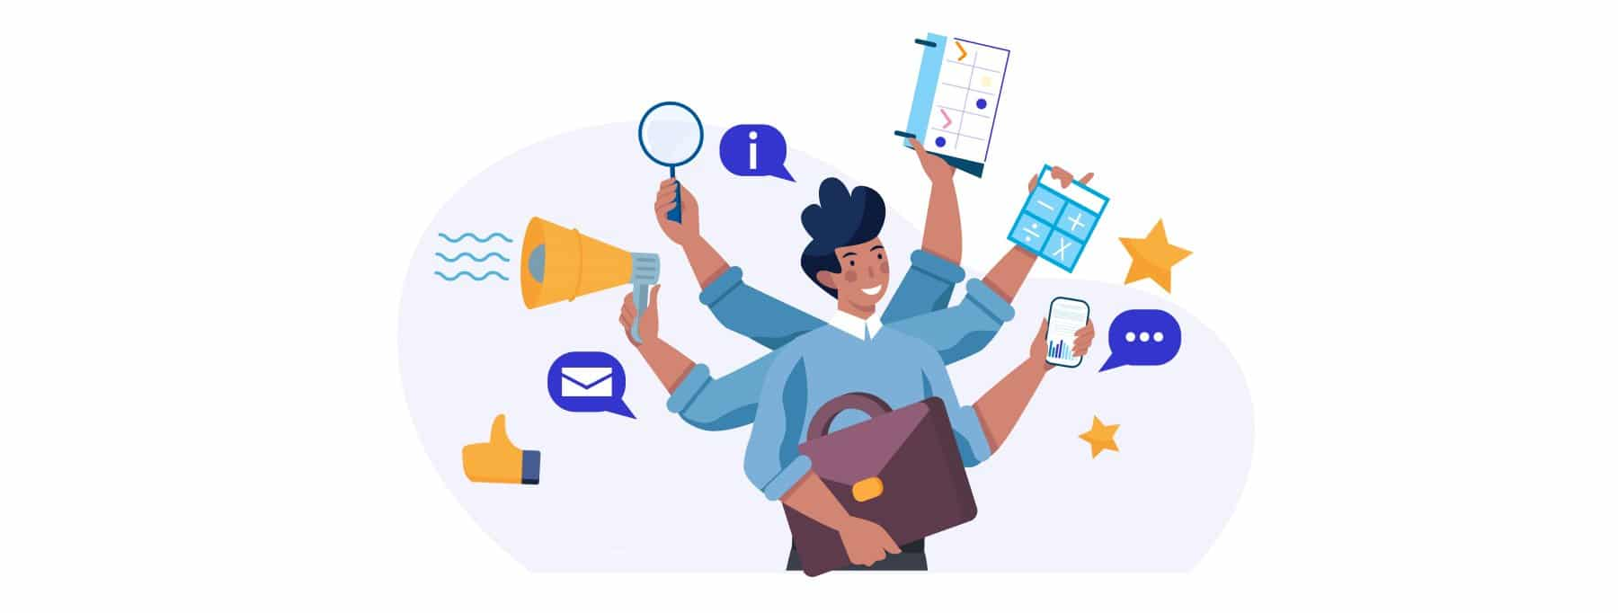
Introduction
This project analyzes customer behavior by studying their spending habits, demographics, and responses to marketing campaigns. The dataset includes details like age, income, family size, and purchases across different product categories. The goal is to group customers based on their habits, identify valuable customers, and understand which marketing strategies work best. This presentation will cover key insights, customer segments, spending trends, and recommendations for better marketing decisions.

Slide 4
Objectives
Analyze Customer Purchase Behavior :
Understand how customers shop through different channels (Web, Store, Catalog).
Identify spending patterns based on marital status and education level.
Evaluate Customer Engagement :
Track the number of customer enrollments per month.
Measure web visits and interactions by different customer groups.
Assess Marketing Campaign Performance :
Analyze response rates to all marketing campaigns.
Identify which customer groups (by marital status & education) engage more with promotions.
Study Income and Demographics Impact :
Compare average income by marital status and education.
Analyze customer age distribution based on marital status and education.
Household Analysis :
Study family structure by analyzing the number of kids and teenagers at home.
Understand how family size impacts purchasing behavior.

Slide 5
Findings
Customer Spending & Income Trends :
Marital Status & Income: "Absurd" category has the highest average income ($72,365), while "Alone" has the lowest ($43,789).
Education & Income: Customers with a PhD earn the highest ($56,145), while those with basic education earn significantly less ($20,306).
2. Purchase Behavior & Preferences :
Shopping Channels: Most purchases are made in physical stores, followed by web and catalog purchases.
Purchases with Discounts: Married customers (39.69%) and those "Together" (25.88%) use discounts the most, while widows use them the least.
Product Preferences: Wine and meat products have the highest spending, while fruits and sweets have the least purchases.
3. Customer Engagement & Web Interactions :
Customer Enrollment Trends: Enrollment fluctuates throughout the year, peaking in certain months.
Web Visits: The number of web visits per month varies, with some customer segments being more active online than others

Slide 6
Findings
4. Marketing Campaign Performance :
Campaign Response: The last campaign had the highest acceptance (334 customers), while the second campaign had the lowest (30 customers).
Marital Status & Campaigns: Married and single customers responded more positively to marketing campaigns than divorced and widowed customers.
5. Household Influence on Spending :
Families with Kids & Teenagers: Spending behavior changes depending on whether customers have children or teenagers at home.
Age Distribution: Customers are mostly in their 30s-50s, with different marital statuses affecting age demographics.
6. Complaints & Customer Satisfaction :
Complaints: Only 0.94% of customers reported complaints, indicating overall satisfaction with products and services.

Slide 7
Insights
Higher-income customers tend to have higher
education levels.
Married customers are the most engaged in
discounts and marketing campaigns.
Web visits and enrollments vary significantly by
customer group.
Customers with kids may have different spending
habits compared to those without children.
Wine and meat are the most popular product
categories.

Slide 8

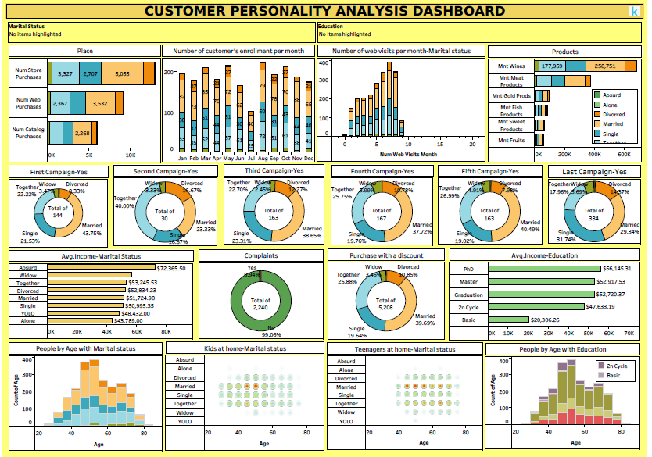
Dashboard Overview
Link

Slide 9
Business Recommendations
Based on the dashboard findings, businesses can take several steps to improve sales and customer engagement.
Better Marketing Strategies:
Focus on Marital Status: Married and "Together" customers respond well to promotions, so special offers should be designed for them.
Improve Customer Engagement:
Better Online Shopping Experience: Many customers shop online, so improving the website and offering online discounts can increase sales.
Offer Personalized Deals:
Suggest the Right Products: Customers with kids and teenagers may have different needs, so offering family-friendly products can increase sales.
Make Campaigns More Effective:
Use Discounts Wisely: Since many customers buy with discounts, limited-time offers can boost sales while keeping profits high.

Slide 10
Challenges & Limitations
Limited Information: The data mainly includes customer details, purchases, and campaign responses. It does not show customer opinions, product reviews, or reasons behind their choices.
No External Factors: It does not consider things like market trends, competitor actions, or seasonal effects, which may influence customer behavior.
Uneven Data: Some categories, like earlier campaigns, have fewer responses, making it harder to draw strong conclusions.
No Real-Time Updates: The data is fixed and does not show recent customer activities or changing buying habits.

Slide 11
Conclusion
This analysis helped us understand customer behavior and spending patterns. We found that income and marital status influence purchasing habits, with married and "together" customers being the most active buyers.
Higher-educated customers tend to earn more, which affects their spending choices.
Most customers prefer in-store purchases, but online and catalog shopping are also popular. Discounts play a big role in purchases, and the last campaign was the most successful. However, earlier campaigns had lower response rates, showing the need for better marketing strategies.
To improve sales, businesses should focus on personalized marketing, offer better online shopping experiences, and use customer insights to design more effective promotions. By making these changes, they can attract more customers and increase profits.

Slide 12
thank you
Muhsina shehzad
DATE: 20-03-2025
Tableau Project Presentation Customer Personality Analysis

