Slide 1
Semester Form Fill Up System
Presented By
16701007 – Foysal Hossain 16701016 – Atikur Rahman 16701019 – Ahsan Ullah 16701051 – Md Jawwad Bin Zahir Seemanta
16701072 – Tamanna Akther Mukta

Slide 2
Overview
Problem Analysis
Project Objectives
Requirement Analysis
Design Specification
Implementation
Screenshots
Testing
Future Works

Slide 3
Problem Analysis
The current Semester Form Fill-up System is,
Manual
Complex
Paper-based
Prone to Errors
Inconvenient
Time Consuming
Unable to handle multiple students at a time

Slide 4
Project Objectives
The main objectives of this project is to make the Semester Form Fill-up System
Fast
Reliable
User friendly
Secured
Robust
Error Free
Able to handle multiple request at a time
Accessible from anywhere

Slide 5
Requirement Analysis
Users
Student
Department Chairman
Department Office
Hall Provost
Accounts Department
Bank

Slide 6
Requirement Analysis
Functions
Student
Fill-Up Form
Department Office
Register New Students
Input Attendance
Department Chairman
Arrange Examination

Slide 7
Requirement Analysis
Functions
Hall Provost
Approve Forms
Accounts Department
Impose Fees
Bank
Confirm Payment

Slide 8
Requirement Analysis
Features
User Authentication
Form Progress Checking
Download Admit Card
Responsive UI
Low Resource Consumption
Portable API

Slide 9
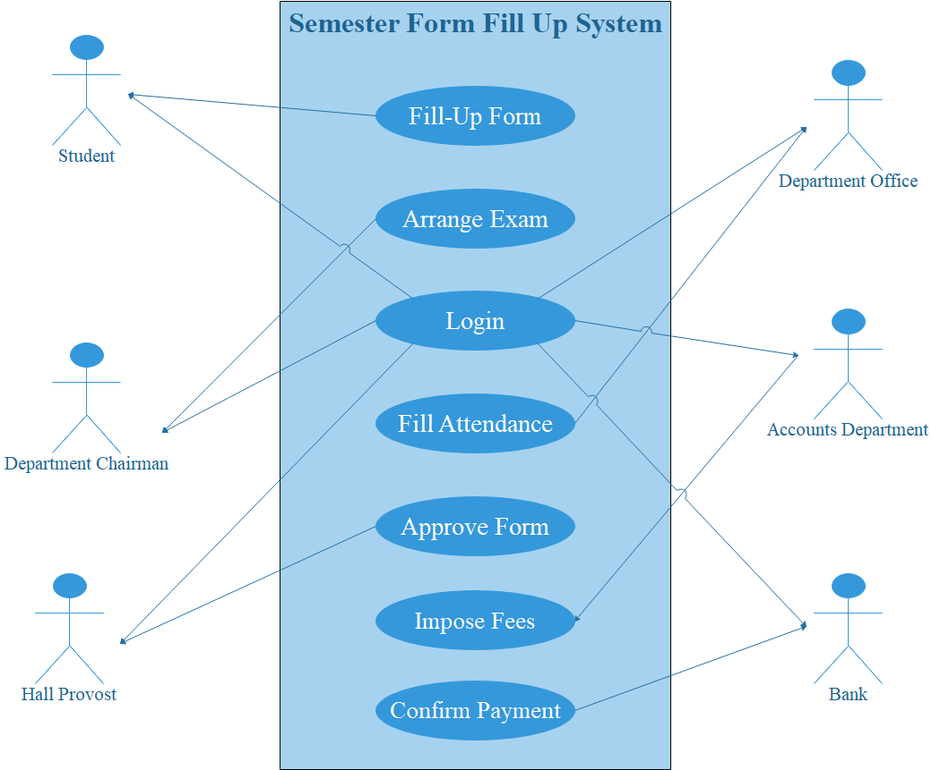
Design Specification
Use Case Diagram

Slide 10
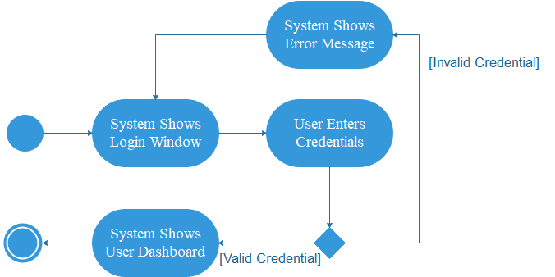
Design Specification
Activity Diagram: Login

Slide 11
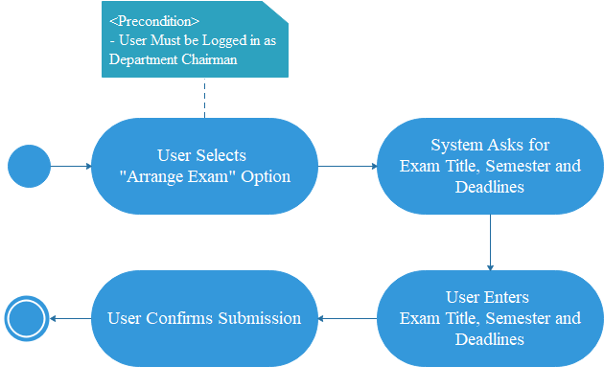
Design Specification
Activity Diagram: Arrange Examination

Slide 12
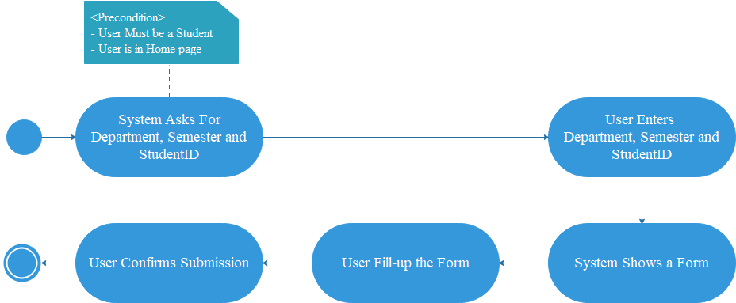
Design Specification
Activity Diagram: Fill-Up Form

Slide 13
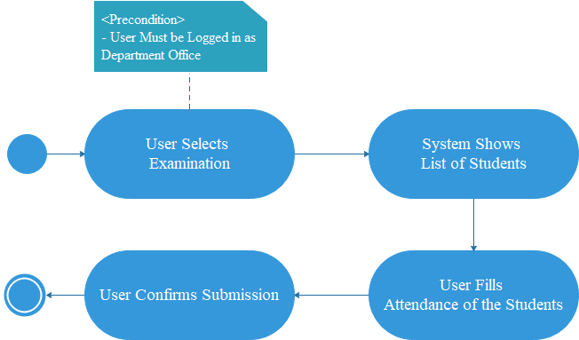
Design Specification
Activity Diagram: Input Attendance

Slide 14
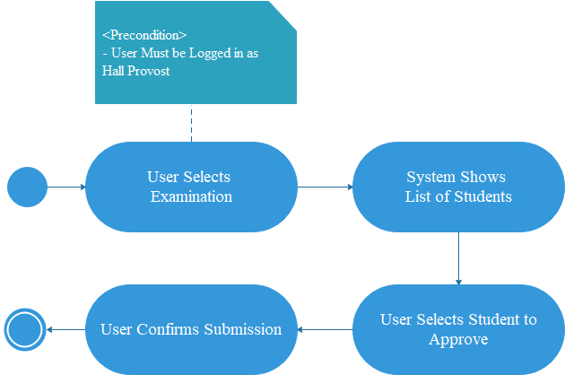
Design Specification
Activity Diagram: Approve Students

Slide 15
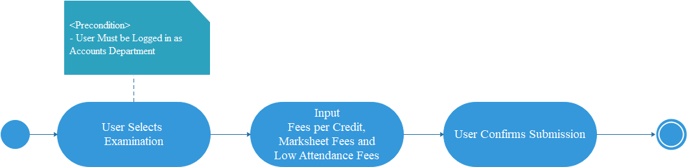
Design Specification
Activity Diagram: Impose Fees

Slide 16
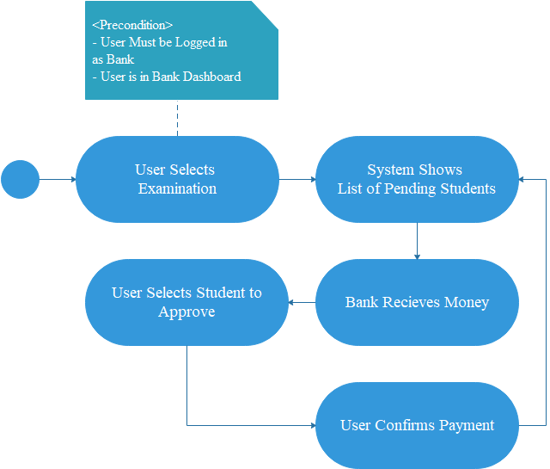
Design Specification
Activity Diagram: Confirm Payment

Slide 17
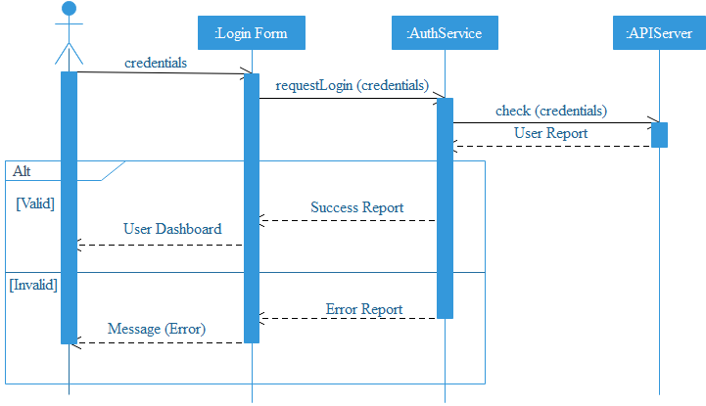
Design Specification
Sequence Diagram: Login

Slide 18
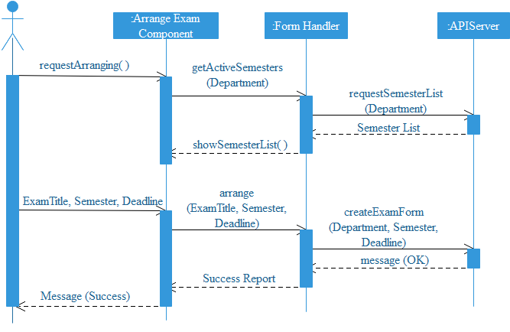
Design Specification
Sequence Diagram: Arrange Examination

Slide 19
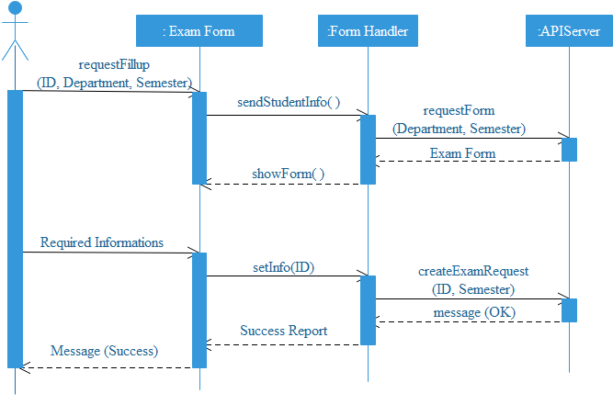
Design Specification
Sequence Diagram: Fill-Up Form

Slide 20
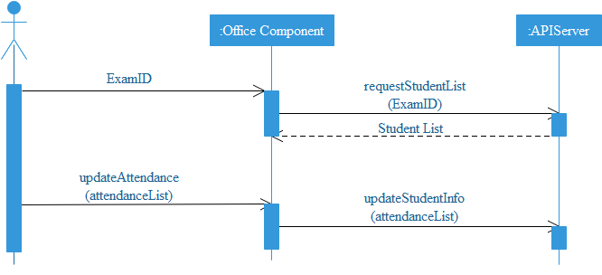
Design Specification
Sequence Diagram: Input Attendance

Slide 21
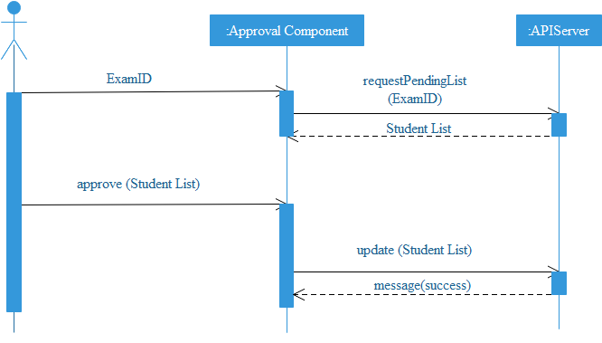
Design Specification
Sequence Diagram: Approve Student

Slide 22
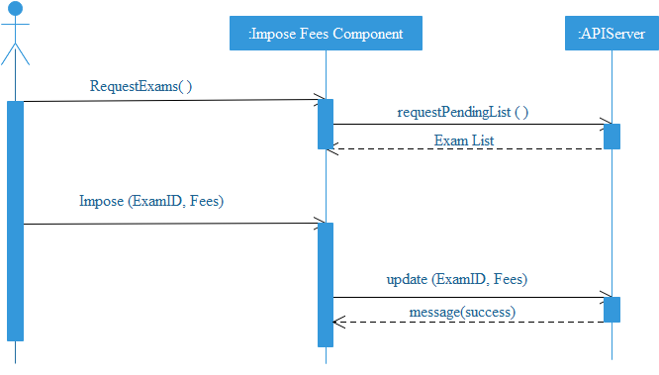
Design Specification
Sequence Diagram: Impose Fees

Slide 23
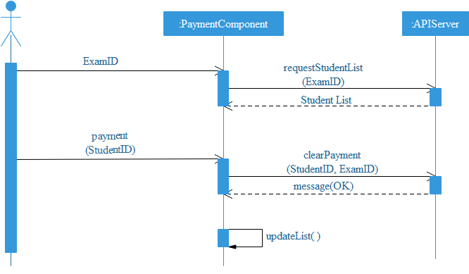
Design Specification
Sequence Diagram: Confirm Payment

Slide 24
Implementation
To implement the project we have used
Angular Framework for Frontend Development
Django Framework for Backend Development
WeasyPrint Python Library as PDF Generator

Slide 25
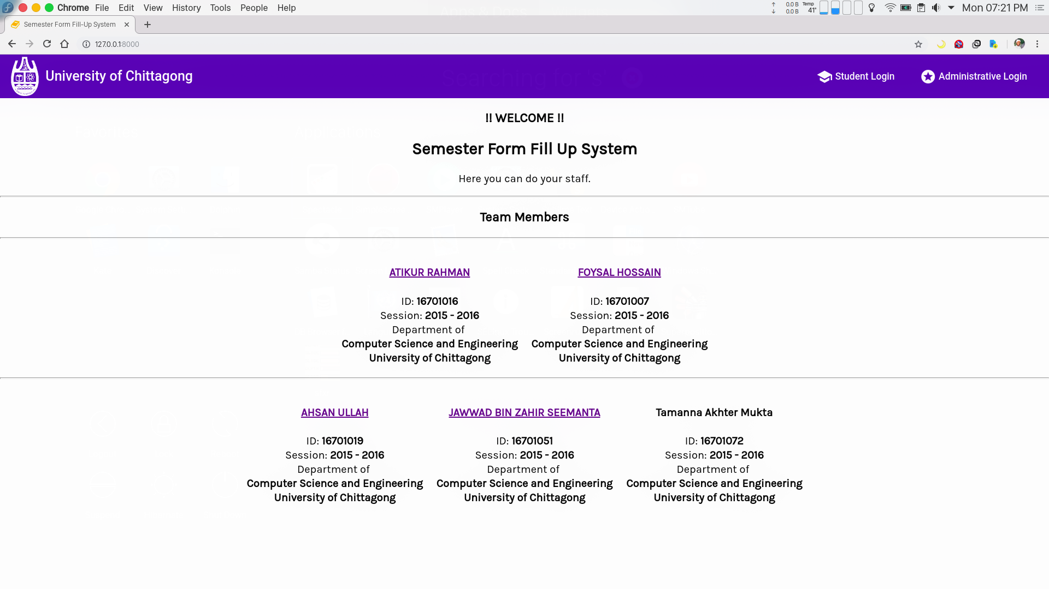
Screenshots
Home Page

Slide 26
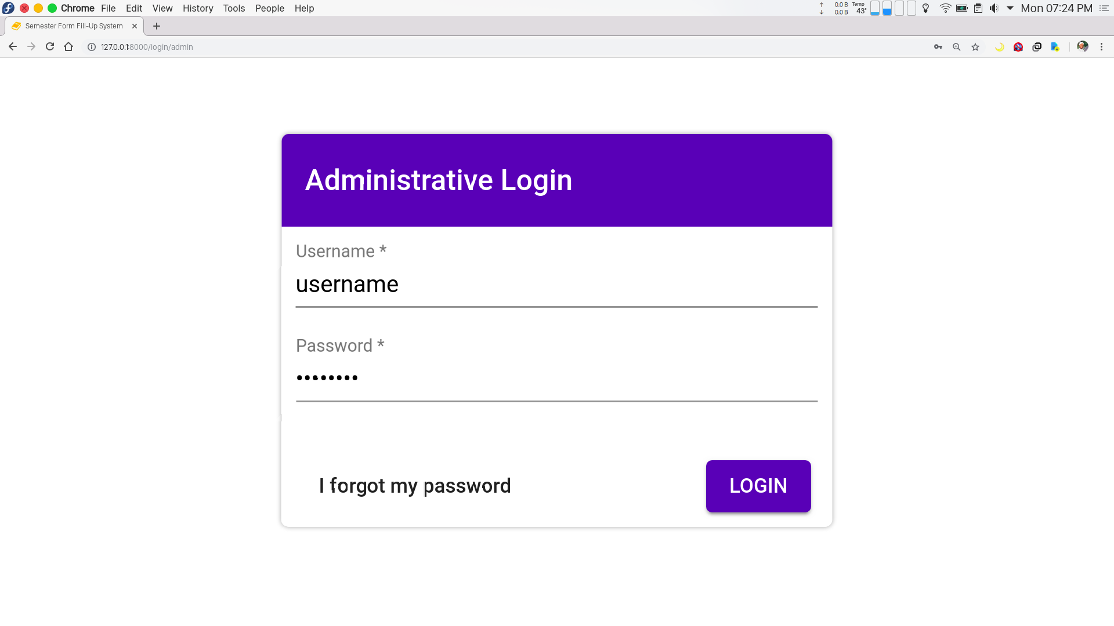
Screenshots
Administrative Login

Slide 27
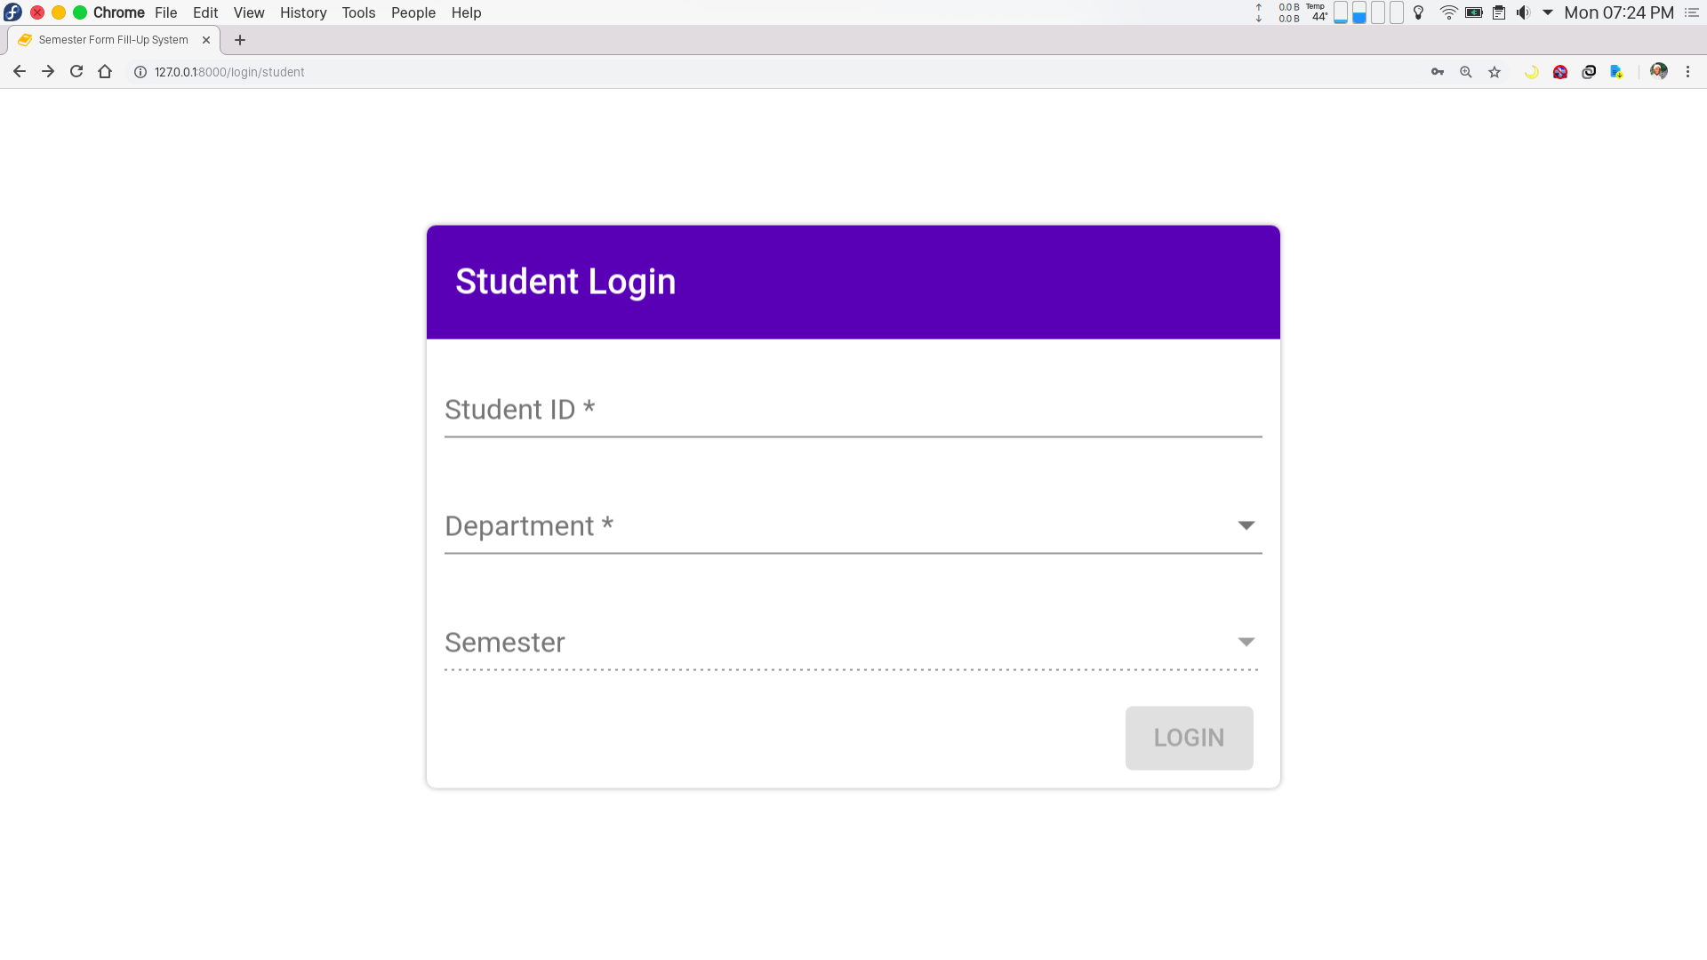
Screenshots
Student Login

Slide 28
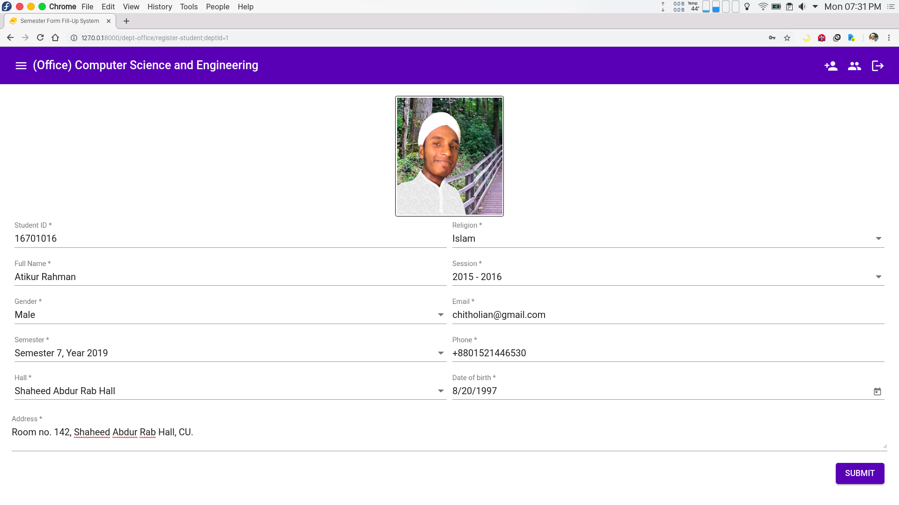
Screenshots
Office: Register New Student

Slide 29
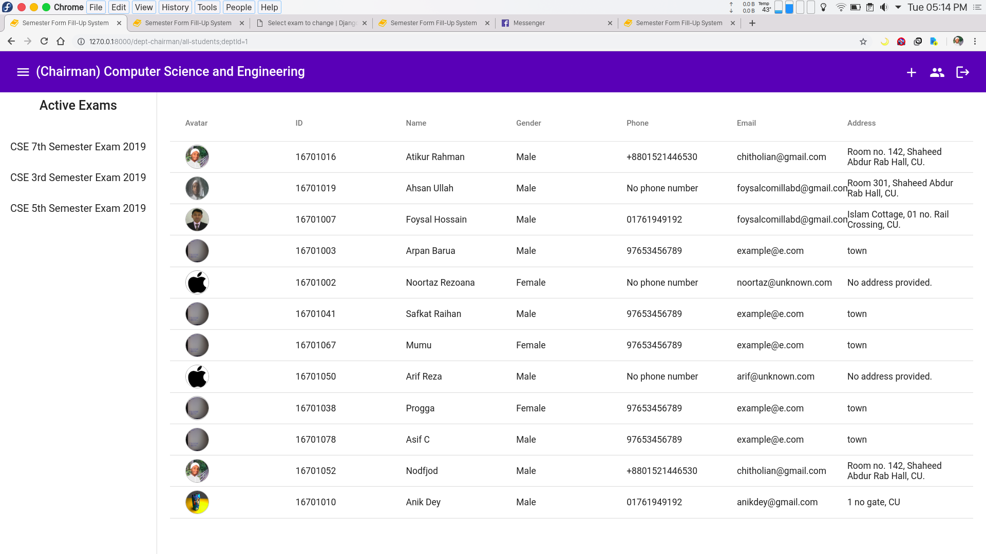
Screenshots
Chairman: View All Students

Slide 30
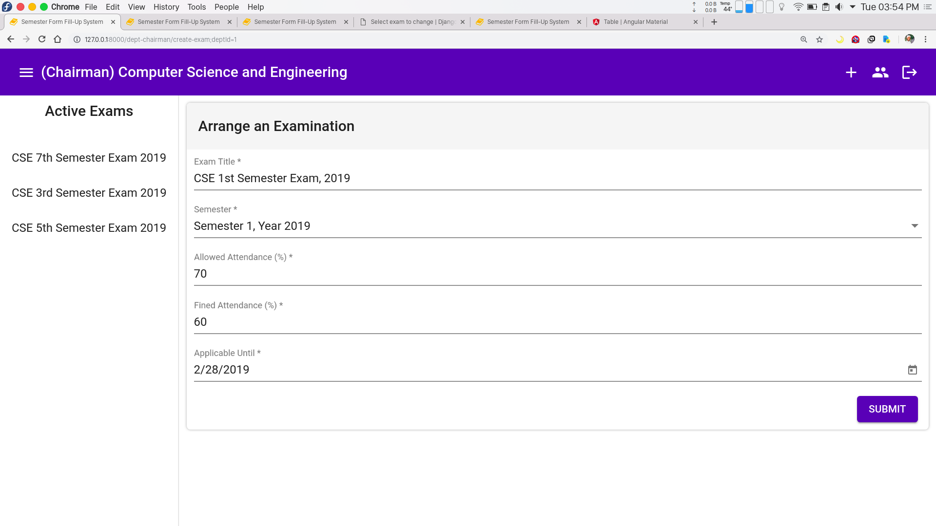
Screenshots
Chairman: Arrange Examinations

Slide 31
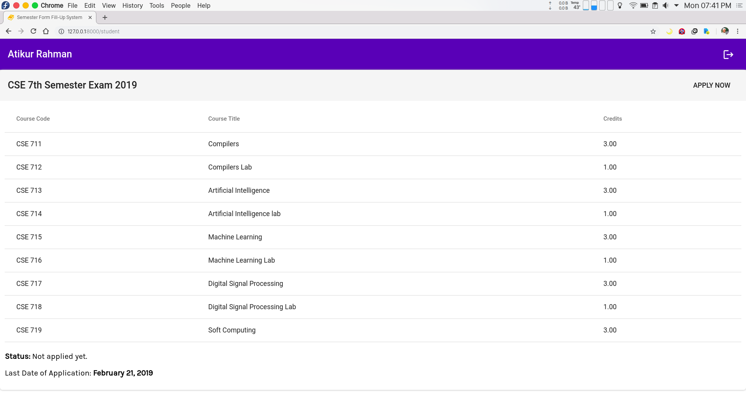
Screenshots
Student : Fill-Up Form

Slide 32
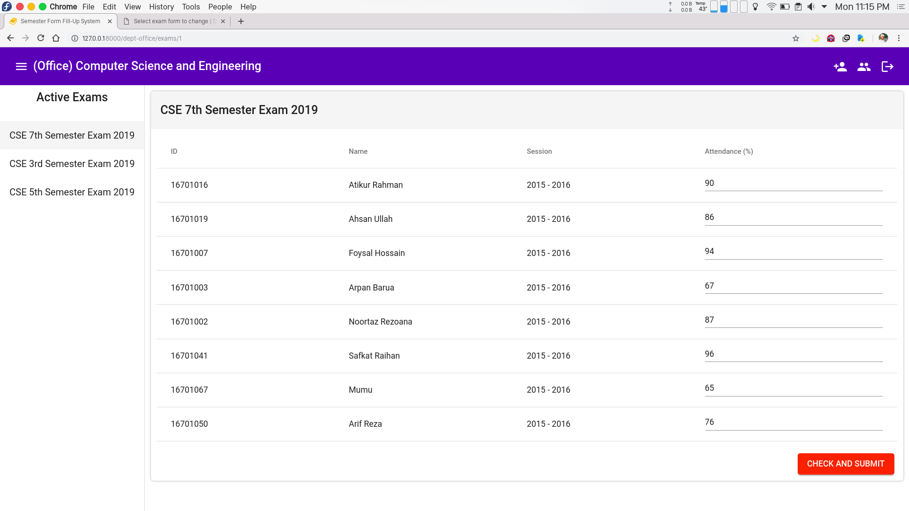
Screenshots
Office : Insert Attendance

Slide 33
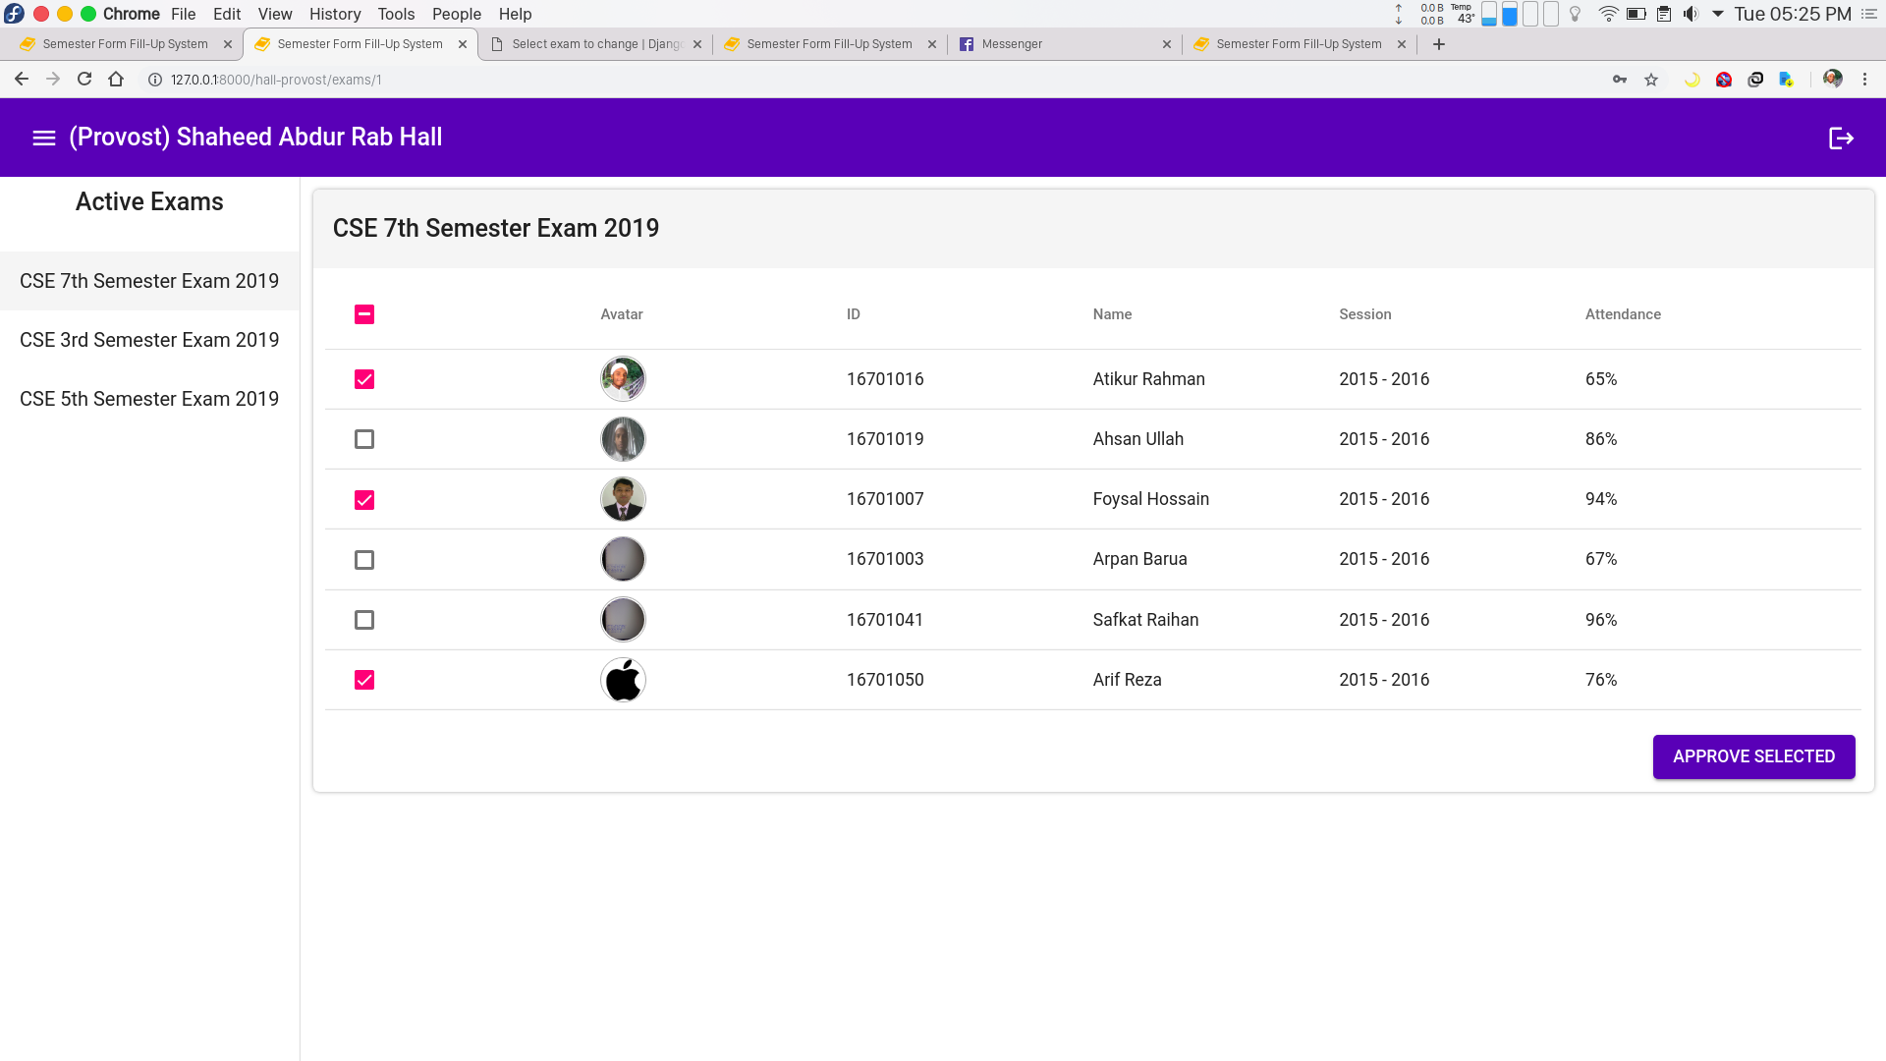
Screenshots
Provost : Approve Forms

Slide 34
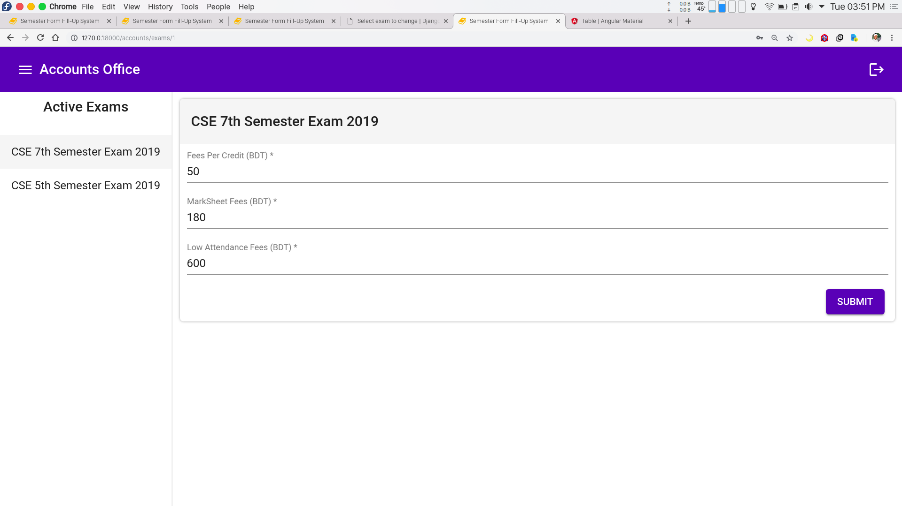
Screenshots
Accounts : Impose Fees

Slide 35
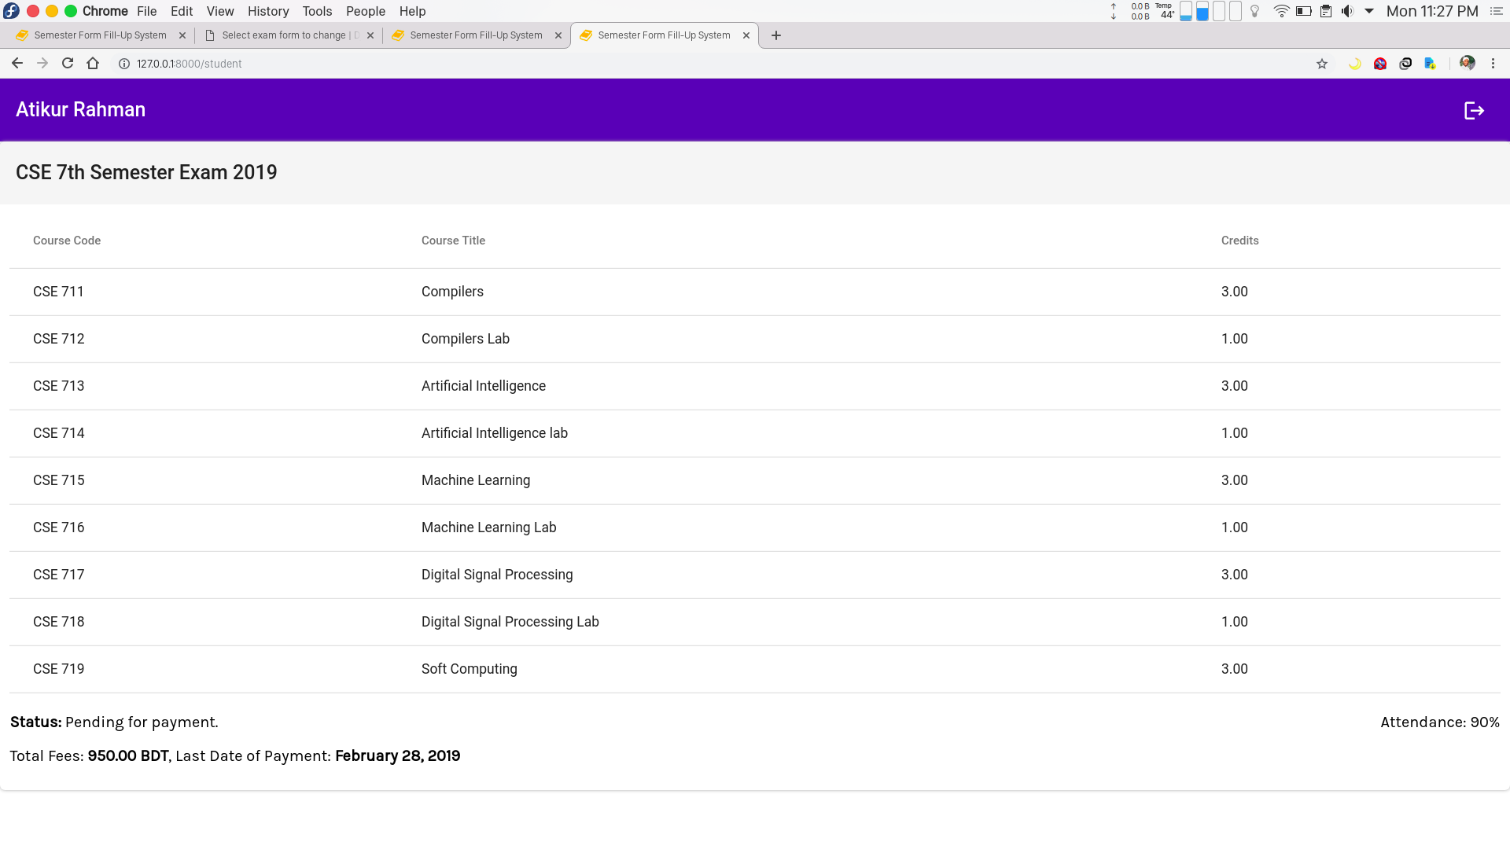
Screenshots
Student: View Exam Fees

Slide 36
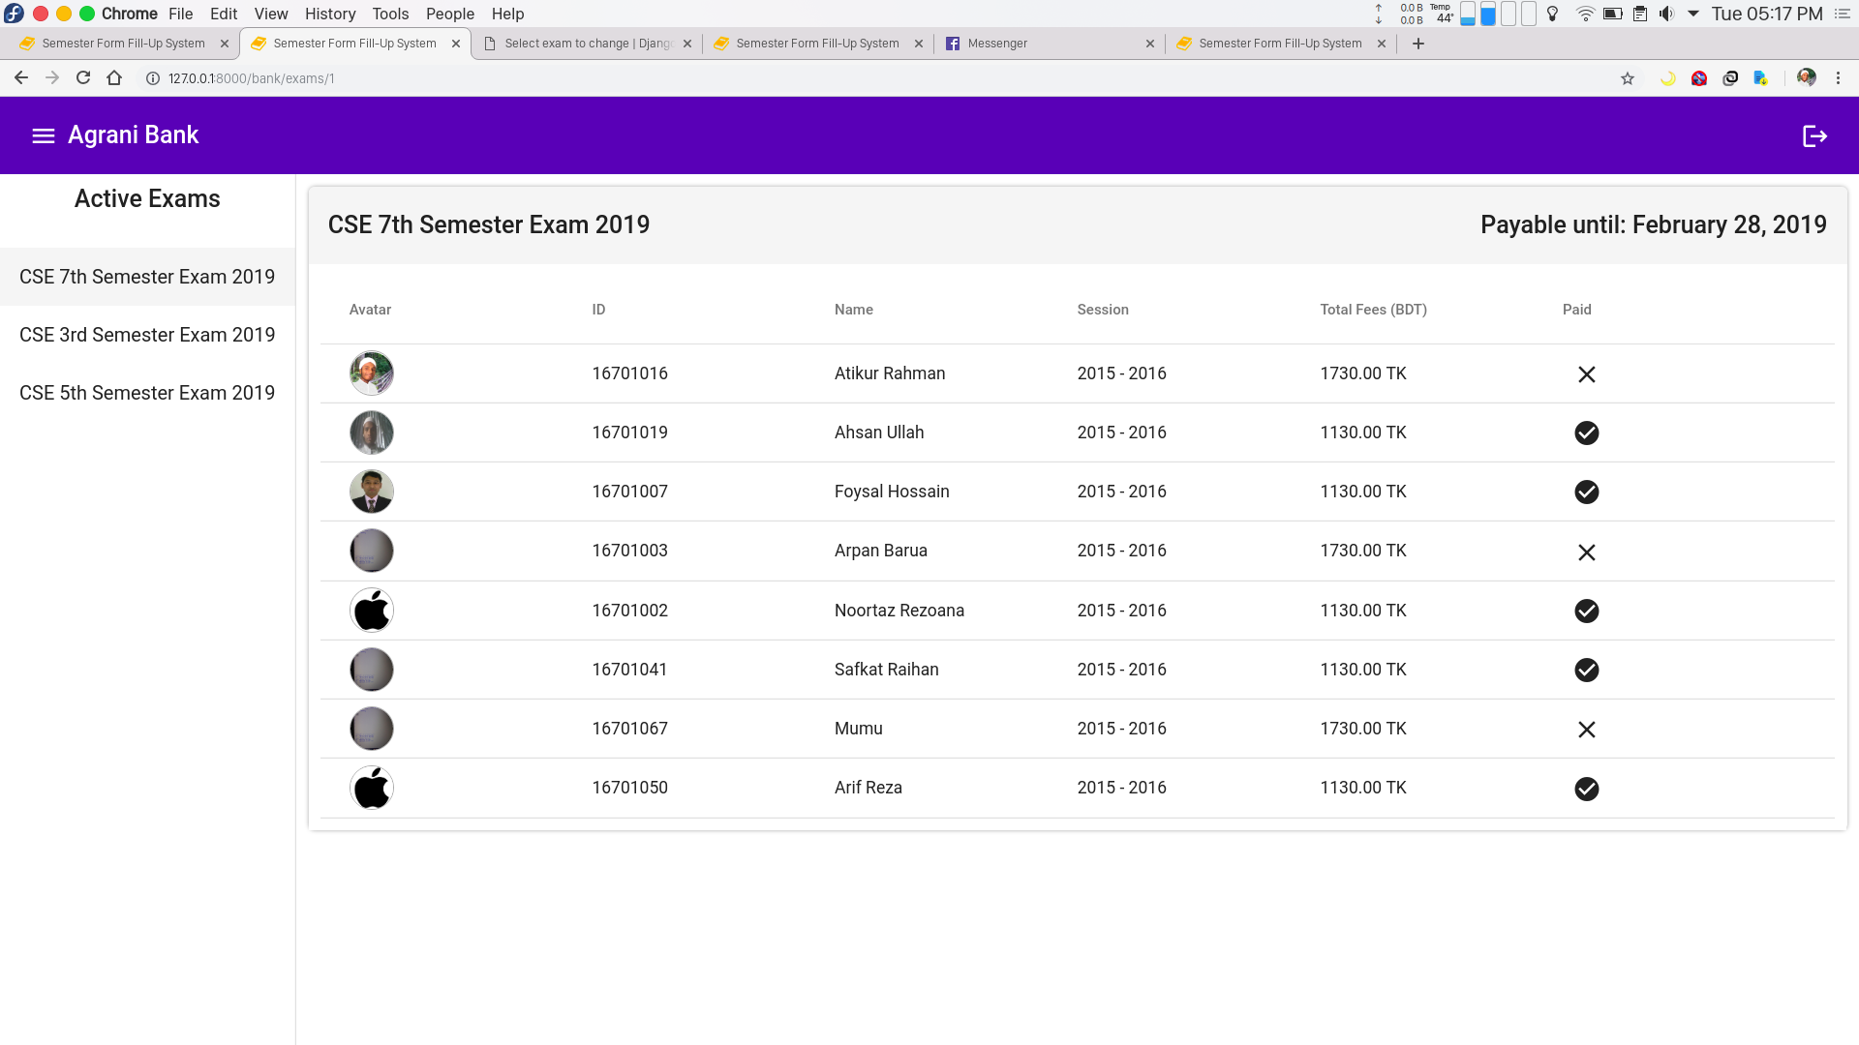
Screenshots
Bank: Confirm Payment

Slide 37
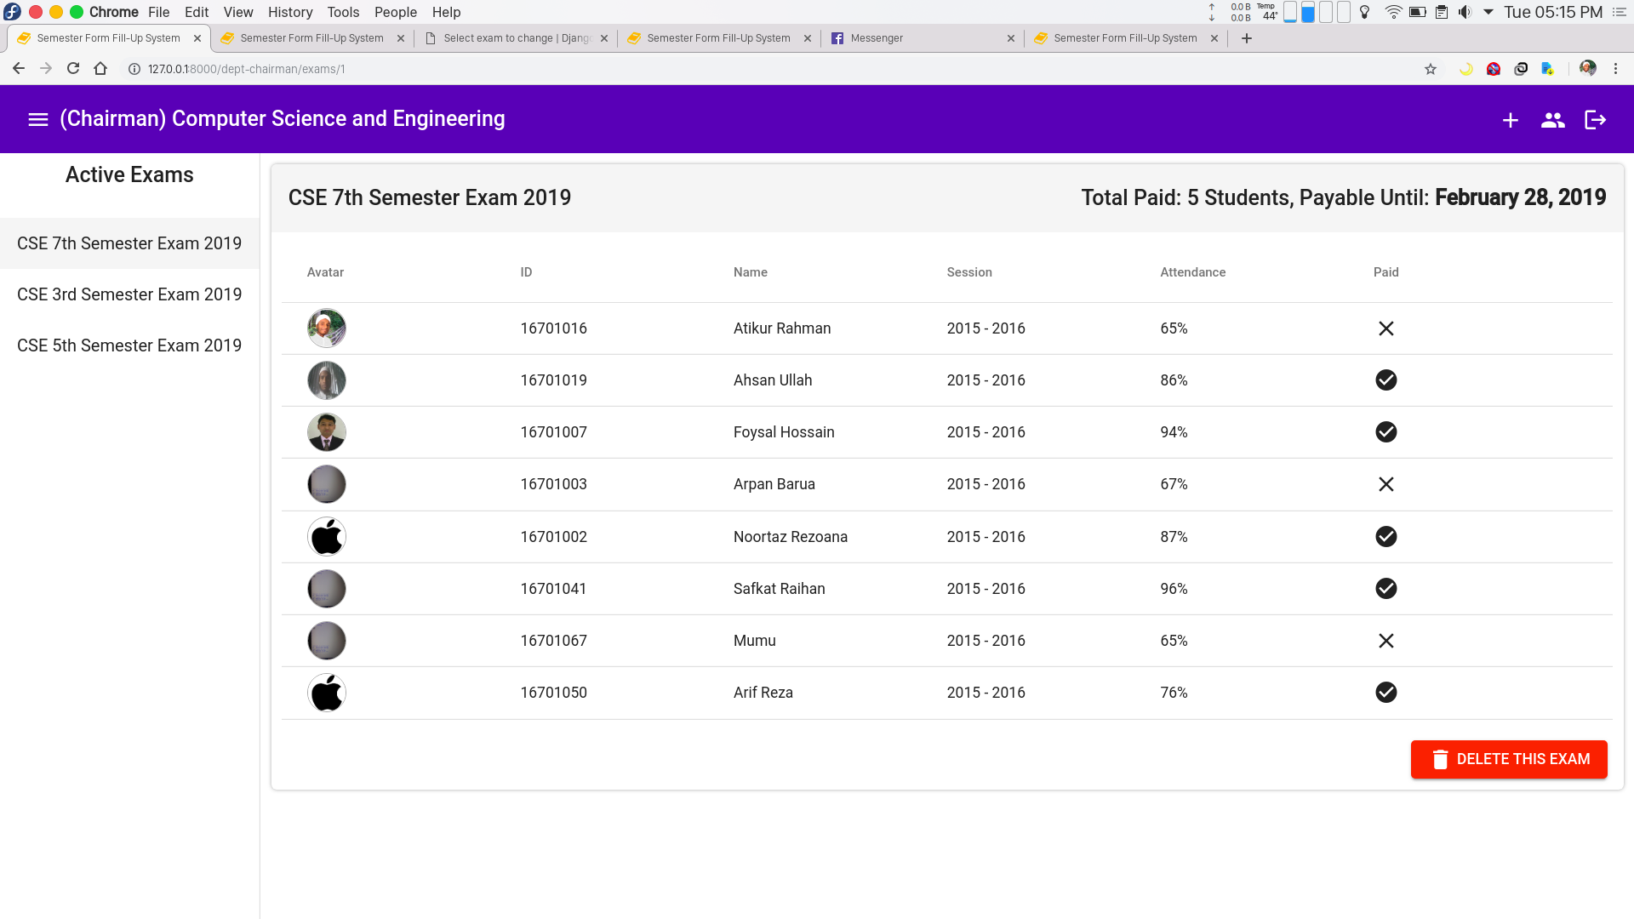
Screenshots
Chairman: View Payment Status

Slide 38
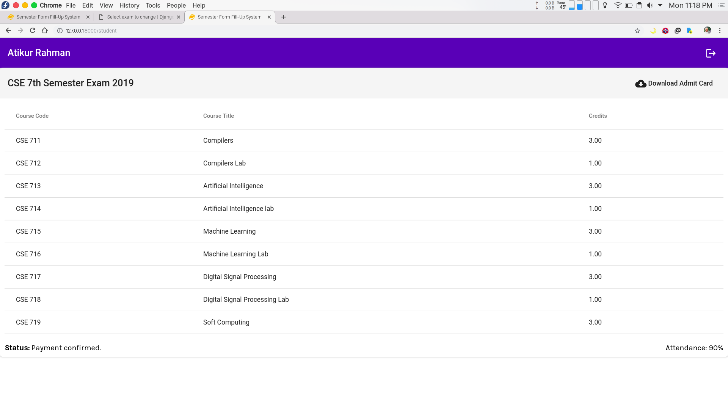
Screenshots
Student: Download Admit Card

Slide 39
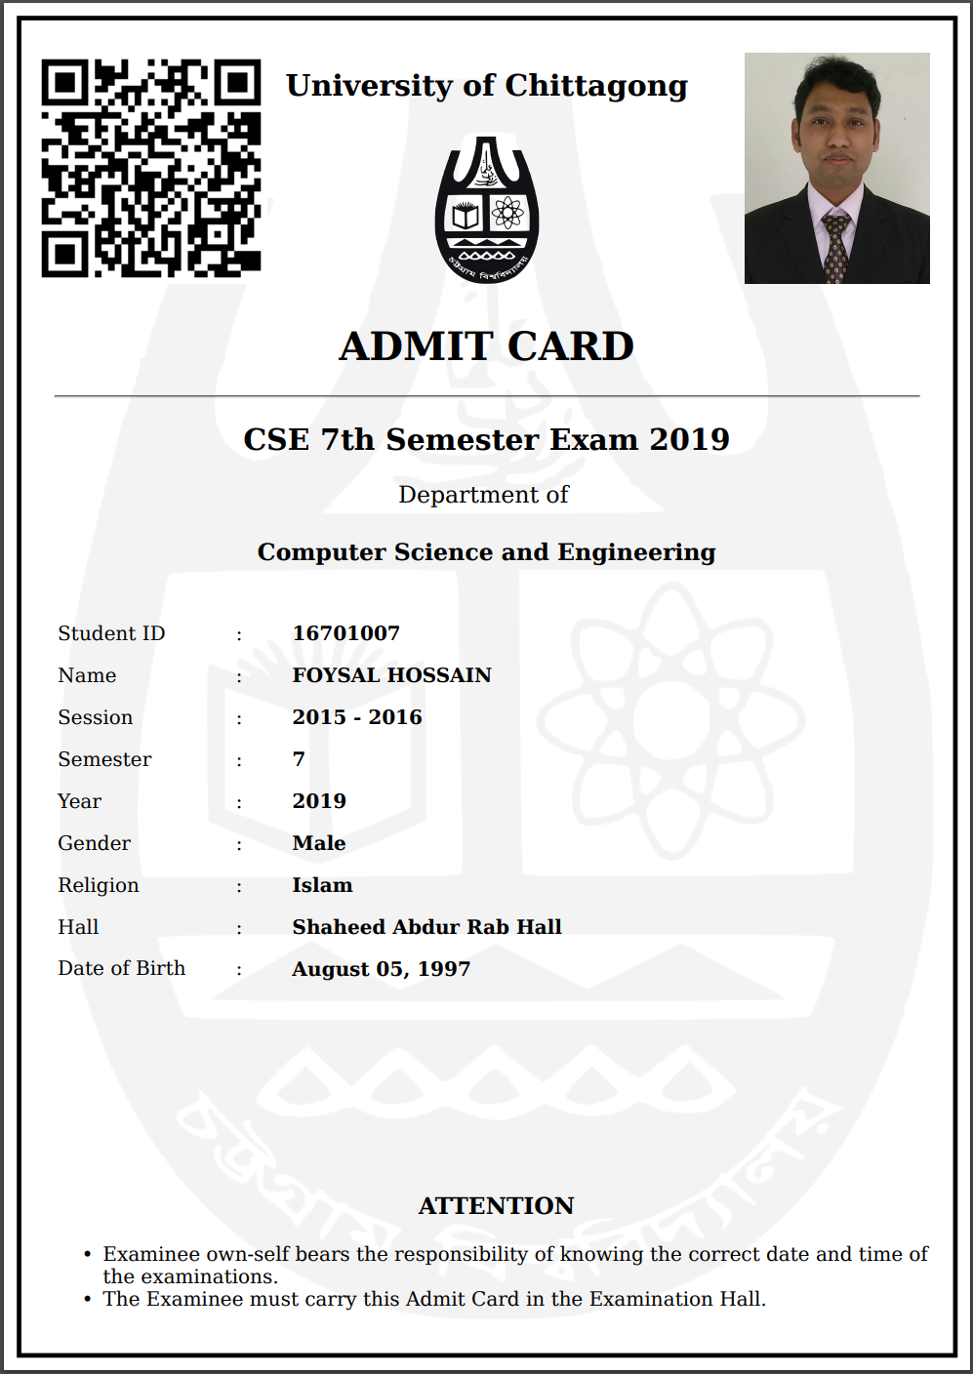
Screenshots
Admit Card

Slide 40
Testing
Sl No | Testing Type | Test Case | Consequence
1 | Security Testing | If either of the username or password is blank | App shows error and prompts to fill both fields
2 | Security Testing | If user can login with invalid credentials | App shows prompts for valid credentials
3 | Security Testing | If anyone can access backend server except super-user | Access is denied
4 | Security Testing | If login to administrator dashboard is using Student Credentials | Access is denied
5 | Functional Testing | If admit card can be downloaded before payment is cleared | HTTP 402 : Payment Required
6 | Functional Testing | If user can submit forms without filling required fields | Submit button stays disable until all required fields are valid
7 | Functional Testing | If invalid inputs are given | Shows error message

Slide 41
Testing
Sl No | Testing Type | Test Case | Consequence
8 | Functional Testing | If numeric values with negative values are accepted | Negative values are not accepted.
9 | Functional Testing | If wrong transaction can be reverted | User can undo the wrong transactions
10 | Database Testing | If student with same id can be created. | Error: Student with same id already exists.
11 | Database Testing | If data is committed to the database only when the operation is successfully completed | Data is committed to database only after operation is successfully completed.
12 | Database Testing | If dependent fields exists even after data deletion | Related data are also deleted.
13 | Usability Testing | If scrollbar enables when necessary | Scrollbar enables only when necessary
14 | Usability Testing | If app shows previews for selected images | App shows previews for selected images

Slide 42
Future Works
We want to extend the functionality of this system by adding the following functionalities:
Update Courses
Update Student Info
View User Profile
Edit User Profile
Password Recovery
Email Verification
Fill-Up Improvement Form
Manage Irregular Student
Manage Late Fees

Slide 43


