Slide 1
Group 03 : CU Online App Store
Members:
16701010 : Anik Dey Shaon
16701041 : S. M. Shafkat Raihan
16701045 : Esrat Arisha Ema
16701046 : Md. Muhtadir Rahman
16701067 : Mumtahina Ahmed

Slide 2
Overview
Problem Statement
Project Objectives
Requirement Analysis
Design Specification
Implementation
Screenshots
Testing
Future Works

Slide 3
Problem Statement
No established way to reserve and promote apps developed by students of CU.
Difficulty in uploading apps to renowned app stores.
Programmers and developers face problems in storing and advertising their works.

Slide 4
Project Objectives
4
Developing an app store of our own and creating an identity for apps developed by the students of Chittagong University.
Teachers and even alumni will also get privilege for storing and advertising their works.
Every entity will be able to upload their apps for free.

Slide 5
Requirement Analysis
Stakeholder :
Primary: Users of the application.
Who are looking for applications developed by students of CU.
Secondary: Administration of CU. Developers of the stored apps.
Tertiary: Developers of the application

Slide 6
Requirement Analysis
Why do we need to develop separate app store instead of having renowned app stores like Google Play?
For making a platform to upload and promote apps with free of cost and create a separate identity of our own apps.
Who would be the developers of the apps?
Current students, teachers and alumnus of CU.
How the authentication and upload will held?
Developers will have to register, login then they can submit, update and manage their apps.

Slide 7
Requirement Analysis
Who will assure the approval of the apps?
Developers or Admin.
What would be the uploaded file types?
Android , web apps and also java apps may be uploaded.
What is the process of app identification or ownership?
Developers would provide and update descriptions of apps.
What is the installation process of apps ?
Apps should be installed into the same device where they are accessed and downloaded.

Slide 8
Requirement Analysis
Functions:
General User:
View apps, Download apps.
System Developer:
View apps, Delete apps, Download apps.
Verified User:
View apps, Upload, update , delete Apps.

Slide 9
Design Content
Design Specification
Use case Diagram
Activity Diagram
Sequence Diagram

Slide 10
USE CASE DIAGRAM
Create Account
Login
General User
View App
Search App
Upload App
System Developer
Update App
Delete App
Download App
Verified User

Slide 11
Activity Diagram : SignUP Activity
Open the web application
View Home Page
Press ‘Sign Up’ Button
Verify Account
Click on
‘Create Account’ button
Enter Credentials

Slide 12
Activity Diagram : Login Activity
Open the web application
View Home Page
Press ‘Login’ Button
Wrong Username & Password
[No]
[Successful?]
Enter Credentials
[Yes]

Slide 13
Activity Diagram : View App Activity
[Search]
S
Arrive at Home Page (H)
Click App Icon
View App
Item Drawer

Slide 14
Activity Diagram : Search Activity
[Make Decision]
Search Item
View Item
S
[found]
[Not found]

Slide 15
Activity Diagram : Upload App Activity
Arrive at Home Page (H)
Choose the category
Provide app information
Click the ‘upload’ button
Choose file to upload from your device location
[Successful]
[Failed]
Upload Correctly
Upload Successful

Slide 16
Activity Diagram : Update App Activity
Arrive at Home Page (H)
Select your app
Press ‘update’ button
Update app information
Click the ‘update’ button
Choose file to upload from your device location
App updated
[Successful]
[Failed]
Update Correctly

Slide 17
Activity Diagram : Download App Activity
Permission
Press Install APK
[Reject]
[Accept]
Wait
While download
[Wait until finished]
Show successfull

Slide 18
Activity Diagram : Delete App Activity
[Show options]
Arrive at Home Page (H)
[Yes]
Press ‘delete’ button
Select your app
Confirm deletion
[Cancel]

Slide 19
Sequence diagram : Create an account
Home Page
Login Page
Database
User
Click Signup button
Open Signup page
Displays Signup Page
loop
Entering Required data
Authenticate Required Data i.e. Save in DB
AppStore’s
Member ID
Displays Home page

Slide 20
Sequence diagram : Log in
Home Page
Login Page
Database
User
Click login button
Open Login page
Displays Login Page
loop
Entering Student ID and password
Authenticate Student ID and Password.
Displays Home Page
Student ID

Slide 21
Sequence diagram : Search App
User
Home Page
Database
Go to “Search Here” option()
Waiting for keyboard Input
Alt
Push(keywords)
Search(keywords)
(Displaying app list)
msg(app list)
[Exists]
[Doesn’t Exist]
msg(null)
(No item found)

Slide 22
Sequence diagram : View App
Home Page
App Profile
User
Open Web App
loop
Click on Icon(app)
Show profile(APP ID)
msg(app profile)
(Displaying app
profile)

Slide 23
Sequence diagram : Upload App
Home Page
Upload Page
Login Page
Database
User
Open web app()
Select Upload
Section()
Alt
(Page
loaded)
(loading)
Upload
Request(info)
[User Logged in]
Enter(info)
Upload (info)
(Upload
Successful)
msg(ok)
[User not Logged in]
Please Login()
Login()
Login confirmed()
Upload Request(info)
Enter(info)
Upload (info)
(Upload
successfull)
msg(ok)

Slide 24
Sequence diagram : Update App
Home Page
Update Page
Login Page
Database
User
Open web app()
Select App()
(Displaying)
(Displays App Profile)
Select_button(update)
Update ()
Alt
(Showing)
(update option)
Update
Request(info)
[User Logged in]
Enter(info)
Update (info)
(Updating
successfull)
msg(ok)
[User not Logged in]
Please Login()
Login()
(Showing) (update option)
Login confirmed()
Update Request(info)
Enter(info)
Update (info)
(Successfull)
(Updating successfull)
msg(ok)

Slide 25
Sequence diagram : Delete App
Home Page
App Profile
Login Page
Database
User
Open web app()
Select App()
Delete app()
Displays App Profile()
Delete()
Alt
Shows prompt (confirm cancel)
Delete Request(App ID)
[User Logged in]
Confirm deletion()
Delete app()
(Successful)
(App Deleted)
msg(ok)
[User not Logged in]
Please Login()
Login()
Shows prompt (confirm cancel)
Login confirmed()
Confirm deletion()
Delete Request()
Delete app()
(Successful)
(App Deleted)
msg(ok)

Slide 26
Sequence diagram : Download App
Home Page
App Profile
Login Page
Database
User
Open web app()
Select App()
Download app()
Displays App Profile()
Download()
Alt
Shows download prompt()
[User Logged in]
Download Request(App ID)
Confirm Download()
Download app()
(Successful)
(Downloading)
msg(app)
[User not Logged in]
Please Login()
Login()
Shows prompt (confirm cancel)
Login confirmed()
Confirm Download()
Dowload Request(App ID)
Download app()
(Successful)
(Downloading)
msg(app)

Slide 27
Implementation: Platforms
Frameworks:
Django
Bootstrap
Database:
SQLite
Languages:
HTML
CSS
Python

Slide 28
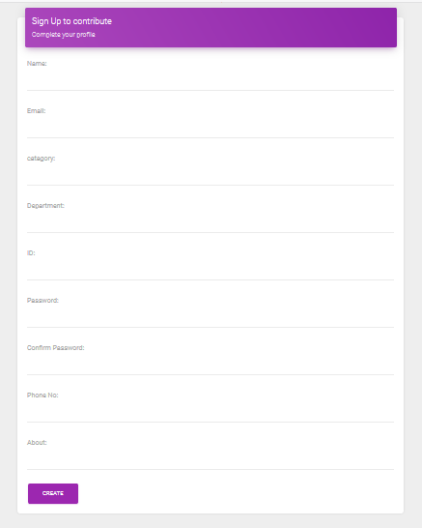
Screenshot : Sign Up
User will provide their primary information to create an account. The users can be a student, a teacher or an alumni.

Slide 29
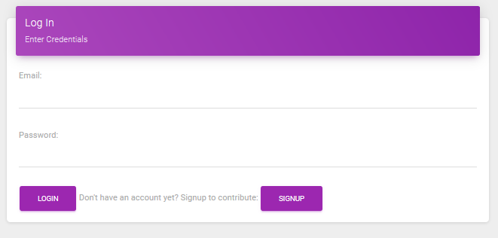
Screenshot : Log In
Registered users will need to enter their credentials for signing in into the “App Store”.

Slide 30
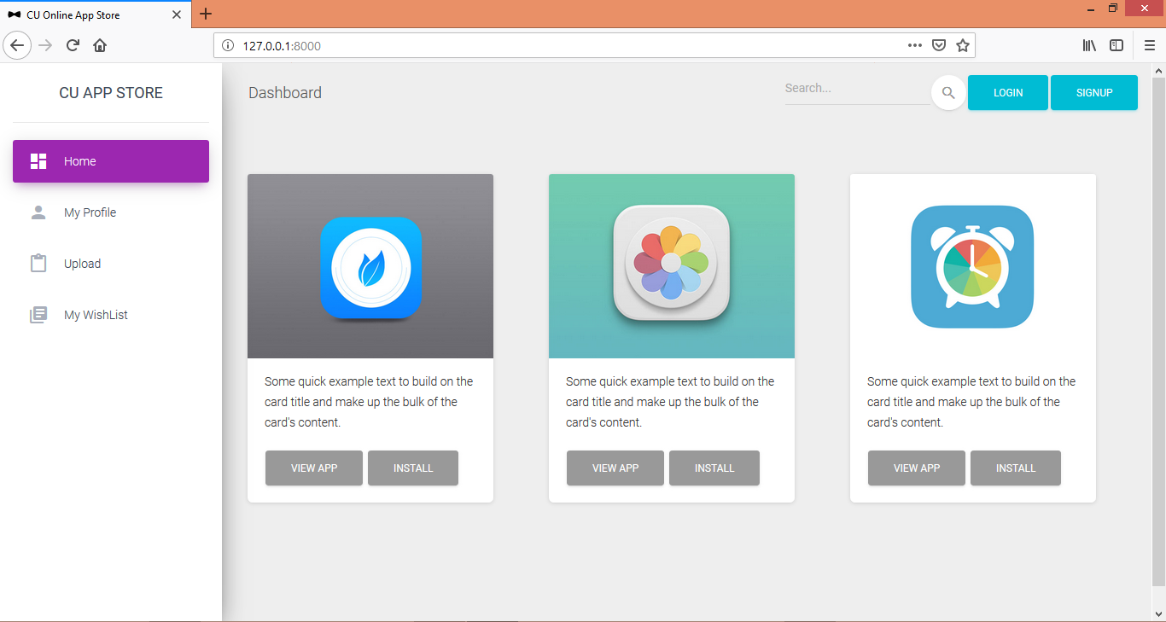
Screenshot: Home
The suggested apps will be seen randomly from the home screen. Here, an user can select their own operations. An user can also directly install or view any app from here.

Slide 31
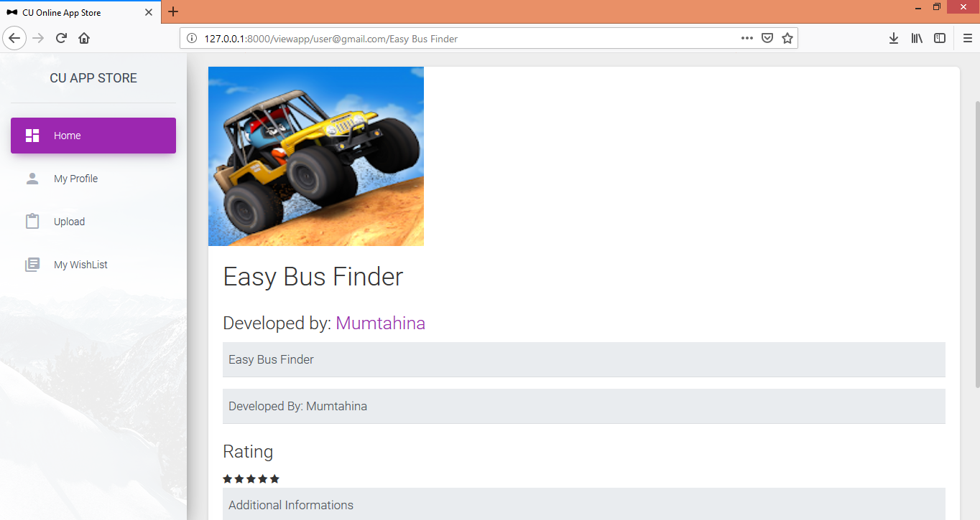
Screenshot : App Profile
While clicked the “View App” option, users wiil directly be surfed to the “App Profile” for seeing app specifications of that specific app.

Slide 32
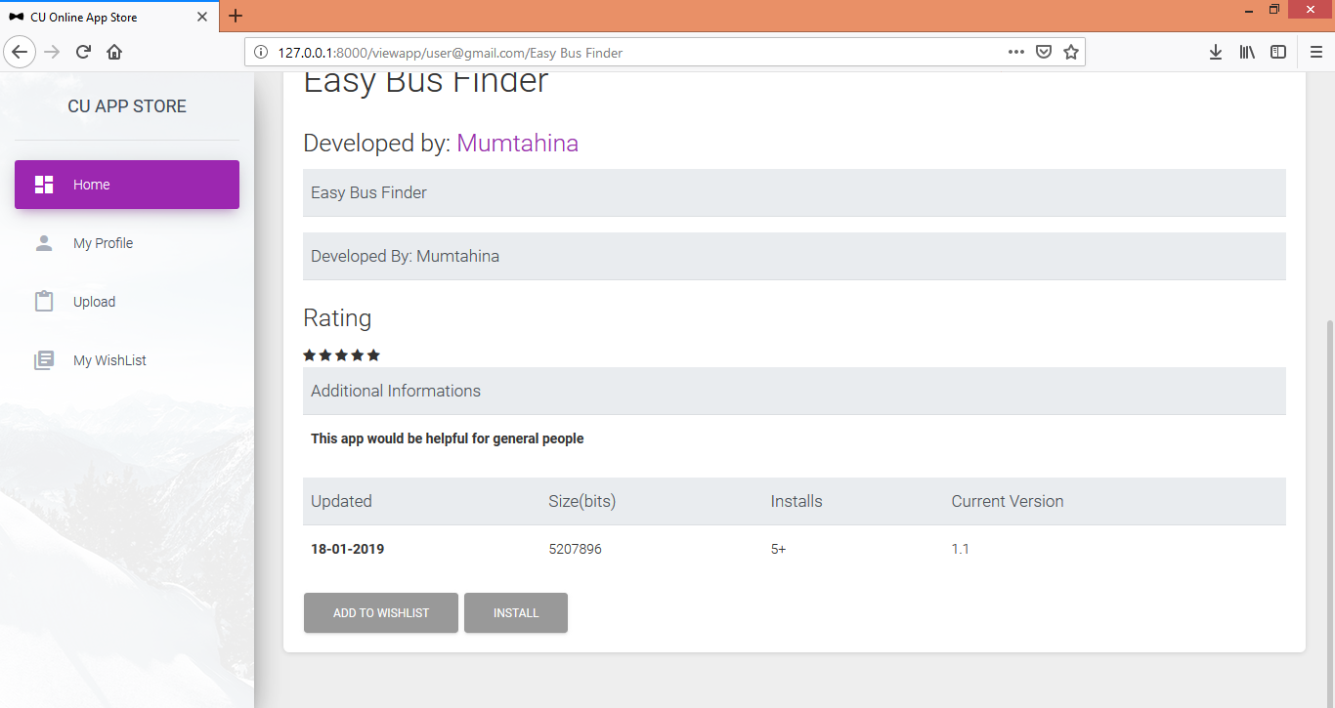
Screenshot : App Profile (continution)_
There are also options for adding apps to the wishlist and install in the “App Profile” page.

Slide 33
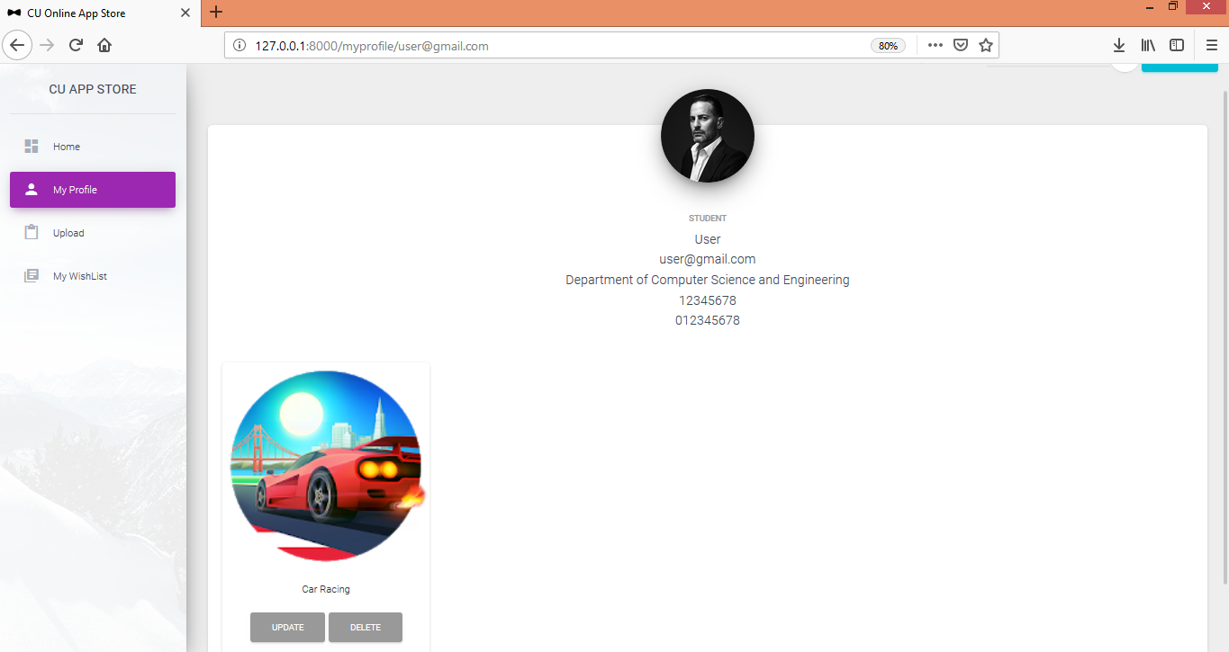
Screenshot : My Profile
This is the individual’s profile where a developer can see his/her own profile. He will also be able to see his her works here so that he can update and delete any of his app from the store.

Slide 34
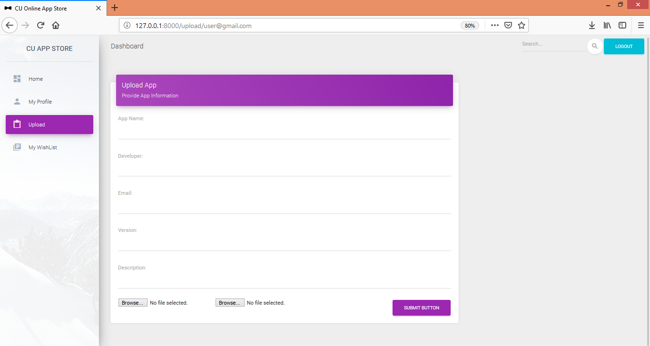
Screenshot : Upload
Developers will upload their app from this option. Theywill give their app a name, and other basic information. Then they will be able to select their app by clicking “browse” so that the file opener gets open and they can select their apk file. Clicking upload button will publish their work to the store.

Slide 35
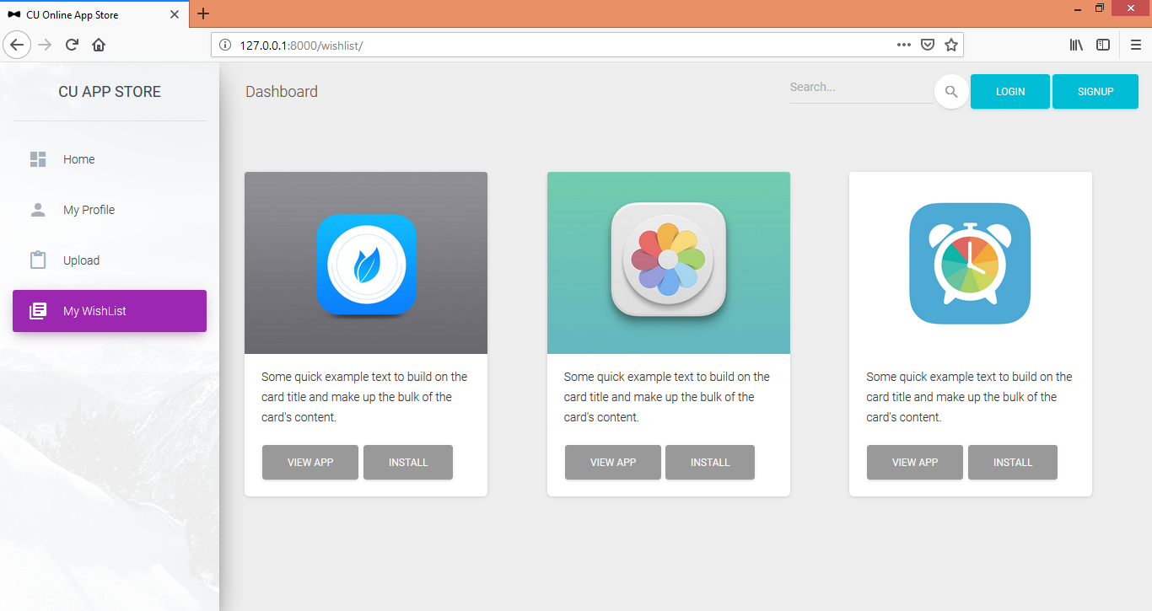
Screenshot : My Wishlist
Users will also see their wished apps list throughing the “My Wishlist” option

Slide 36

Testing: Levels
Sl No | Testing Type | Test Case | Consequence
1 | Security Testing | If either of the username or password is blank | App shows error and prompts to fill both fields
2 | Security Testing | If user can login with invalid credentials | App shows prompts for valid credentials
3 | Security Testing | If anyone can access backend server except super-user | Access is denied
4 | Security Testing | If general user tries to login to developers dashboard | Access is denied
5 | Functional Testing | If apps can be uploaded before signup or login to developer’s profile | Signup or login is required
6 | Functional Testing | If developer can upload apps without filling required fields | Submit button stays disable until all required fields are valid
7 | Functional Testing | If invalid inputs are given | Shows error message

Slide 37
Testing: Levels
Sl No | Testing Type | Test Case | Consequence
8 | Functional Testing | If wrong formatted data are accepted. | Wrong formatted data are not accepted.
9 | Database Testing | If user with same id can be created. | Error: User with same id already exists.
10 | Database Testing | If data is committed to the database only when the operation is successfully completed | Data is committed to database only after operation is successfully completed.
11 | Database Testing | If dependent fields exists even after data deletion | Related data are also deleted.
12 | Usability Testing | If any app can be added into My Wishlist for future downloads. | Any apps can be added into My Wishlist for future downloads.
13 | Usability Testing | If uploaded apps show in the My Profile | Uploaded apps are visible from My Profile.

Slide 38
Future Works
Subscription
Improving developer sign up mechanism
App suggestion
App review
Powerful Searching mechanism

Slide 39
Thank you

