Slide 1

PRE-DEFENSE PRESENTATION
Tutors Aid
Muhtasim Rahman
172-35-2193
23rd Batch

Slide 2

Supervised By
Ms. Farzana Sadia
Assistant Professor
Department of Software Engineering
Daffodil University

Slide 3

Project preview
Developed to help teachers & assistants manage their work
Improved solution for several issues going on in this platform
Very helpful for new teachers who recently started
Can be used to manage masses of students
Makes communications better
Secured file sharing and information storage

Slide 4

Project Purpose
Aims to make the classroom better
Tackle all the problems observed over the years
Offer better security for sensitive data
Give students and teachers have a common platform
to communicate
Provide a user friendly interface for best experience
Each and quick login and logout for admin

Slide 5

background
Having worked in this occupation for many years there has been several hard ships faced
Information had to be written down and had little or no security.
Student data could be also easily accessed and thus many issues
and crimes came to light.
Teachers had to keep multiple assistants for these and most
of their income were spend for that

Slide 6

Benefits and beneficiaries
Students no longer have to wait for hours to talk to teachers personally
Students can get solutions easily through discussion panel
They can view and access information easily
Admins can uploads all the information to the system no external means needed
Assignments can be submitted in the system.
Normally most of these are done my hired admins which will no longer be necessary

Slide 7

goals
Make a common platform to interact
Allow to communicate with teachers privately
Save all Information in the application
Add File upload system saves times and effort
Make user friendly interface for best experience

Slide 8

stakeholders
Administration (teacher/teacher’s assistant)
Student

Slide 9
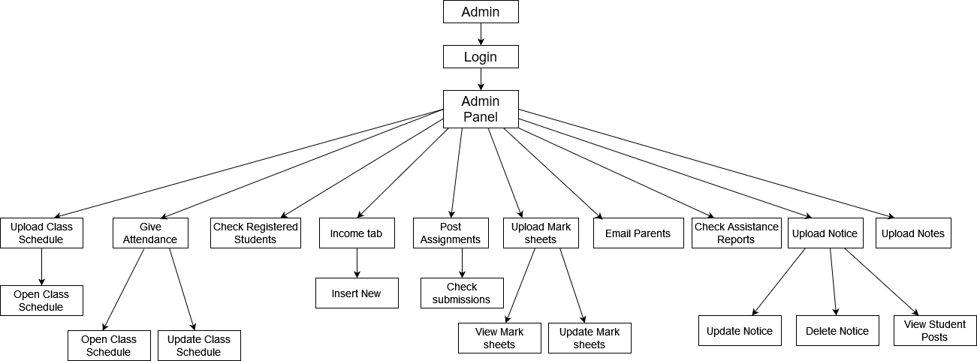
Admin Block Diagram

Slide 10
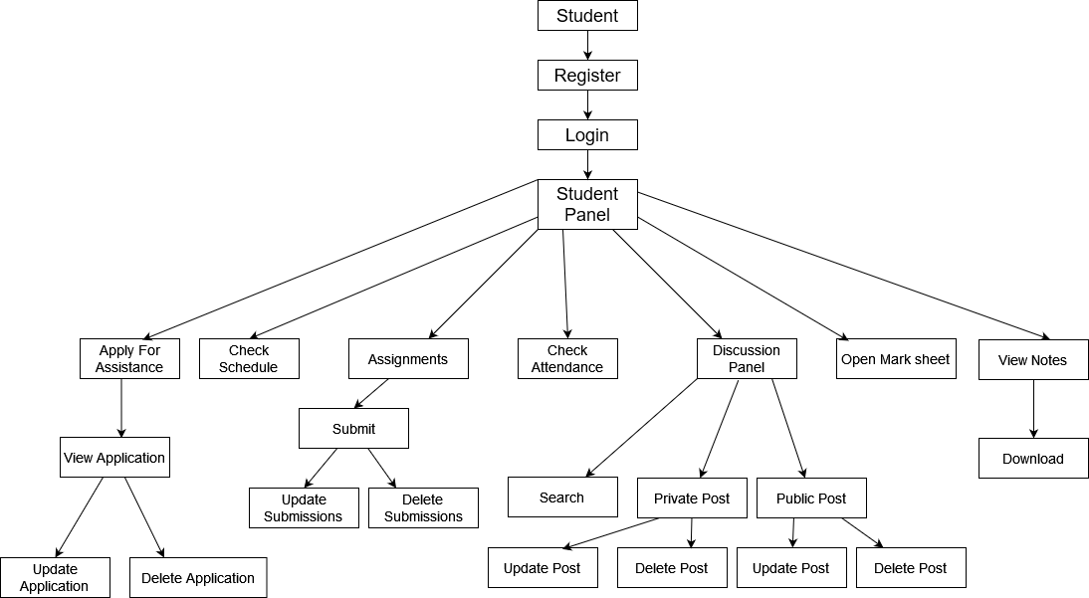
Student Block Diagram

Slide 11
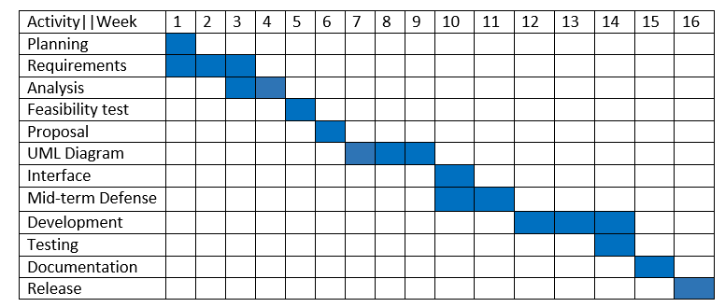
Gantt Chart

Slide 12

Functional
requirements
admin

Slide 13

Requirement ID | Requirement Name | Description | Stake Holder
FR.A.1 | Login | Admin logs in into the system using his/her name and code | Admin
FR.A.2 | Upload Class schedule | Admin can upload class schedule to the system after logging in | Admin
FR.A.3 | Open Class schedule | Admin can open class schedule to the system | Admin
FR.A.4 | Give Attendance | Admin inserts the attendance to the system | Admin
FR.A.5 | Check Attendance | Admin checks the attendance to the system | Admin
FR.A.6 | Update Attendance | Admin update the attendance to the system | Admin
FR.A.7 | Check registered students | Admin can check the students who are registered to the system | Admin
FR.A.8 | Income tab | This tab helps the admin to keep track of their incomes and show how much they are making monthly | Admin
FR.A.9 | Add New | This tab helps admin add more incomes to the income tab | Admin
FR.A.10 | Post Assignments | Admin can post Assignments to the system | Admin
FR.A.11 | Check Submission | Admin can view the submissions of the students | Admin
FR.A.12 | Upload Mark Sheets | Admin uploads the mark sheets to the system | Admin
FR.A.13 | View Mark Sheets | Admin views the mark sheets in the system | Admin
FR.A.14 | Update Mark Sheets | Admin update the mark sheets in the system | Admin
FR.A.15 | Email Parents | Admin can email the students’ parents from the system | Admin
FR.A.16 | Check Assistance Reports | Views students assistance reports in the system | Admin
FR.A.17 | Upload Notice | Admin uploads the notice to the discussion panel | Admin
FR.A.18 | View Notice | Admin views the notice in the discussion panel | Admin
FR.A.19 | Update Notice | Admin update the notice in the discussion panel | Admin
FR.A.20 | Delete Notice | Admin deletes the notice in the discussion panel | Admin
FR.A.21 | View Student Posts | The admin can view the student posts in the discussion panel | Admin
FR.A.22 | Upload Notes | The admin uploads the notes to the discussion panel | Admin

Slide 14
Functional
requirements
student

Slide 15
Requirement ID | Requirement Name | Description | Stake Holder
FR.S.1 | Register | Student can register into the system | Student
FR.S.2 | Login | After registering the Student can login | Student
FR.S.3 | Discussion Panel | After log in students can open the discussion panel | Student
FR.S.4 | Post | Students can post tin the discussion Panel | Student
FR.S.5 | Update Post | Students can update their post in the discussion panel | Student
FR.S.6 | Delete Post | Students can delete their post in the discussion panel | Student
FR.S.7 | Search | Students can search through different posts in the Discussion panel | Student
FR.S.8 | Check schedule | Students can check the class schedule | Student
FR.S.9 | Apply for assistance | Students can apply for assistance in the system. | Student
FR.S.10 | View Applications | Students can view their applications in the system. | Student
FR.S.11 | Update Applications | Students can update their applications in the system. | Student
FR.S.12 | Delete Applications | Students can delete their applications in the system. | Student
FR.S.13 | Check Attendance | Students can check attendance in the system. | Student
FR.S.14 | Assignments | Students can view assignments in the system. | Student
FR.S.15 | Submit Assignments | Students can submit assignments in the system. | Student
FR.S.16 | Update Submissions | Students can update their applications in the system. | Student
FR.S.17 | Delete Submissions | Students can delete their applications in the system. | Student
FR.S.18 | Open Mark Sheets | Students can open Mark Sheets in the system. | Student
FR.S.19 | View Notes | Students can view notes in the system. | Student
FR.S.20 | Download Notes | Students can download notes in the system. | Student

Slide 16
non-functional requirements
Performance
Defines how fast a software system
Its particular piece responds to certain users’ actions under certain workload
How much a user must wait before the target operation happens
Reliability
How often does the system experience critical failures?
And how much time is it available to users at times of need?
Usability
How easy is it for a student to use the system ?
Can users with less computer knowledge use this application smoothly ?

Slide 17


Slide 18

Use case for admin

Slide 19
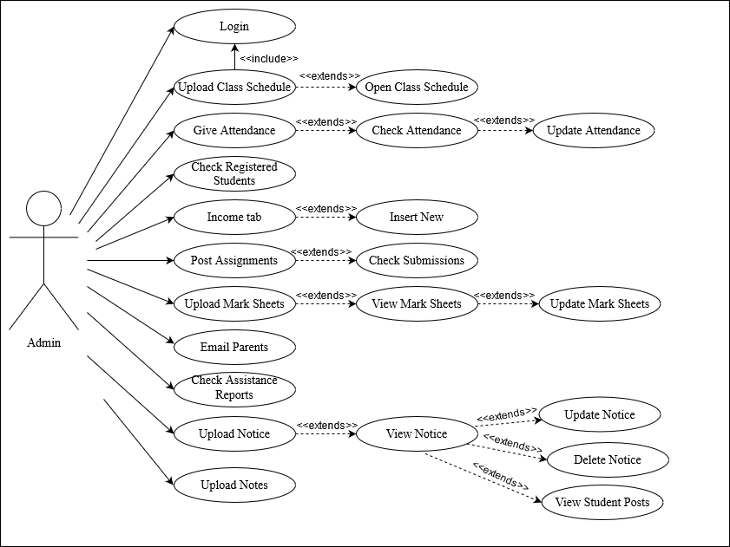

Slide 20

Use case for Student

Slide 21
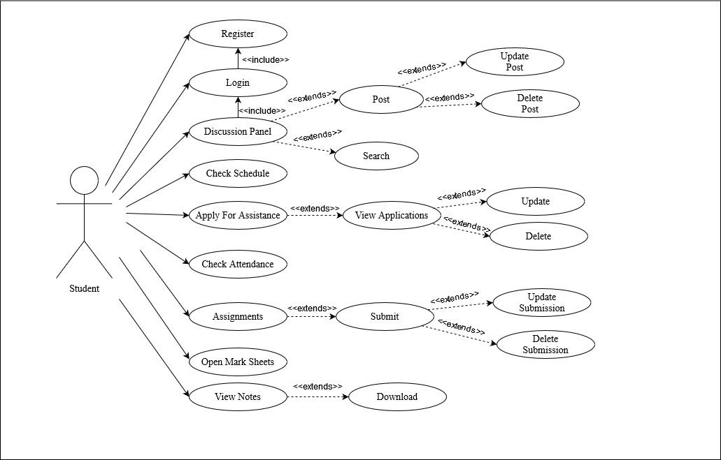

Slide 22
Sequence diagram for Admin

Slide 23
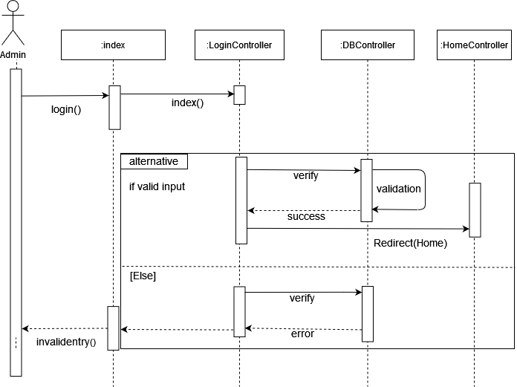

Slide 24
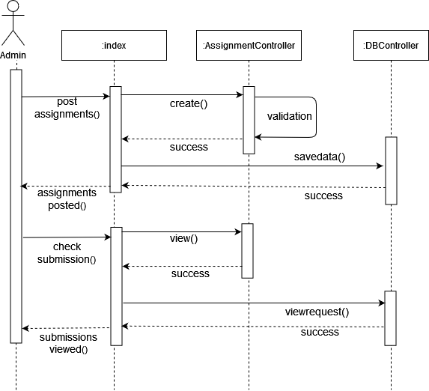

Slide 25
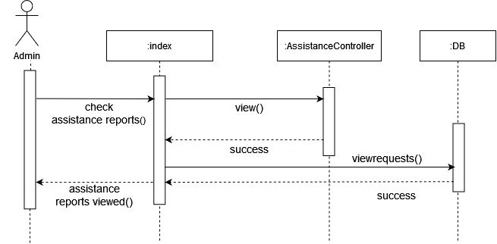

Slide 26
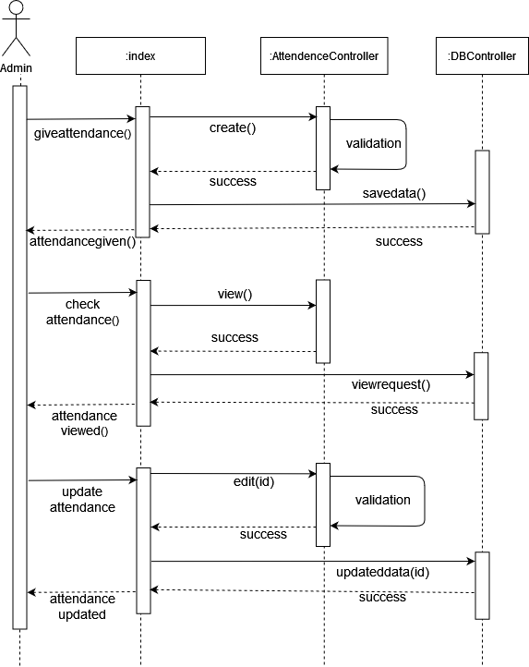

Slide 27
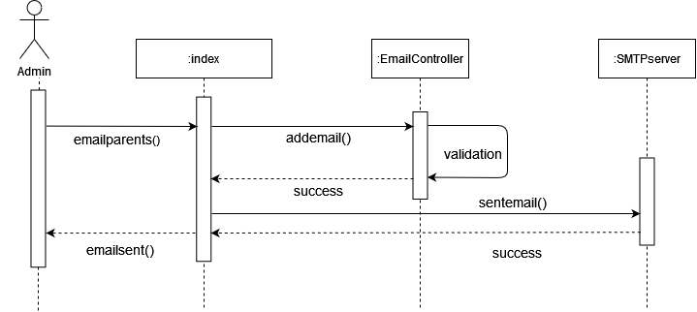

Slide 28


Slide 29
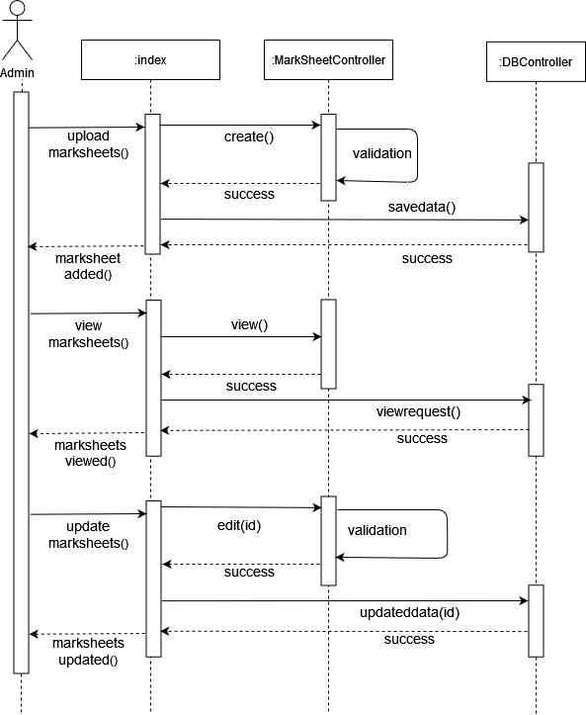

Slide 30
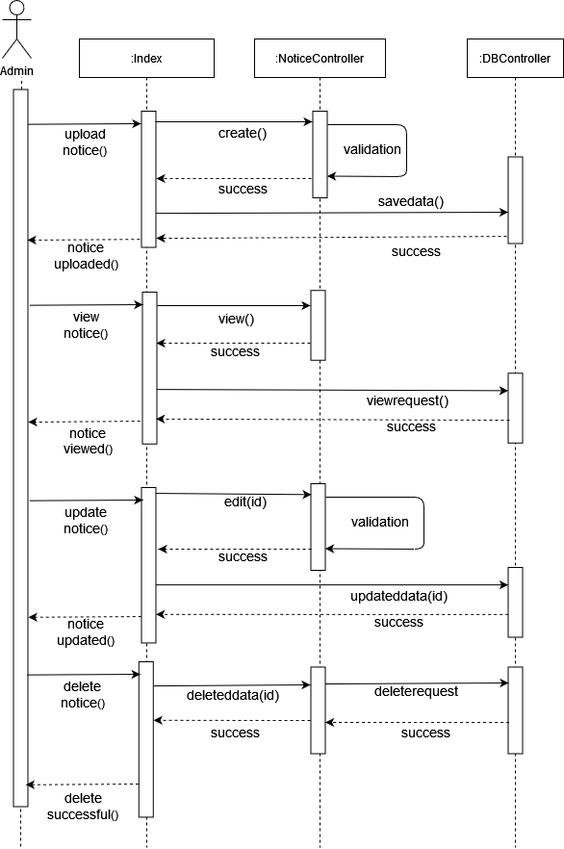

Slide 31
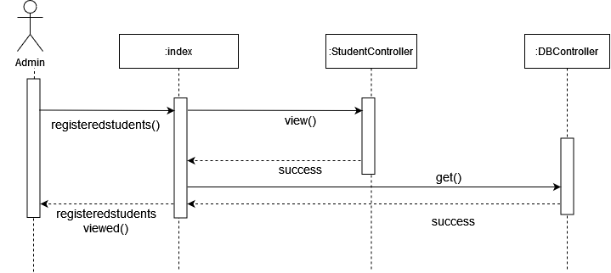

Slide 32
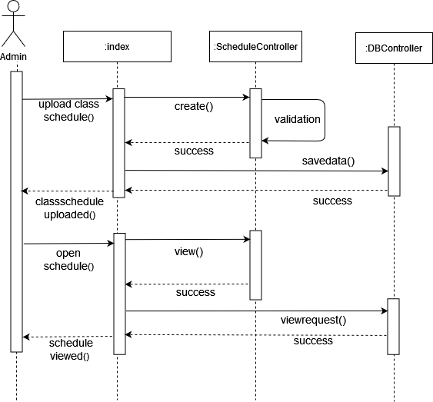

Slide 33
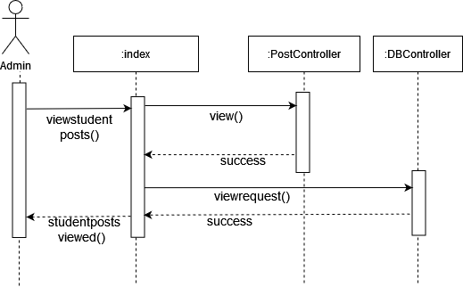

Slide 34
Sequence diagram for Student

Slide 35
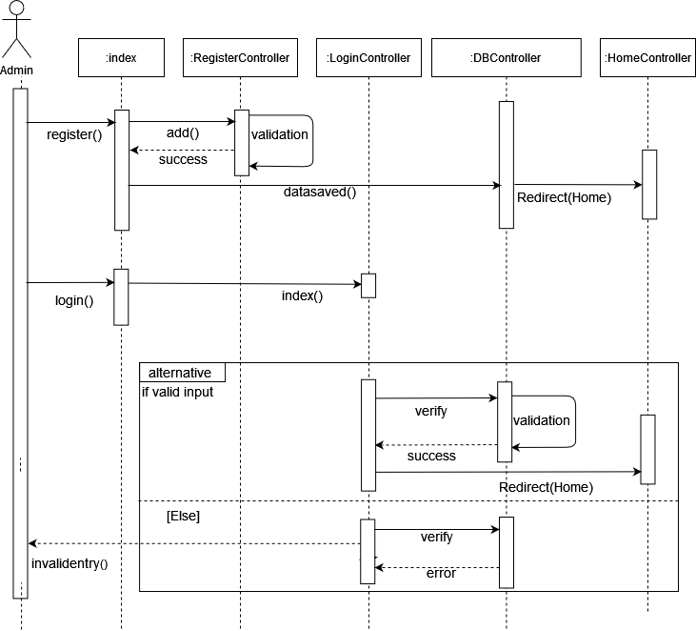

Slide 36
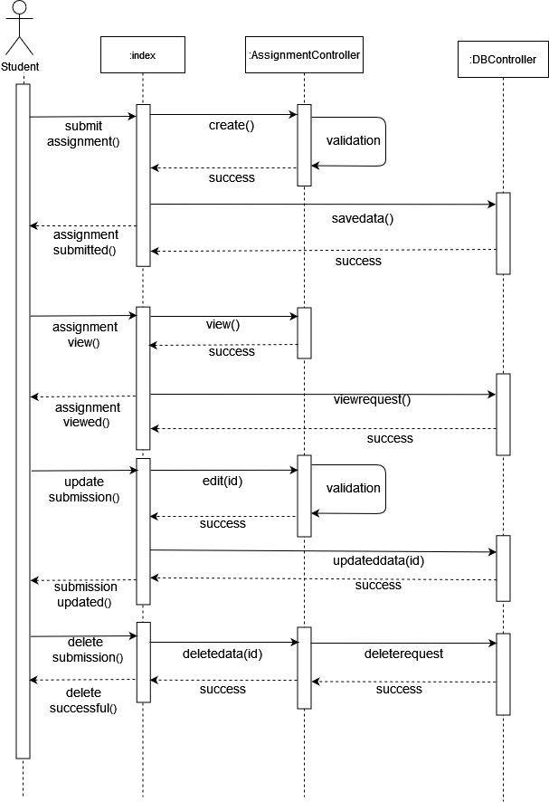

Slide 37
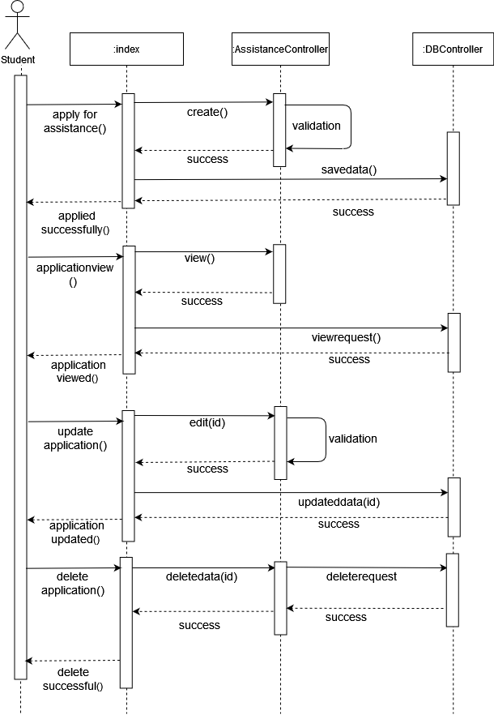

Slide 38
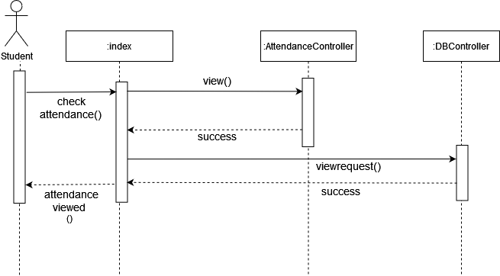

Slide 39
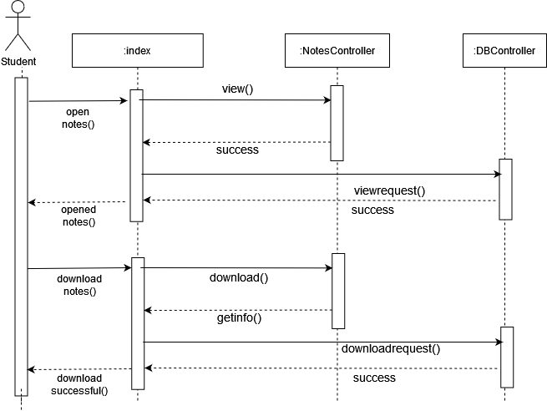

Slide 40


Slide 41


Slide 42

Entity-Relationship Diagram

Slide 43
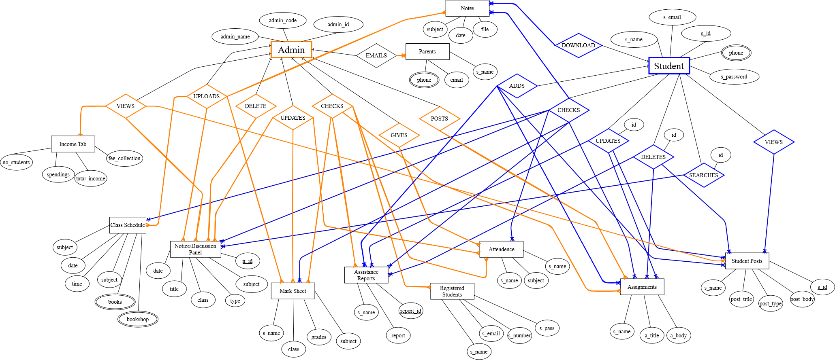

Slide 44

Activity Diagram for Admin

Slide 45
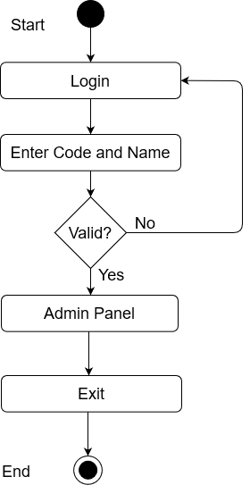
Admin Login

Slide 46
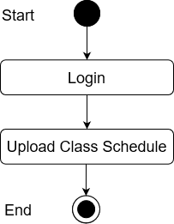
Upload Class Schedule

Slide 47
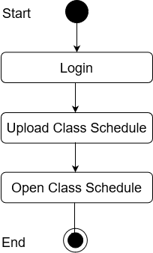
Open class schedule

Slide 48
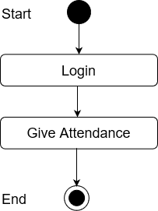
Give Attendance

Slide 49
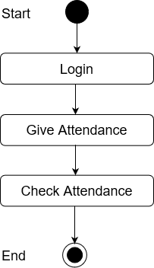
Check attendance

Slide 50
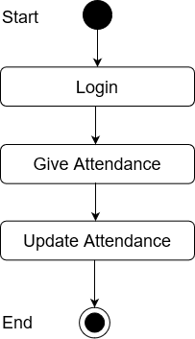
Update Attendance

Slide 51
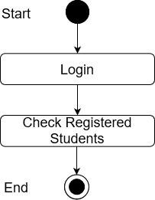
Check Registered Students

Slide 52
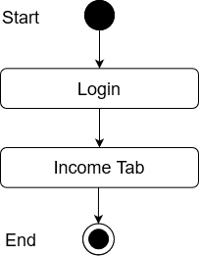
Income Tab

Slide 53
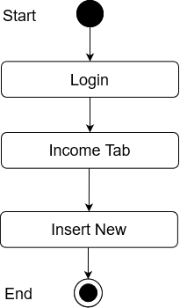
Insert New

Slide 54
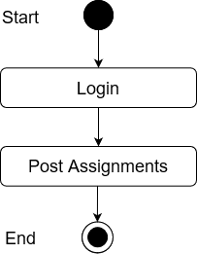
Post Assignments

Slide 55

Check Submissions

Slide 56
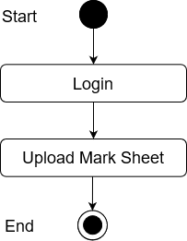
Upload Mark Sheet

Slide 57
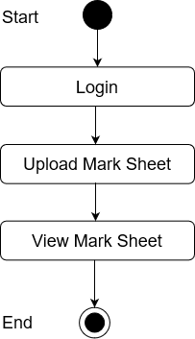
View Mark Sheet

Slide 58

Update Mark Sheet

Slide 59
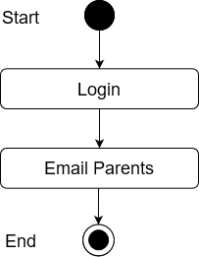
Email Parents

Slide 60
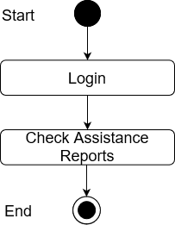
Check Assistance Report

Slide 61
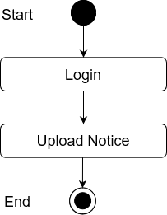
Upload Notice

Slide 62

View Notice

Slide 63

Update Notice

Slide 64

Delete Notice

Slide 65
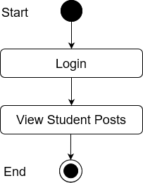
View Student Posts

Slide 66
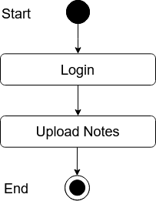
Upload Notes

Slide 67

Activity Diagram for Student

Slide 68
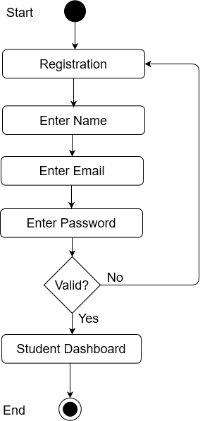
Register

Slide 69
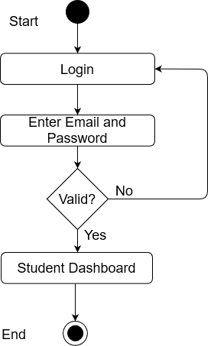
Login

Slide 70
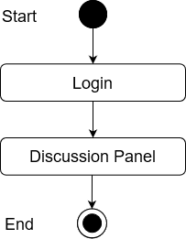
Discussion Panel

Slide 71

Post

Slide 72
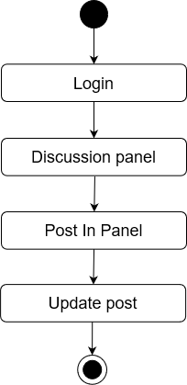
Update Post

Slide 73

Delete Post

Slide 74

Search

Slide 75
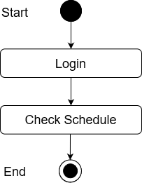
Check Schedule

Slide 76
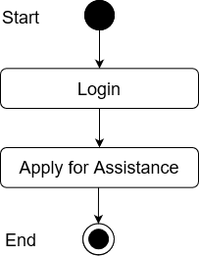
Apply for Assistance

Slide 77
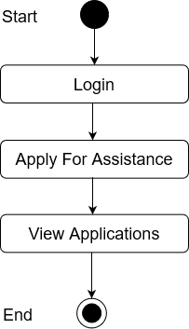
View Application

Slide 78
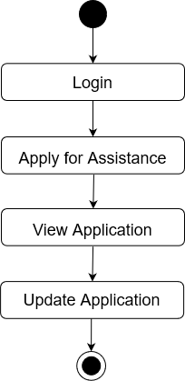
Update Application

Slide 79

Delete Application

Slide 80

Check Attendance

Slide 81
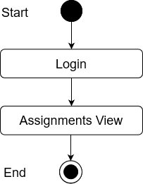
View Assignments

Slide 82
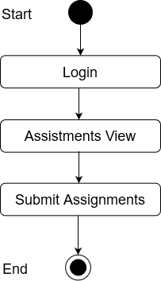
Submit

Slide 83
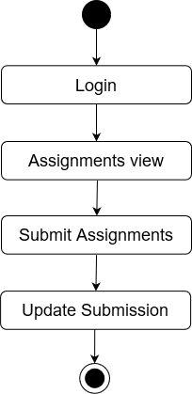
Update Submission

Slide 84

Delete Submission

Slide 85
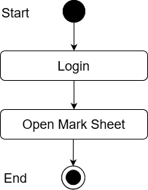
Open Mark Sheet

Slide 86

View Notes

Slide 87

Download Notes

Slide 88


