Slide 1

Implementation of Chained Hash Table
Presented by
Muhtasim-Ul-Alam(2016-1-60-079)
Sayed Shafa (2017-3-60-016)
Introduction

Slide 2
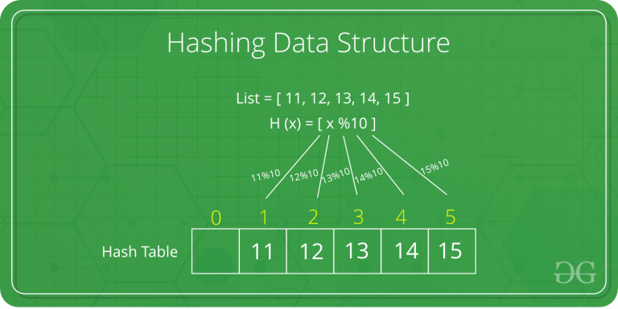
Hashing
Hashing is an important Data Structure which is designed to use a special function called the Hash function which is used to map a given value with a particular key for faster access of elements. The efficiency of mapping depends of the efficiency of the hash function used.
Introduction

Slide 3
Cz
Collision
Since a hash function gets us a small number for a key which is a big integer or string, there is a possibility that two keys result in the same value. The situation where a newly inserted key maps to an already occupied slot in the hash table is called collision and must be handled using some collision handling technique.
Introduction

Slide 4
Real Time Masked Face Recognition for Authentication
How to handle Collisions?
1) Separate Chaining
Thesis Presentation
23rd October 2020
Solution
solution
2) Open Addressing

Slide 5

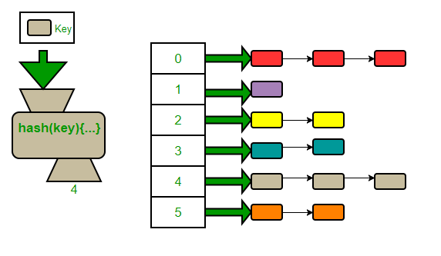
Implementations
Real Time Masked Face Recognition for Authentication
Thesis Presentation
23rd October 2020
Implementation

Slide 6
Implementations
Real Time Masked Face Recognition for Authentication
Thesis Presentation
23rd October 2020
Structure & initialize
Insertion
Showing Hash table
Search
Delete
Implementation

Slide 7
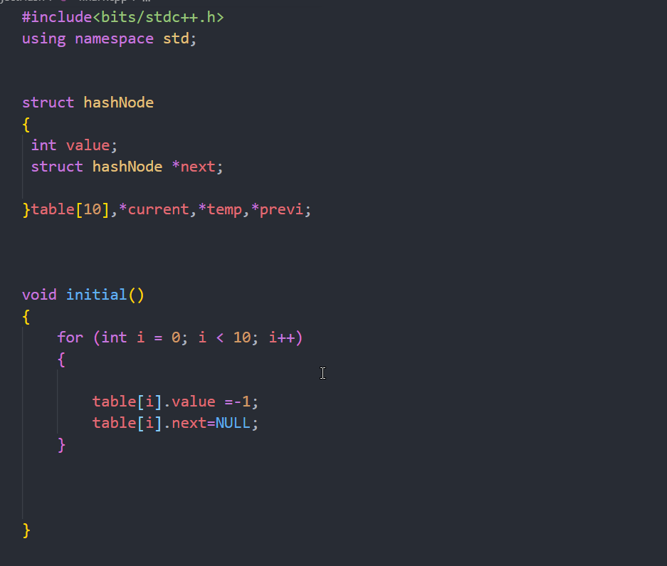
Real Time Masked Face Recognition for Authentication
Thesis Presentation
23rd October 2020
Implementation

Slide 8
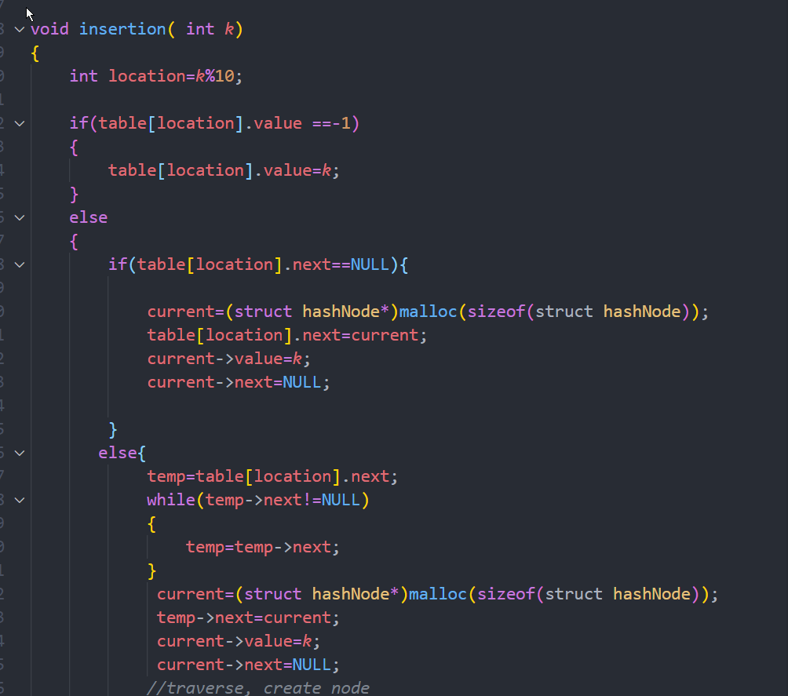
Real Time Masked Face Recognition for Authentication
Thesis Presentation
23rd October 2020
Implementation

Slide 9
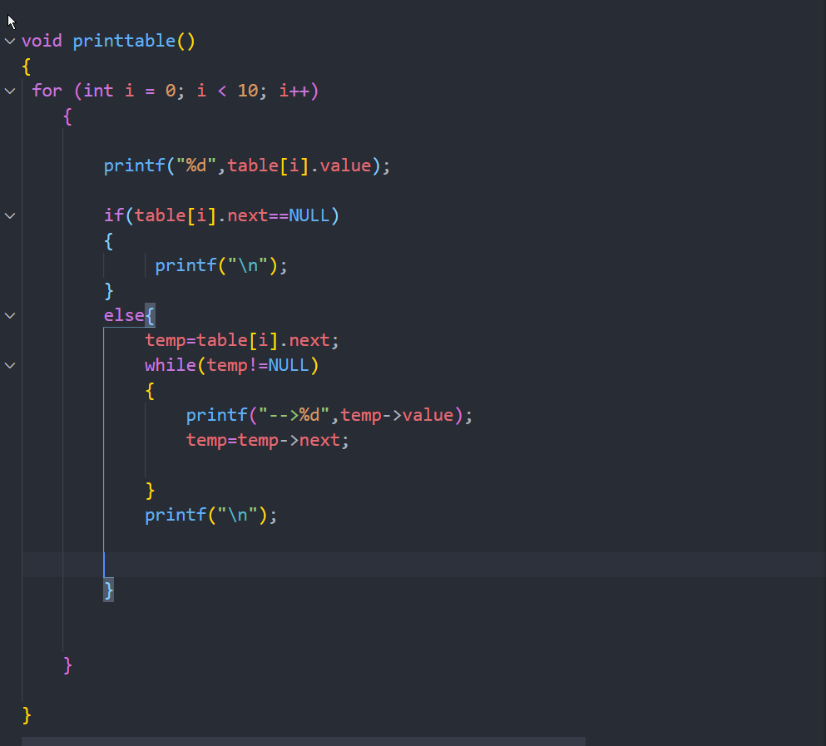
Real Time Masked Face Recognition for Authentication
Thesis Presentation
23rd October 2020
Implementation

Slide 10
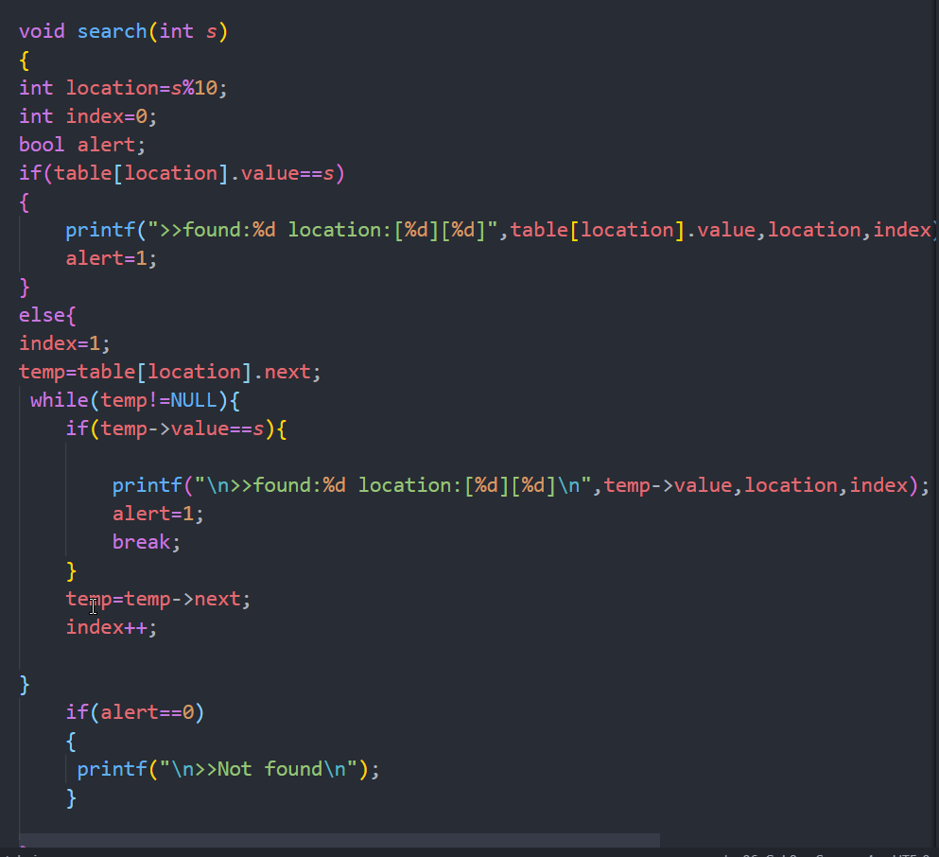
Real Time Masked Face Recognition for Authentication
Thesis Presentation
23rd October 2020
Implementation

Slide 11
Real Time Masked Face Recognition for Authentication
LIMITATIONS
Thesis Presentation
23rd October 2020
Implementation
Not capable to handle negative number

