Slide 1
How to read code
Terence Parr
MSDS program University of San Francisco

Slide 2
Why must we be able to read code?
Fundamentally, programmers communicate with code
It’s how we express our thoughts to the computer and also to other developers
It's how we learn from others and improve our skills; example:
Student was doing
df['A'] = False df.loc[(df['type']=='foo')&(df['alt_aa']==df['ref_aa']),'A']=True
Later, they saw this
df[‘A’] = (df[‘type’]==‘foo’)&(df[‘ref_aa’]==df[‘alt_aa’])

Slide 3
Reading code is also part of your process
We can often find hints or solutions to a coding problem through code snippets found via Google search or at StackOverlow
The code is the documentation
The complete behavior of a function isn’t always clear from just the name or parameter list
Looking at the source code is the best way to understand what it does
All code has bugs, particularly code we just wrote that has not been tested exhaustively
As part of the coding process, we are constantly bouncing around, reading our existing code base to make sure everything fits together

Slide 4
How to read code
Our first clue comes from the fact that we are not computers, hence, we should not read code like a computer, examining one symbol after the other
Instead, we look for key elements and code patterns
We reverse the process followed by the code author
Code author thought “convert prices into a new list by dividing by 2,” which they converted to “map” pattern and then to a Python loop
We must reverse this and imagine the original goal of author
Don’t try to determine functionality by simulating the loops statements literally in your head or on paper
Rather, look for patterns that tell us what high-level operations are being performed

Slide 5
Good incentive to write clear code
You should emphasize clarity when writing code, so that reading the code quickly leads the reader to your intentions
The reader could be you or…
There is an excellent quote (by John F. Woods I think) that summarizes things well:
“Always code as if the person who ends up maintaining your code will be a violent psychopath who knows where you live.”

Slide 6
Getting the gist of a program
When looking at a textbook for the first time, it makes sense to scan through the table of contents to get an overall view of the content
Same for code: Look through all of the files and the names of the functions contained in those files
Figure out where the main program is
Depending on your purpose in reading the program, you might start stepping through the main program or immediately jump to a function of interest.
Look at the input-output pairs of the program from sample runs or tests because it helps you understand the program's functionality

Slide 7
Getting the gist of a function

Slide 8
Look at the function name
Once we identify a main program or function to examine, it's time to reverse-engineer the function work plan / algorithm
The function's name is perhaps the biggest clue as to what the function does, assuming the code author was a decent programmer; e.g., there is no doubt what the following function's goal is:
(Using a generic function name like f is how faculty write code-reading questions without giving away the answer.)
def average(...):
...

Slide 9
Function comments
Sometimes programmers will provide comments about the usage of a function, but be careful!
Programmers often change the code without changing the comments and so the comments will be misleading

Slide 10
Function parameters and return value
The next step is to identify the parameters and return value(s)
The names of the parameters often tell us a lot
Unfortunately, Python usually does not have explicit types (they aren't checked by Python anyway) so we have to figure that out ourselves
Knowing the types of values and variables is critical to understanding a function; without knowing the types, you cannot know what the function does
def average(data):
...
return sum/n
Don't fall for this trick in interviews.
W/o knowing the type, we don't know what the operators do

Slide 11
Reading the function code itself
Scan the statements of the function looking for loops; all of the action occurs in the loops
An inexperienced programmer examines the statements of the function individually and literally, emulating a computer to figure out the emergent behavior
An experienced programmer looks for patterns in the code that are implementations of high-level ops like map, search, filter, etc...
Analogy: consider memorizing the state of a chessboard in the middle of play
A beginner has to memorize where all of the pieces are individually
A chessmaster recognizes that the board is, say, merely a variation on the Budapest Gambit

Slide 12
Identify the pattern, fill in the holes
What pattern is this code following? I.e., what’s it doing?
It’s using the accumulator pattern, “sum up a bunch of stuff”
The “holes” are: what we are accumulating (data), the operation is summation; we might also have to look for loop bounds
sum = 0.0
for x in data:
sum = sum + x

Slide 13
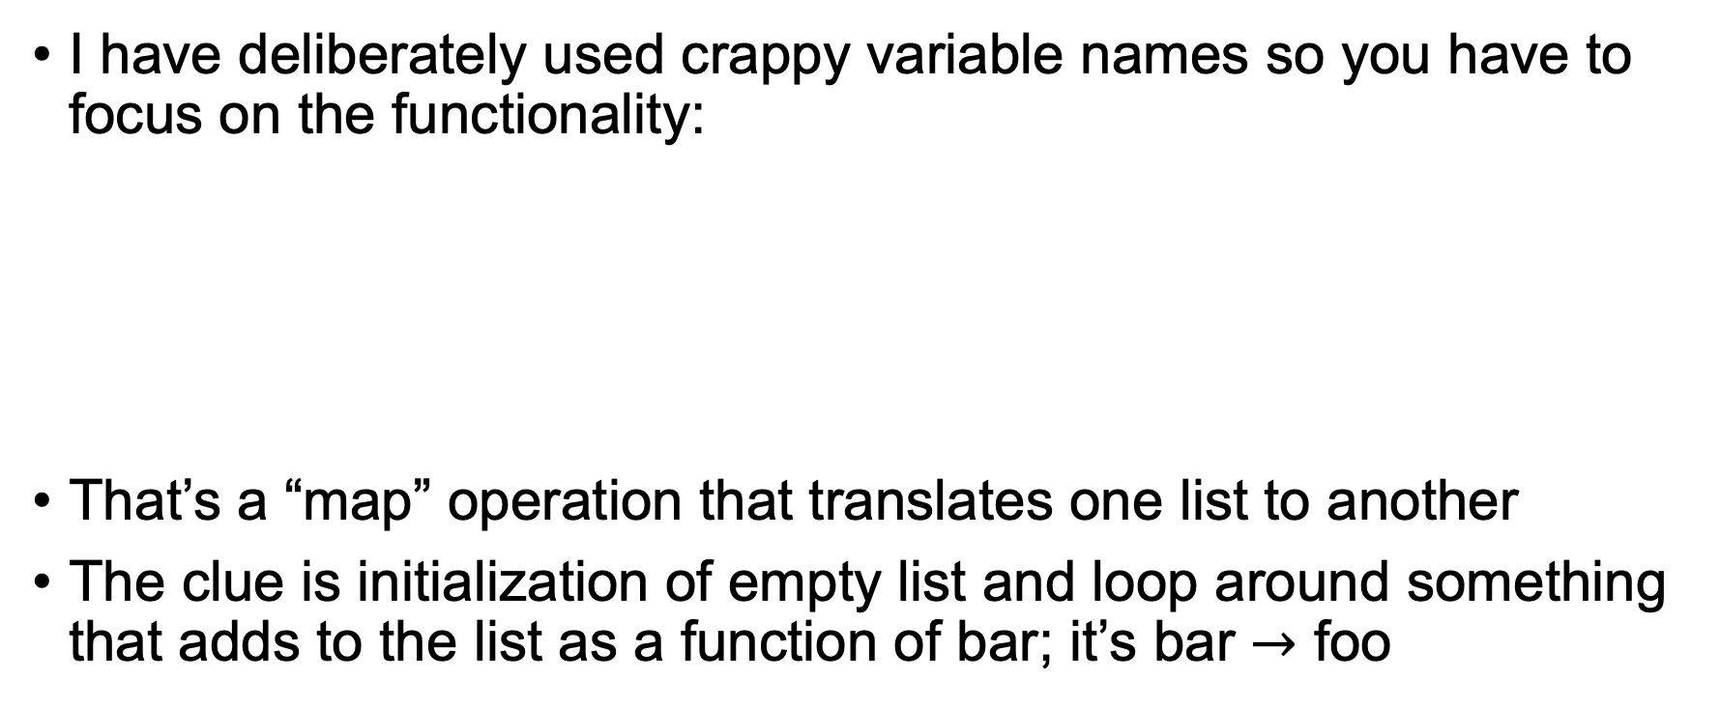
Code sample
I have deliberately used crappy variable names so you have to focus on the functionality:
That’s a “map” operation that translates one list to another
The clue is initialization of empty list and loop around something that adds to the list as a function of bar; it’s bar $→$ foo
foo = []
for blah in blort:
foo.append(bar * 2)

Slide 14
Code sample
What high-level math operation is this performing?
The key is to read “nested loop” as all combinations of n x n
Then look at the operation, which is adding two elements
Putting it together, add two matrices
See nested loops? Think matrix or image operations
for i in range(n):
for j in range(n):
C[i][j] = A[i][j] + B[i][j]

Slide 15
Code sample
Quick! What does this do?
Finds max value in x
Anytime you see an if statement inside of a loop, think filter or search or accumulator with condition.
blort = -99999
for x in X:
if x > blort:
blort = x
print(blort)

Slide 16
Code sample
Describe what value bar has after this code completes
Nothing more than two patterns in a sequence
Map blort into foo then filter values in foo to get zoo
foo = []
bar = []
for blah in blort:
foo.append(blah * 2)
for zoo in foo:
if zoo>10: bar.append(zoo)

Slide 17
Summary
Code is how we communicate; code is the documentation
Reading code is about identifying patterns, reverse engineering the intent of the original programmer
Be kind to other developers and your future self by writing high-quality code; and include useful comments
That includes choosing excellent variable and function names and writing code that clearly illustrates your intent

