Slide 1


DEPARTMENT OF COMPUTER SCIENCE AND ENGINEERING
20CS7503 & DESIGN PROJECT – III
END SEMESTER PRACTICAL EXAMINATION- NOV / DEC 2025
REVIEW PRESENTATION
Batch No.:14
Date:28.11.2025
Session: AN

Slide 2
ACADEMIC AND PLACEMENT TRACKER
Guide Name:
Ms .R.MADHUMATHI, M.E.,
Team Members:
KEERTHIVASAN S J (811722104074)
MUHUNDAN S (811722104095)
RAJESH R (811722104117)

Slide 3
OBJECTIVE OF THE PROJECT
1. To monitor academic performance by tracking students’ grades, credits, attendance, and overall progress.
2. To streamline placement activities by maintaining records of placement status ,company details, and roles offered.
3. To enable data-driven decision-making that helps students, faculty, and placement officers with better planning and career guidance.
4. To enhance accessibility and efficiency by reducing manual effort, ensuring accuracy, and allowing quick retrieval of academic and placement information.

Slide 4
INTRODUCTION
1.The Academic and Placement Tracker is designed to manage and monitor students academic performance and placement activities in a systematic way.
2.It provides an organized platform to record and analyze data such as grades, attendance, credits, placement status, and company details.
3.The system helps students evaluate their academic progress while also preparing for career opportunities.
4.It assists faculty and placement officers in tracking student readiness, identifying gaps, and supporting decision-making with accurate data.
5.By reducing manual work and enhancing accessibility, the tracker ensures efficiency, accuracy, and ease of use for all stakeholders.

Slide 5
LITERATURE SURVEY
TITLE OF PAPER | AUTHOR(S) | PAPER GIST | TECHNOLOGY USED
Educational data mining and learning analytics: An updated survey | C. Romero, S. Ventura | Reviews major techniques in educational data mining and learning analytics. | Data Mining, Learning Analytics, Big Data, Predictive Modeling
Campus Placements Prediction & Analysis using Machine Learning | Priyanka Shahane | Analyzes key academic and skill-based factors influencing placement outcomes. | Machine Learning (Logistic Regression, Decision Tree, KNN, Random Forest)
A Development of Web Based Placement Management System for Campus Recruitment | Sachin Shukla, S. K. Shinde, Komal Jiwatode, Utkarsh Somvanshi | Proposes an online system to automate placement activities and student data handling. | Web Development (JSP, Servlets), Database (MySQL), Real-time Notifications
Literature Survey on Student’s Performance Prediction in Education using Data Mining Techniques | Mukesh Kumar, A. J. Singh, Disha Handa | Surveys data mining methods used to classify and predict student academic performance. | Classification Algorithms, Data Mining Techniques

Slide 6
TITLE OF PAPER | AUTHOR(S) | PAPER GIST | TECHNOLOGY USED
A Survey of machine learning techniques for student performance and placement | Pallavi Devendra Tawde, Dr. Sarika Chouhan | Highlights how various models help institutions make data-driven academic decisions. | Machine Learning (Neural Networks, SVM, Decision Trees, Bayesian, Random Forest)
A Survey: Predicting Academic Success in Higher Education: Literature Review and Best Practices | Eyman Alyahyan & Dilek Düştegör | Discusses best practices for improving prediction accuracy and student support systems. | Regression, Classification, Clustering, Association (ML + Data Mining)
Litertature Survey for Digital Transformation of Academic Activities Using Web Development | B. Abhijith, Pushpak S, Krutharth R, Sarmad, Dr. Nagaraj J | Emphasizes the role of web systems in automating records, communication, and academic management. | Web Development (Java, JSP, Servlets), MySQL Database

Slide 7
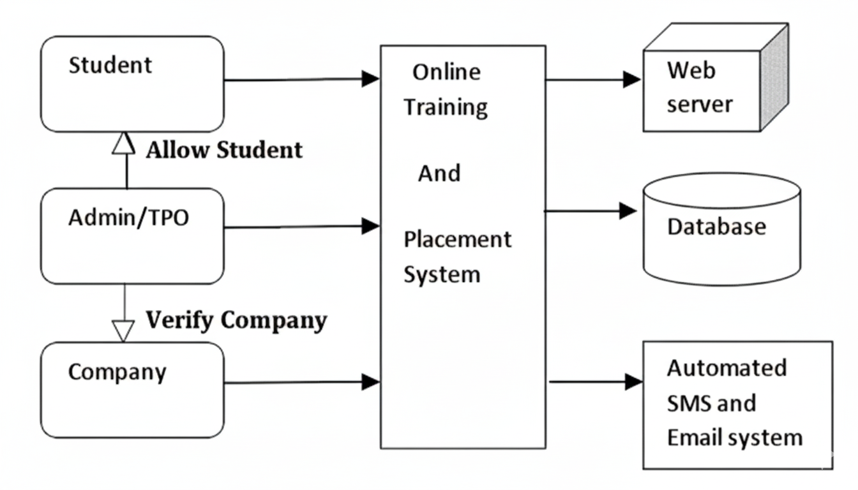
EXISTING SYSTEM ARCHITECTURE

Slide 8
PROBLEM IDENTIFICAITON
Data Fragmentation:
Academic records and placement details were stored on separate platforms, making it difficult to access or correlate student performance with placement outcomes.
2) Redundant Data Entry:
Students and administrators had to enter the same information (like personal or academic details) multiple times on both systems, leading to duplication and inconsistencies.
3) Lack of Unified Analytics:
Since academic and placement data were isolated, it was not possible to generate combined reports or analyze how academic performance influenced placement results.

Slide 9
4) Inefficient Communication:
Placement officers and faculty could not easily coordinate or share updates about student progress or eligibility, causing delays in information flow.
5) Poor User Experience:
Users had to manage multiple logins and navigate between two interfaces, which reduced usability and increased confusion for both students and administrators.

Slide 10
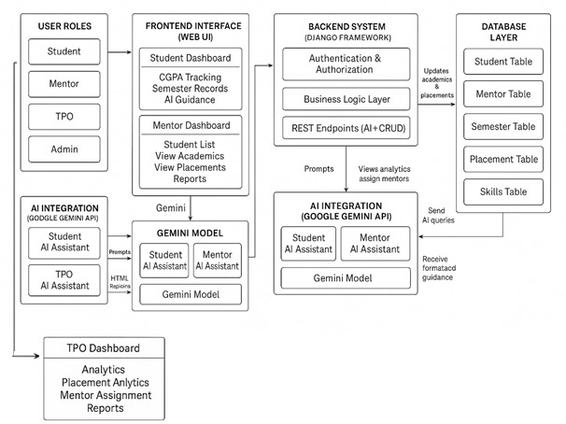
PROPOSED SYSTEM ARCHITECTURE

Slide 11
SOFTWARE AND HARDWARE REQUIREMENTS
HARDWARE
1. Processor: Dual-core or higher (Intel i3)
2. RAM: Minimum 4 GB (8 GB recommended)
3. Storage: Minimum 500 MB free space
SOFTWARE
1. AI Integration:Google Gemini API
2. Backend Framework: Django 5.x
3. Database: SQLite (development),MySQL / PostgreSQL
4. Libraries: Django,google-genai

Slide 12
MODULES
1.Student Information Management Module
2.Academic Performance Tracking Module
3.Placement Records Management Module
4.Reporting and Analytics Module
5.User Access and Administration Module

Slide 13
Student Information Management Module
Stores complete student profiles including personal, academic, and contact details.
Centralized database to access and update student records efficiently.
Supports categorization by department, year, and batch for quick retrieval.
Ensures data accuracy and minimizes duplication through validation checks.
Acts as the foundational layer for all other academic and placement operations.

Slide 14
Academic Performance Tracking Module
Tracks semester-wise CGPA, grades, internal marks, and attendance.
Provides visual insights through charts and progress graphs.
Helps identify academically weak or high-performing students.
Enables faculty to monitor academic growth and offer timely support.
Facilitates automated report generation for academic reviews and audits.

Slide 15
Placement Records Management Module
Stores details of campus drives, recruiters, job roles, and eligibility criteria.
Tracks each student’s placement status, offer letters, and company details.
Helps placement officers maintain updated records of selected and unplaced students.
Provides insights into hiring trends and recruiter participation.
Ensures smooth coordination between students, mentors, and the placement cell.

Slide 16
Reporting and Analytics Module
Generates detailed reports on academic, placement, and attendance data.
Provides graphical dashboards for fast decision-making.
Helps analyze trends such as CGPA improvement, placement ratios, and student performance.
Offers customizable filters for department-wise or batch-wise analytics.
Supports data-driven planning for institutional improvements.

Slide 17
User Access and Administration Module
Manages login roles for students, mentors, placement officers, and administrators.
Ensures secure access using authentication and permission controls.
Allows admins to add, edit, or remove users and assign privileges.
Maintains data confidentiality by restricting unauthorized access.
Provides activity logs to track system usage and ensure accountability.

Slide 18
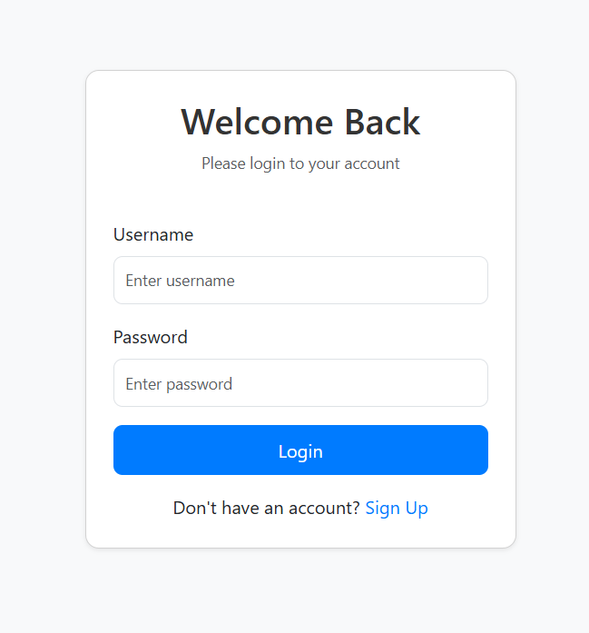
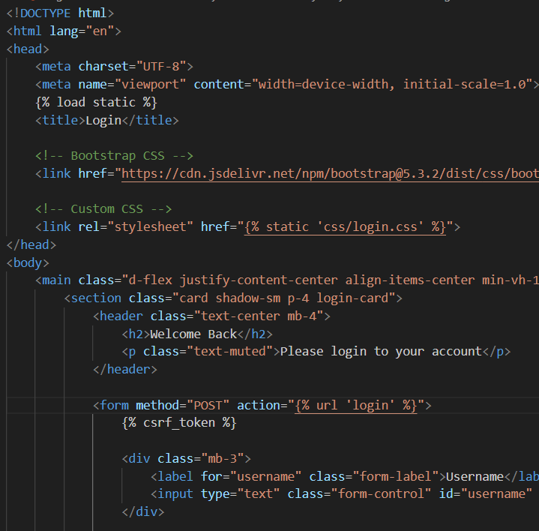
IMPLEMENTATION OF MODULE-1

Slide 19
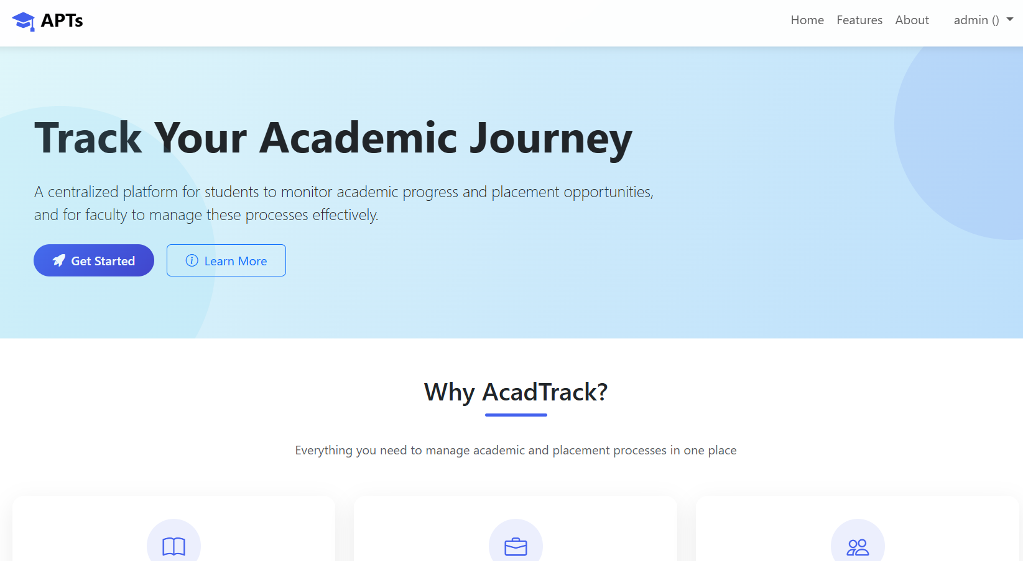
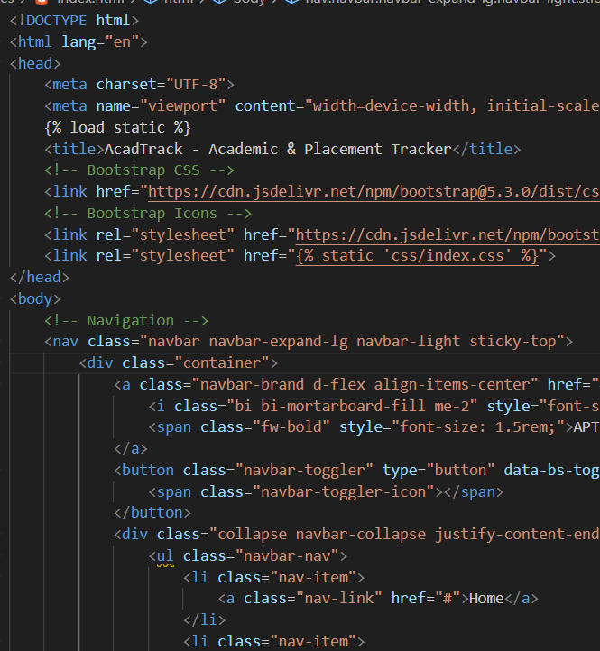
IMPLEMENTATION OF MODULE-2

Slide 20
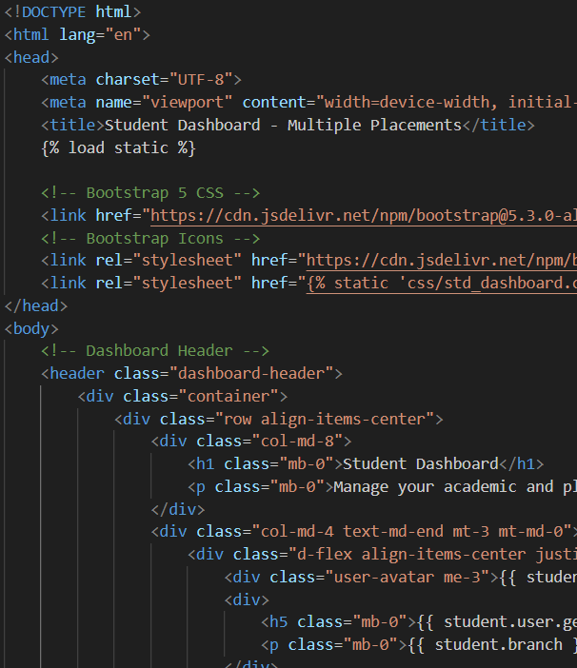
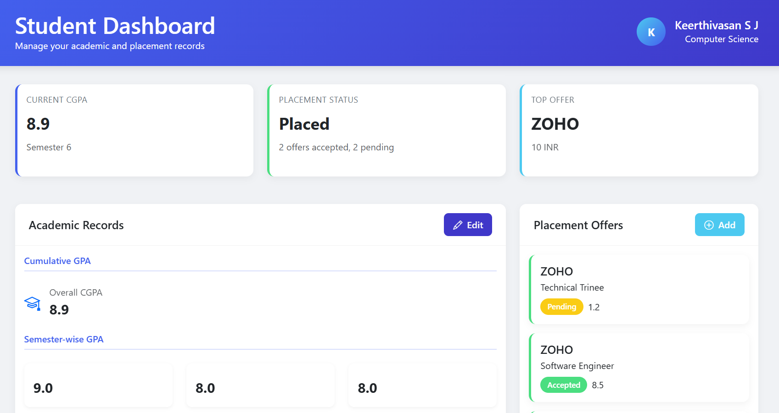
IMPLEMENTATION OF MODULE-3

Slide 21
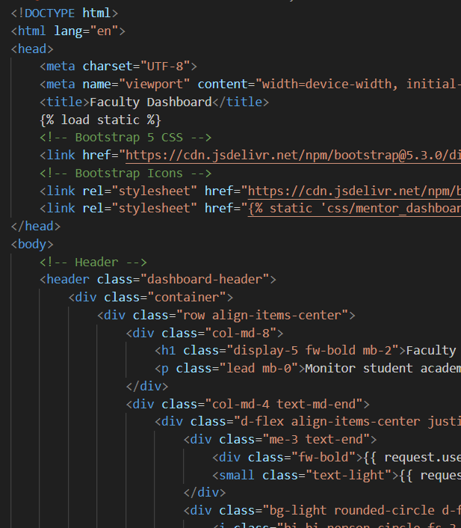
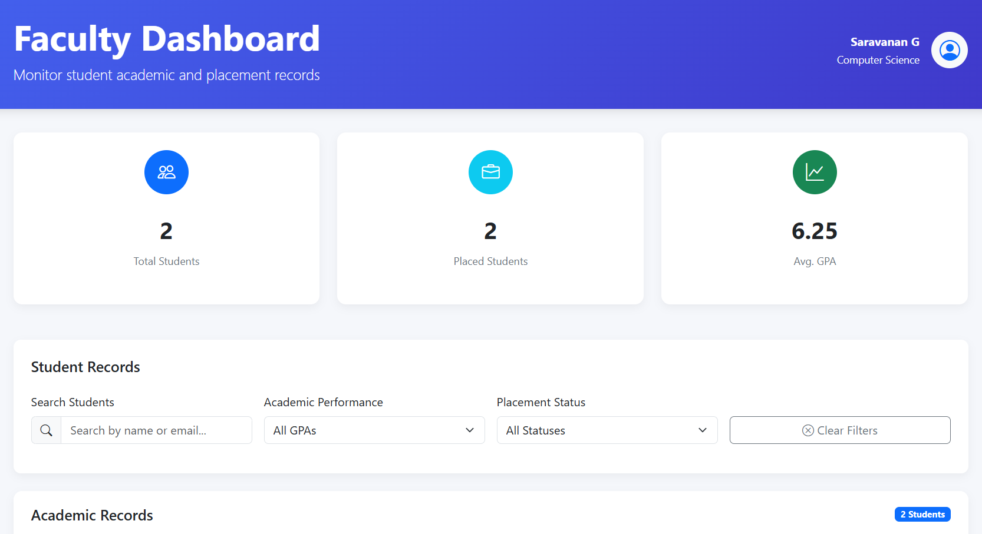
IMPLEMENTATION OF MODULE-4

Slide 22
CONCLUSION
1.The Academic and Placement Tracker successfully integrates academic monitoring and placement management into a single platform.
2.It minimizes manual work, reduces errors, and improves efficiency in handling student records.
3.The system benefits students by helping them evaluate their academic growth and placement readiness.
4.Faculty and placement officers gain accurate, real-time data for better decision-making and guidance.
5.Overall, the project ensures transparency, accessibility, and reliability in managing both academic and placement activities.

Slide 23
FUTURE ENHANCEMENTS
Integration of Attendance Tracking System
Add automated attendance monitoring with QR codes, GPS, or biometric support to provide accurate and real-time attendance records.
Assignment Management Module
Introduce assignment upload, deadline reminders, grading, and feedback features to help students and mentors manage academic tasks efficiently.
AI-Based Performance Prediction
Implement machine learning models to predict academic outcomes, placement chances, and recommend improvement areas for students.
Industry Notification & Internship Alerts
Add automatic job, internship, and company update notifications based on student skills, CGPA, and department.

