Slide 1

Exploration Algorithm for a Mobile Cleaning Robot
Presented By
Mohammad Muinul Islam

Slide 2

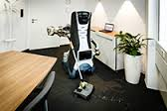
Robot Platform: Care-O-Bot 3

Slide 3
Tasks of Mobile Cleaning Robot:
It will get a office floor plan or any floor plan of any building.
Then it will visit the nearest room from its current position.
During exploration of that room it will detect the dirt and trash bin.
Then it will go to the trash bin position and clear it.
Later it will change the tool to collect dirt by a vacuum cleaner.
Then it will set the room as cleaned and will search for a nearest un-cleaned room.

Slide 4
Main Tasks of Exploration Algorithm:
To explore a office floor or any kind of surface independent of mobile base platform.
Detection of rooms in the floor.
Calculation of the Nearest room location from the base position and command the base to enter into the room
Calculation of accessible areas of the room including dynamic obstacles.
Visit every accessible points.
When finish set the room as processed and search for another unprocessed room.

Slide 5
Why do we need this algorithm?
Exploration algorithm support dirt detection and trash bin detection during exploration.
It helps the dirt detection algorithm to create a dirt map which is used later to detect dirt during cleaning.
Command the robot a shortest(cost-effective) and suitable path for collecting dirt and cleaning the trash bin based on static and dynamic obstacles.

Slide 6
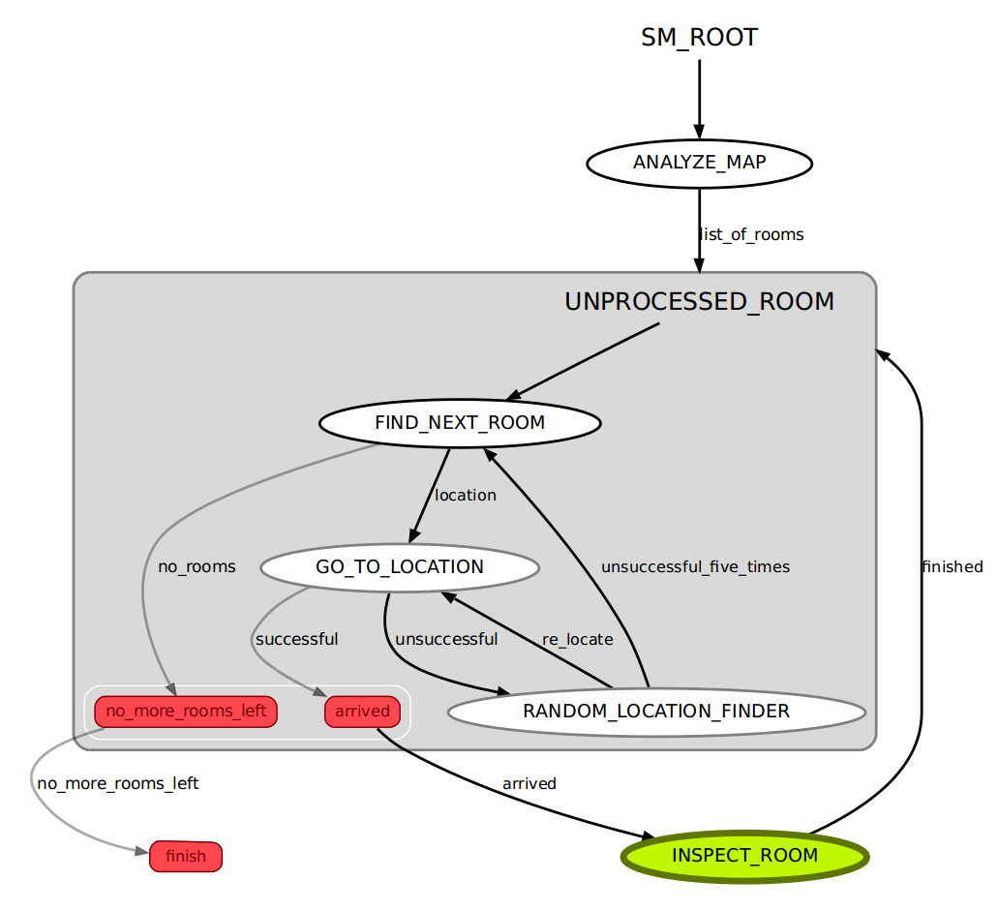
State Machine representation of Exploration Algorithm

Slide 7
Map Segmentation Algorithm
Collect the navigation data from analyze map action client
Erode the image until get the last room
Find contours
For each contour check if contour fulfills criteria of a room
If contour fulfill the criteria save the contour somewhere else
Exit the loop if there are no more contours
Copy original image
Copy the stored contours into the map and fill each with a unique
Id number repeat until convergence(i.e there are no more white pixels)

Slide 8
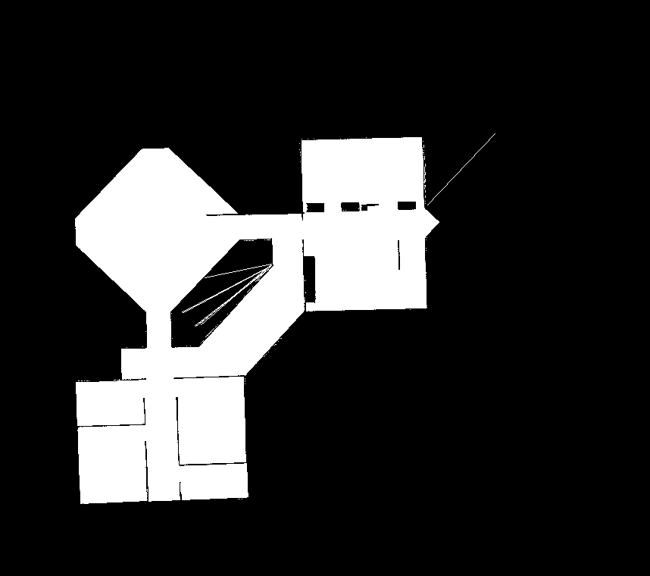
Analyze Floor Plan

Slide 9
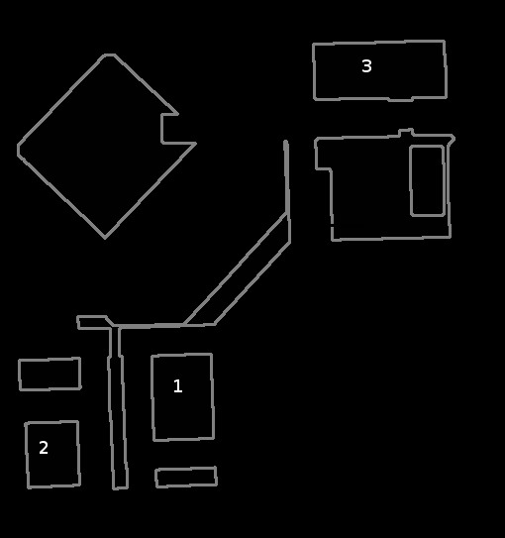
Analyze Floor Plan

Slide 10
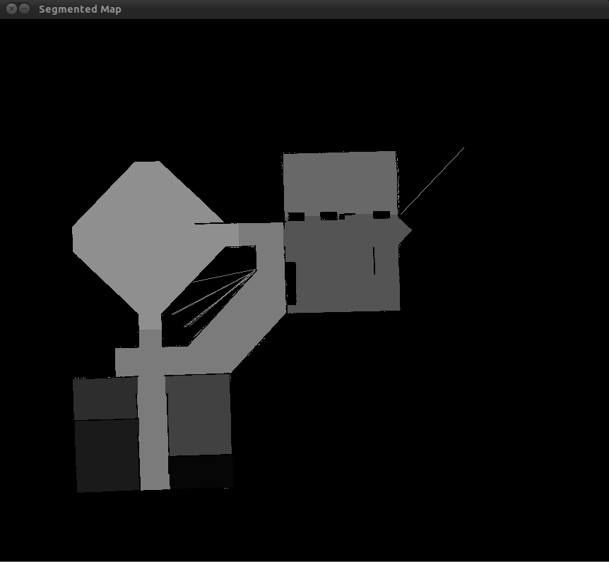
Analyze Floor Plan

Slide 11
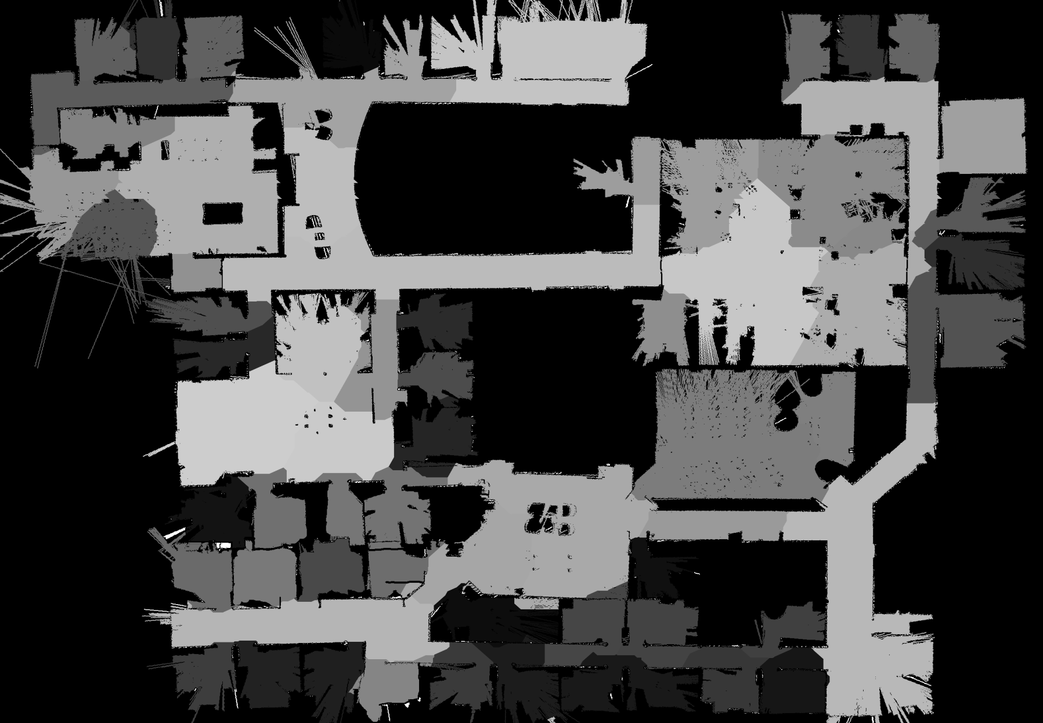
Segmentation Algorithm on Willow Garage Floor Plan

Slide 12
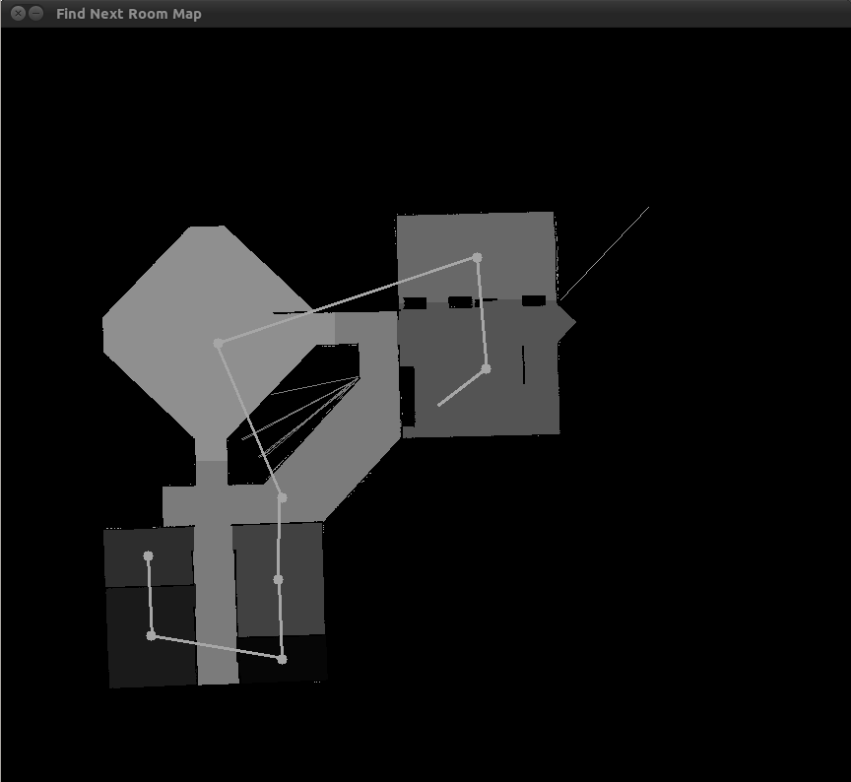
Find Next Unprocessed Room And Go To The Room Location

Slide 13
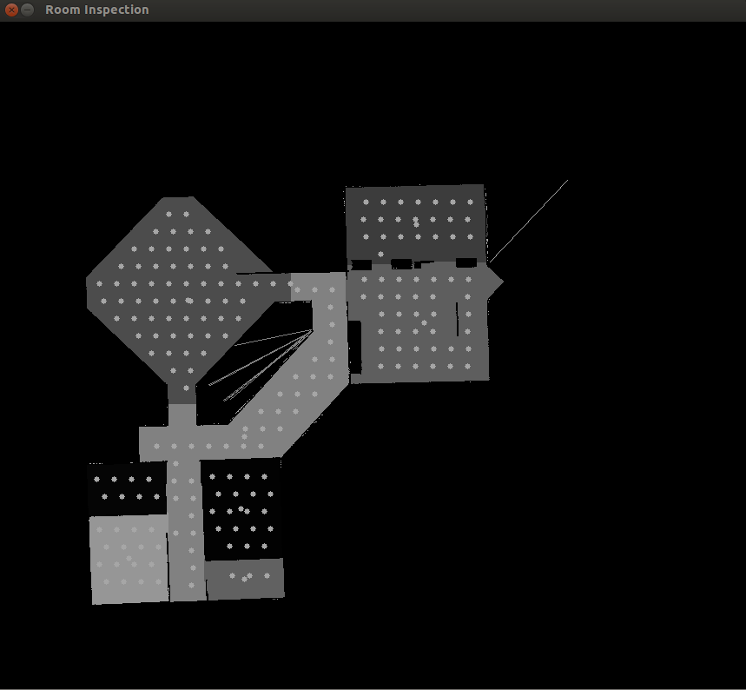
Inspect Room

Slide 14
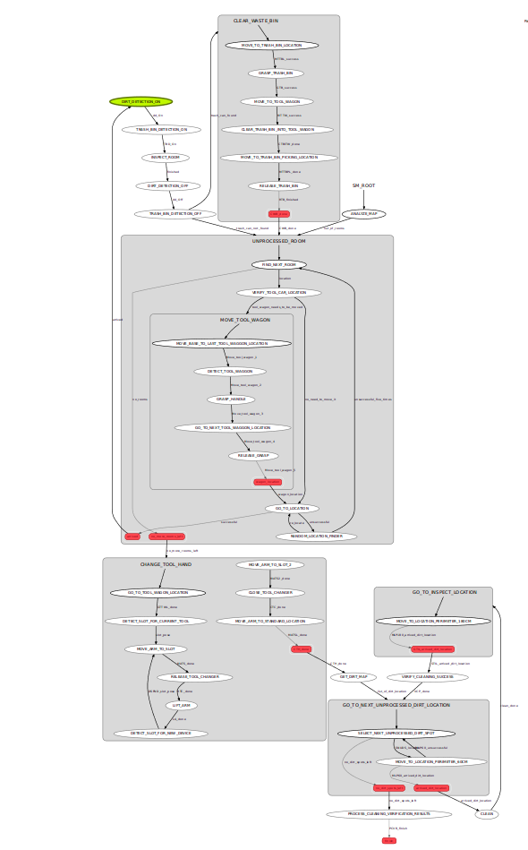
Tasks of Mobile Cleaning Robot:

Slide 15
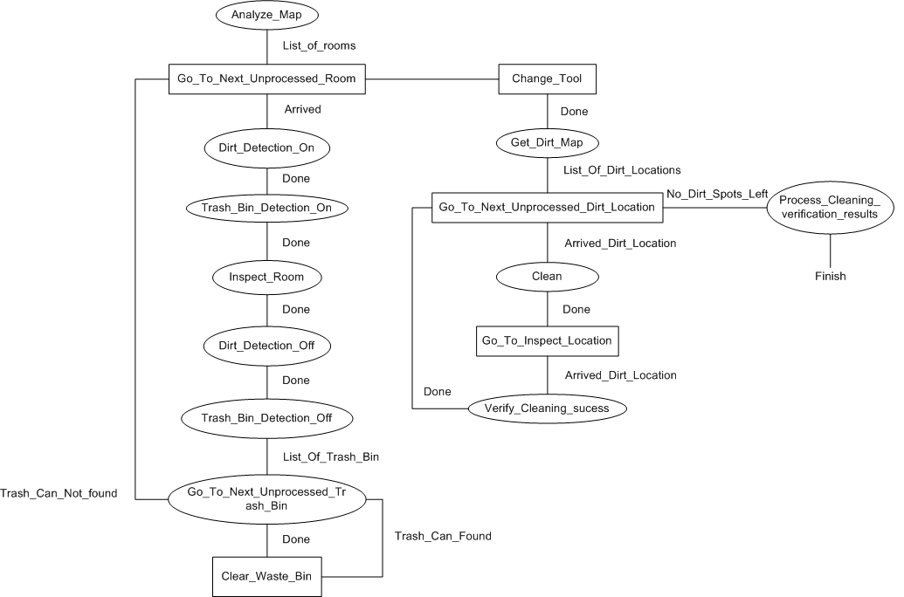
Tasks of Mobile Cleaning Robot:

Slide 16

Video of Exploration Algorithm

Slide 17
Conclusion
Finally we can say, Exploration Algorithm is
essential for the autonomous cleaning job and is
independent of mobile platform and floor plan.
But this Exploration Algorithm we can use for
other purpose like switching-Off all the energy
device in a busy office at the end of a working day
or during the weekend. We can also use this
algorithm in surveillance task and so on.

Slide 18
Thanks to all

