Slide 1
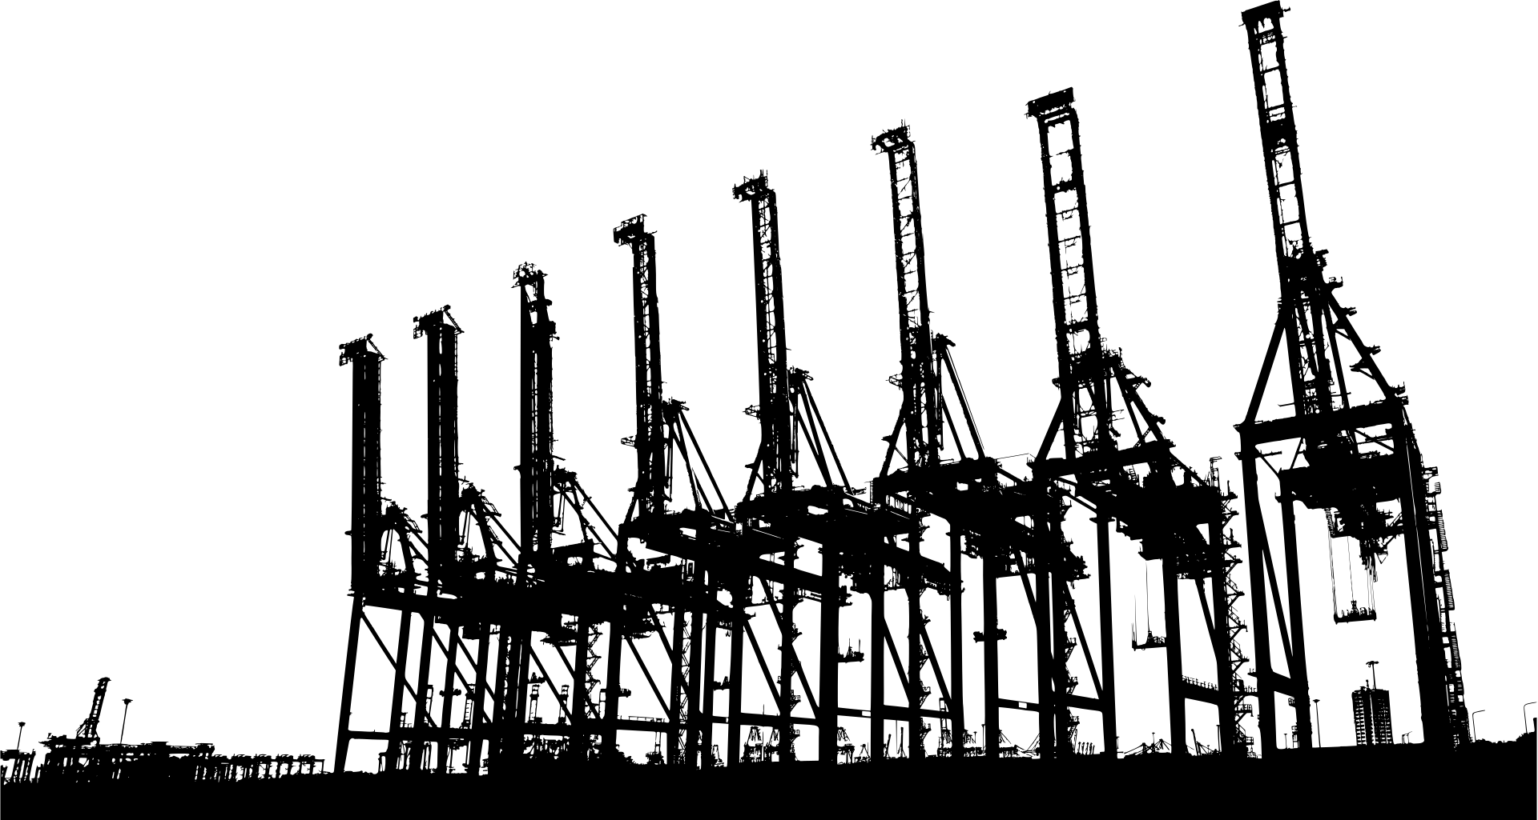
SAMADHAN
Team ID :
RICR-HIM-1050
Harsh Shrivastava
Divyanshu Kubde
Muiz Khan

Slide 2

THE PROBLEM
REPORTING A PROBLEM IS EASY. GETTING IT RESOLVED IS NOT. MAIN CONTENT CITIES RECEIVE THOUSANDS OF COMPLAINTS ABOUT:
• POTHOLES AND DAMAGED ROADS
• GARBAGE AND SANITATION
•WATER LEAKAGE AND DRAINAGE
• BROKEN STREETLIGHTS
• OTHER CIVIC PROBLEMS
• PUBLIC INFRASTRUCTURE DAMAGE
BUT TRADITIONAL COMPLAINT SYSTEMS OFTEN STOP AT COMPLAINT REGISTRATION.
THE
REAL
PROBLEMS
DUPLICATE
COMPLAINTS
NO CLEAR ACCOUNTABILITY
WRONG DEPARTMENT ROUTING
INTER-DEPARTMENT DEPENDENCIES
LACK OF TRANSPARENCY
RESOLVED PROBLEMS

Slide 3
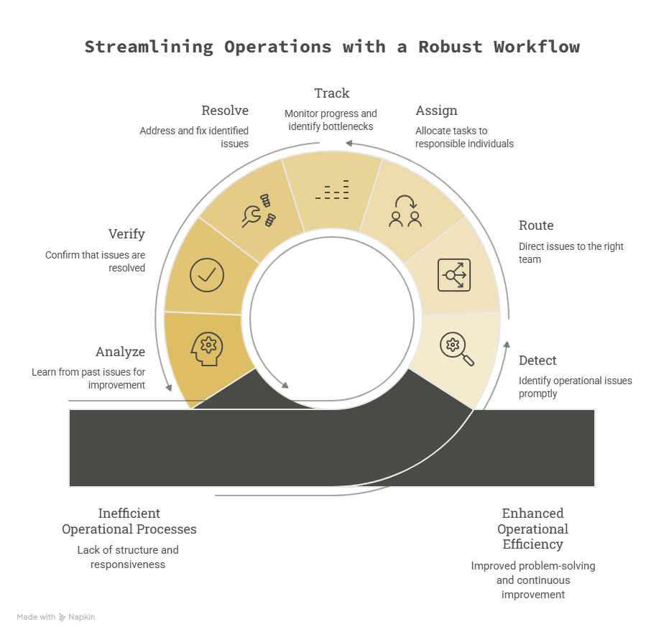
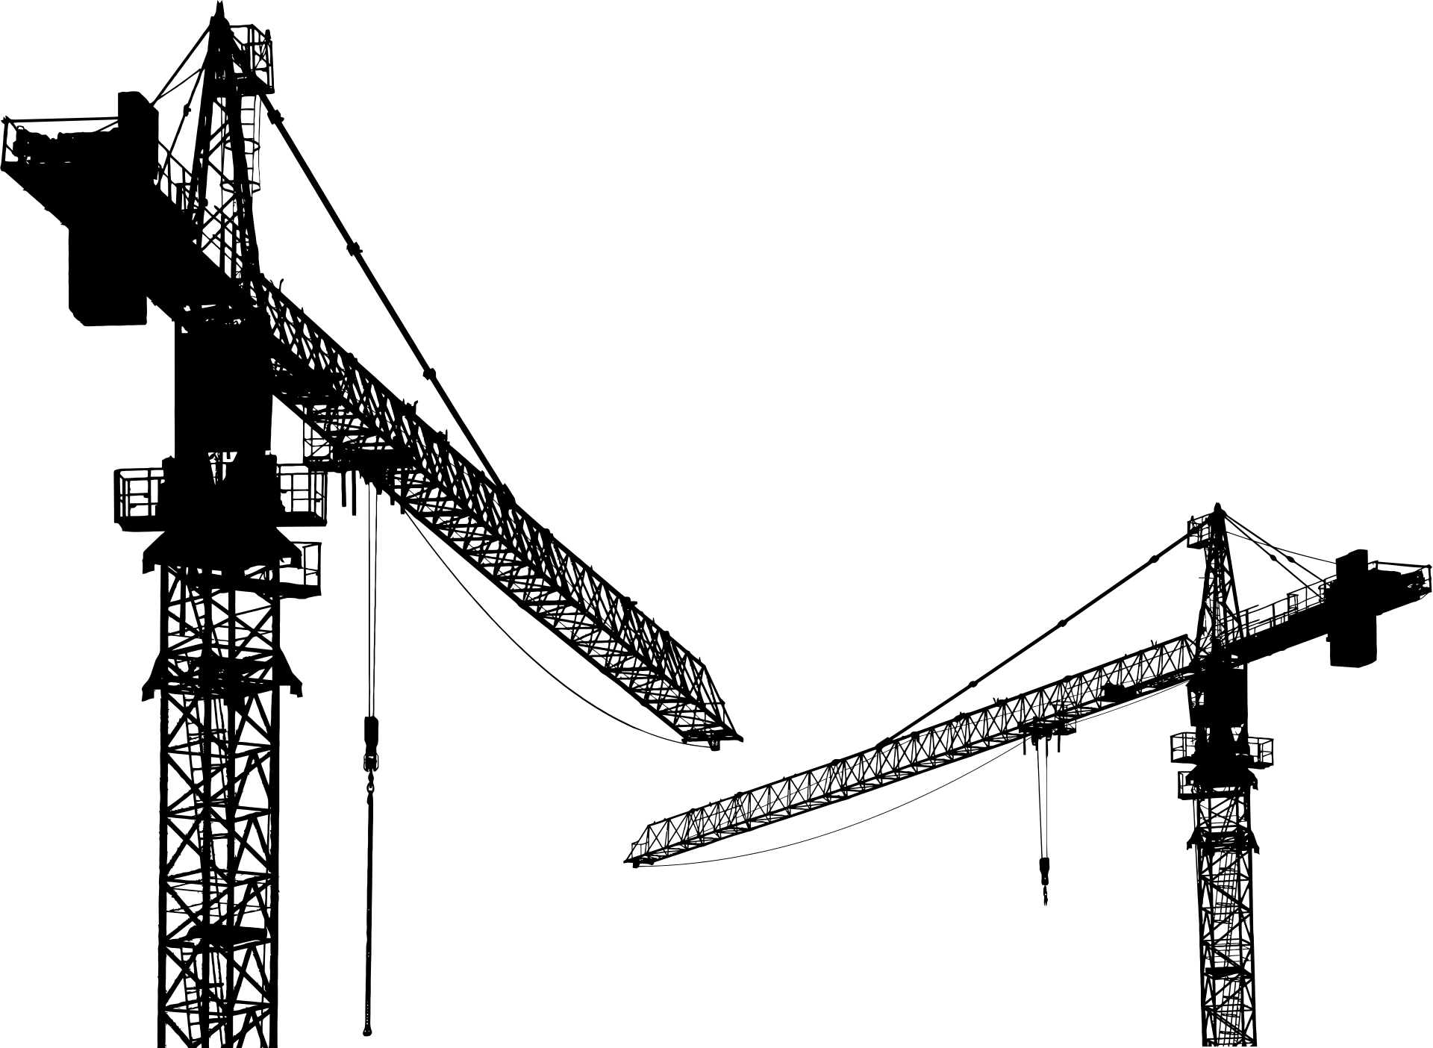
PROPOSED SOLUTION
MEET SAMADHAN
SAMADHAN IS A FULL-STACK CIVIC ISSUE RESOLUTION PLATFORM THAT CONNECTS:
CITIZENS:
  RESIDENTS
  STUDENTS
  COMMUTERS
  SHOPKEEPERS/BUSINESS OWNERS
DEPARTMENTS
  PUBLIC WORKS / ROADS DEPARTMENT → POTHOLES, DAMAGED ROADS, FOOTPATHS
  WATER SUPPLY DEPARTMENT → WATER LEAKS, BROKEN PIPELINES
ADMINISTRATORS
  ADDITIONAL/DEPUTY MUNICIPAL COMMISSIONER
  DEPARTMENT HEADS
  MUNICIPAL/CORPORATION SUPERVISORS

Slide 4
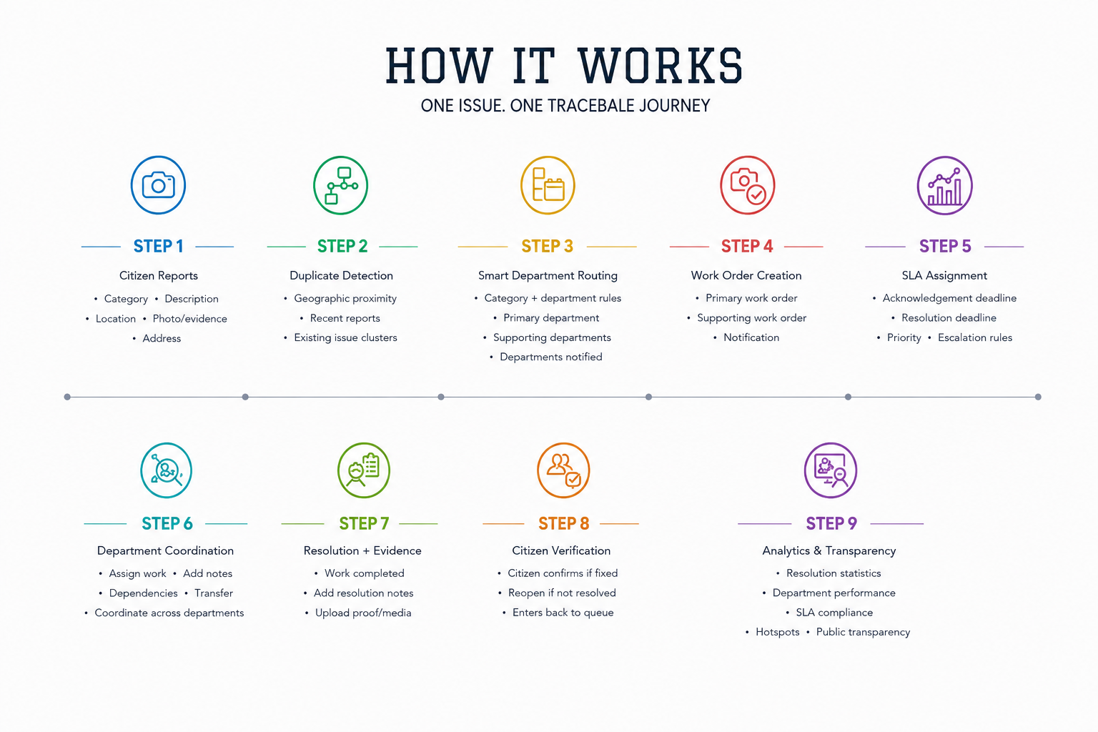

Slide 5
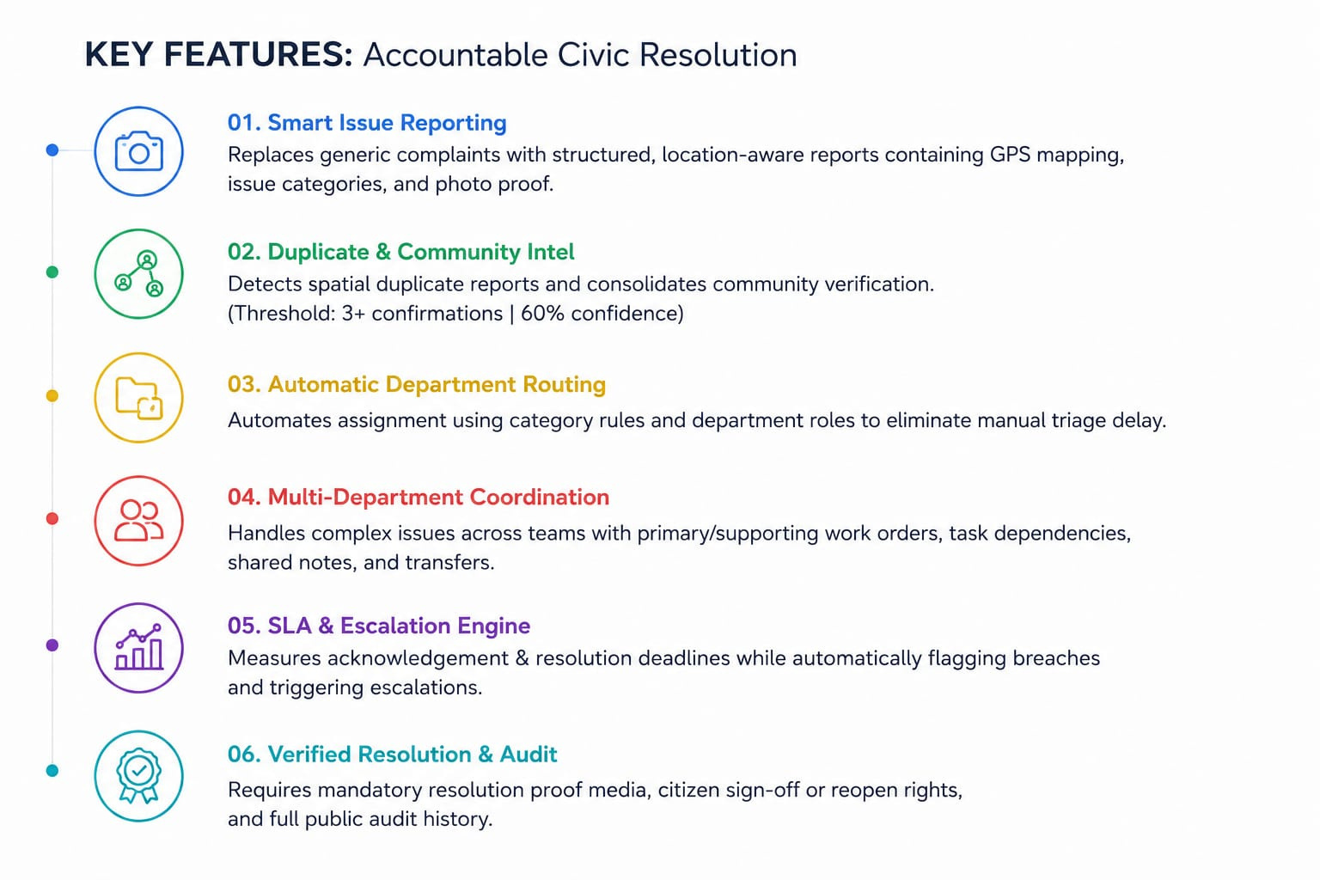

Slide 6
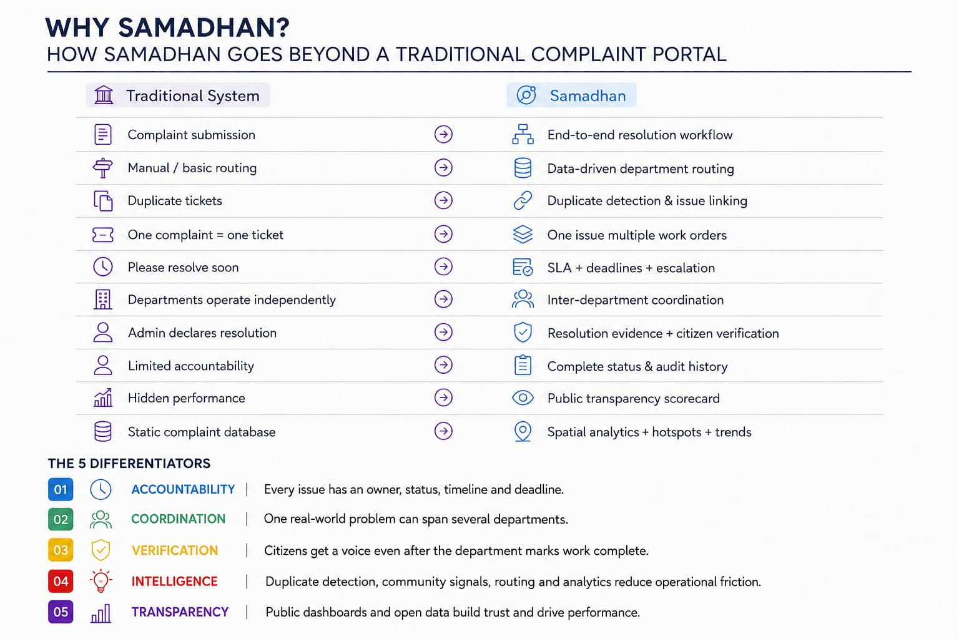

Slide 7
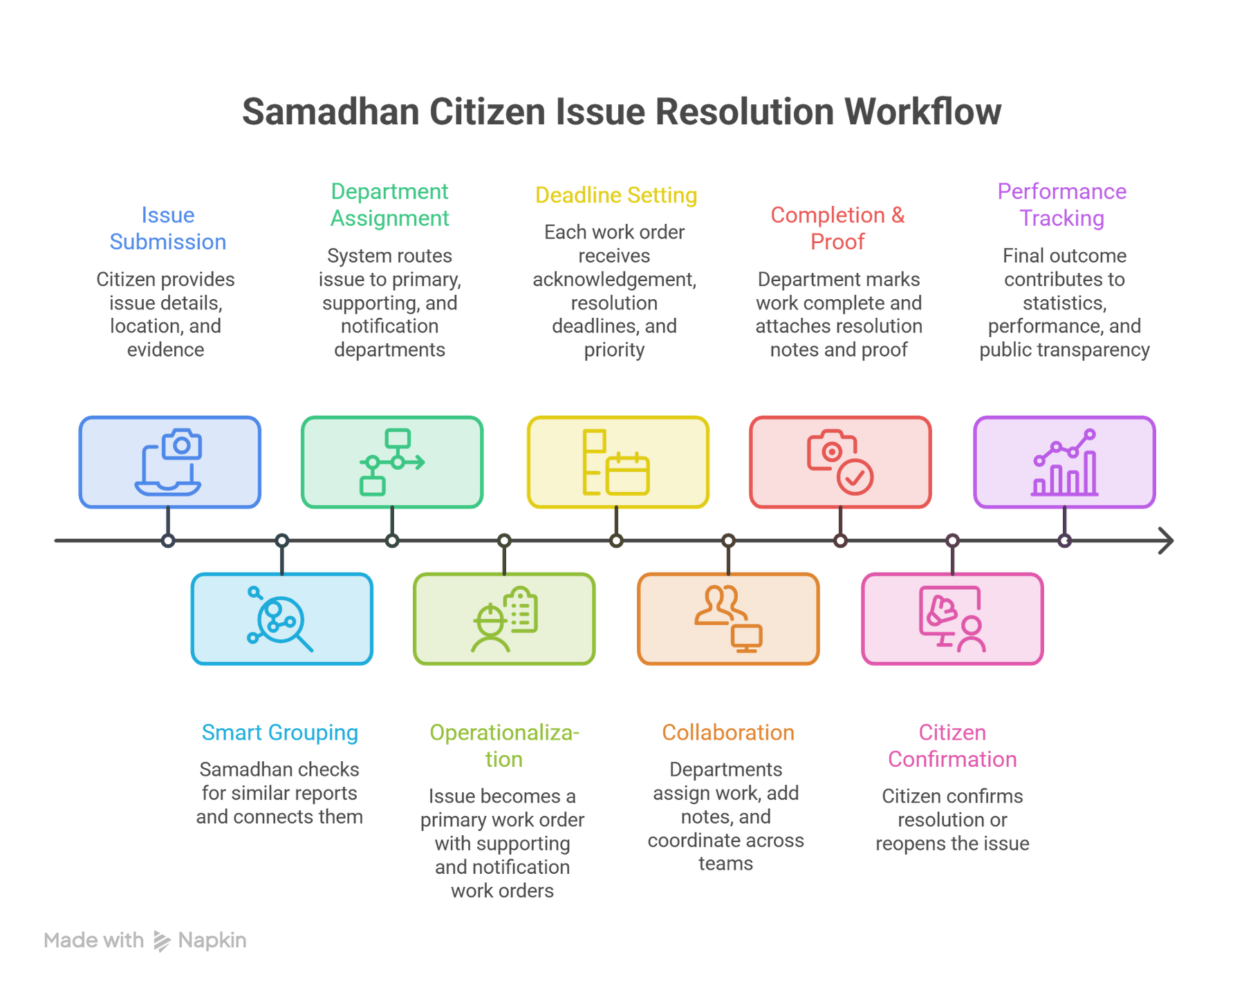

Slide 8
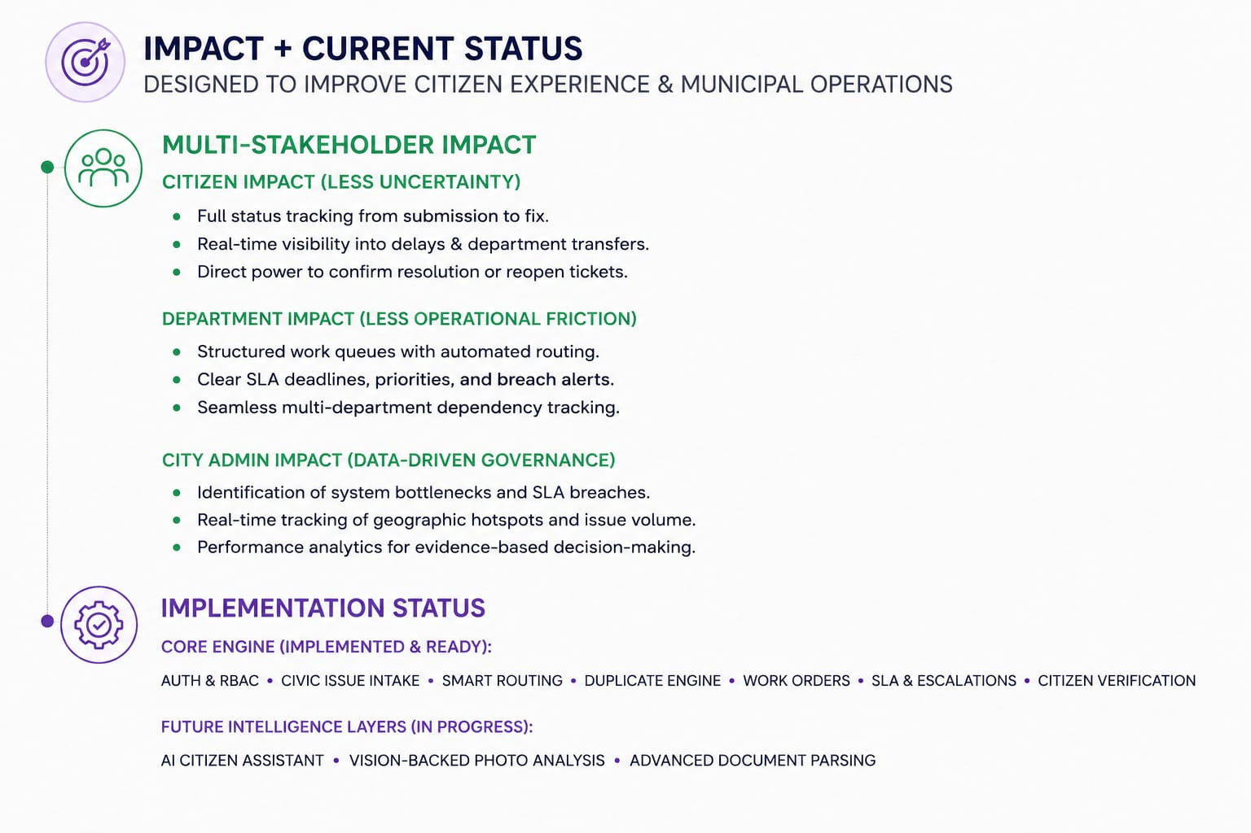

Slide 9
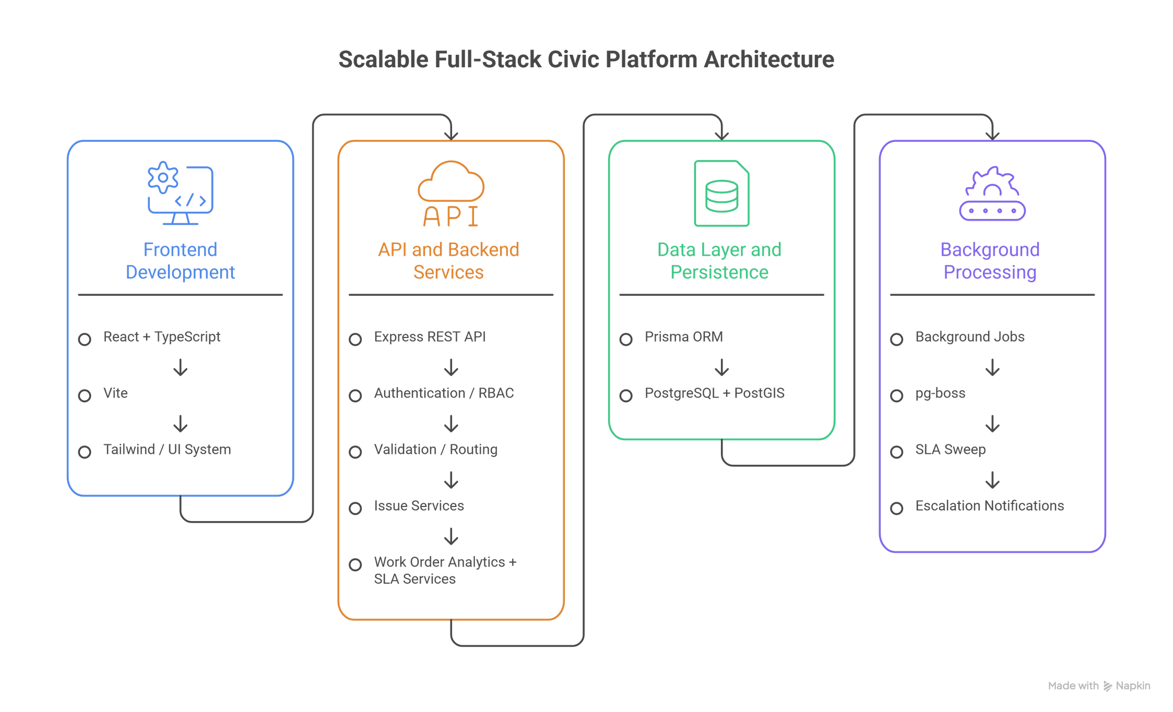
TECH STACK

Slide 10
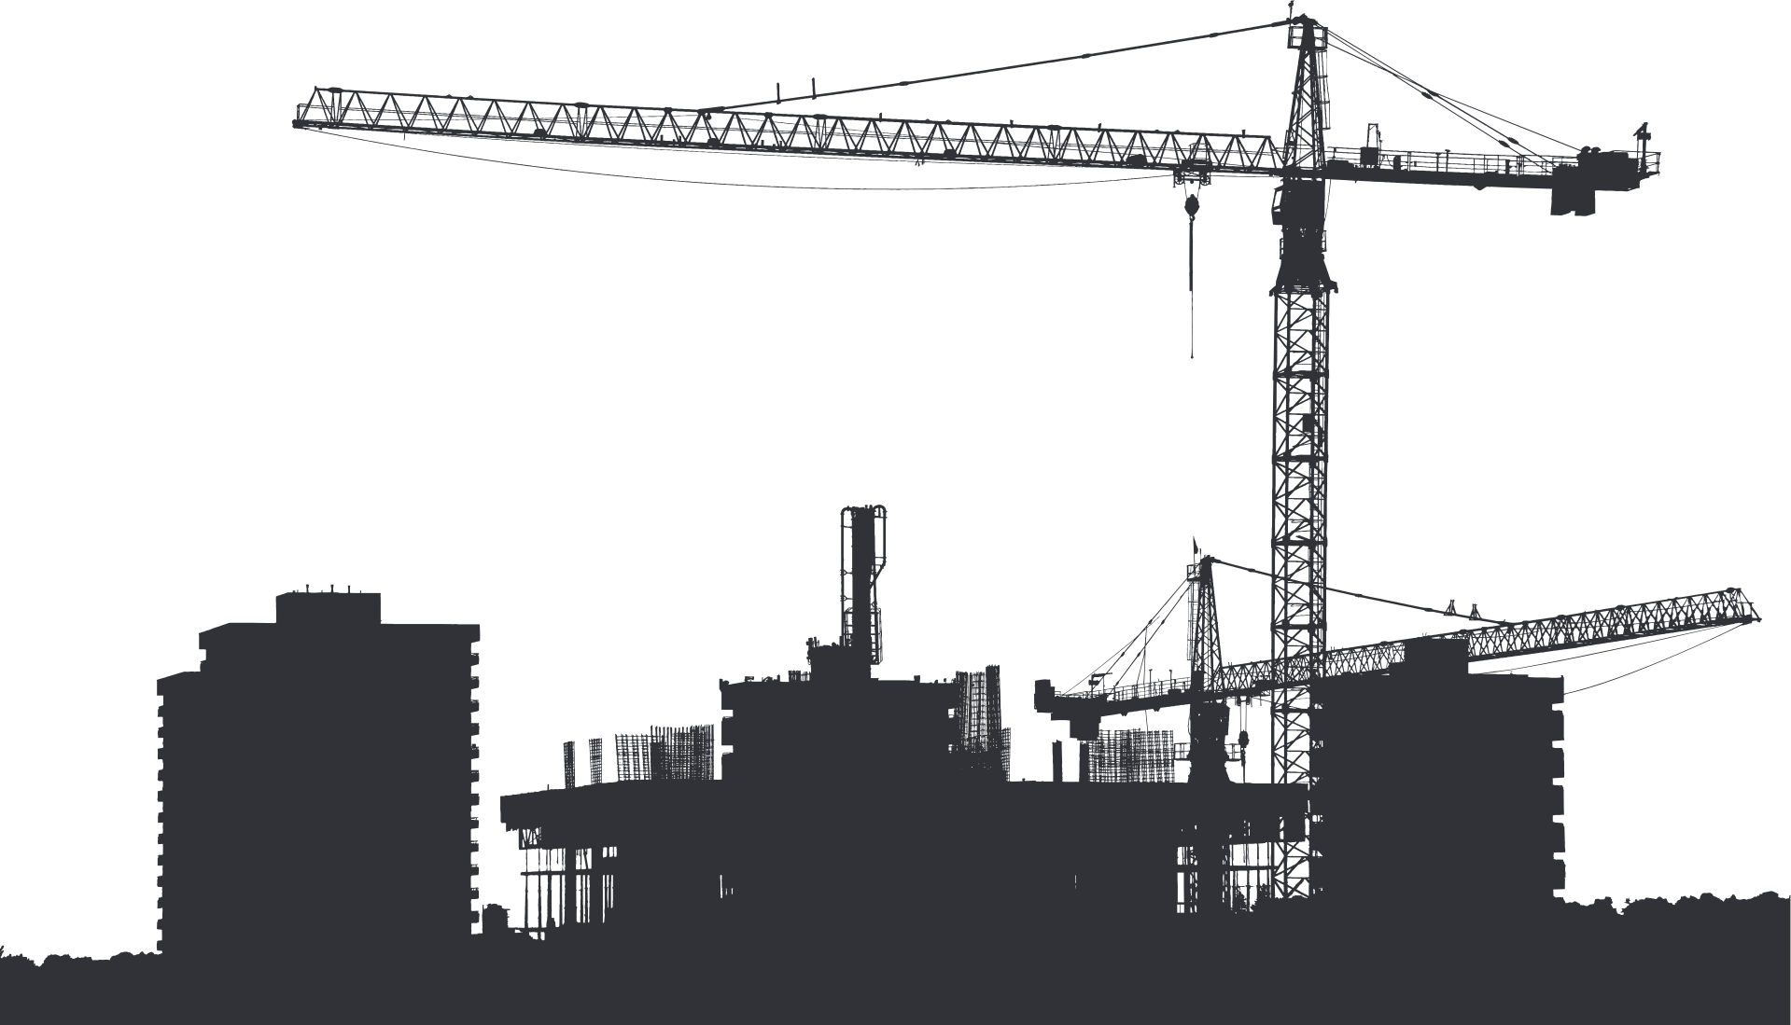
THANK YOU

