Slide 1
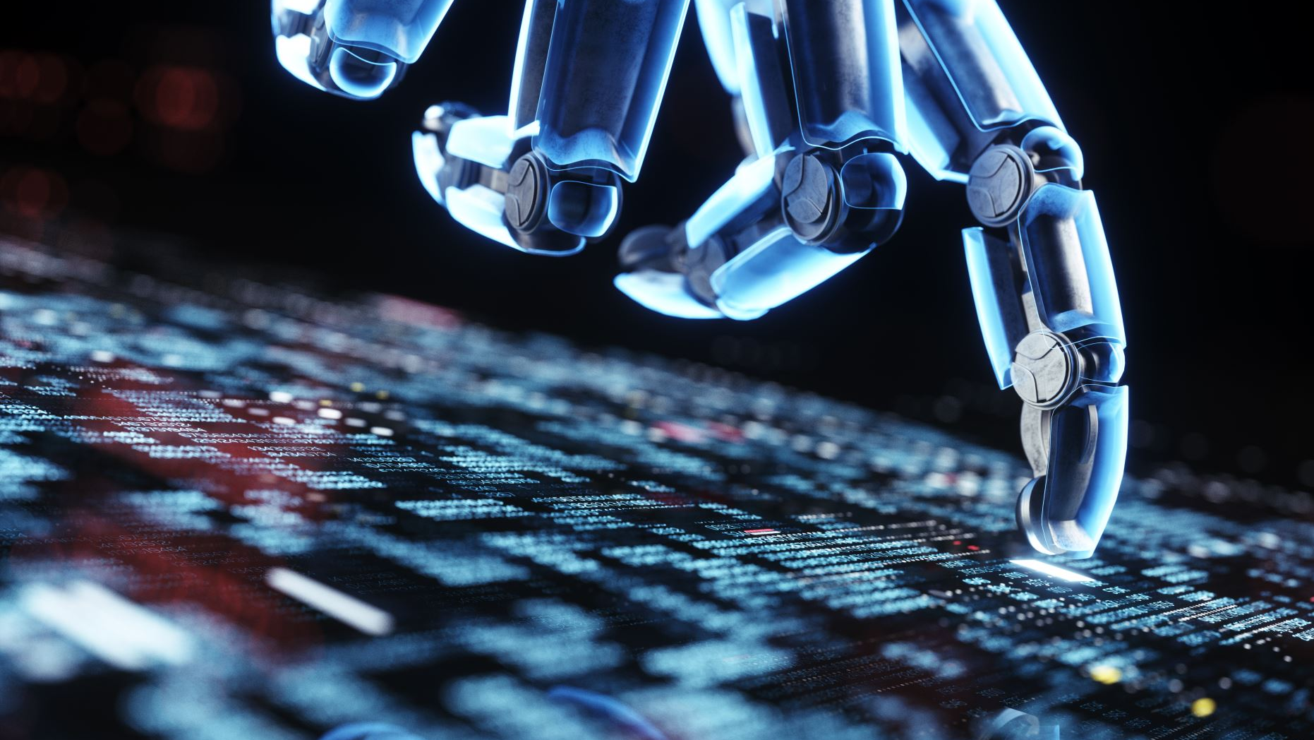
How do we govern AI and Machine Learning
Mujtaba khider

Slide 2
Content
Definition
Artificial Intelligence
Why AI governance is necessary
Why governments need to regulate AI
What should AI regulation contain
Conclusion

Slide 3

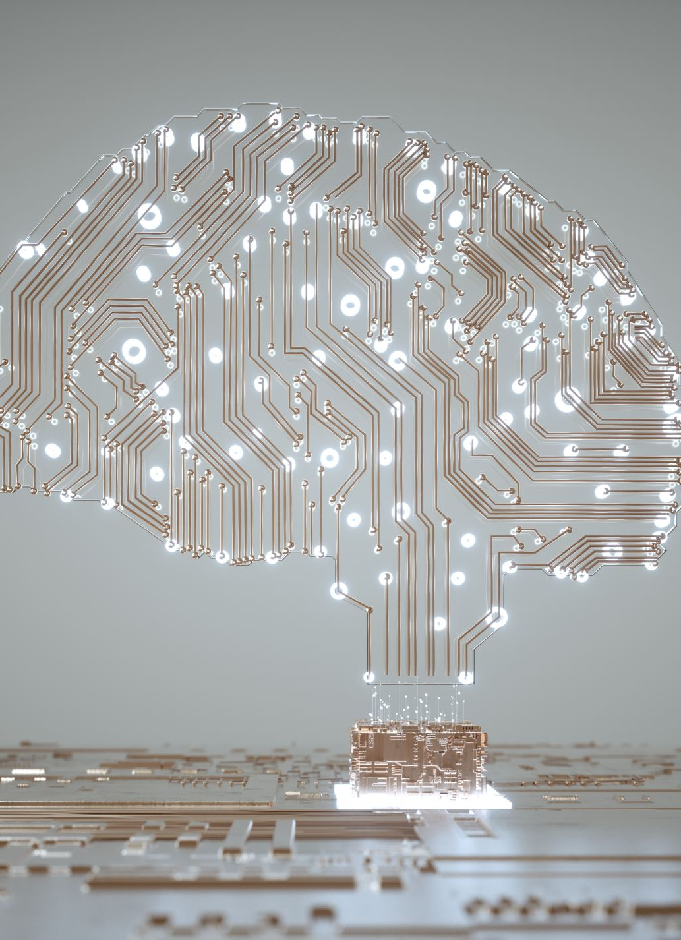
Definition
Artificial intelligence (AI)
Artificial intelligence is a branch of computer science that seeks to simulate human intelligence in a machine. AI systems are powered by algorithms, using techniques such as machine learning and deep learning to demonstrate “intelligent” behaviour.
Machine learning
A computer “learns” when its software is able to successfully predict and react to unfolding scenarios based on previous outcomes. Machine learning refers to the process by which computers develop pattern recognition, or the ability to continuously learn from and make predictions based on data and can make adjustments without being specifically programmed to do so.

Slide 4
Artificial Intelligence
Governments and corporates uses artificial intelligence to take decisions that can have a significant impact on our lives. AI must be regulated to protect ourselves, and to use technology without manipulation or bias. Here's how it should be done.
AI systems are threatening our fundamental rights. For example, algorithms that moderate content on social media platforms can restrict free speech in an unfair manner and influence public debate.
Algorithms rely on massive sets of personal data, the collection, processing and storage of which frequently violates our data privacy and protection rights. Algorithmic bias can perpetuate existing structures of inequality in our societies and lead to discrimination and alienation of certain groups.
To prevent and protect us from these threats, AI must be regulated. Legislators across the globe have failed to design laws that specifically regulate the use of AI. This allows profit-oriented companies to develop systems that may cause harm to individuals. Some of these systems already exist and are being used.
Notes:
Governments and corporates uses artificial intelligence to take decisions that can have a significant impact on our lives. AI must be regulated to protect ourselves, and to use technology without manipulation or bias. Here's how it should be done.
AI systems are threatening our fundamental rights. For example, algorithms that moderate content on social media platforms can restrict free speech in an unfair manner and influence public debate.
Algorithms rely on massive sets of personal data, the collection, processing and storage of which frequently violates our data protection rights. Algorithmic bias can perpetuate existing structures of inequality in our societies and lead to discrimination and alienation of minorities.
To prevent and protect us from these threats, AI must be regulated. Legislators across the globe have to this day failed to design laws that specifically regulate the use of AI. This allows profit-oriented companies to develop systems that may cause harm to individuals. Some of these systems already exist and are being used.

Slide 5
Why AI governance is necessary
We need to regulate AI for many reasons . However, there are two reasons to focus on.
Governments and corporates use of AI in decision making. that impact our lives directly Hence, a regulations are required in order to maintain the public interest.
The necessity of the accountability for those who use the AI in the public and private sectors
Notes:
First, because governments and companies use AI to take decisions that can have a significant impact on our lives. For example, algorithms that calculate school performance can have a devastating effect. In the UK, the Secretary of State for Education used an algorithm to determine the final exam grade of students across the country. The result: almost 40 percent of students received lower grades than grades previously issued by their teachers. In addition, the algorithm was not only inaccurate, but it also favoured students in private schools over those in public ones. AI has also shown its limitations in the private sector. In one case, a credit card introduced by tech giant Apple offered lower credit limits for women than for men. AI systems that calculate the likelihood of recidivism and determine length of prison sentences of defendants can also significantly alter a person’s life. Without proper rules, the systems are more likely to be inaccurate and biased as companies have less incentive to invest in safety measures and assure the quality and unbiased nature of its data.

Slide 6
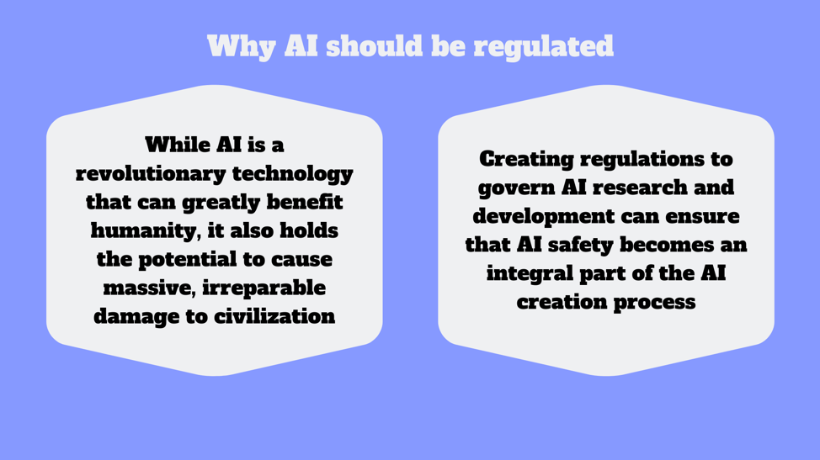
Why governments need to regulate AI
To prevent AI from doing things wrong (or doing wrong things), it is important for the developers to exercise more caution and care while creating these systems.
it is necessary to transform AI ethics into laws, which will make regulating AI and its impact easier for governments and international entities

Slide 7
What should AI regulations contain?
AI regulation must contain the following:
AI regulations must prohibit practices that violate data protections and privacy fundamental rights: e.g. Biometric mass surveillance and predictive policing systems.
There must be clear policies setting out requirement for companies to provide transparent details about their products. Companies must provide a detailed description of the AI system itself. This includes information on the data it uses, the development process, the systems’ purpose and where and by whom it is used.
Rights group and organisations need to be able to hold governments and corporations accountable when there are problems. Existing rules on accountability must be adapted to recognise that decisions are made by algorithm and not by the user.
Regulations for continuous monitoring of public and private sectors law abidance and practice.
AI regulation should also contain safeguards to protect the most vulnerable. It should set up a system that allows people who have been harmed by AI systems to make a complaint and get compensation. And workers should have the right to take action against invasive AI systems used by their employer without fear of retaliation.
Notes:
AI regulation must, at a minimum, contain the following safeguards:
it must prohibit technologies that violate our fundamental rights, such as biometric mass surveillance or predictive policing systems. The prohibition should not contain exceptions that allow corporations or public authorities to use them “under certain conditions.
there must be clear rules setting out exactly what companies have to make public about their products. Companies must provide a detailed description of the AI system itself. This includes information on the data it uses, the development process, the systems’ purpose and where and by whom it is used.
individuals and organisations protecting consumers need to be able to hold governments and corporations responsible when there are problems. Existing rules on accountability must be adapted to recognise that decisions are made by an algorithm and not by the user.
new regulations must make sure that there is a regulator to check that companies and the authorities are following the rules properly.
AI regulation should also contain safeguards to protect the most vulnerable. It should set up a system that allows people who have been harmed by AI systems to make a complaint and get compensation. And workers should have the right to take action against invasive AI systems used by their employer without fear of retaliation.

Slide 8
Conclusion
While regulating AI is necessary, it should not be done in a way that stifles the existing momentum in AI research and development. Thus, the challenge will be to strike a balance between allowing enough freedom to developers to ensure the continued growth of AI research and bringing in more accountability for the makers of AI. While too much regulation can prove to be the enemy of progress, no regulation at all can lead to the propagation of AI systems that can not only halt progress but can potentially lead to destruction and global decline.

