Slide 1

Sprocket Central Pty Ltd
Data analytics approach
Mujaheed Abdul Wahab

Slide 2
Agenda
Introduction
Data Exploration
Model Development
Interpretation

Slide 3
Introduction
Analyze, Identify & Recommend High Value Related Customers
Business Problem
Sprocket Central is a company that specializes in high-quality Bikes and Accessories, their marketing team are trying to figure out best approach to boost their sales, and target 1000 new customers that will bring highest revenue to their business.
Analysis Approach
Top Industries contributing to the maximum profile on Bike related sales
Wealth Segment by Age
Count of Car owners in each State
Gender classification on bike purchase for Past 3 Years.
Customer Classifications
Notes:
By applying the RFM approach( i.e The Recency, Frequency and Monetary) I came up with the following approaches

Slide 4
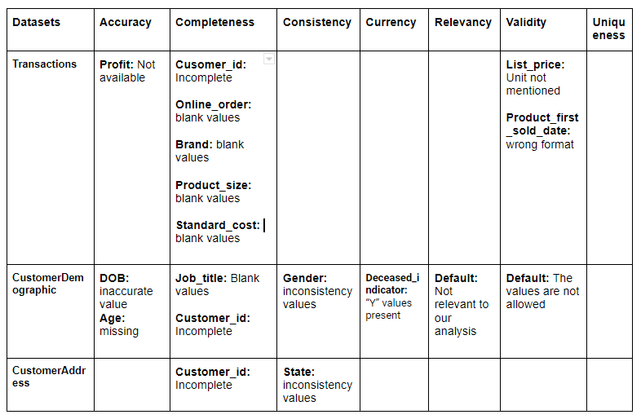
Data Exploration
Data Quality Assessment
The table below highlights the main issue dealt with for the data quality issue

Slide 5
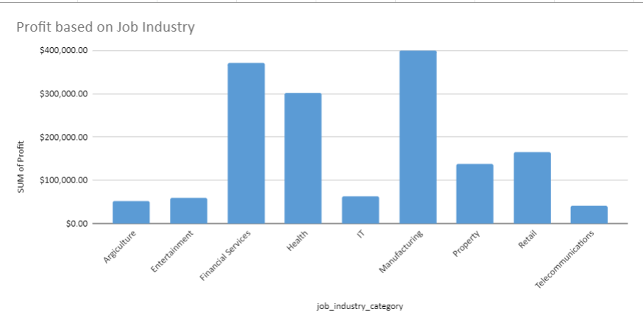
Data Exploration
Job Category Contribution for the Maximum Profit & Bike Related Purchases
The Financial Services, Manufacturing and Health are the Top 3 Industry that have contributed to the highest profit of the company
Majority of the Industries have returned less than $1million profit
Notes:
We also observed that the top 3 industries has contributed to more than 2Million USD individually.

Slide 6
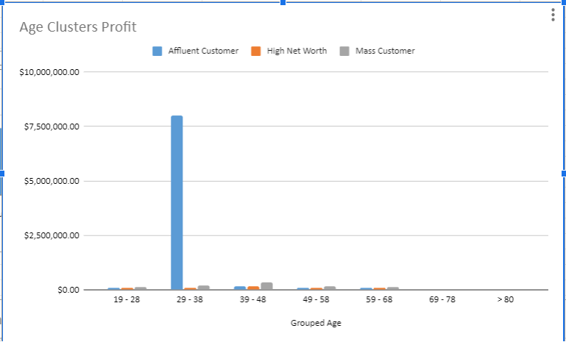
Data Exploration
Profit Contribution of the Wealth Segment by Age Clusters
Among all the grouped Age, it is observed that the wealth segment of age range 29-38 has contributed to the highest profit of the company
This same segment has a very good buying power that ranged for almost 10years (i.e 29-38)

Slide 7
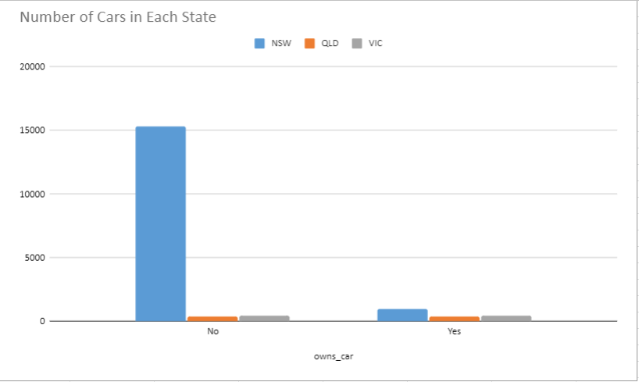
Data Exploration
Count of Car Owners in each State.
We can target NSW state as more people didn’t have a car there than other state.
OLD & VIC states can also be targeted, as lesser people has cars in these state as well.

Slide 8
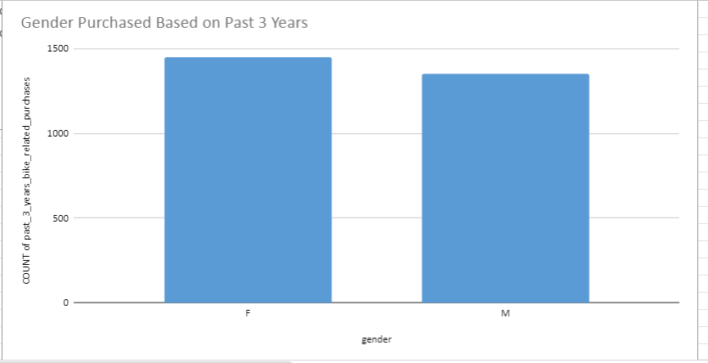
Data Exploration
Bike Purchased for Past 3years based on Gender
It’s deduced that Female Gender bought more bikes than the Male Gender.
Therefore, the female gender should be target more as the tend to bring more revenue to the business.
Notes:
We also observed that female bought more bikes than the male, thy should give more preference by the marketing while lunching the campaign

Slide 9
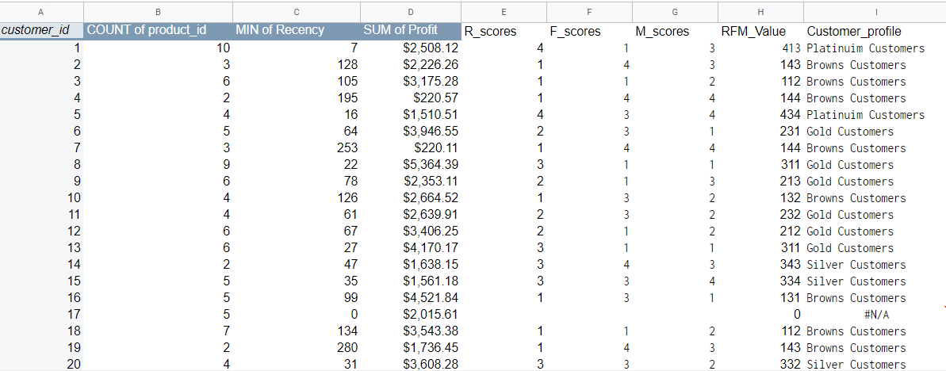
Model Development
RFM Analysis And Customer Classifications
The table was derived when calculating the RFN values for each customer profiles.
This is used to determine which customer a business should target more to increase their revenue and value.

Slide 10
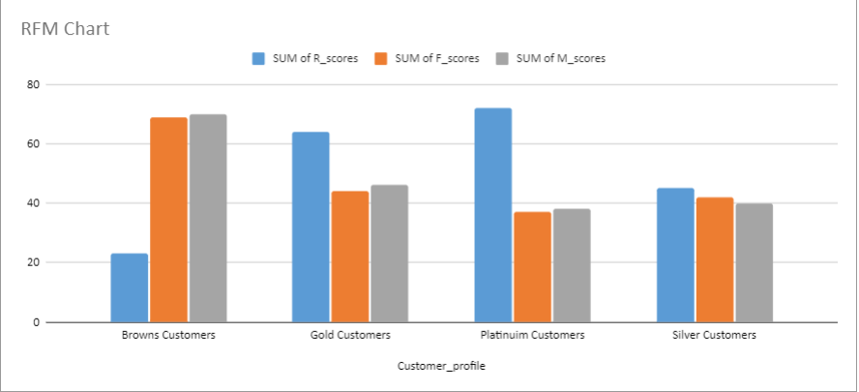
Model Development
RFM Vs Customer Profile
The RFM(Recency, Frequency, and Monetary) model chart distribution that showed the customer profiles with high level of engagement with the business.

Slide 11
Interpretation
The high Value Customers Classifications & Recommendations
The listed below should be targeted customers for our campaign.
The financial Services, Health and Manufacturing Industry Employees
They should be between the Age of 29-38
Who resides currently in NSW, VIC
And the should be Female.

Slide 12
Thank You!

