Slide 1
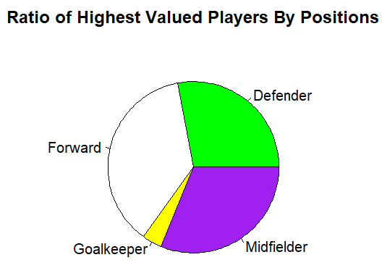
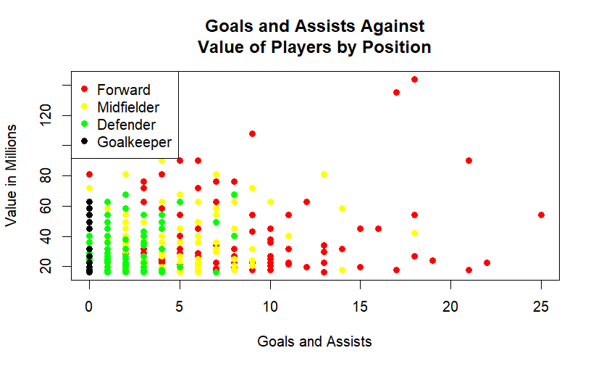
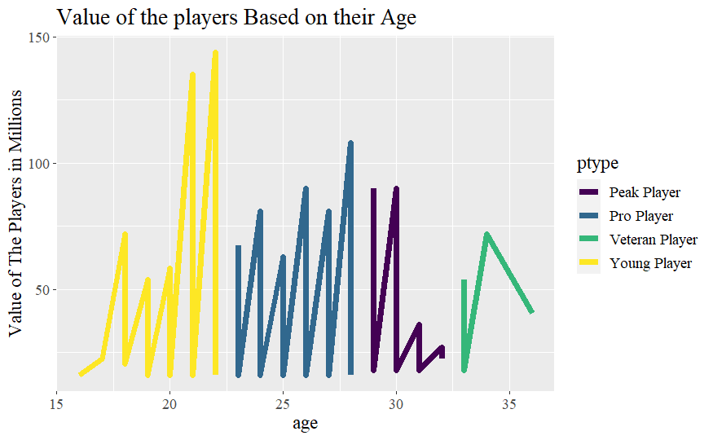
FOOTBALL PLAYERS MARKET VALUE IN RELATION TO THEIR STATS AND POSITION
Concept
H0
Forwards are valued more because they get the most goals and assists
A Footballer’s market value is the amount willing to be paid by a club to acquire their services regardless of his value to his current club
A footballer’s value is not heavily associated with their goals and assists rate
To be tested via correlation.
Players are valued more at age range of 20-22 and when they reach their peak at 26-28
Research shoed that Goals and Assist are significant in a player’s valuation but player position is also a key factor
28%
37%
31%
Age
26-28
Age 20-22
REFERENCES
1.Sanjeet, S. N.(2021). Most Expensive Footballers 2021 [Data set]. https://www.kaggle.com/datasets/sanjeetsinghnaik/most-expensive-footballers-2021?resource=download
2. Herm, S., Callsen-Bracker, H. M., & Kreis, H. (2014). When the crowd evaluates soccer players’ market values: Accuracy and evaluation attributes of an online community. Management Review, 17(4), 484-492.
3. X, M. (2013, July 30). Are Strikers Really Worth More Than Defenders in the Transfer Market? Are Strikers Really Worth More Than Defenders in the Transfer Market? | News, Scores, Highlights, Stats, and Rumors | Bleacher Report. https://bleacherreport.com/articles/1719218-are-strikers-really-worth-more-than-defenders-in-the-transfer-market
4. This infographic was created using Microsoft PowerPoint.
Correlation coefficient
0.25
P < 0.001
Ho

