Slide 1
Model Deployment using Random Forest
Now that we have calculated accuracy score for all the models, we will select the best model i.e. random forest using Gini Index to deploy our model locally and globally.

Slide 2
Model Deployment – Locally – Part 1
Before we deploy our model, we need to load our model in our pickle format from where streamlit will run our main python file.
We use the below code to prepare the .pkl file and save it in our path(# Saving the model to disk - dump(rfc, open('rfcintel1.pkl', 'wb’)))
Preparing the python file with the our parameters(with all the our prediction variables)
Saving the .py and .pkl file in our path so that we can run them locally.
We can deploy the model using anaconda prompt > create a virtual environment > create a folder to store our data files> run that folder using streamlit command.

Slide 3
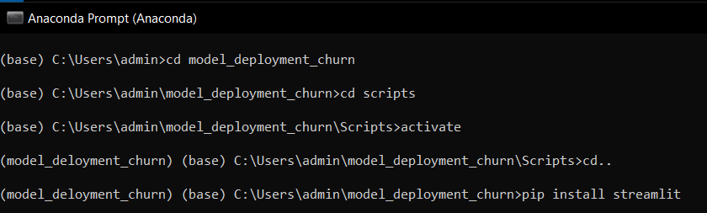
Model Deployment – Locally – Part 2
Create a virtual environment and data folder in your local disk.
Run the model using streamlit (i.e. streamlit run random_for.py). Which will create a local page (http://localhost:8501)

Slide 4
Model Deployment – Globally – Part 1
Here we will deploy our model globally, using Github and streamlit.
Below are the steps to follow :
Create a GitHub Account
Upload your data files in Github by creating a repository
Upload an additional file named requirements.txt, here you will need to add our libraries that will be required to run your file.
Open streamlit web page > share.streamlit.io
Open/Link your Github account with Streamlit account
Run streamlit/Deploy options to run the data file

Slide 5
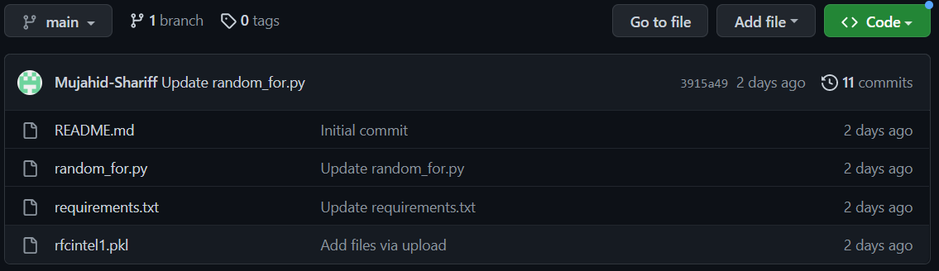
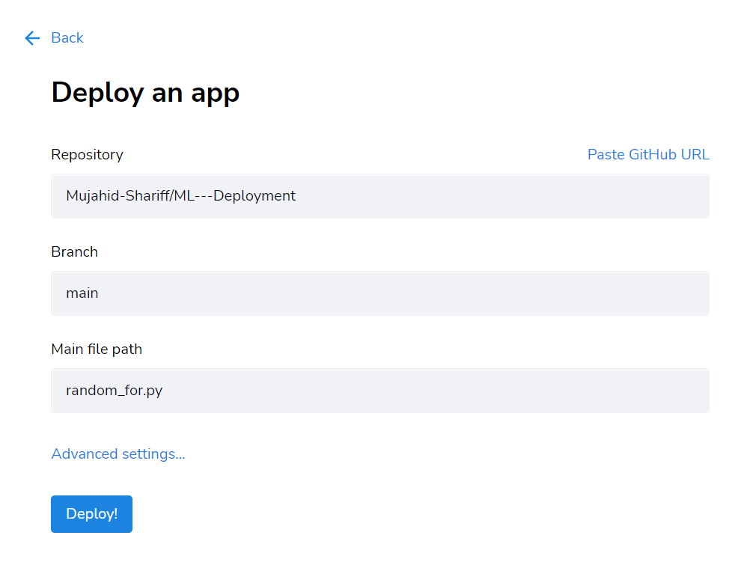
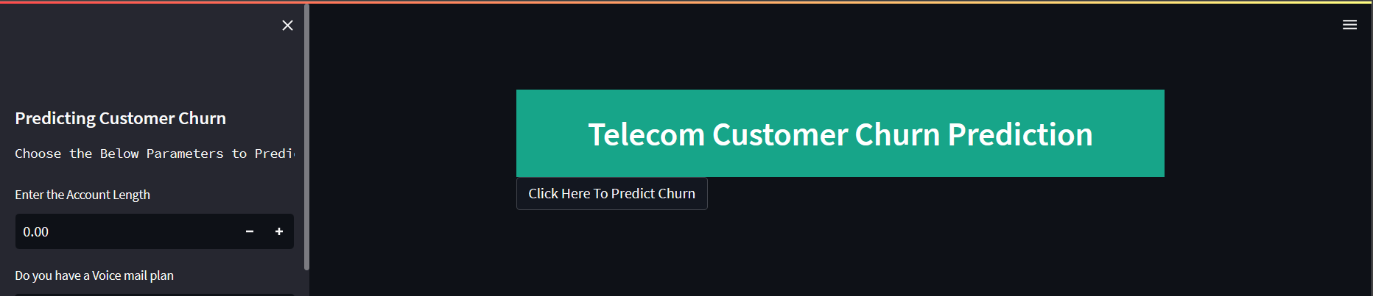
Once you successfully select the repository>give the branch> .py file for model deployment.
Click Deploy > Your model is successfully deployed.
Model Deployment Link –> Access Churn Prediction

Slide 6
Thank you!

