Slide 1
adidas sales report
Sales report of 2020-2021 data (used from kaggle)

Slide 2
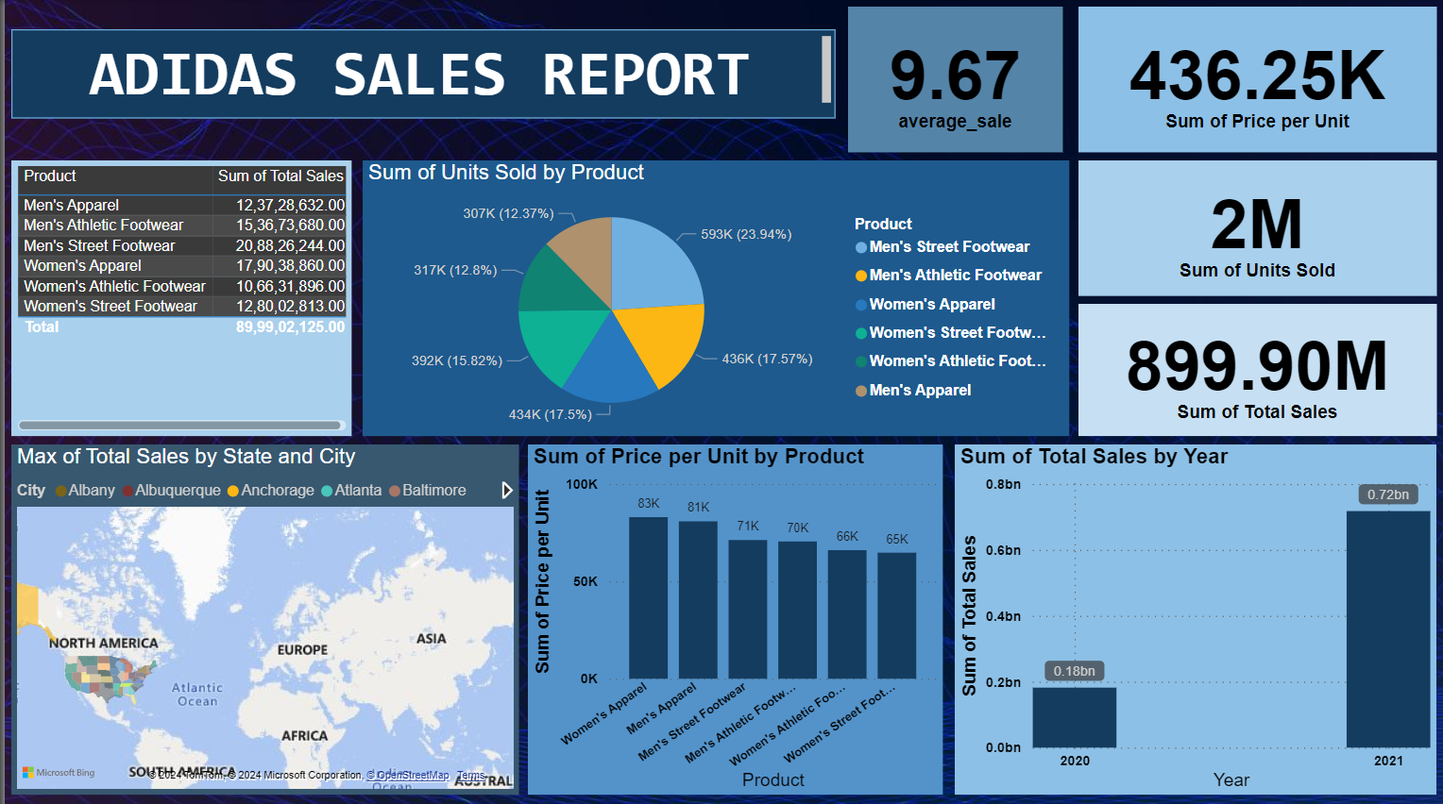
Dashboard of adidas sale

Slide 3
overview
Total Sales : $899.90M
Total Units sold : 2M Units
Average Sales Per unit : $436.25k
Product performance
Top product categories by Sales
Man’s Street Footwear : $20.88M (23.94%)
Women’s Apparel : $17.90M (17.57%)
Men’s Athletic Footwear : $15.37(17.50%)
Lowest Sales : Women’s Street Footwear : $12.80M (12.8%)

Slide 4
Units Sold by product
highest units sold : Men’s street footwear (593k,23.94%)
Key contribution Products
women’s Apparel (436k, 17.57%)
Men’s Athletic footwear (434k, 17.50%)
Revenue insights
price per Unit Analysis:
Women’s Apparel : $83k/unit
Men’s Apparel : $81k/unit
Men’s Street Footwear : $71/unit
lowest price per unit: Women’s street footwear : $65K/unit

Slide 5
Key Insights
Strong Growth : 2021 outperformed 2020 by a substantial margin.
Product Contribution : Men’s Street Footwear is the leading category by revenue and units sold.
Regional Success : High sales concentrated in key cities.
CONCLUSION
Summarize the sales performance and future growth opportunities.
Provide actionable strategies for continued success.

