Slide 1
Algebra Tutor
Mujeeb Adelekan
CS6345 E-learning and gamification

Slide 2

Problem and Motivation
Algebra is a turning-point in math education
Arithmetic is a tool, algebra is a higher-level discipline
Often Overlooked in terms of resources
Elementary and higher Math gets more attention.
Pivotal middle-ground missing or underdeveloped
Visual aspect of algebra often overlooked.
NUMBERS ARE MEANT TO REPRESENT. THEY HAVE meaning.
WHAT IS HAPPENING WHEN SOMEONE SOLVES FOR A VARIABLE?
Importance of BUILDING OFF PRIOR KNOWLEDGE AND TRANSFER.

Slide 3

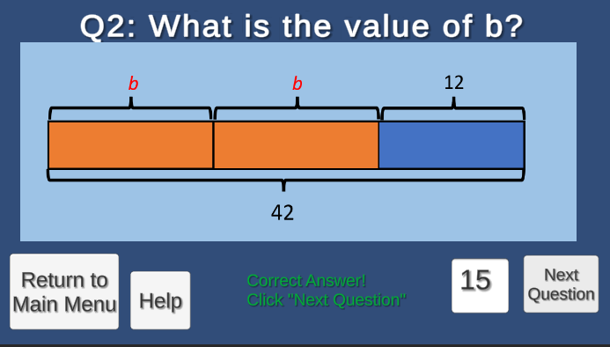
Solution
Algebra Tutor is…
A single-user application
Intended for students struggling with algebra concepts
8th and 9th grade LEVEL

Slide 4


DEVELOPMENT TOOLS AND LANGUAGES
Operating system: WINDOWS 10
LANGUAGE: c#
GAME EDITOR: UNTY 3D
Ide: visual studio 2019
PLATFORM: WINDOWS 10 PC

Slide 5

System Requirements
Hardware:
Windows machine
Intel/AMD/Nvidia Processor
Mouse, Keyboard, and Monitor
Software:
Operating System: Windows 10+
Code Editor: Notepad or Visual Studio (2015) or newer

Slide 6
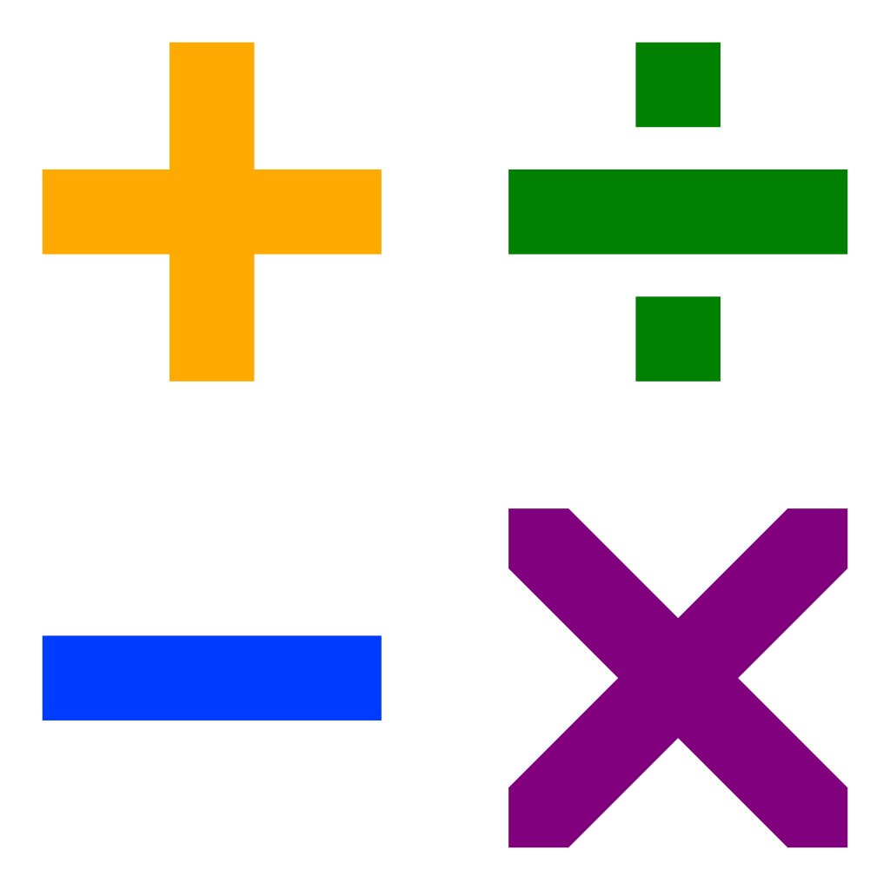
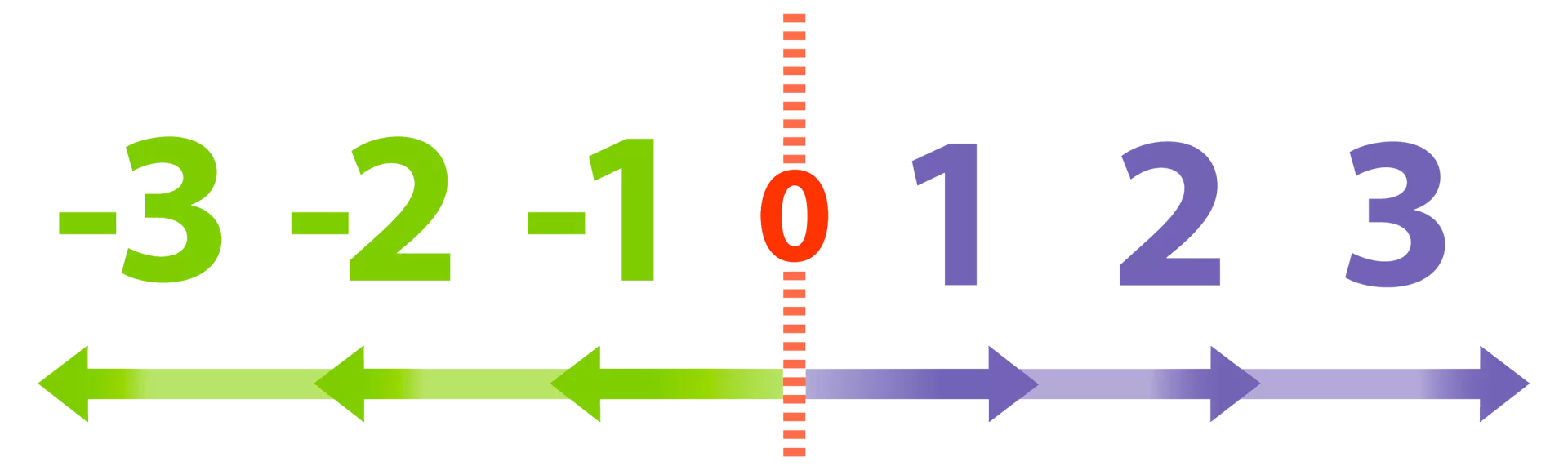
Player Requirements
Basic English reading ability
Familiarity with basic arithmetic
Familiarity with math concepts up to the seventh-grade level, including but not limited to:
Negative numbers
Coordinate planes
Parts of a whole

