Slide 1

Rogue Programming Language
Mujeeb Adelekan
CS6395 Comprehensive Project
MS in Computer Science
St. Mary’s University
Spring 2024

Slide 2

Problem Statement
Modularity important in programming
Keeping track of program modules can be cumbersome
Example.
{ } pairs in C and C++
Indentation in Python
IDEs must make up for confusing syntax

Slide 3

Solution: Rogue
A programming language that prioritizes
Readability
Writability
Modularity
End of modules are explicitly marked with corresponding keywords.
end main
end for
end if
end while
end proc
end func
Extension of project for:
CS6375 Compilers
CS6340 Advanced Software Engineering

Slide 4
Analysis: Functional Requirements
The Rogue Programmer will be able to:
Compile Rogue source programs into assembly code that can be executed on STM, the target virtual machine, designed by Dr. Hanna
Write the following new Rogue language features in a code editor:
Pointer dereferences
Associative arrays
Enumerations
The Rogue Compiler will be able to:
Identify tokens and parse elements (i.e., analyze the syntax) of the Rogue programming language.
Perform the compilation of Rogue source code into STM assembly code.
Raise error messages and quit compilation if a syntax error is encountered.
Create a listing file annotated with compilation information, including errors and their source line.

Slide 5
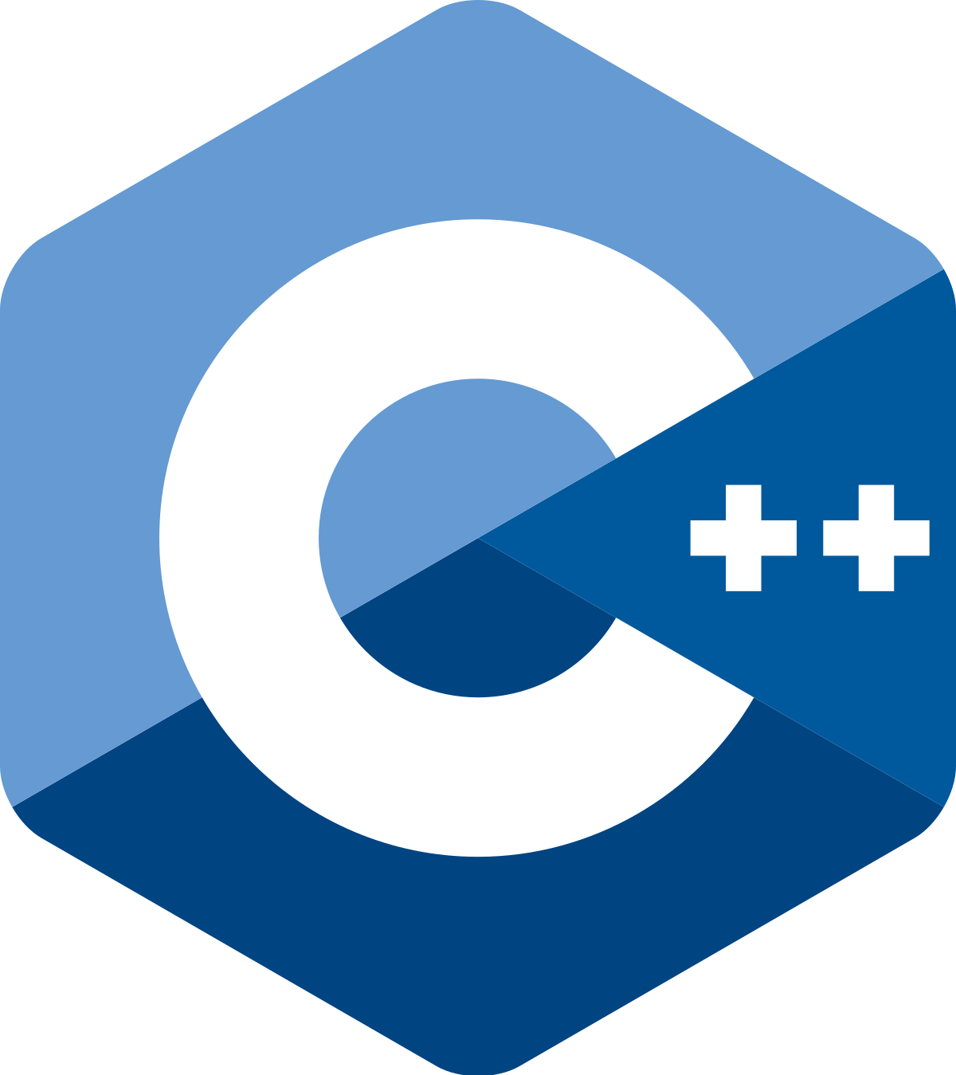


Analysis: Non-functional Requirements
Developer Hardware and Software
Processor: AMD Ryzen 3700U with Radeon Vega Mobile GFX 2.30 GHZ
Memory (RAM): 16 GB
Rogue programs written in Visual Studio Code
Rogue Compiler written in Visual Studio 2019
Language: C++
Translated to Dr. Hanna’s STM assembly language

Slide 6
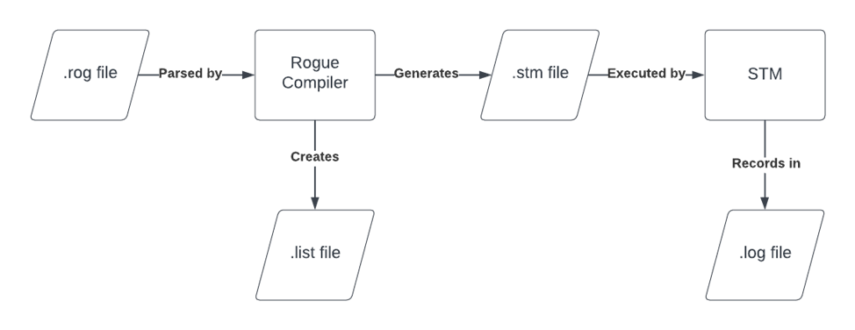
Design: Compilation Process
Notes:
Exit and Demonstrate Rogue Programs (skip Demo3.rog)

Slide 7
STM Stack Implementation: Associative Arrays
size
count of (key, value) pairs
capacity
maximum number of (key, value) pairs
key #1
value #1
For an associative array declared:
assoc a_arr{<capacity>};
key #2
value #2
2 + 2*<capacity> contiguous 16-bit words will be reserved.
…
key #capacity
value #capacity

Slide 8
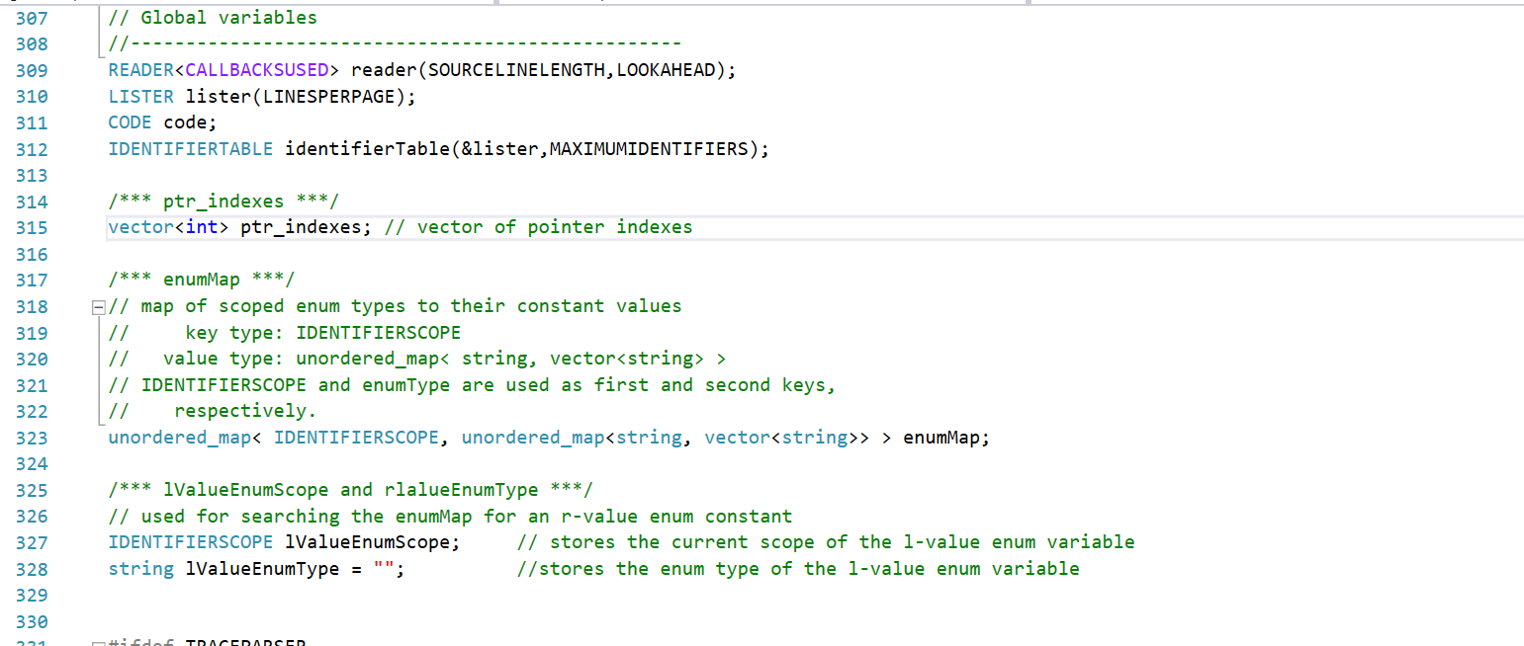
Code: THREE-DIMENSIONAL ENUM_MAP

Slide 9
TECHNICAL LESSONS LEARNED
Checking the datatype of a value for a given key in an associative array:
Rogue is a statically-typed language
Created the type cast operator ‘as’
Language design is influenced by the typing method used.
Keeping track of the enumeration constants declared for an enumeration type:
Created a three-dimensional C# <unordered_map>
Research and utilize the libraries available.

Slide 10
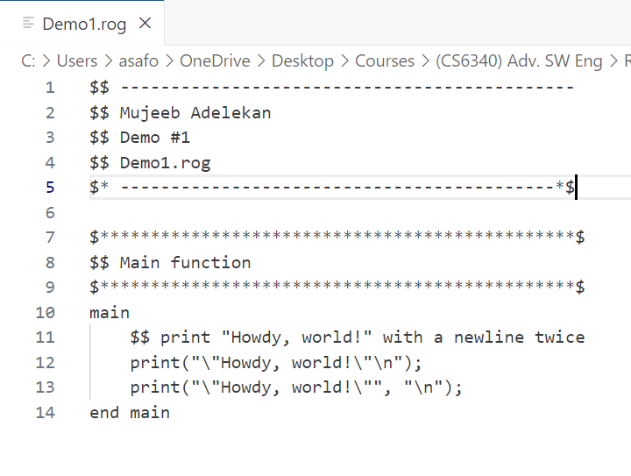
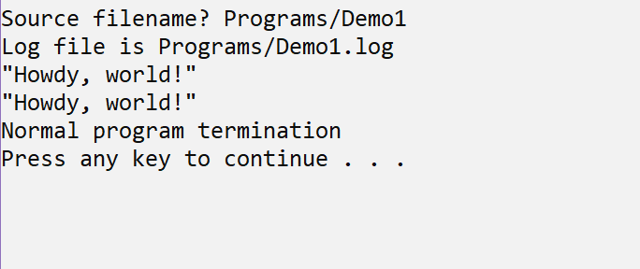
DEMONSTRATION AND QUESTIONS

