Slide 1


SMART LEARN PIPELINE

Slide 2





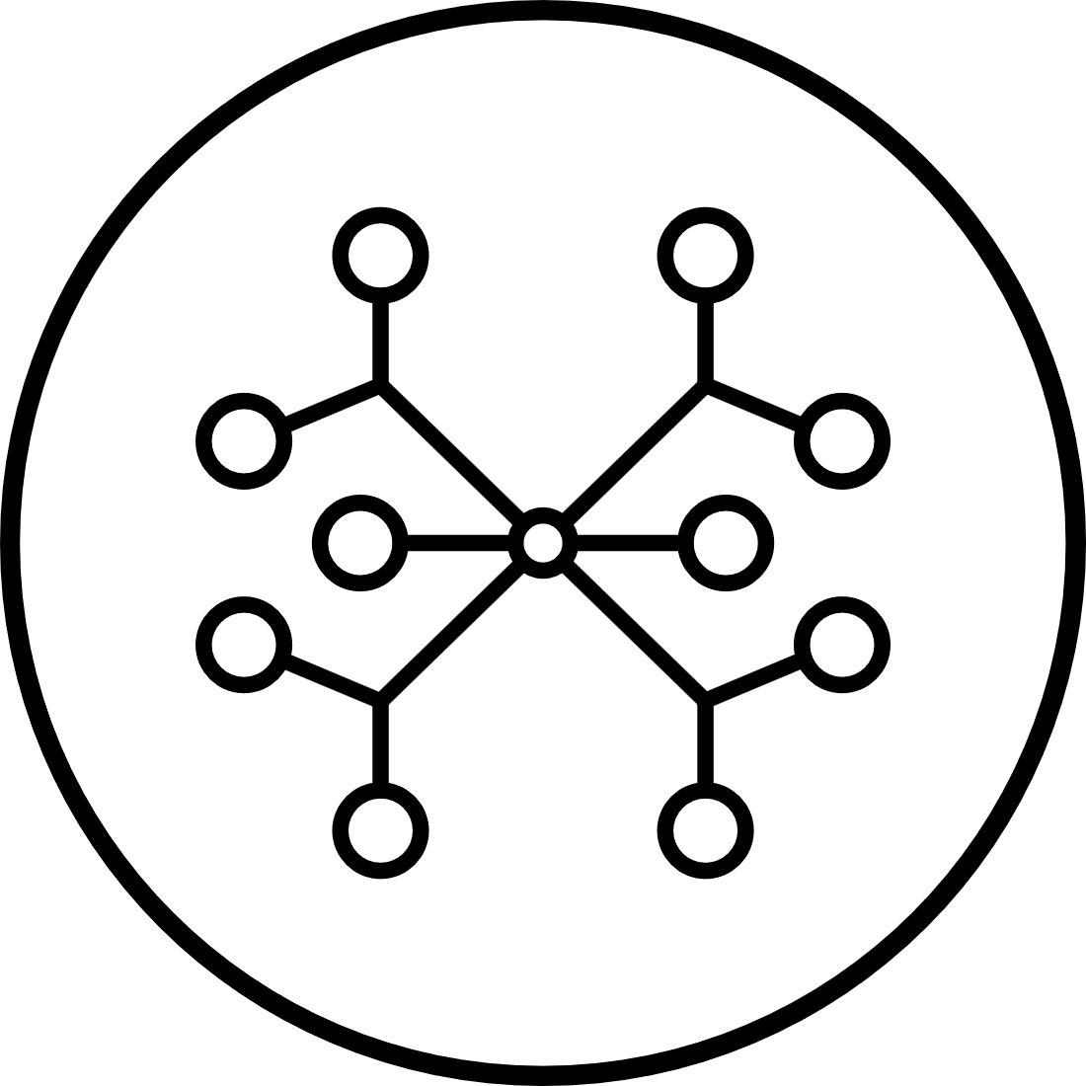




Project
Introduction
Talking Points:
This project is called Smart Learn Pipeline.
The goal is to analyze student performance data, identify weak areas, predict future mastery, and provide tutoring recommendations.
Each module in the pipeline plays a specific role, from cleaning raw data to visualization.
The central concept is “mastery”: the level of knowledge a student has achieved on a given topic.
Data Loader
Difficulty
Progress
Clustering
Prediction
Recommendations
Dashboard

Slide 3

Module: data_loader.py
Main Tasks
Raw Student Scores
Read data from CSV (or database).
Fill missing values (using per-student mean or per-topic mean).
Scale all scores to 0–100 if they are in 0–1.
Clip scores to valid range.
Add normalized columns for ML models.
Studen ID
Subject
Score
001
Math
105
002
History
05
003
Science
78
Cleaned Student Scores
Sample Code
Studen ID
Subject
Score
def LoadData(path_or_df="students.csv", from_df=False, id_col='student_id', name_col='student_name'):
df = pd.read_csv(path_or_df) if not from_df else path_or_df.copy()
...
return out_df, topic_cols
001
Math
100
002
History
50
003
Science
78

Slide 4














Module: difficulty.py
Purpose: Measure which topics are hardest for students overall.
Topic Difficulty Leaderboard
Ranked from Most difficult to least difficult
Quantum Physics
Main Tasks
95/100
Calculate the mean score for each topic.
Define difficulty = 100 – mean_score.
Sort topics from hardest → easiest.
Differential Calculus
88/100
Organic Chemistry
75/100
Probability Theory
Sample Code
62/100
Ancient History
def CalculateTopicDifficulty(df, topic_cols):
means = df[topic_cols].mean()
difficulty = 100 - means
return difficulty_df
45/100
Basic Grammar
30/100

Slide 5

Module: progress.py
Purpose: Track individual student progress and weak areas.
Weak Topics
Difficulty Score of Topic
Studen ID
Main Tasks:
Compare each student’s topic scores against a threshold (default = 70%).
Collect a list of weak topics per student.
Output:
Structured list (for logic)
DataFrame (for reporting)
Differential Calculus
001
88
Basic Grammar
002
30
Sample Code
003
Probability Theory
62
def TrackStudentProgress(df, topic_cols, threshold=70):
weak = [t for t in topic_cols if row[t] < threshold]
...
return students, progress_df
Quantum Physics
004
95

Slide 6
Module: clustering.py
Purpose: Group students with similar performance profiles.
Main Tasks
Sample Code
Convert each student’s scores into a numerical vector.
Apply K-Means clustering to group similar learners.
Return:
Cluster labels (which group each student belongs to)
Cluster centers (average profile per group)
def ClusterStudents(progress_students, topic_cols, num_clusters=3):
vectors, ids = convertProgressToVectors(progress_students, topic_cols)
kmeans = KMeans(n_clusters=num_clusters).fit(vectors)
return {...}

Slide 7
Module: prediction.py
Purpose: Predict future mastery scores.
Main Tasks
Student Score Comparison: Current vs. Predicted
Train ML models per topic (RandomForest or LinearRegression).
Predict future scores using other topics as features.
If not enough data, fallback = current score.
Output: prediction dictionary + DataFrame.
Current Score
Predicted Score
Subject
Sample Code
Mathematics
85%
88%
def PredictMastery(df, topic_cols):
model = RandomForestRegressor().fit(X, y)
preds = model.predict(X)
...
return predictions, pred_df
Physics
62%
75%
History
90%
89%
English
70%
65%

Slide 8
Module: recommendations.py
Purpose: Alert teachers and suggest tutoring.
Student Intervention and Group Tutoring
Main Tasks
Sample Code
Identify students with predicted mastery < 60%.
Detect common weak topics within each cluster.
Generate two outputs:
Individual alerts
Group tutoring recommendations
alerts.append({
'student_name': sname,
'topic': t,
'predicted_score': pred,
})
At-risk students
Group tutoring topics
Differential Calculus (88)
Studen 001
Organic Chemistry (75)
Studen 002
Quantum Physics (95)
Studen 003

Slide 9

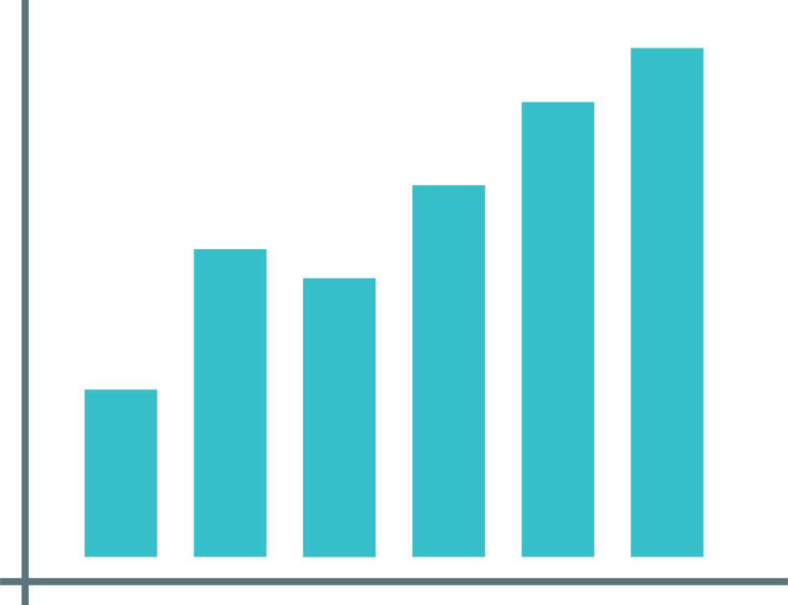

Module: dashboard.py
Purpose: Create visual analytics dashboards.
Visual Outputs
Sample Code
Heatmap of student-topic performance.
Difficulty leaderboard (bar chart).
Cluster visualization (PCA 2D scatter plot).
Files saved as PNG for reporting.
Sample Code:
plt.imshow(scores_df.values, aspect='auto')
plt.colorbar(label='Score')
plt.title('Student-Topic Score Heatmap')
plt.savefig("dashboard_heatmap.png")

Slide 10
Concept of Mastery
Data Loader
Difficulty
Concept of Mastery
Mastery = a student’s level of command of a topic.
Progress
How it’s used:
Current performance: actual scores.
Future predictions: ML models estimate likely outcomes.
Threshold: If predicted mastery < 60%, student is flagged as at-risk.
Clustering
Prediction
Role in the pipeline
Recommendations
Connects all modules:
data_loader → difficulty → progress → clustering → prediction → recommendations → dashboard
Guides interventions: tutoring, alerts, and reports.
Dashboard
MASTERY

