Slide 1


INTRODUCTION
Building Single Page Applications with Angular 4 using Angular CLI
Mujib ur Rahman
Web developer & Trainer
www.ngblog.in

Slide 2
TECH STACK
Angular 2
Typescript
Bootstrap
GIT (git lab)
Npm and angular-cli
IDE: Visual studio code

Slide 3


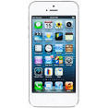
MULTI CLIENT SERVICE ORIENTED ARCHITECTURE
Api/products/get
Controllers
BL Layer
List<Products>
Repository
Database
Web Api

Slide 4
SPA using Components
Menu
Login
App
Home/About..
Footer

Slide 5
What to expect
A complete SPA

Slide 6






Why Angular 4
Google Supports
No Scopes
Mobile
Fast
Typescript

Slide 7

TYPESCRIPT
class
constructor
data types
decorator

Slide 8
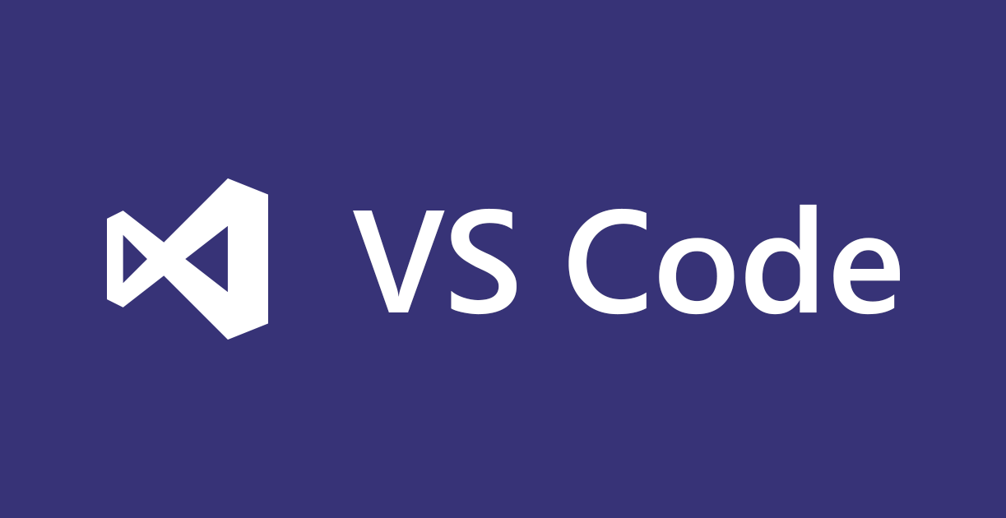

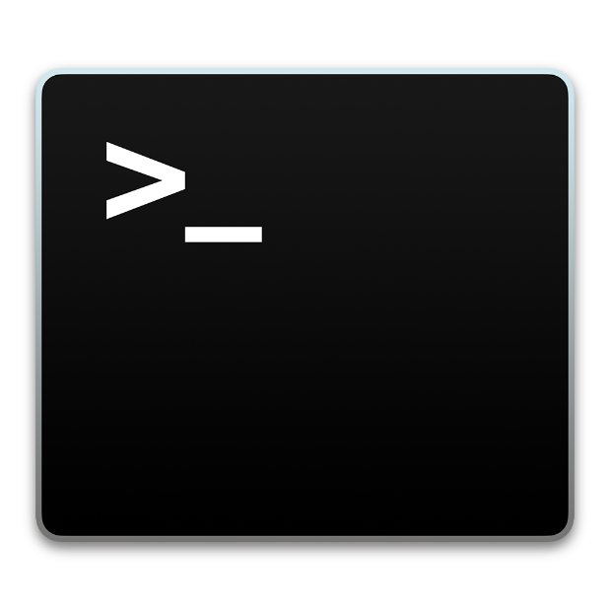

IDE

Slide 9
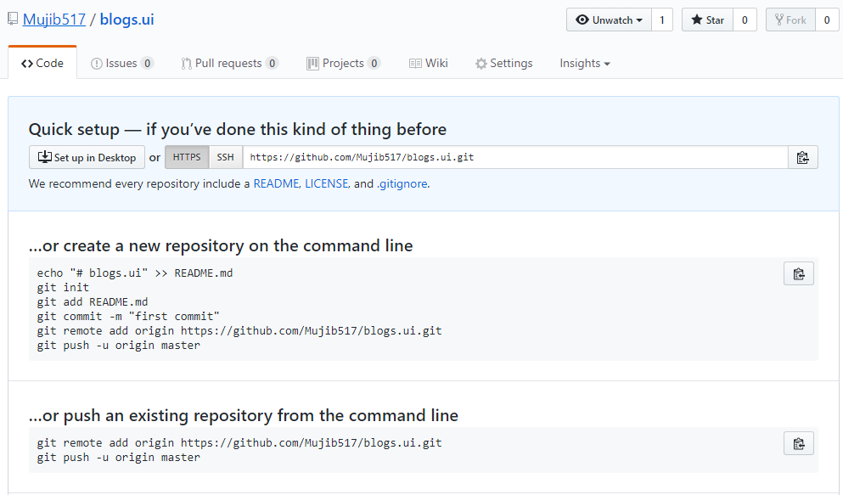
COURSE CODE

Slide 10



INSTALLATIONS & SETUP
npm install @angular/cli -g
ng new proj-name

Slide 11
SUMMARY
Introduction to SOA
Introduction to Angular 4
Angular CLI

