Slide 1
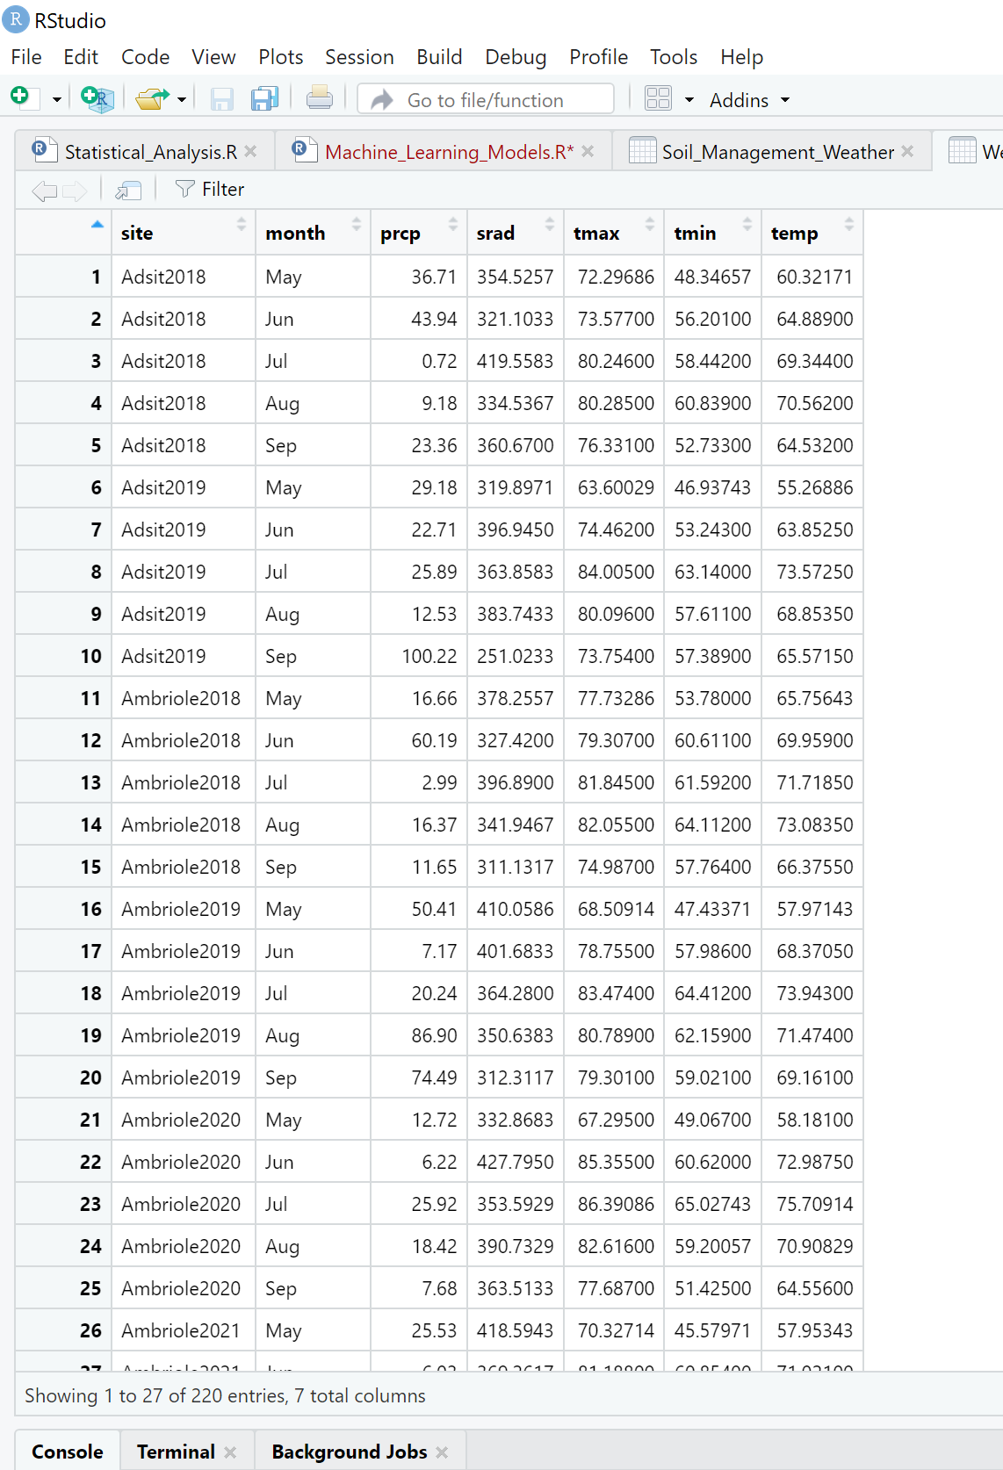
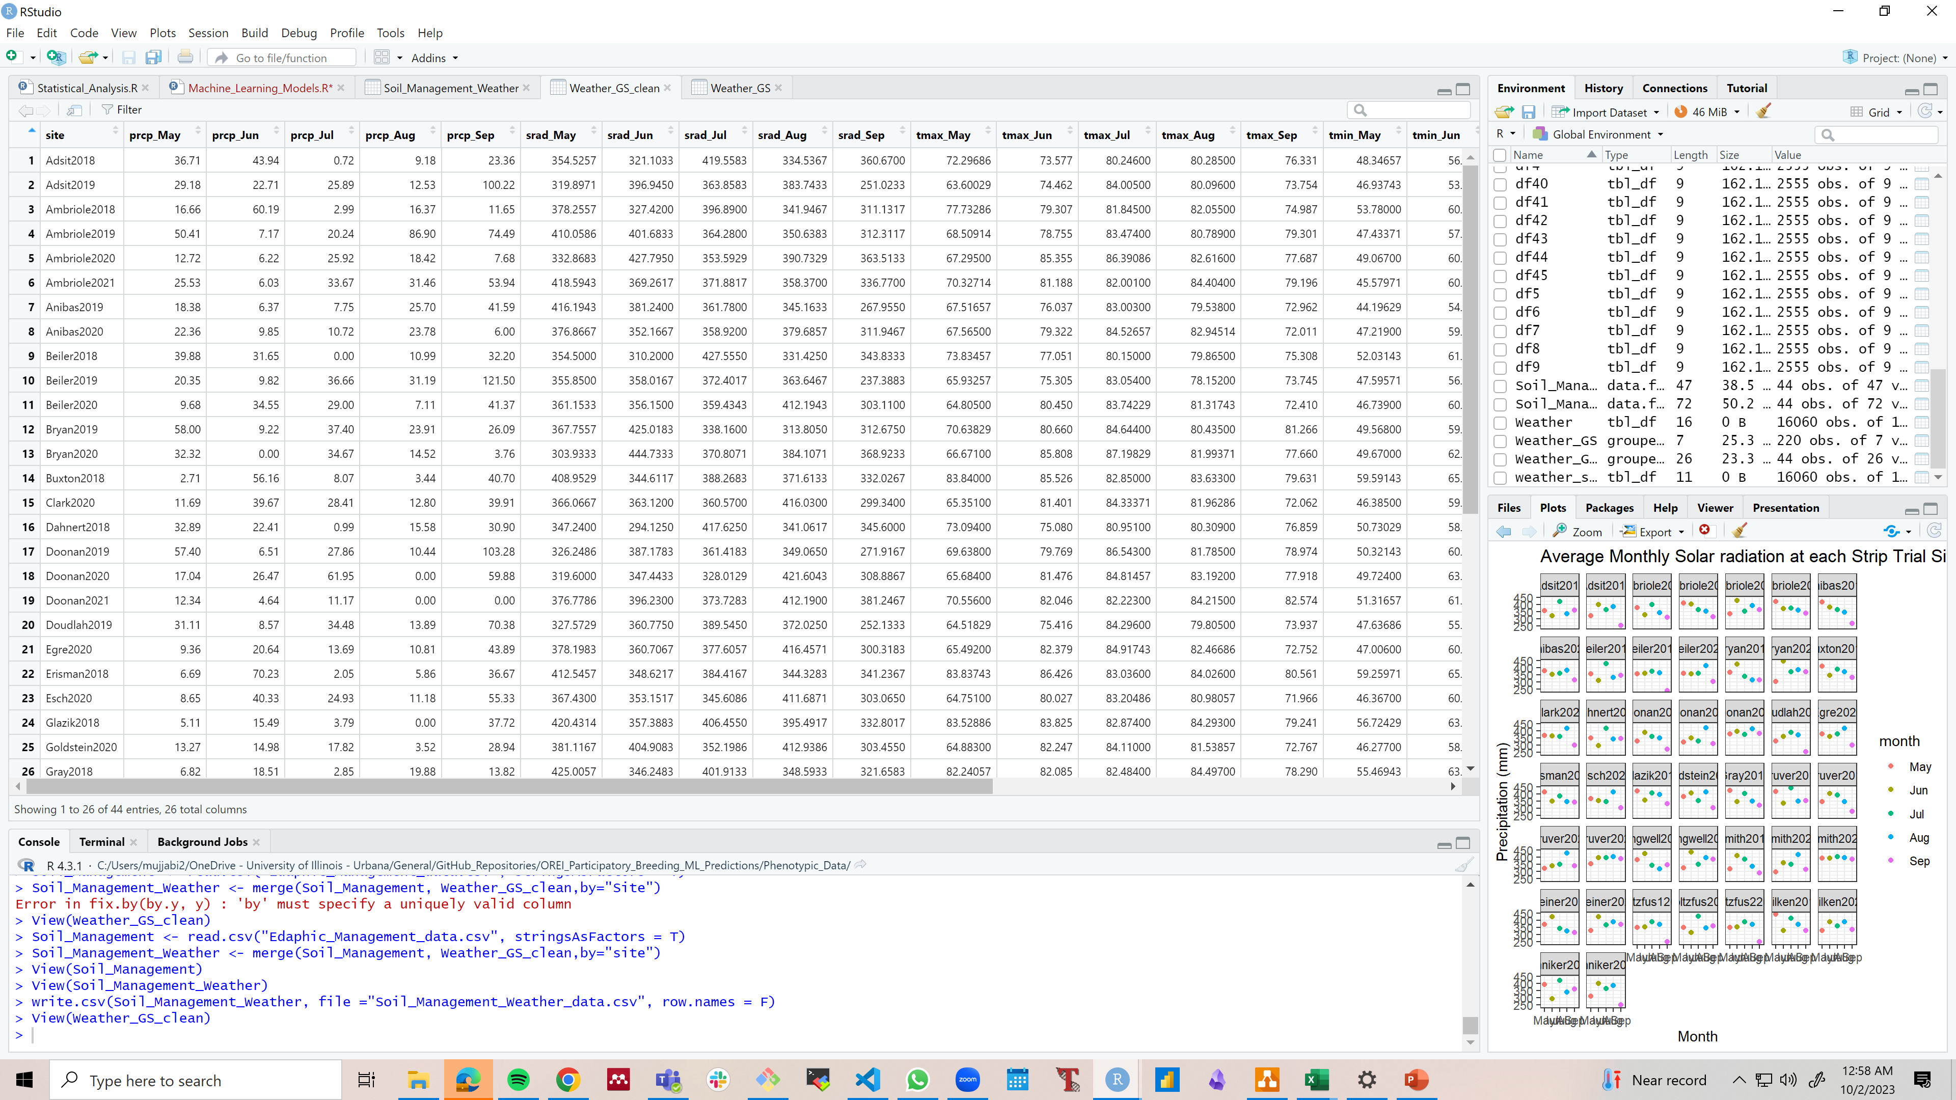

Slide 2
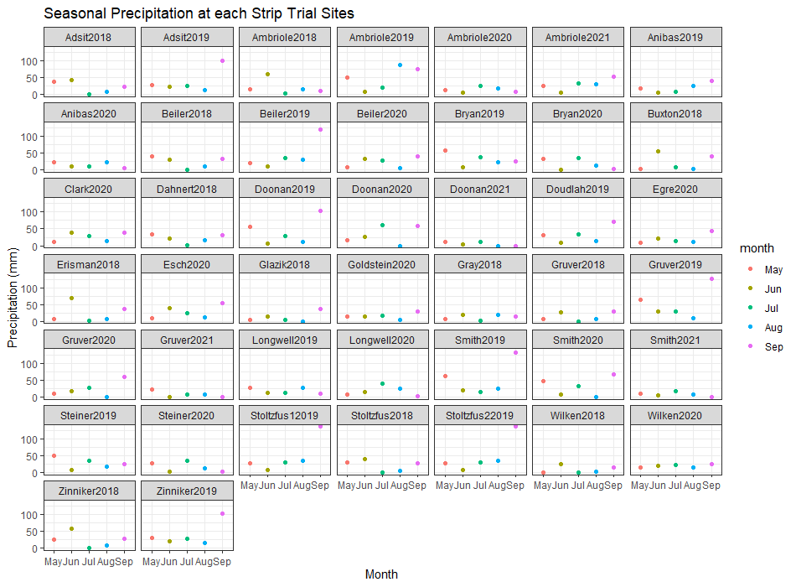

Slide 3
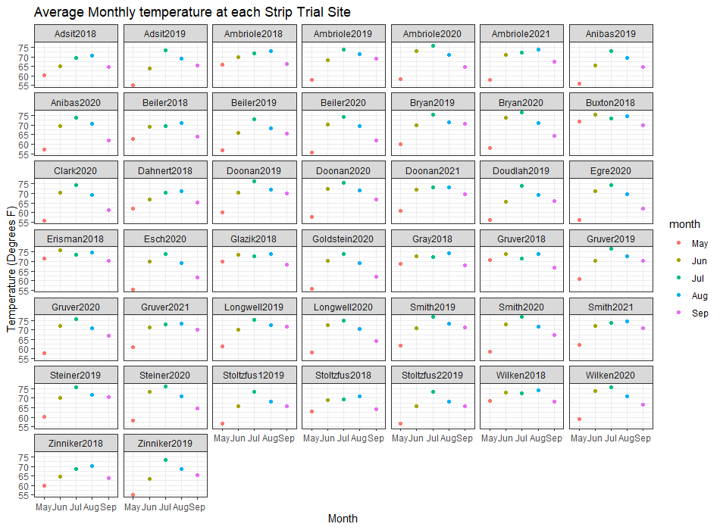

Slide 4
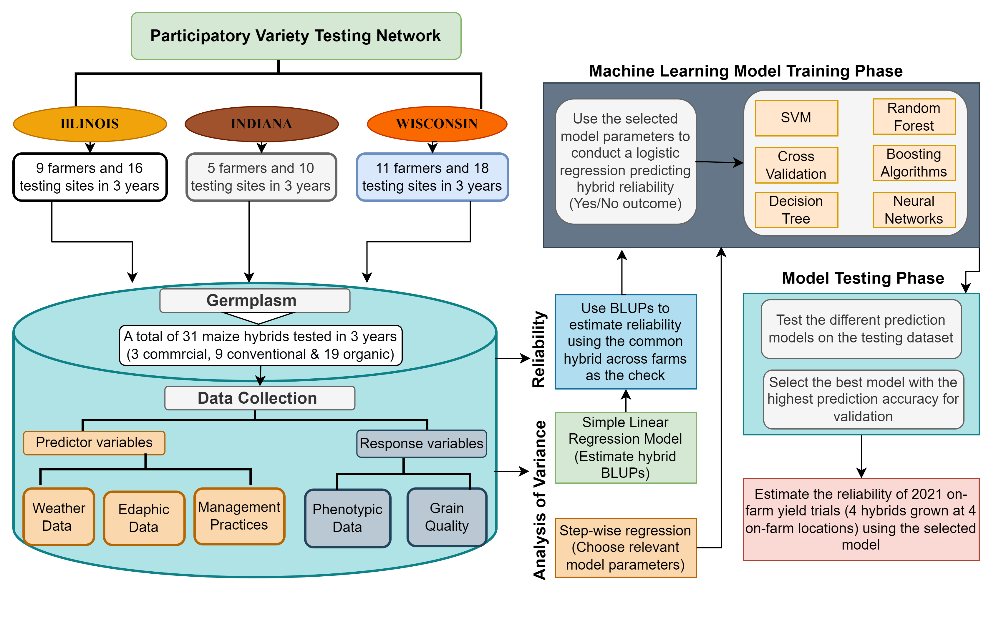

Slide 5
ML Model | Accuracy | Kappa | 95% CI
CV | 0.8704 | 0.6947 | 0.751 - 0.9463
Adaptive CV | 0.9074 | 0.7894 | 0.797 - 0.9692
Repeated CV | 0.9074 | 0.7739 | 0.797 - 0.9692
LGOCV | 0.9074 | 0.7739 | 0.797 - 0.9692
Bootstrapping | 0.9259 | 0.8224 | 0.821 - 0.9794
Bootstrapping0.632 | 0.9259 | 0.8157 | 0.821 - 0.9794
Optimism Boot | 0.9074 | 0.7739 | 0.797 - 0.9692
Boot_All | 0.8704 | 0.6947 | 0.751 - 0.9463
Adaptive Boot | 0.9074 | 0.7739 | 0.797 - 0.9692

Slide 6
