Slide 1
Evaluation of the Potential Usefulness of exPVP Maize Germplasm in Varietal Development for Organic Systems Using Participatory Variety Testing and Machine Learning Models
Objectives
Characterize the agronomic performance of experimental maize hybrids from organic and conventional breeding programs using a Participatory Testing Network
Determine the effect of agronomic management heterogeneity across farms on hybrid performance
Use machine-learning models to predict the reliability of experimental hybrid performance across different organic fields.

Slide 2
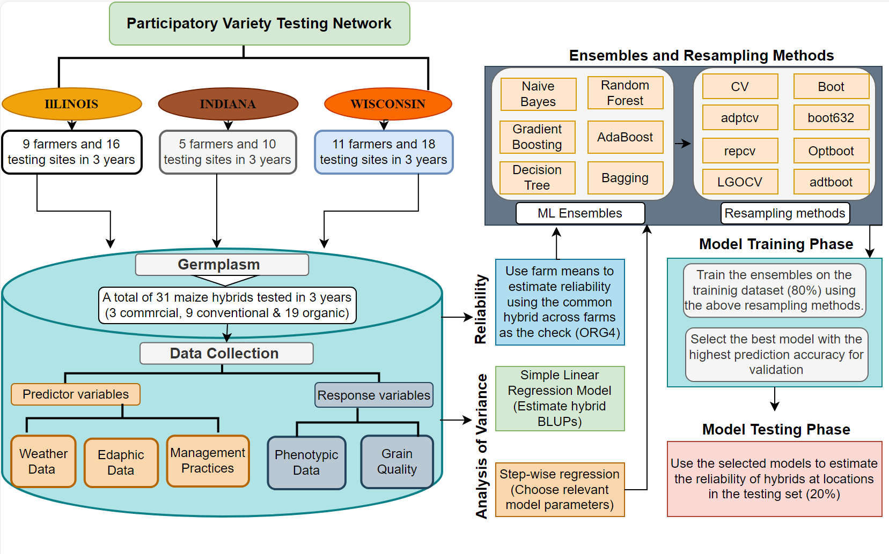
Analysis Workflow

Slide 3
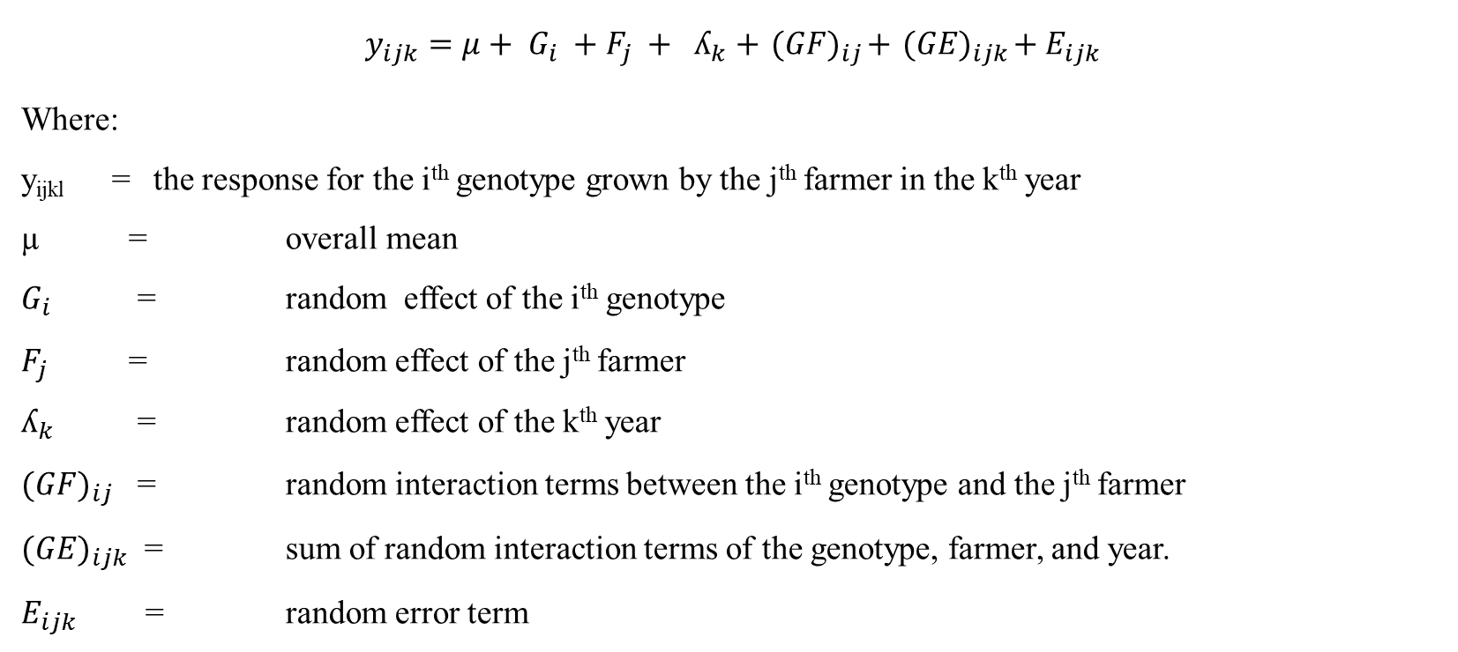
First Stage
$$y_{ijk}=μ+ G_{i} +F_{j} + ʎ_{k}+{ (GF)}_{ij}+{ (GE)}_{ijk}+E_{ijk}$$
Where:
y_{ijkl} = the response for the i^{th} genotype grown by the j^{th} farmer in the k^{th} year
µ = overall mean
$G_{i}$ = random effect of the i^{th} genotype
$F_{j}$ = random effect of the j^{th} farmer
$ʎ_{k}$ = random effect of the k^{th} year
${(GF)}_{ij}$ = random interaction terms between the i^{th} genotype and the j^{th} farmer
${(GE)}_{ijk}$ = sum of random interaction terms of the genotype, farmer, and year.
$E_{ijk}$ = random error term

Slide 4
Hybrid Means – IL&IN
HYB | PHT | EHT | SDL | SDS | TWT | KWT300 | YIELD | PRO | OIL | STA
ORG1 | 222.2 d | 106.6 bc | 21.1 c | 18.9 cde | 9.9 de | 77.3 ef | 7.9 de | 8.4 b | 4.7 b | 67.9 h
ORG4 | 224.3 d | 114.4 a | 21.9 abc | 19.6 abcd | 10.7 cd | 73.1 g | 8.6 cd | 8.2 d | 4.9 a | 67.9 h
ORG2 | 228.1 cd | 110.4 abc | 21.5 abc | 19 bcde | 7.7 f | 69.5 h | 6.1 f | 9.2 a | 4.7 b | 69.5 e
CHECK1 | 242.3 b | 110.6 ab | 21.2 bc | 18.8 de | 12.3 ab | 76.3 f | 9.9 ab | 7.4 i | 3.3 j | 71.4 c
KEV1 | 226.8 cd | 110.8 ab | 21.8 abc | 19.5 abcd | 11.5 bc | 76.7 ef | 9.2 bc | 7.9 f | 4.2 e | 71.8 a
KEV2 | 229.4 cd | 109.1 abc | 21.6 abc | 20.1 ab | 9.2 ef | 84.8 a | 7.3 ef | 8.4 b | 4.5 c | 71 d
ORG5 | 224.8 cd | 102.9 bcd | 19.8 d | 17.9 e | 9.1 ef | 68.5 h | 7.3 ef | 8.3 c | 4.1 e | 71 d
KEV3 | 211.7 e | 94.9 d | 20.8 cd | 19.4 abcd | 10.4 cde | 79.3 cde | 8.3 cde | 8 ef | 4.3 d | 71.6 b
UIUC1 | 227.1 cd | 100.7 cd | 21.4 bc | 19.3 bcd | 12.3 ab | 80.7 bc | 9.9 ab | 7.7 g | 3.5 hi | 69.5 e
UIUC7 | 232.5 c | 103.5 bcd | 22.1 ab | 19.9 ab | 10.4 cde | 77.6 def | 8.3 cde | 8.2 d | 3.7 f | 68.9 g
UIUC3 | 244.6 b | 110.7 ab | 22.1 ab | 19.7 abc | 13.2 a | 81.6 b | 10.5 a | 8 e | 3.4 i | 69.3 f
UIUC2 | 232.3 c | 109.7 abc | 22.5 a | 20.3 a | 12.8 ab | 79.6 cd | 10.2 ab | 7.5 h | 3.5 gh | 69.6 e
UIUC4 | 257.3 a | 114.7 a | 21.4 bc | 19.2 bcd | 13.2 a | 84.1 a | 10.5 a | 7.5 h | 3.6 g | 69.3 f

Slide 5
Year Means – IL&IN
YEAR | PHT | EHT | SDL | SDS | TWT | KWT300 | YIELD | PRO | OIL | STA
2018 | 228.6 b | 108.9 b | 21.1 c | 19 b | 10.2 c | 74.6 b | 8.2 c | 8.1 b | 4.3 a | 71.2 b
2019 | 225.7 c | 101.8 c | 21.5 b | 19.5 a | 11.2 b | 73 c | 9 b | 8.2 a | 3.7 c | 72.3 a
2020 | 241.5 a | 113.4 a | 22 a | 19.6 a | 12.4 a | 85.1 a | 9.9 a | 7.6 c | 4 b | 65.8 c

Slide 6
Farmer Means – IL&IN
FAR | PHT | EHT | SDL | SDS | TWT | KWT300 | YIELD | PRO | OIL | STA
Ambriole | 214.9 f | 99.1 e | 20.6 ef | 18.5 ef | 11 de | 77.3 ef | 8.8 de | 8.2 de | 4.1 c | 69.4 h
Buxton | 258.1 a | 122.8 a | 24.6 a | 22.1 a | 14.9 a | 86.1 b | 11.9 a | 8.6 b | 4.3 b | 70.8 d
Erisman | 227.2 de | 111.9 abc | 22.8 bc | 20.7 abc | 10.2 ef | 84.9 b | 8.2 ef | 9 a | 4.4 a | 70.3 e
Glazik | 222 ef | 114.9 abc | 20.4 ef | 18.3 ef | 8.8 fg | 74.5 fg | 7 fg | 7.4 i | 3.9 d | 72.5 a
Gray | 224.6 e | 108.2 bcde | 21.4 cde | 19.4 cde | 7.6 g | 64.4 i | 6.1 g | 6.7 j | 4.4 a | 72.1 b
Gruver | 232.9 cd | 102.8 de | 21.1 de | 18.9 de | 12 c | 77 f | 9.6 c | 8.1 e | 4 c | 69.8 g
Wilken | 228.5 de | 103.4 cde | 20.8 ef | 18.6 ef | 10.3 ef | 79 de | 8.3 ef | 8 f | 4.1 c | 68.4 k
Smith | 257.8 a | 116.4 ab | 21.9 cd | 19.8 cd | 12.5 bc | 79.9 cd | 10 bc | 7.7 g | 3.9 d | 69.1 j
Longwell | 247.7 b | 115.2 ab | 22.8 bc | 20.5 bc | 11.8 cd | 69.6 h | 9.4 cd | 7.6 h | 3.8 e | 69.2 i
Steiner | 236.9 c | 109.7 bcd | 23.9 ab | 21.6 ab | 12.6 bc | 71.4 gh | 10.1 bc | 8.4 c | 3.8 e | 72 c
Doonan | 223 e | 110.2 bc | 19.9 f | 17.8 f | 9.7 f | 81.7 c | 7.8 f | 7.6 h | 3.6 f | 69.9 f
Bryan | 223 ef | 113.2 abc | 22.3 bcd | 20 cd | 13.9 ab | 93.7 a | 11.1 ab | 8.2 d | 4 d | 65.3 l
Names will be replaced with farmer codes

Slide 7
Similar tables with the Wisconsin data

Slide 8
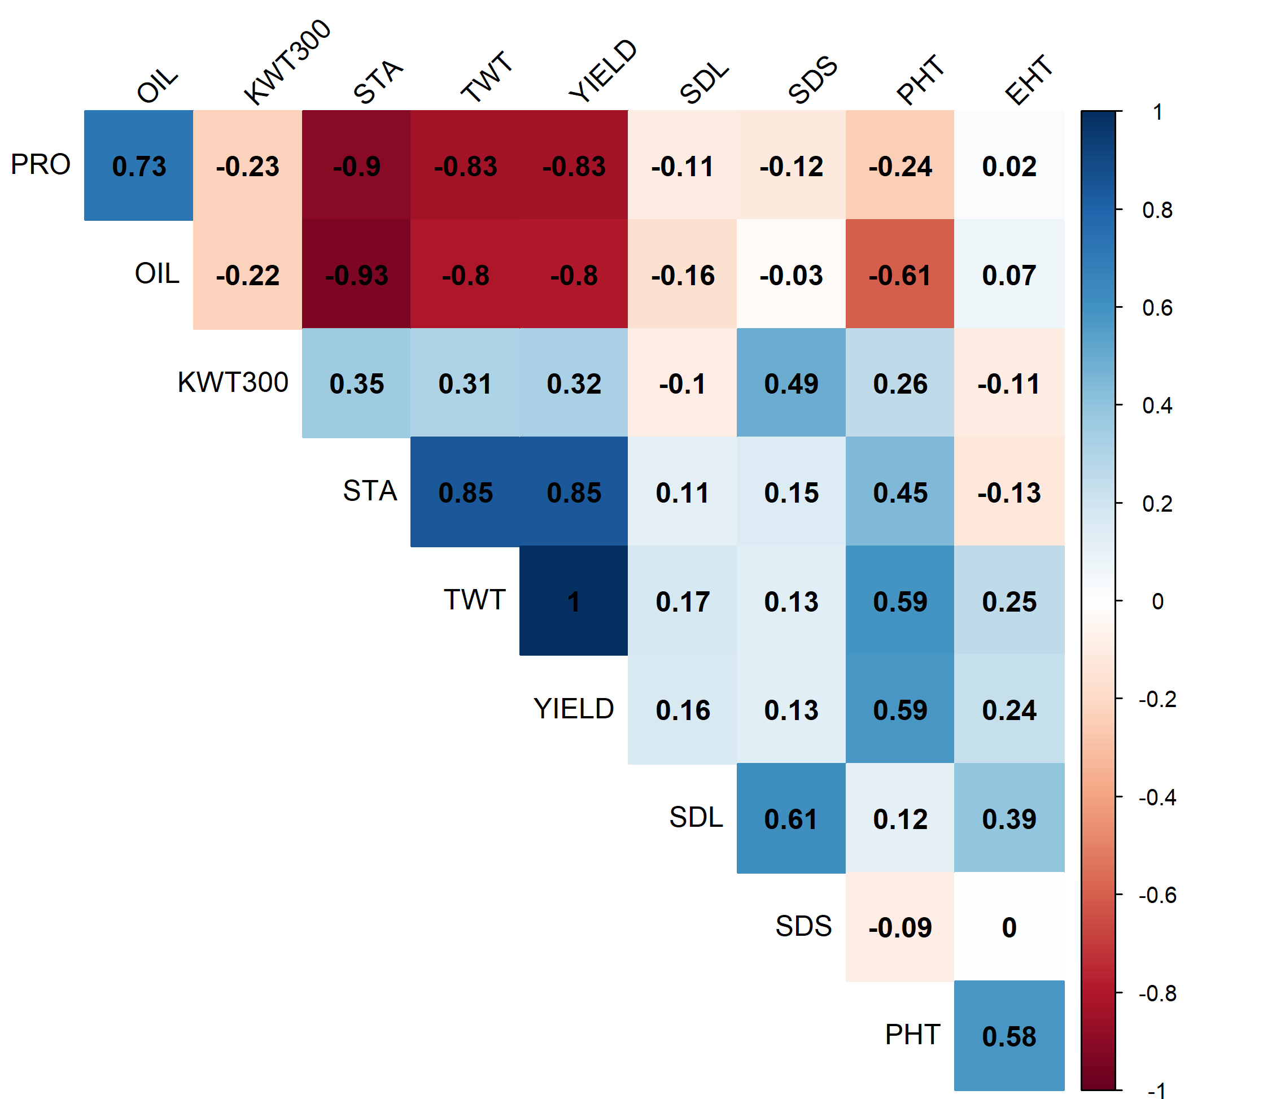
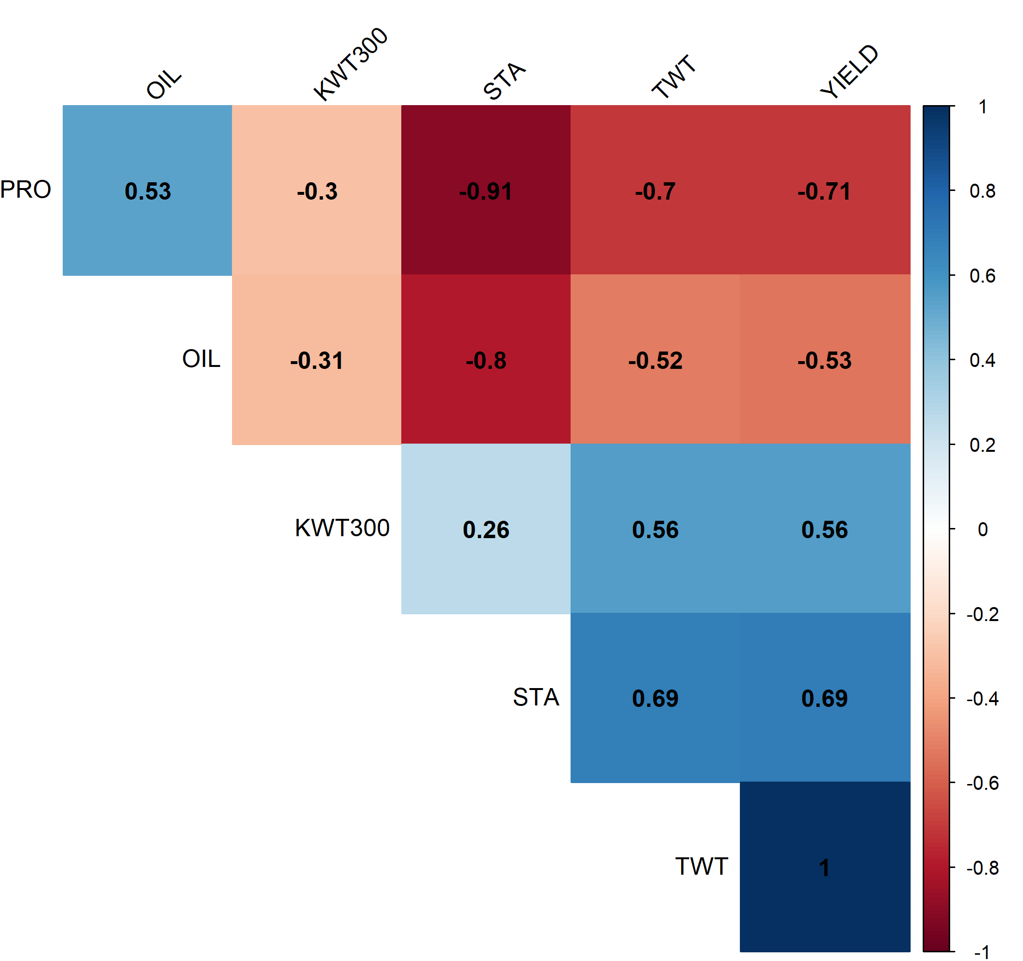
Trait Correlations
Illinois
Wisconsin

Slide 9
Second Stage – Stepwise Regression – Bothside
full_model <- lm(YIELD ~., data = Data)
step_model2 <- step(full_model, scope = . ~ .^2, direction = 'both’)
anova(step_model2) ## Removing interactions that are not significant
step_model3 <- lm(formula = YIELD ~ HYB + FS + CC + WRT + Density + CI + CD + PER + HYB:Density + HYB:WRT + HYB:CI, data = Data)

Slide 10
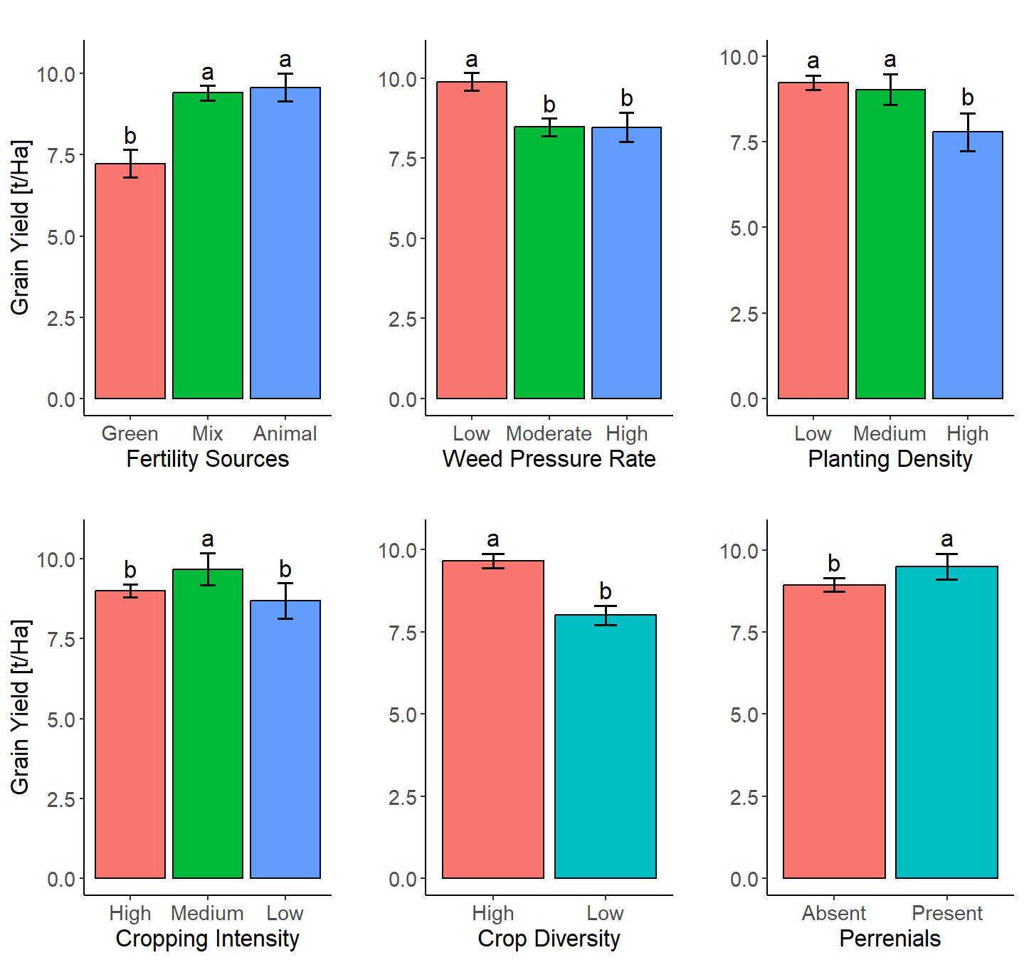

Effect of Management of Grain Yield – IL & IN
Diversity index (DI) =
$$\frac{ΣNumber of unique plant species}{Cropping years}$$
DI < 1 = Low
DI > 1 = High
Cropping Intensity (CI)
Low | Medium | High
Presence of at least two years of a perennial phase (≥2 years) that minimized tillage frequency than the intermediate category in the cropping sequence. | Presence of annual cover crops, one cash crop with less tillage frequency than high category, and presence of a perennial phase (1 year) in the cropping sequence. | Presence of annual cover crops and at least two cash crops with frequent primary and secondary tillage before and during planting and absence of perennials in the cropping sequence.

Slide 11
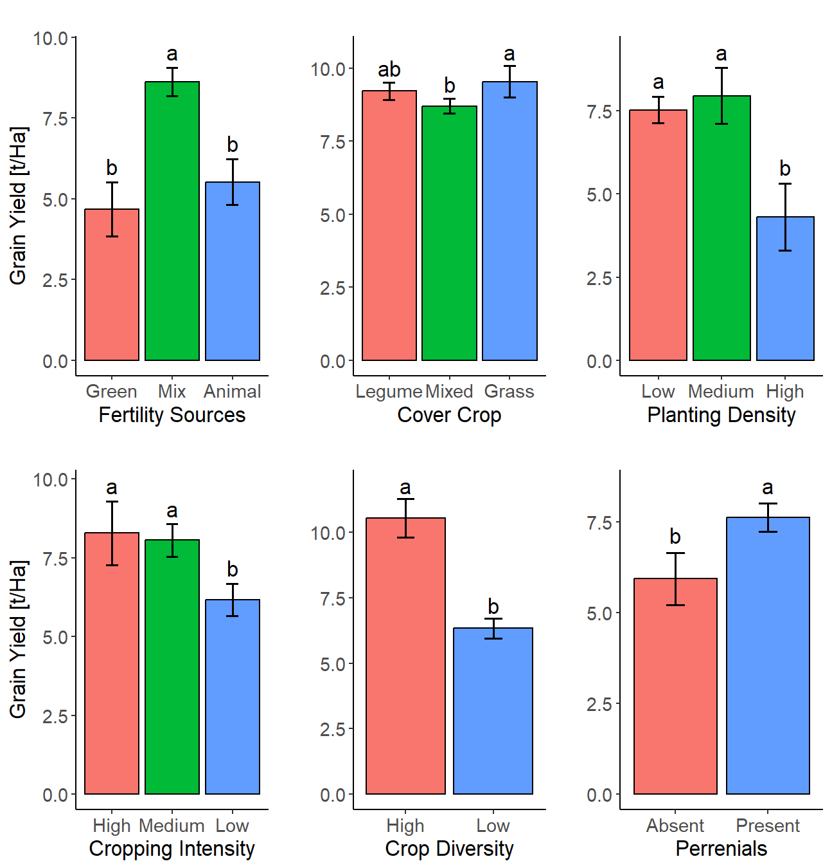

Effect of Management of Grain Yield – WN
Diversity index (DI) =
$$\frac{ΣNumber of unique plant species}{Cropping years}$$
DI < 1 = Low
DI > 1 = High
Cropping Intensity (CI)
Low | Medium | High
Presence of at least two years of a perennial phase (≥2 years) that minimized tillage frequency than the intermediate category in the cropping sequence. | Presence of annual cover crops, one cash crop with less tillage frequency than high category, and presence of a perennial phase (1 year) in the cropping sequence. | Presence of annual cover crops and at least two cash crops with frequent primary and secondary tillage before and during planting and absence of perennials in the cropping sequence.

Slide 12
Effect of management on other traits– IL&IN
Management | Levels | PHT | EHT | SDL | SDS | TWT | KWT300 | PRO | OIL | STA
FS | Animal | 231 ab | 103.1 b | 21.8 a | 19.6 a | 12 a | 72.9 c | 8.6 a | 3.9 ab | 71.6 a
 | Mix | 235.1 a | 109.2 a | 21.8 a | 19.6 a | 11.8 a | 79.6 a | 8 b | 4.1 a | 68.8 b
 | Green | 223.3 b | 110.4 a | 20.4 b | 18.3 b | 9 b | 76.1 b | 7.3 c | 3.8 b | 70.9 a
WRT | Low | 245 a | 111.1 a | 22.1 a | 19.8 a | 12.3 a | 76.7 b | 7.9 b | 4 a | 69.6 a
 | Moderate | 226 b | 106.8 b | 21.2 b | 19 b | 10.6 b | 77.1 b | 7.9 b | 4 a | 69.6 a
 | High | 216.4 c | 105.3 b | 21.3 b | 19.1 b | 10.6 b | 83.4 a | 8.3 a | 3.9 a | 69.8 a
Dens | Low | 234.2 a | 109.5 a | 21.9 a | 19.7 a | 11.5 a | 77.2 b | 8 b | 4.1 a | 69.6 a
 | Medium | 229.8 ab | 101.5 b | 20.9 b | 18.7 b | 11.3 a | 78.5 ab | 8.3 a | 4 a | 69.5 a
 | High | 223 b | 110.2 a | 19.9 c | 17.8 c | 9.7 b | 81.7 a | 7.6 c | 3.6 b | 69.9 a
CI | High | 230.6 b | 105 b | 21.4 a | 19.2 a | 11.2 b | 76.2 c | 8 a | 4 a | 70.2 a
 | Medium | 239.6 a | 119.2 a | 22 a | 19.7 a | 12.1 a | 79.9 b | 7.6 b | 4 a | 67.1 b
 | Low | 236.8 ab | 120.2 a | 22 a | 19.8 a | 10.9 b | 87.6 a | 8.2 a | 4.1 a | 68.4 b
CD | High | 235.8 a | 109.9 a | 21.9 a | 19.7 a | 12.1 a | 79.6 a | 8 a | 4 a | 69.2 b
 | Low | 226.4 b | 105.7 b | 21 b | 18.8 b | 10 b | 75 b | 7.8 b | 3.9 b | 70.3 a
PER | Absent | 231.2 b | 106.9 b | 21.3 b | 19.1 b | 11.2 b | 77.6 a | 7.9 b | 4 a | 69.9 a
 | Present | 236.8 a | 113.9 a | 22.7 a | 20.4 a | 11.9 a | 79 a | 8.1 a | 4 a | 68.6 b

Slide 13
Reliability Estimation – IL&IN
HYB | MeanY | SDY | MeanYD | SDYD | Env | n | Ra | Rb
KEV1 | 8.14 | 3.39 | -1.63 | 2.17 | 7 | 2 | 0.23 | 0.29
KEV2 | 7.34 | 1.8 | -2.44 | 1.63 | 7 | 1 | 0.07 | 0.14
KEV3 | 8.3 | 2.11 | -1.47 | 1.36 | 7 | 1 | 0.14 | 0.14
ORG1 | 7.89 | 1.94 | -2.16 | 2.39 | 19 | 5 | 0.18 | 0.26
ORG2 | 6.85 | 2.12 | -3.16 | 1.68 | 6 | 1 | 0.03 | 0.17
ORG4 | 8.59 | 2.25 | -1.47 | 2.35 | 19 | 7 | 0.27 | 0.37
ORG5 | 7.32 | 2.55 | -2.69 | 1.76 | 6 | 0 | 0.06 | 0
UIUC1 | 9.85 | 1.28 | -0.22 | 2.56 | 13 | 5 | 0.47 | 0.38
UIUC2 | 10.23 | 2.21 | 0.16 | 2.2 | 13 | 6 | 0.53 | 0.46
UIUC3 | 10.52 | 1.55 | 0.45 | 2.98 | 13 | 5 | 0.56 | 0.38
UIUC4 | 10.36 | 1.05 | 0.28 | 3.04 | 13 | 7 | 0.54 | 0.54
UIUC7 | 8.35 | 2.3 | -1.73 | 2.54 | 13 | 2 | 0.25 | 0.15

Slide 14
Reliability Estimation – WS
HYB | MeanY | SDY | MeanYD | SDYD | Env | n | Ra | Rb
CHECK2 | 10.69 | 3.54 | 1.33 | 0.98 | 5 | 4 | 0.91 | 0.8
CHECK3 | 8.91 | 5.41 | 1.69 | 3.54 | 12 | 9 | 0.68 | 0.75
ORG1 | 8.31 | 4.35 | 0.46 | 2.43 | 17 | 8 | 0.57 | 0.47
ORG10 | 9.4 | 2.52 | -0.72 | 1.7 | 6 | 2 | 0.34 | 0.33
ORG11 | 9.56 | 3.89 | -0.05 | 1.88 | 7 | 3 | 0.49 | 0.43
ORG14 | 7.53 | 3.4 | -2.09 | 2.53 | 7 | 1 | 0.21 | 0.14
ORG18 | 7.13 | 3.4 | -2.23 | 1.28 | 5 | 0 | 0.04 | 0
ORG19 | 7.98 | 3.24 | -1.38 | 0.83 | 5 | 0 | 0.05 | 0
ORG2 | 7.39 | 2.09 | -1.97 | 1.59 | 5 | 0 | 0.11 | 0
ORG2_Inoc | 6.36 | 1.51 | -2.15 | 1.07 | 4 | 0 | 0.02 | 0
ORG20 | 8.37 | 4.45 | -0.94 | 3.29 | 6 | 3 | 0.39 | 0.5
ORG21 | 4.36 | 4.16 | 0.49 | 3.45 | 5 | 2 | 0.56 | 0.4
ORG22 | 5.33 | 5.38 | 1.46 | 4.11 | 5 | 2 | 0.64 | 0.4
ORG23 | 5.16 | 3.22 | 1.29 | 2.47 | 5 | 4 | 0.7 | 0.8
ORG24 | 3.71 | 2.63 | -0.16 | 2.63 | 5 | 2 | 0.48 | 0.4
ORG25 | 3.96 | 2.67 | 0.08 | 0.89 | 5 | 3 | 0.54 | 0.6
ORG3 | 6.69 | 4.02 | -0.53 | 1.52 | 12 | 7 | 0.36 | 0.58
ORG8 | 4.42 | 1.38 | -4.94 | 2.49 | 5 | 0 | 0.02 | 0

Slide 15
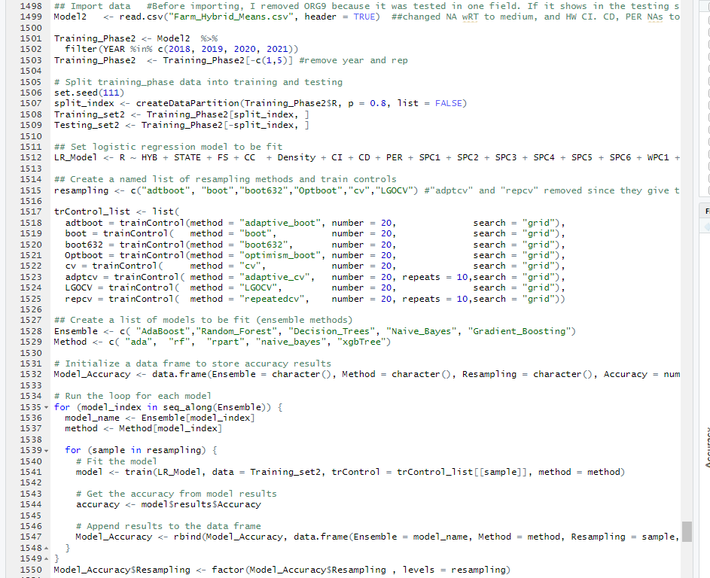
Machine Learning – Predicting R using Logistic regression

Slide 16
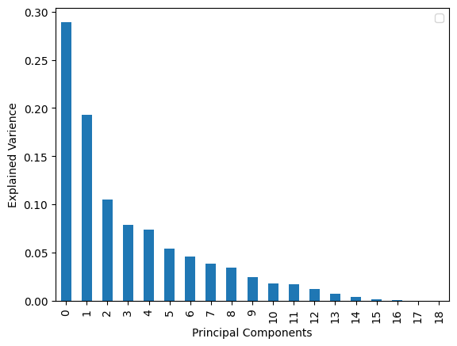
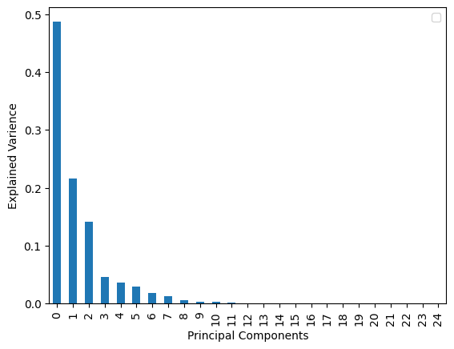
Dimension Reduction using PCA
Soil PCs
Weather PCs

Slide 17
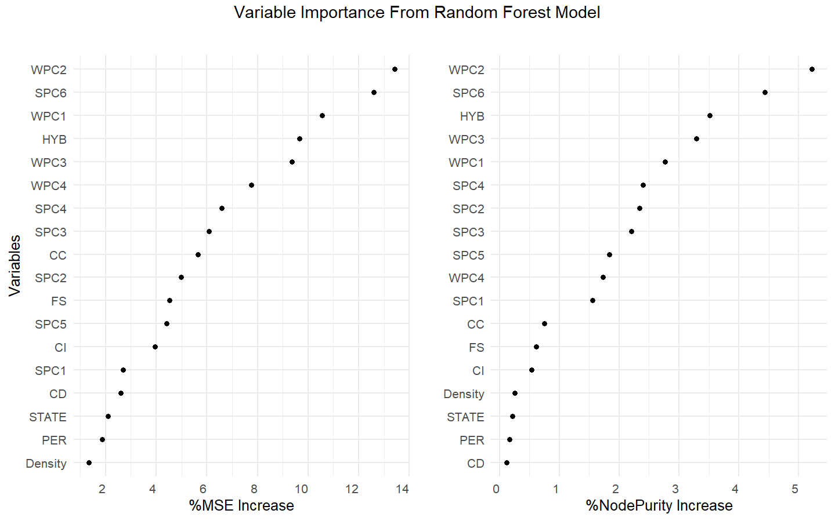
Variable Importance in RF Model

Slide 18
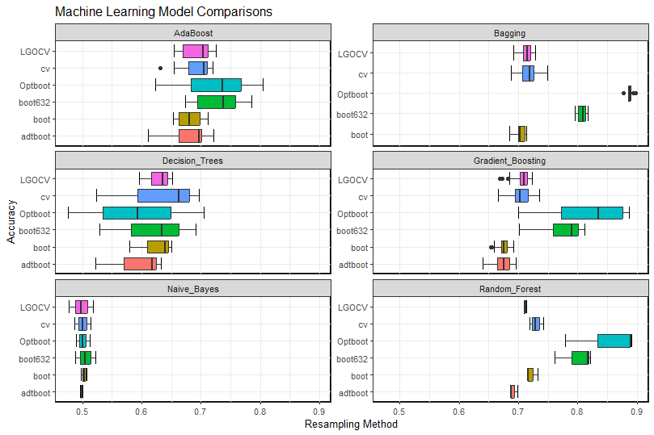
Model Comparisons

Slide 19
Model Validation
Selected Models were tested on the Validation set (20%)
Metrics
Accuracy: Proportion of correctly classified instances out of all instances in the dataset.
Precision: proportion of true positive predictions out of all positive predictions made by the model.
Recall (Sensitivity): proportion of true positive predictions out of all actual positive instances in the dataset
Baseline: represents the performance of a trivial or naive model that always predicts the majority class (or any predefined class) in the dataset. It serves as a reference point for comparing the performance of more sophisticated models.
Models | accuracy | precision | recall | baseline
RF_Optboot | 0.85 | 0.87 | 0.8 | 0.56
RF_boot632 | 0.85 | 0.87 | 0.8 | 0.56
Bagging_Optboot | 0.83 | 0.86 | 0.76 | 0.58
Bagging_boot632 | 0.81 | 0.83 | 0.76 | 0.56
GB_Optboot | 0.83 | 0.83 | 0.8 | 0.54

Slide 20
About the models and Resampling methods
AdaBoost (ada): AdaBoost combines multiple weak learners into a strong classifier by sequentially training them, with each focusing on correcting the mistakes of its predecessors. Advantages: Effective in handling complex classification tasks; resistant to overfitting. Disadvantages: Sensitive to noisy data; computationally intensive.
Random Forest (rf): Random Forest constructs multiple decision trees independently and aggregates their predictions through voting. Advantages: High accuracy; robust to overfitting and noisy data. Disadvantages: Can be slow to train on large datasets; less interpretable compared to individual trees.
Decision Trees (rpart): Decision Trees recursively partition the feature space based on the values of predictor variables. Advantages: Simple to interpret; capable of capturing nonlinear relationships. Disadvantages: Prone to overfitting; sensitive to small variations in data.
Naive Bayes (naive_bayes): Naive Bayes is a probabilistic classifier based on Bayes' theorem with the assumption of feature independence. Advantages: Simple and computationally efficient; performs well with small datasets. Disadvantages: Assumes feature independence, which may not hold true in practice; limited expressiveness.
Gradient Boosting (xgbTree): Gradient Boosting sequentially adds weak learners to correct the errors of previous models, leading to a strong ensemble model. Advantages: High predictive accuracy; handles complex datasets well. Disadvantages: Sensitive to hyperparameter tuning; prone to overfitting on noisy data.
Bagging(treebag): short for Bootstrap Aggregating, is an ensemble learning technique used to improve the stability and accuracy of machine learning models, especially those that are sensitive to the variance in the training data. It works by training multiple instances of the same base learning algorithm on different subsets of the training data and then aggregating their predictions to make a final prediction.

Slide 21
Resampling methods
Adaptive Bootstrapping (adtboot): Description: Adaptive Bootstrapping dynamically adjusts the size of bootstrap samples based on the model's performance. It adapts the sampling distribution to focus more on instances that are challenging to classify, improving the model's robustness.
Bootstrapping (boot): Description: Bootstrapping involves generating multiple bootstrap samples from the original dataset with replacement. Each sample is of the same size as the original dataset, allowing for estimation of sampling variability and uncertainty in model performance.
632 Bootstrapping (boot632): Description: .632 Bootstrapping addresses potential overfitting by using a weighted average of the training error and the out-of-bag error. It balances the bias-variance trade-off and provides a robust estimate of model performance.
Optimism Bootstrapping (Optboot): Description: Optimism Bootstrapping estimates the optimism in model performance by comparing the performance on bootstrap samples with the performance on the original dataset. It helps in assessing the generalization ability of the model and identifying potential overfitting.
Cross-Validation (cv): Description: Cross-Validation partitions the dataset into k subsets and iteratively trains the model on k-1 subsets while validating it on the remaining subset. This process is repeated k times, and the average performance across all folds is used to estimate the model's performance.
Adaptive Cross-Validation (adptcv): Description: Adaptive Cross-Validation dynamically adjusts the number of repeats based on the model's performance. It adapts the number of repeats to focus more on challenging instances, improving the accuracy of performance estimation.
Leave-Group-Out Cross-Validation (LGOCV): Description: LGOCV leaves entire groups or clusters of related samples out as validation sets. This method is particularly useful for datasets with group structures or dependencies among samples.
Repeated Cross-Validation (repcv): Description: Repeated Cross-Validation repeats the cross-validation process multiple times with different random splits of the data. This helps in obtaining a more stable estimate of model performance.

