Slide 1
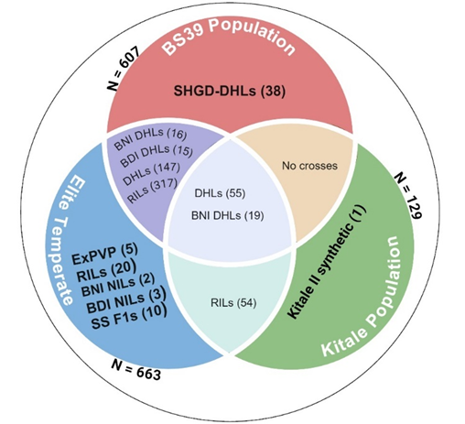
Derived Inbred lines
Total of 623 Inbreds
- 252 DH lines (in 2 years)
- 371 Recombinant inbred lines
Primarily BS39 background (570 lines)**
Testcrossed with 3 testers (~800 hybrids)
Phenotyped for PHT, EHT and flowering
Genotyped using 9000 SNP markers
Genetic and phenotypic characterization

Slide 2
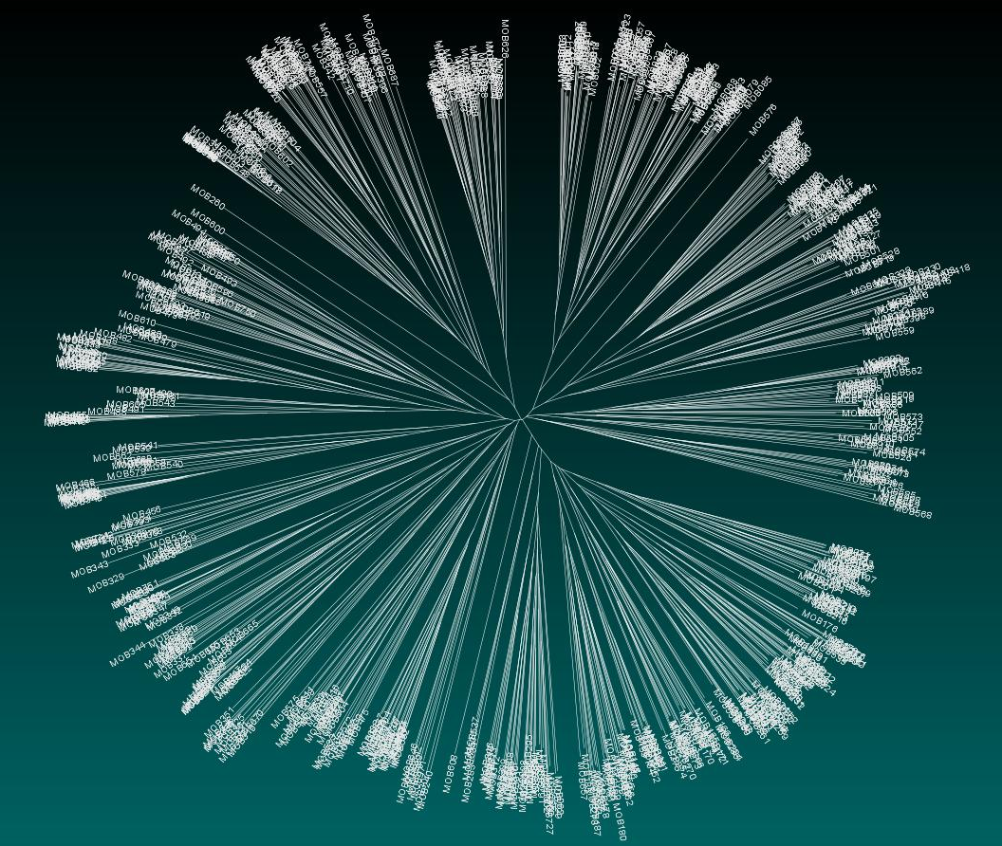

Slide 3
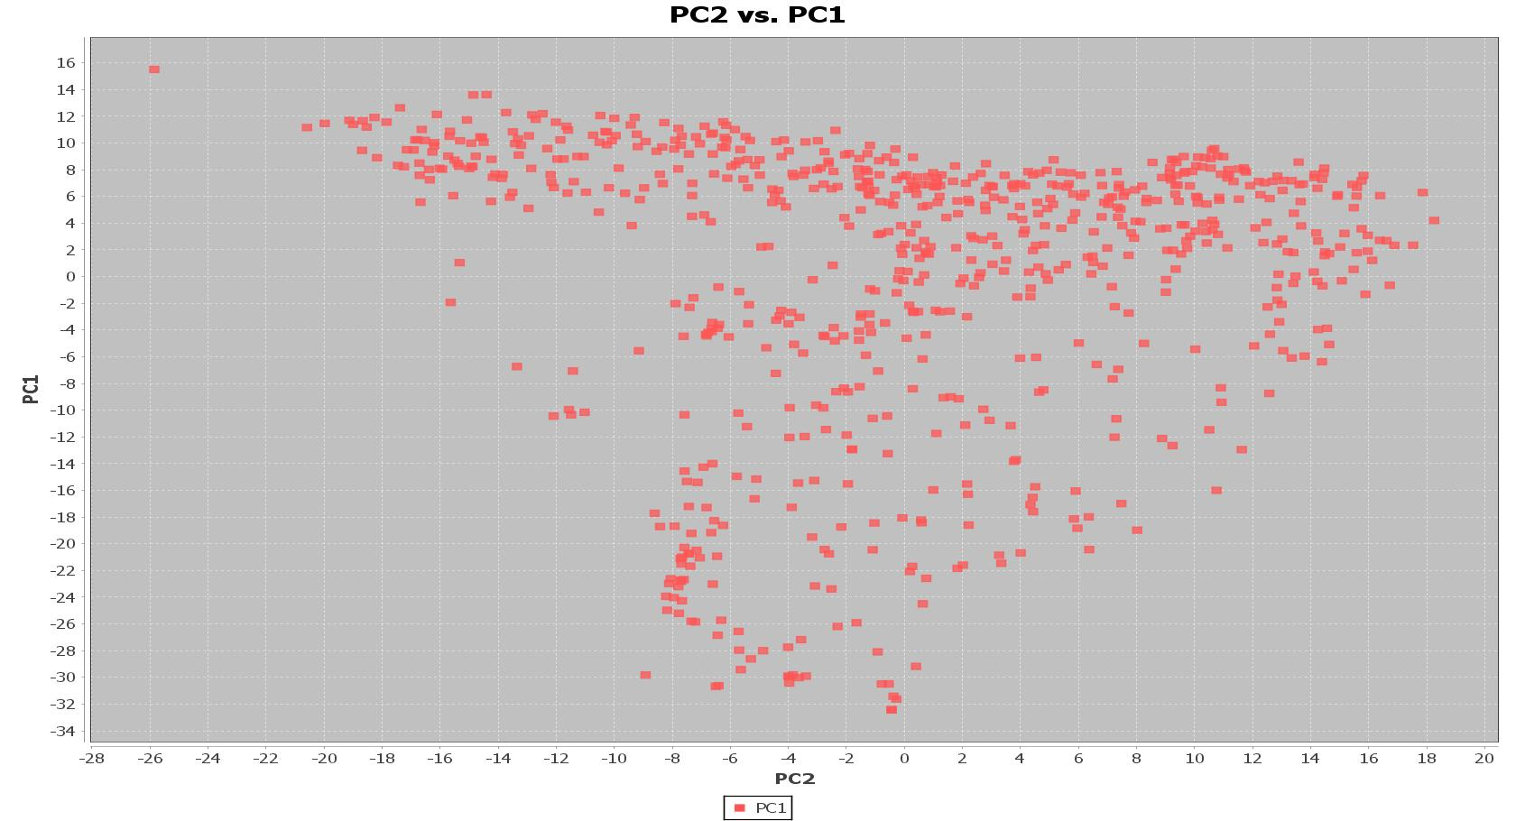

Slide 4
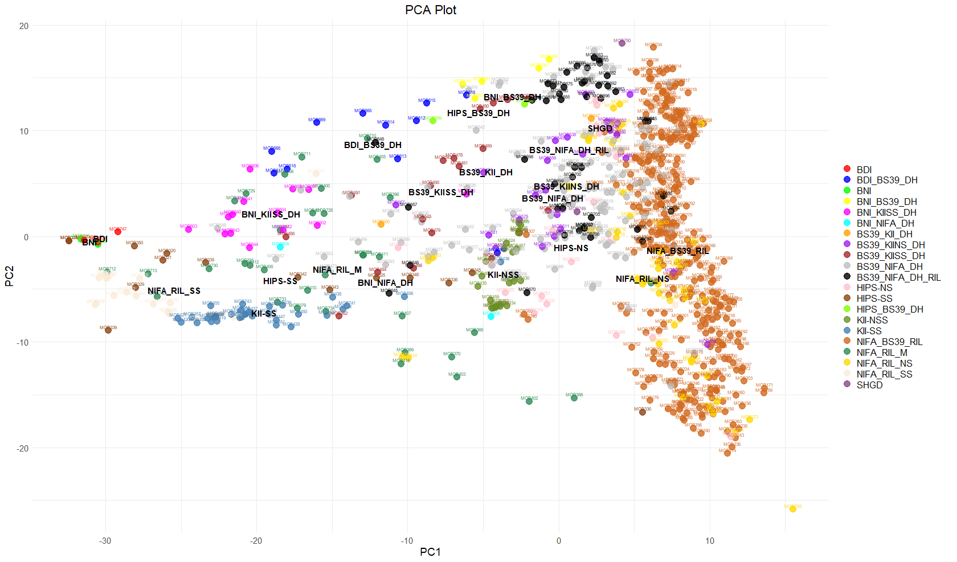

Slide 5
Tassel Videos
Genomic Bootcamp: https://www.youtube.com/watch?v=73hD5n-OOJc
Filtering: https://www.youtube.com/watch?v=w6ZY3E5LX14
LD, PCA, Kinship, GWAS: https://www.youtube.com/watch?v=hiReCEINEVs
Data formatting, Gwas, ld : https://www.youtube.com/watch?v=TNAnSu-nM_E
Data Formats: https://www.youtube.com/watch?v=4W3Ohw6Zckg
Structure software
Structure: https://www.youtube.com/watch?v=s-Eyn6jhOgw
Indian guy: https://www.youtube.com/watch?v=_8TEIkvcw4E
Abincha: https://www.youtube.com/watch?v=s-Eyn6jhOgw

Slide 6

