Slide 1
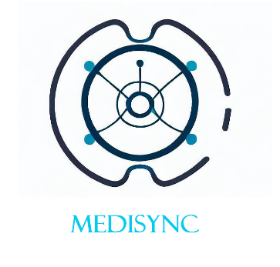
MediSync Hub: Unified Patient-Doctor Record Management
Make Your Life Easier
Submitted by:
Abu Mukaddim Rahi (2022027042)​
Sadman Israk Sporsho (2012213042​)
Yuki Bhowmik (2012168042)
Rafsan Jani Chowdhury (2011424642​)

Slide 2
What is it?
This is a web-based, centralized database containing comprehensive medical records for each patient.
Our system allows doctors and hospitals to instantly get a patient's complete medical history by entering their National ID (NID) and by further authorization by the patient.
Healthcare professionals can access comprehensive patient information in real-time, enabling more accurate diagnoses, better treatment decisions, and improved patient outcomes.
The objective is to flawlessly integrate patient data with hospitals, eliminating the necessity to carry prior prescriptions and streamlining the entire process for enhanced efficiency.

Slide 3
Target audience or market
Healthcare providers: Accurate and up-to-date medical records help prevent medication errors, allergies, and potential adverse reactions, contributing to overall patient safety.
General patients: Patients will not have to carry physical copies of prior prescriptions and medical records when visiting a doctor
Pharmaceutical companies: The prescription can be access if authorized by the patient by pharmacies
Insurance companies: Insurance providers can access accurate medical records for efficient claims processing and determining appropriate coverage

Slide 4
What problem or need is it fulfilling?
For long-term patients, it is a tedious and cumbersome task to gather all their relevant medical documents prior to a visit to a new doctor. On top of that, the need of having a digitized copy of said records was especially felt during the COVID-19 lockdowns.
This database will enable a more streamlined process for both patients and doctors while also helping Telemedicine services and remote healthcare providers can securely access patient records, enabling virtual consultations and accurate medical guidance.
In case of emergencies where the patient is found unconscious or disabled, his NID can be used to pull up a list of relevant public data such as allergies, kidney/heart status or pressure issues. This will help minimize accidental treatments.

Slide 5
Functionality
Comprehensive patient profile containing personal information, medical history and prior medical treatments which will require authorization from the patient to access. Certain crucial data will be public on the profile such as allergies and organ conditions.
There will be a patient profile directory and also a healthcare provider and doctor profile directory and interactions between the two will be timestamped and recorded.
Enable pharmacies to access relevant prescriptions upon authorization from the patient (OTP/App confirmation)

Slide 6
Functionality
Security features such as 2 factor authentication from the user upon new hospital access attempt, which will also be recorded
Consultation timestamps and automatic updates of medical history, prescriptions and new doctor visits will be added to the directory.
Extension idea: Once a patient has visited a doctor, they can leave an anonymous review on the doctor’s profile. Note that he will only be allowed to leave a rating and review if the doctor exists in the patients’ medical consultation history

