Slide 1




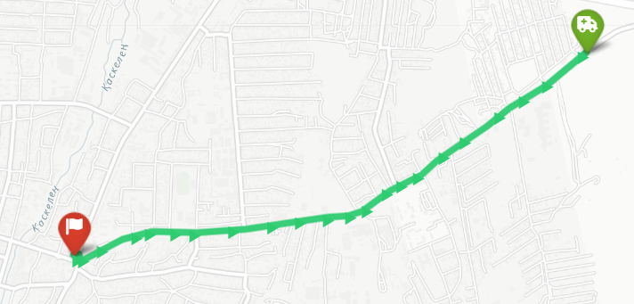
🚑
DATASET
LIVE DEMO RESULTS
DISASTER ZONE
RESCUE PLANNER
166,891
20945
346,732
Qaskelen
Road Nodes
Road Ways
Directed Edges
OSM Source
G
A* Pathfinding on Real OpenStreetMap Data
INF375 · Artificial Intelligence · Final Project
HOW A* WORKS
GOAL
f(n) = g(n) + h(n)
g(n) = actual cost from start h(n) = heuristic to goal
S
Design an intelligent rescue agent that finds the most efficient path through a city during a disaster scenario with blocked roads and damaged intersections.
Qaskelen road network — A* path visualized
1
Insert START into open list with f = h(start)
KEY RESULTS
2
Pop node with lowest f(n) from priority queue
~13 ms
AI TECHNIQUES
3
If node = GOAL → reconstruct path and return
Avg search time (A*)
A* Search
111
f(n)=g(n)+h(n), optimal + complete
4
For each neighbour: compute new g, update if better
Nodes in typical path
UCS / Dijkstra
3,316
Zero heuristic baseline
5
Skip blocked roads/nodes (disaster simulation)
Nodes explored (haversine)
Haversine h(n)
9,100
Admissible, never over-estimates
HEURISTIC COMPARISON
Nodes explored (Dijkstra)
DISASTER SIMULATION
Euclidean h(n)
Non-admissible, fewer nodes explored
✓
Randomly block X% of roads before search
Graph Theory
✓
Block Y% of intersections (nodes)
Directed weighted adjacency list
✓
A* auto-reroutes — reports unreachable if no path
✓
Live stats: explored nodes, cost, CPU time
Data: OpenStreetMap © ODbL | Tools: Python · Streamlit · Folium · A* Search | INF375 Artificial Intelligence | Almaty, Kazakhstan

