Slide 1
AJAX

Slide 2
AJAX Introduction
JAX is a developer's dream, because you can:
Update a web page without reloading the page
Request data from a server - after the page has loaded
Receive data from a server - after the page has loaded
Send data to a server - in the background

Slide 3
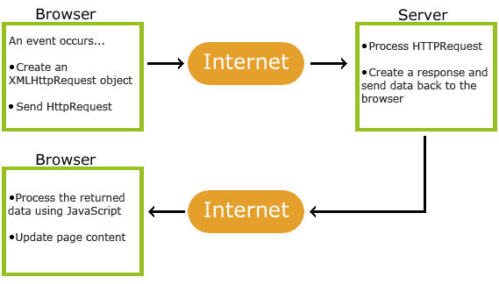
How AJAX Works

Slide 4
1. An event occurs in a web page (the page is loaded, a button is clicked)
2. An XMLHttpRequest object is created by JavaScript
3. The XMLHttpRequest object sends a request to a web server
4. The server processes the request
5. The server sends a response back to the web page
6. The response is read by JavaScript
7. Proper action (like page update) is performed by JavaScript

Slide 5
The XMLHttpRequest Object
All modern browsers support the XMLHttpRequest object.
The XMLHttpRequest object can be used to exchange data with a server behind the scenes. This means that it is possible to update parts of a web page, without reloading the whole page

Slide 6
Create an XMLHttpRequest Object
All modern browsers (Chrome, Firefox, IE7+, Edge, Safari Opera) have a built-in XMLHttpRequest object.
Syntax for creating an XMLHttpRequest object:
variable = new XMLHttpRequest();
var xhttp = new XMLHttpRequest();

