Slide 1
CSS
Cascading Style Sheets

Slide 2
INTRODUCTION
CSS is a language that describes the style of an HTML document.
CSS describes how HTML elements should be displayed.
CSS stands for Cascading Style Sheets
CSS describes how HTML elements are to be displayed on screen
CSS saves a lot of work. It can control the layout of multiple web pages all at once

Slide 3
Why Use CSS?
CSS is used to define styles for your web pages, including the design, layout and variations in display for different devices and screen sizes.
The style definitions are normally saved in external .css files.
With an external stylesheet file, you can change the look of an entire website by changing just one file!

Slide 4
Three Ways to Insert CSS
External style sheet
Internal style sheet
Inline style

Slide 5

External Style Sheet
With an external style sheet, you can change the look of an entire website by changing just one file!
Each page must include a reference to the external style sheet file inside the <link> element. The <link> element goes inside the <head> section:

Slide 6
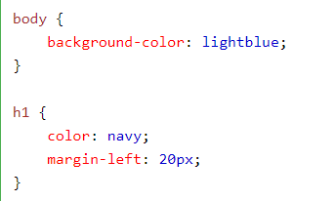
An external style sheet can be written in any text editor. The file should not contain any html tags. The style sheet file must be saved with a .css extension.
Here is how the "mystyle.css" looks

Slide 7
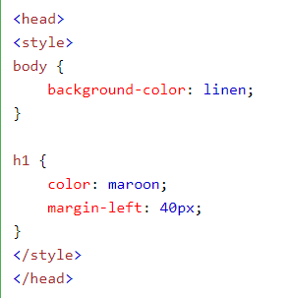
Internal Style Sheet
An internal style sheet may be used if one single page has a unique style.
Internal styles are defined within the <style> element, inside the <head> section of an HTML page:

Slide 8
Inline Styles
An inline style may be used to apply a unique style for a single element.
To use inline styles, add the style attribute to the relevant element. The style attribute can contain any CSS property.
The example below shows how to change the color and the left margin of a <h1> element:

Slide 9
Cascading Order
What style will be used when there is more than one style specified for an HTML element?
Generally speaking we can say that all the styles will "cascade" into a new "virtual" style sheet by the following rules, where number one has the highest priority:
Inline style (inside an HTML element)
External and internal style sheets (in the head section)
Browser default
So, an inline style (inside a specific HTML element) has the highest priority, which means that it will override a style defined inside the <head> tag, or in an external style sheet, or a browser default value.

Slide 10
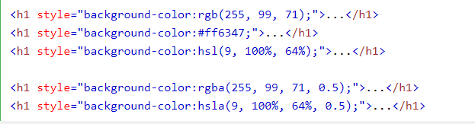
CSS Colors
Colors are specified using predefined color names, or RGB, HEX, RGBA values.

Slide 11
RGB Value
In HTML, a color can be specified as an RGB value, using this formula:
rgb(red, green, blue)
Each parameter (red, green, and blue) defines the intensity of the color between 0 and 255.
For example, rgb(255, 0, 0) is displayed as red, because red is set to its highest value (255) and the others are set to 0.
To display the color black, all color parameters must be set to 0, like this: rgb(0, 0, 0).
To display the color white, all color parameters must be set to 255, like this: rgb(255, 255, 255).

Slide 12
HEX Value
In HTML, a color can be specified using a hexadecimal value in the form:
#rrggbb
Where rr (red), gg (green) and bb (blue) are hexadecimal values between 00 and ff (same as decimal 0-255).
For example, #ff0000 is displayed as red, because red is set to its highest value (ff) and the others are set to the lowest value (00).

Slide 13
RGBA Value
RGBA color values are an extension of RGB color values with an alpha channel - which specifies the opacity for a color.
An RGBA color value is specified with:
rgba(red, green, blue, alpha)
The alpha parameter is a number between 0.0 (fully transparent) and 1.0 (not transparent at all):

Slide 14
CSS Backgrounds
The CSS background properties are used to define the background effects for elements.
CSS background properties:
background-color
background-image
background-repeat
background-attachment
background-position

Slide 15

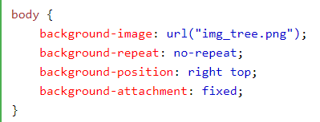

Background - Shorthand property
To shorten the code, it is also possible to specify all the background properties in one single property. This is called a shorthand property.
The shorthand property for background is background:

Slide 16
CSS Borders
The CSS border properties allow you to specify the style, width, and color of an element's border.
he border-style property specifies what kind of border to display.
The following values are allowed:
dotted - Defines a dotted border
dashed - Defines a dashed border
solid - Defines a solid border
double - Defines a double border
groove - Defines a 3D grooved border. The effect depends on the border-color value
ridge - Defines a 3D ridged border. The effect depends on the border-color value
inset - Defines a 3D inset border. The effect depends on the border-color value
outset - Defines a 3D outset border. The effect depends on the border-color value
none - Defines no border
hidden - Defines a hidden border

Slide 17
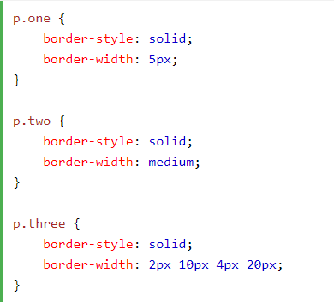
Border Width
The border-width property specifies the width of the four borders.
The width can be set as a specific size (in px, pt, cm, em, etc) or by using one of the three pre-defined values: thin, medium, or thick.
The border-width property can have from one to four values (for the top border, right border, bottom border, and the left border).

Slide 18
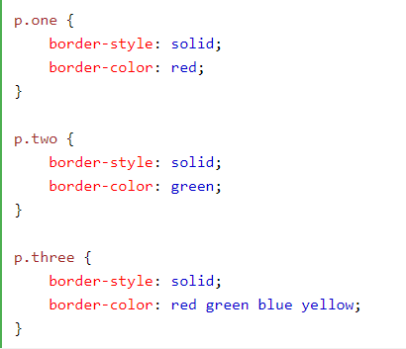
Border Color
The border-color property can have from one to four values (for the top border, right border, bottom border, and the left border).
If border-color is not set, it inherits the color of the element.

Slide 19
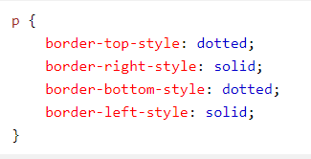

Border - Individual Sides
From the examples above you have seen that it is possible to specify a different border for each side.
In CSS, there are also properties for specifying each of the borders (top, right, bottom, and left):
The example above gives the same result as this:

Slide 20

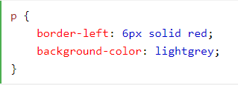
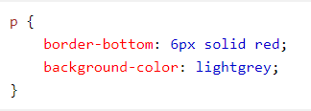
Border - Shorthand Property
You can also specify all the individual border properties for just one side:
Left Border
Bottom Border

Slide 21
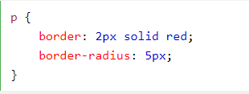
Rounded Borders

Slide 22
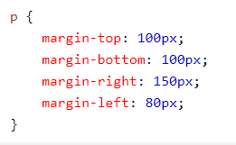
CSS Margins
The CSS margin properties are used to create space around elements, outside of any defined borders.
With CSS, you have full control over the margins. There are properties for setting the margin for each side of an element (top, right, bottom, and left).
margin-top
margin-right
margin-bottom
margin-left
All the margin properties can have the following values:
auto - the browser calculates the margin
length - specifies a margin in px, pt, cm, etc.
% - specifies a margin in % of the width of the containing element
inherit - specifies that the margin should be inherited from the parent element

Slide 23




Margin - Shorthand Property
margin: 25px 50px;top and bottom margins are 25px
right and left margins are 50px
margin: 25px 50px 75px;
top margin is 25px
right and left margins are 50px
bottom margin is 75px
margin: 25px;all four margins are 25p

Slide 24
CSS Padding
The CSS padding properties are used to generate space around an element's content, inside of any defined borders.
With CSS, you have full control over the padding. There are properties for setting the padding for each side of an element (top, right, bottom, and left).
padding-top
padding-right
padding-bottom
padding-left
All the padding properties can have the following values:
length - specifies a padding in px, pt, cm, etc.
% - specifies a padding in % of the width of the containing element
inherit - specifies that the padding should be inherited from the parent element

Slide 25
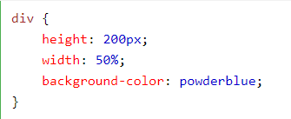
CSS Height and Width
The height and width properties are used to set the height and width of an element.
The height and width can be set to auto (this is default. Means that the browser calculates the height and width), or be specified in length values, like px, cm, etc., or in percent (%) of the containing block.

Slide 26
CSS Box Model
All HTML elements can be considered as boxes. In CSS, the term "box model" is used when talking about design and layout.
The CSS box model is essentially a box that wraps around every HTML element. It consists of: margins, borders, padding, and the actual content. The image below illustrates the box model:
Content - The content of the box, where text and images appear
Padding - Clears an area around the content. The padding is transparent
Border - A border that goes around the padding and content
Margin - Clears an area outside the border. The margin is transparent
              div {
              width: 300px;
              border: 25px solid green;
              padding: 25px;
              margin: 25px;
              }

Slide 27
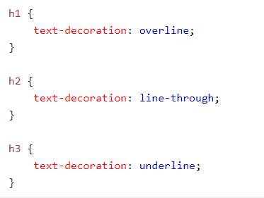
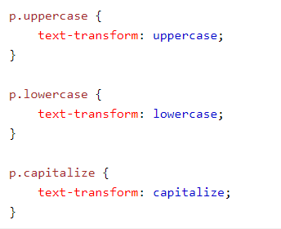
CSS Text
Color:blue
Text-align:center

Slide 28
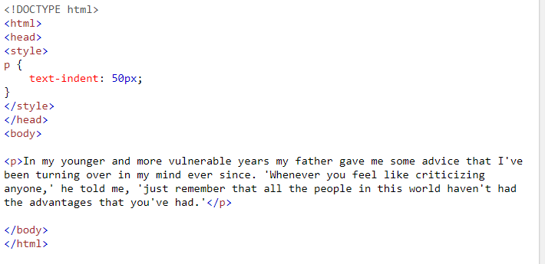
Text Indentation

Slide 29
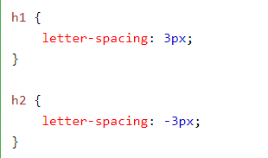
Letter Spacing

Slide 30
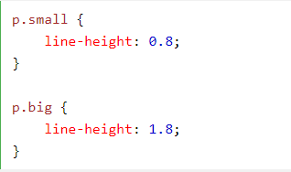

Line Height
Text Direction

Slide 31
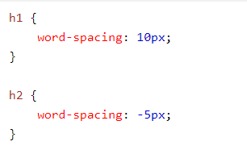

Word Spacing
Text Shadow
text-shadow: h-shadow v-shadow blur-radius color|;
h1 {
text-shadow: 2px 2px 8px #FF0000;
}

Slide 32
TRY these values by yourself with text-shadow property
2px 2px red
5px 5px red
20px 20px red
-10px 10px red
-10px -10px red
5px 5px red
5px 5px 1px red
5px 5px 2px red
5px 5px 3px red
5px 5px 4px red
5px 5px 5px red
5px 5px 10px red
5px 5px 10px blue
5px 5px 10px black
5px 5px 10px #00FF00

Slide 33
CSS Icons
The simplest way to add an icon to your HTML page, is with an icon library, such as Font Awesome.
Add the name of the specified icon class to any inline HTML element (like <i> or <span>).
All the icons in the icon libraries below, are scalable vectors that can be customized with CSS (size, color, shadow, etc.)

Slide 34
To use the Font Awesome icons, add the following line inside the <head> section of your HTML page:
<link rel="stylesheet" href="https://cdnjs.cloudflare.com/ajax/libs/font-awesome/4.7.0/css/font-awesome.min.css">

Slide 35
CSS Links
Links can be styled with any CSS property (e.g. color, font-family, background, etc.).
a:link - a normal, unvisited link
a:visited - a link the user has visited
a:hover - a link when the user mouses over it
a:active - a link the moment it is clicked

Slide 36
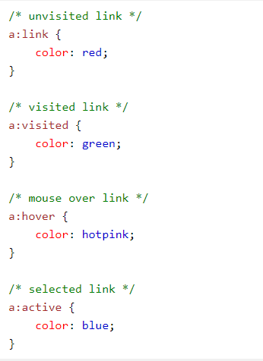
When setting the style for several link states, there are some order rules:
a:hover MUST come after a:link and a:visited
a:active MUST come after a:hover

Slide 37
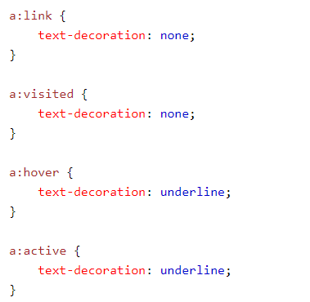
The text-decoration property is mostly used to remove underlines from links:

Slide 38
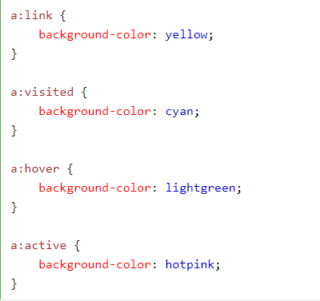
The background-color property can be used to specify a background color for links:

Slide 39
Advanced - Link Buttons
<!DOCTYPE html>
<html>
<head>
<style>
a:link, a:visited {
background-color: #f44336;
color: white;
padding: 14px 25px;
text-align: center;
text-decoration: none;
display: inline-block;
}
a:hover, a:active {
background-color: red;
}
</style>
</head>
<body>
<a href="default.asp" target="_blank">This is a link</a>
</body>
</html>

