Slide 1
Java SCRIPT

Slide 2
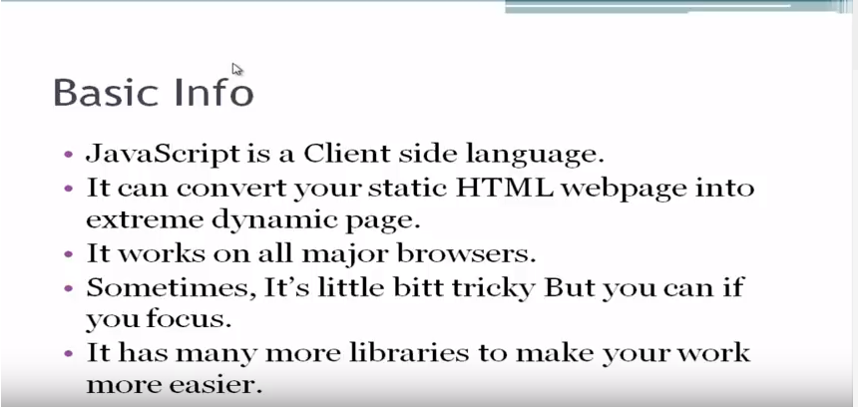

Slide 3
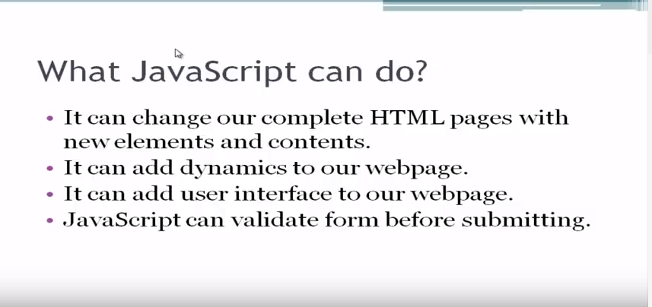

Slide 4
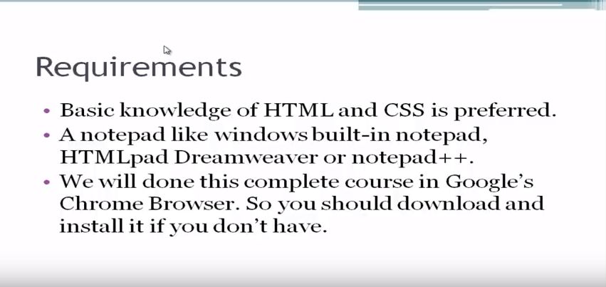

Slide 5
Message
It is case sensitive language.
alert('hello');
Display
document.write('we are learning javascript');

Slide 6
Documentation/Comments
// Coments
/*NS
*/
Display
document.write('we are learning javascript');

Slide 7
External File Support
Make new file
Write java code with ext js
Don’t need to write script tags in js files
<script src = “ path of file ”>

Slide 8
Data types
String ‘shahwaiz’
Integer 6, 7, 9
Variable assign value, simple text
Space not allowed
name = ‘shahwaiz’;
document.write(name);

Slide 9
Data types
V1=3;
V2=4;
document.write(v1+v2);
alert(v1+v2);

Slide 10
Using HTML in java script
document.write(‘<h1>html</h1>in java script’);
document.write(‘style=“background:red”java script’);

Slide 11
Pop up box
Prompt(‘Enter your name’,’name’);
name = Prompt(‘Enter your name’,’name’)
document.write(‘hello<h3>’+name+’</h3>welcome’);

Slide 12
Math Operator
+
-
*
/
%
=
++
--

Slide 13
IF-ELSE
var1 = 3;
var2=4;
if(var1 == 3){
alert(‘Display’);
}
!== -> type
===

Slide 14
Logical op
&&
||
!

Slide 15
Function
function myFunction()
{
document.write(‘this is function’);
}
myFunction();

Slide 16
JavaScript Objects
Real Life Objects, Properties, and Methods
A car has properties like weight and color, and methods like start and stop:
<!DOCTYPE html>
<html>
<body>
<p>Creating a JavaScript Variable.</p>
<p id="demo"></p>
<script>
var car = "Fiat";
document.getElementById("demo").innerHTML = car;
</script>
</body>
</html>

Slide 17
<!DOCTYPE html>
<html>
<body>
<p>Creating a JavaScript Object.</p>
<p id="demo"></p>
<script>
var car = {type:"Fiat", model:"500", color:"white"};
document.getElementById("demo").innerHTML = car.type;
</script>
</body>
</html>

Slide 18
<!DOCTYPE html>
<html>
<body>
<p>Creating a JavaScript Object.</p>
<p id="demo"></p>
<script>
var person = {
firstName : "John",
lastName : "Doe",
age : 50,
eyeColor : "blue"
};
document.getElementById("demo").innerHTML =
person.firstName + " is " + person.age + " years old.";
</script>
</body>
</html>

Slide 19
Accessing Object Properties
p id="demo"></p>
<script>
var person = {
firstName: "John",
lastName : "Doe",
id : 5566
};
document.getElementById("demo").innerHTML =
person.firstName + " " + person.lastName;
</script>
objectName.propertyName
Or
objectName["propertyName"]

Slide 20
Accessing Object Methods
<p id="demo"></p>
<script>
var person = {
firstName: "John",
lastName : "Doe",
id : 5566,
fullName : function() {
return this.firstName + " " + this.lastName;
}
};
document.getElementById("demo").innerHTML = person.fullName();
</script>
objectName.methodName()
or
name = person.fullName();

Slide 21
JavaScript Events
HTML events are "things" that happen to HTML elements.
When JavaScript is used in HTML pages, JavaScript can "react" on these events.
An HTML web page has finished loading
An HTML input field was changed
An HTML button was clicked

Slide 22
Common HTML Events
onclick The user clicks an HTML element
onmouseover The user moves the mouse over an HTML element
onmouseout The user moves the mouse away from an HTML element
onkeydown The user pushes a keyboard key
onload The browser has finished loading the page

Slide 23
Samples
<button onclick="document.getElementById('demo').innerHTML = Date()">The time is?</button>
<button onclick="this.innerHTML = Date()">The time is?</button>
<button onclick="displayDate()">The time is?</button>

Slide 24
String
<script>
var txt = ‘ABCDEFGHIJKLMNOPQRSTUVWXYZ’;
document.getElementById("demo").innerHTML = txt.length;
</script>

Slide 25
Special Characters
The backslash (\) escape character turns special characters into string characters:
\' ' Single quote
\" " Double quote
\\ \ Backslash

Slide 26
Str Method
The indexOf() method returns the index of (the position of) the first occurrence of a specified text in a string:
var str = "Please locate where 'locate' occurs!"; var pos = str.indexOf("locate“, 15);

Slide 27
The lastIndexOf() method returns the index of the last occurrence of a specified text in a string:
Both methods accept a second parameter as the starting position for the search:
var str = "Please locate where 'locate' occurs!"; var pos = str.indexOf("locate“, 15);
The search() method searches a string for a specified value and returns the position of the match:

Slide 28
Extracting String Parts
slice(start, end)
substring(start, end)
Var x =substr(start, length)

Slide 29
Replacing String Content
str = "Please visit Micrsoft!"; var n = str.replace(“microsoft", "W3Schools");
By default, the replace() function is case sensitive. Writing MICROSOFT (with upper-case) will not work:
o replace case insensitive, use a regular expression with an /i flag (insensitive):
str = "Please visit Microsoft!"; var n = str.replace(/MICROSOFT/ig, "W3Schools");

Slide 30
To replace all matches, use a regular expression with a /g flag (global match):
str = "Please visit Microsoft and Microsoft!"; var n = str.replace(/Microsoft/g, "W3Schools");

Slide 31
JavaScript Numbers
JavaScript has only one type of number. Numbers can be written with or without decimals.
If you add two numbers, the result will be a number:
If you add two strings, the result will be a string concatenation:
If you add a number and a string, the result will be a string concatenation:
If you add a string and a number, the result will be a string concatenation:

Slide 32
JavaScript Math Object
The JavaScript Math object allows you to perform mathematical tasks on numbers.
Math.PI; // returns 3.141592653589793
Math.round(4.7); // returns 5 Math.round(4.4); // returns 4
Math.pow(8, 2); // returns 64
Math.sqrt(64); // returns 8
Math.abs(-4.7); // returns 4.7
Math.ceil(4.4); // returns 5
Math.floor(4.7); // returns 4

Slide 33
JavaScript Math Object
Math.min(0, 150, 30, 20, -8, -200); // returns -200
Math.random(); // returns a random number

Slide 34
JavaScript Math Object
Math.E // returns Euler's number Math.PI // returns PI Math.SQRT2 // returns the square root of 2 Math.SQRT1_2 // returns the square root of 1/2 Math.LN2 // returns the natural logarithm of 2 Math.LN10 // returns the natural logarithm of 10 Math.LOG2E // returns base 2 logarithm of E Math.LOG10E // returns base 10 logarithm of E

Slide 35
JavaScript Dates
var d = new Date(); document.getElementById("demo").innerHTML = d;
Years
Months
Days
Hours
Seconds
Milliseconds

Slide 36
JavaScript Get Date Methods
Method Description
getFullYear() Get the year as a four digit number (yyyy)
getMonth() Get the month as a number (0-11)
getDate() Get the day as a number (1-31)
getHours() Get the hour (0-23)
getMinutes() Get the minute (0-59)
getSeconds() Get the second (0-59)
getMilliseconds() Get the millisecond (0-999)
getTime() Get the time (milliseconds since January 1, 1970)
getDay() Get the weekday as a number (0-6)

Slide 37
JavaScript Set Date Methods
Method Description
setDate() Set the day as a number (1-31)
setFullYear() Set the year (optionally month and day)
setHours() Set the hour (0-23)
setMilliseconds() Set the milliseconds (0-999)
setMinutes() Set the minutes (0-59)
setMonth() Set the month (0-11)
setSeconds() Set the seconds (0-59)
setTime() Set the time (milliseconds since January 1, 1970)

Slide 38
<script> var d = new Date(); d.setFullYear(2024); document.getElementById("demo").innerHTML = d; </script>

Slide 39
JavaScript Arrays
JavaScript arrays are used to store multiple values in a single variable.
var cars = ["Saab", "Volvo", "BMW"];
var cars = new Array("Saab", "Volvo", "BMW");
cars[0] = "Opel";
var cars = ["Saab", "Volvo", "BMW"]; document.getElementById("demo").innerHTML = cars[0];

Slide 40
Access the Full Array
var cars = ["Saab", "Volvo", "BMW"]; document.getElementById("demo").innerHTML = cars;

Slide 41
Reversing an Array
var fruits = ["Banana", "Orange", "Apple", "Mango"]; fruits.sort(); // Sorts the elements of fruits fruits.reverse(); // Reverses the order of the elements

Slide 42
Try it yourself (string)
charAt() | Returns the character at the specified index (position)
charCodeAt() | Returns the Unicode of the character at the specified index
concat() | Joins two or more strings, and returns a new joined strings
endsWith() | Checks whether a string ends with specified string/characters
fromCharCode() | Converts Unicode values to characters

Slide 43
includes() | Checks whether a string contains the specified string/characters
indexOf() | Returns the position of the first found occurrence of a specified value in a string
lastIndexOf() | Returns the position of the last found occurrence of a specified value in a string
localeCompare() | Compares two strings in the current locale
match() | Searches a string for a match against a regular expression, and returns the matches
repeat() | Returns a new string with a specified number of copies of an existing string
replace() | Searches a string for a specified value, or a regular expression, and returns a new string where the specified values are replaced
search() | Searches a string for a specified value, or regular expression, and returns the position of the match
slice() | Extracts a part of a string and returns a new string
split() | Splits a string into an array of substrings
startsWith() | Checks whether a string begins with specified characters
substr() | Extracts the characters from a string, beginning at a specified start position, and through the specified number of character

Slide 44
substring() | Extracts the characters from a string, between two specified indices
toLocaleLowerCase() | Converts a string to lowercase letters, according to the host's locale
toLocaleUpperCase() | Converts a string to uppercase letters, according to the host's locale
toLowerCase() | Converts a string to lowercase letters
toString() | Returns the value of a String object
toUpperCase() | Converts a string to uppercase letters
trim() | Removes whitespace from both ends of a string
valueOf() | Returns the primitive value of a String object

Slide 45
Math
abs(x) | Returns the absolute value of x
acos(x) | Returns the arccosine of x, in radians
acosh(x) | Returns the hyperbolic arccosine of x
asin(x) | Returns the arcsine of x, in radians
asinh(x) | Returns the hyperbolic arcsine of x
atan(x) | Returns the arctangent of x as a numeric value between -PI/2 and PI/2 radians
atan2(y, x) | Returns the arctangent of the quotient of its arguments
atanh(x) | Returns the hyperbolic arctangent of x
cbrt(x) | Returns the cubic root of x
ceil(x) | Returns x, rounded upwards to the nearest integer
cos(x) | Returns the cosine of x (x is in radians)
cosh(x) | Returns the hyperbolic cosine of x

Slide 46
exp(x) | Returns the value of E^{x}
floor(x) | Returns x, rounded downwards to the nearest integer
log(x) | Returns the natural logarithm (base E) of x
max(x, y, z, ..., n) | Returns the number with the highest value
min(x, y, z, ..., n) | Returns the number with the lowest value
pow(x, y) | Returns the value of x to the power of y
random() | Returns a random number between 0 and 1
round(x) | Rounds x to the nearest integer
sin(x) | Returns the sine of x (x is in radians)
sinh(x) | Returns the hyperbolic sine of x
sqrt(x) | Returns the square root of x
tan(x) | Returns the tangent of an angle
tanh(x) | Returns the hyperbolic tangent of a number
trunc(x) | Returns the integer part of a number (x)

Slide 47
Array Methods
concat() | Joins two or more arrays, and returns a copy of the joined arrays
copyWithin() | Copies array elements within the array, to and from specified positions
entries() | Returns a key/value pair Array Iteration Object
every() | Checks if every element in an array pass a test
fill() | Fill the elements in an array with a static value
filter() | Creates a new array with every element in an array that pass a test
find() | Returns the value of the first element in an array that pass a test
findIndex() | Returns the index of the first element in an array that pass a test
forEach() | Calls a function for each array element
from() | Creates an array from an object
includes() | Check if an array contains the specified element
indexOf() | Search the array for an element and returns its position

Slide 48
join() | Joins all elements of an array into a string
keys() | Returns a Array Iteration Object, containing the keys of the original array
lastIndexOf() | Search the array for an element, starting at the end, and returns its position
map() | Creates a new array with the result of calling a function for each array element
pop() | Removes the last element of an array, and returns that element
push() | Adds new elements to the end of an array, and returns the new length
reduce() | Reduce the values of an array to a single value (going left-to-right)
reduceRight() | Reduce the values of an array to a single value (going right-to-left)
reverse() | Reverses the order of the elements in an array
shift() | Removes the first element of an array, and returns that element
slice() | Selects a part of an array, and returns the new array
some() | Checks if any of the elements in an array pass a test
sort() | Sorts the elements of an array
splice() | Adds/Removes elements from an array
toString() | Converts an array to a string, and returns the result
unshift() | Adds new elements to the beginning of an array, and returns the new length

Slide 49
Exercise and solution 1. Write a javascript program to display the current day and time in the following format. Sample output : today is : tuesday. Current time is : 10 PM : 30 : 38
Solution:
<!DOCTYPE html>
<html>
<head>
<meta charset="utf-8">
<title>JavaScript current day and time</title>
</head>
<body></body>
</html>

Slide 50
var today = new Date();
var day = today.getDay();
var daylist = ["Sunday","Monday","Tuesday","Wednesday ","Thursday","Friday","Saturday"];
document.write("Today is : " + daylist[day] + ".");
var hour = today.getHours();
var minute = today.getMinutes();
var second = today.getSeconds();
var prepand = (hour >= 12)? " PM ":" AM ";
hour = (hour >= 12)? hour - 12: hour;
if (hour===0 && prepand===' PM ')
{
if (minute===0 && second===0)
{
hour=12;
prepand=' Noon';
}
else
{
hour=12;
prepand=' PM';
}
}
if (hour===0 && prepand===' AM ')
{
if (minute===0 && second===0)
{
hour=12;
prepand=' Midnight';
}
else
{
hour=12;
prepand=' AM';
}
}
Document.write("Current Time : "+hour + prepand + " : " + minute + " : " + second);

Slide 51
2. Write a JavaScript program to print the contents of the current window
function print_current_page()
{
window.print();
}

Slide 52
2. Write a JavaScript program to print the contents of the current window
function print_current_page()
{
window.print();
}
3. Write a JavaScript program to get the website URL (loading page)
Document.write(document.URL);

Slide 53
PRACTICE QUESTIONS
Write a JavaScript program to compare two objects to determine if the first one contains equivalent property values to the second one
Write a JavaScript function to get the number of occurrences of each letter in specified string.
Write a JavaScript program to find duplicate values in a JavaScript array.
Write a JavaScript program to set the background color of a paragraph

