Slide 1

BATCH - 16
DEPARTMENT OF ARTIFICIAL INTELLIGENCE
20AM6203 - DESIGN PROJECT - II
TEAM MEMBERS:
KARTHICK DHARSHAN S -811722001021
MELVIN JEFFERSON M -811722001030
MUKESH KANNAN A -811722001035
GUIDED BY:
Mrs. Joany Franklin
Assistant Professor,AI

Slide 2
AI-POWERED WASTE REUSE RECOMMENDATION SYSTEM

Slide 3
OBJECTIVE
To develop a Generative AI model that suggests creative reuse ideas for waste materials based on either image. The system leverages image recognition, natural language processing (NLP), and Generative AI to provide sustainable and innovative recycling solutions, promoting eco-friendly practices and waste reduction.

Slide 4
EXISTING SYSTEM
Traditional waste management systems rely heavily on manual segregation, lack user engagement, and often focus on recycling rather than reuse. Most recycling guidance is generic and inaccessible to the common public.
Demerits:
No Image-Based Input Support
Time-Consuming for Users
Manual Segregation

Slide 5
PROPOSED SYSTEM
The proposed system leverages artificial intelligence to bridge this gap. It accepts image inputs of waste materials and uses MobileNetV2 for real-time classification of the waste item. Once the item is identified, it passes the classification to a powerful language model (Together AI’s Mixtral-8x7B) to generate personalized reuse instructions.
The output is presented via a Gradio web interface, making the application intuitive and accessible. This system not only simplifies identification but also empowers users with creative, eco-friendly solutions tailored to the detected item.

Slide 6
LITERATURE SURVEY
S.NO | Paper Title | Author(s) | Publication/ Year | Techniques | Pros | Cons
1 | Generative AI for Sustainable Design | Alice Lee, Mark Johnson | 2024 | Generative AI, NLP-based Idea Generation | Creativity, Sustainability, Personalization | Feasibility, Model Updates
2 | Intelligent waste classification | M. Chhabra, B. Sharan, M. Elbarachi, et al. | 2024 | Improved multi-layered CNN for waste classification | Enhanced accuracy; scalable approach | May need extensive training data
3 | AI-Based Image Recognition for Waste Classification | John Doe, Jane Smith | 2023 | Image Processing, Deep Learning | Accuracy, Automation, Efficiency | Data Dependency, Misclassification
4 | Artificial intelligence for waste management in smart cities | Bingbing Fang | 2023 | AI-based waste classification, Generative AI for reuse ideas | Optimization, Efficiency, Sustainability | Complexity, Implementation Challenges
5 | Generative AI for Eco-Friendly Suggestions | A. Mehta, K. Iyer | 2023 | LLMs for text generation | Generates diverse reuse ideas | May hallucinate or give generic responses

Slide 7
DATAFLOW DIAGRAM
Gradio Web Interface
Image Processing
Image Classification
Together AI API(Mixtral-8x7B)
Step-By-Step RStep-By-Step Reuse Instruction Generator Instruction Generator

Slide 8
SYSTEM & SOFTWARE SPECIFICATIONS
Hardware Requirements
Processor: Intel Core i5/i7 or AMD Ryzen 5/7
RAM: 8 GB minimum (16 GB recommended)
Storage: 10 GB SSD (minimum)
GPU (optional): NVIDIA GPU with CUDA support (e.g., GTX 1650 or higher)
Deployment Platform: Cloud (e.g., Hugging Face Spaces )
Network: Stable internet connection for API and UI access

Slide 9
Software Requirements
Operating System: Windows 10/11, Ubuntu 20.04+, or macOS
Programming Language: Python 3.8 or higher
Libraries/Frameworks:
PyTorch
OpenCV, PIL (Pillow)
NumPy
Requests
Gradio
APIs Used: Together AI (Mixtral-8x7B model)
Deployment Tool: Gradio on Hugging Face

Slide 10
MODULES
Image Upload and Preprocessing
Waste Item Classification
Reuse Idea Generation
Gradio-based User Interface

Slide 11
MODULE 1:IMAGE UPLOAD AND PREPROCESSING
This module allows users to upload images of waste items for classification and reuse recommendation.
Key Features:
Easy Image Upload: Users can upload images via a simple web interface.
Preprocessing: The image is resized and normalized to prepare it for classification.

Slide 12
Working Mechanism:
The image is checked for compatibility (file size, format) and then resized to fit the MobileNetV2 input size (224x224 pixels).
This step ensures the image is suitable for further analysis.
Gradio Image Upload Interface
Provides a user-friendly interface for uploading waste item images through drag-and-drop or file selection.
Pillow (PIL) Library
Used to open and convert uploaded images into RGB format for uniformity.
Handles image file formats like JPG, PNG, and BMP

Slide 13
MODULE 2:WASTE ITEM CLASSIFICATION
This module uses MobileNetV2 to classify the waste item in the uploaded image.
Key Features:
Pre-trained Model: MobileNetV2 is fine-tuned with a dataset of waste items.
Real-Time Classification: The model classifies the waste item as soon as the image is uploaded.

Slide 14
Working Mechanism:
The model processes the image and identifies the type of waste, such as plastic, paper, or metal.
The classification result is used to generate the corresponding reuse instructions.
MobileNetV2:
The preprocessed image is passed into the MobileNetV2 model.
The model processes the image through its convolutional layers to extract features.
It predicts the waste category (e.g., plastic, glass, paper) using a softmax layer.
This predicted label is then forwarded to the next module for reuse idea generation.

Slide 15
MODULE 3:REUSE IDEA GENERATION
This module generates detailed reuse or recycling instructions using Together AI’s Mixtral-8x7B model.
Key Features:
Natural Language Generation: Mixtral-8x7B creates step-by-step instructions for recycling or repurposing the waste.
Eco-friendly Suggestions: The system promotes sustainable actions with actionable reuse ideas.

Slide 16
Working Mechanism:
The classification result triggers a query to the model, which generates detailed reuse instructions.
Users receive instructions specific to the type of waste item.
Mixtral-8x7B:
The waste label (e.g., “plastic bottle”) is used to form a text prompt.
The prompt is sent to Mixtral-8x7B via Together AI’s API.
The model generates step-by-step reuse or recycling instructions based on the waste type.
The generated response is returned as text to display on the UI.

Slide 17
MODULE 4:GRADIO-BASED USER INTERFACE
The Gradio UI enables users to interact with the system in an easy-to-use web interface.
Key Features:
Interactive Interface: Users can upload images, view classification results, and get reuse suggestions.
Real-Time Feedback: The UI displays the classified waste type and reuse instructions immediately.

Slide 18
Working Mechanism:
The backend integrates with Gradio to update the UI in real-time, displaying the image, classification, and reuse instructions.
The design is intuitive, supporting both desktop and mobile users.
Gradio-based User Interface:
Gradio connects all the modules in one interactive interface.
It sends the uploaded image to the backend (for classification and reuse suggestion).
Allows real-time interaction and smooth user experience without extra code for the frontend.

Slide 19
ADVANTAGES
Promotes environmental awareness and sustainability
Reduces dependency on search engines for reuse ideas
Fast, intelligent, and creative reuse suggestions
Easy-to-use interface for all age groups
Lightweight system deployable on low-resource machines

Slide 20
APPLICATIONS
Educational platforms promoting environmental science
Smart waste management mobile or web applications
Community-driven recycling programs
Eco-friendly DIY platforms
Household upcycling projects

Slide 21
CONCLUSION
This project shows how AI can support sustainability by turning waste into useful resources. It uses image classification and language generation to identify waste items and suggest smart, eco-friendly reuse ideas. With an easy-to-use interface and real-time results, the system promotes responsible recycling and helps reduce environmental impact.

Slide 22
REFERENCES
Wang, S., & Huang, L. (2021). Deep Learning for Waste Classification.
Patel, M., & Singh, K. (2022). Generative AI in Eco-Innovation.
Morris, R. J. et al. (2020). Image Classification in Smart Waste Systems.
Zhao, T., & Lin, Y. (2023). Language Models for Instruction Generation.

Slide 23
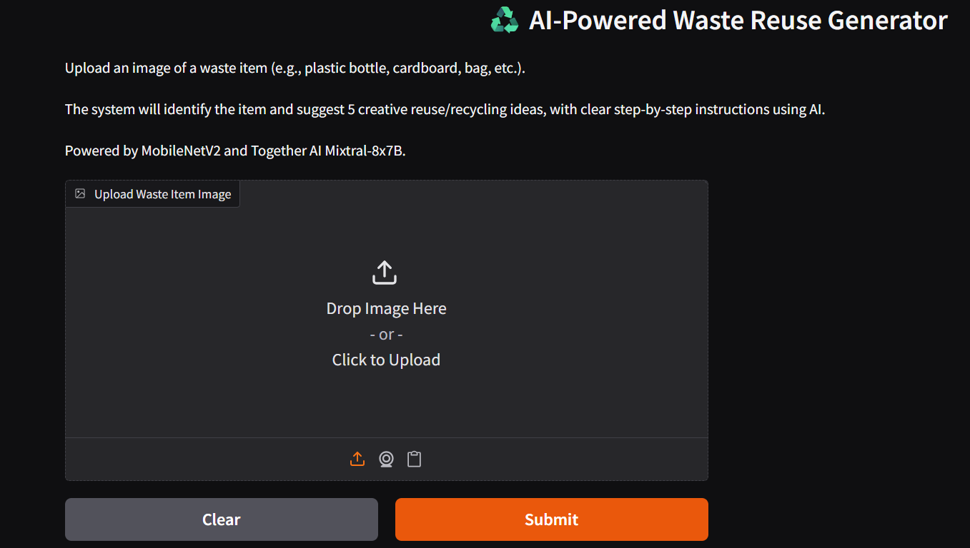
SCREENSHOTS

Slide 24
