Slide 1
TEAM-4
Smart Inventory AI
Revenue Recovery & Inventory Intelligence
An AI-powered decision support platform that predicts expiry risks, optimizes inventory, and maximizes revenue recovery — transforming reactive inventory management into proactive intelligence.
AI
DATA ANALYTICS
BUSINESS INTELLIGENCE
PYTHON · SQL · POWER BI · ML · STREAMLIT
Notes:
1

Slide 2
THE PROBLEM
Why Businesses Lose Revenue
Most inventory systems track stock and expiry dates but lack predictive intelligence to prevent losses before they occur.
Product Expiry
Overstocking & Understocking
Goods expire before they can be sold or discounted.
Poor demand forecasting leads to imbalanced inventory levels.
Delayed Discounts
No Intelligent Recommendations
Manual decisions miss the optimal window for revenue recovery.
Existing systems report problems but never prescribe solutions.
Notes:
2

Slide 3




OUR SOLUTION
Smart Inventory AI — Predict, Recover, Optimize
Instead of reacting to losses, businesses can prevent them. Smart Inventory AI is an AI-powered platform that predicts expiry risks, forecasts demand, recovers revenue, and recommends proactive actions.
Expiry Prediction
Demand Forecasting
Identifies products likely to expire before they can be sold.
AI-driven forecasts to optimize purchasing and production.
Revenue Recovery
Real-Time Dashboards
Estimates revenue at risk and suggests smart dynamic discounts.
Live business intelligence for data-driven decisions.
Notes:
3

Slide 4
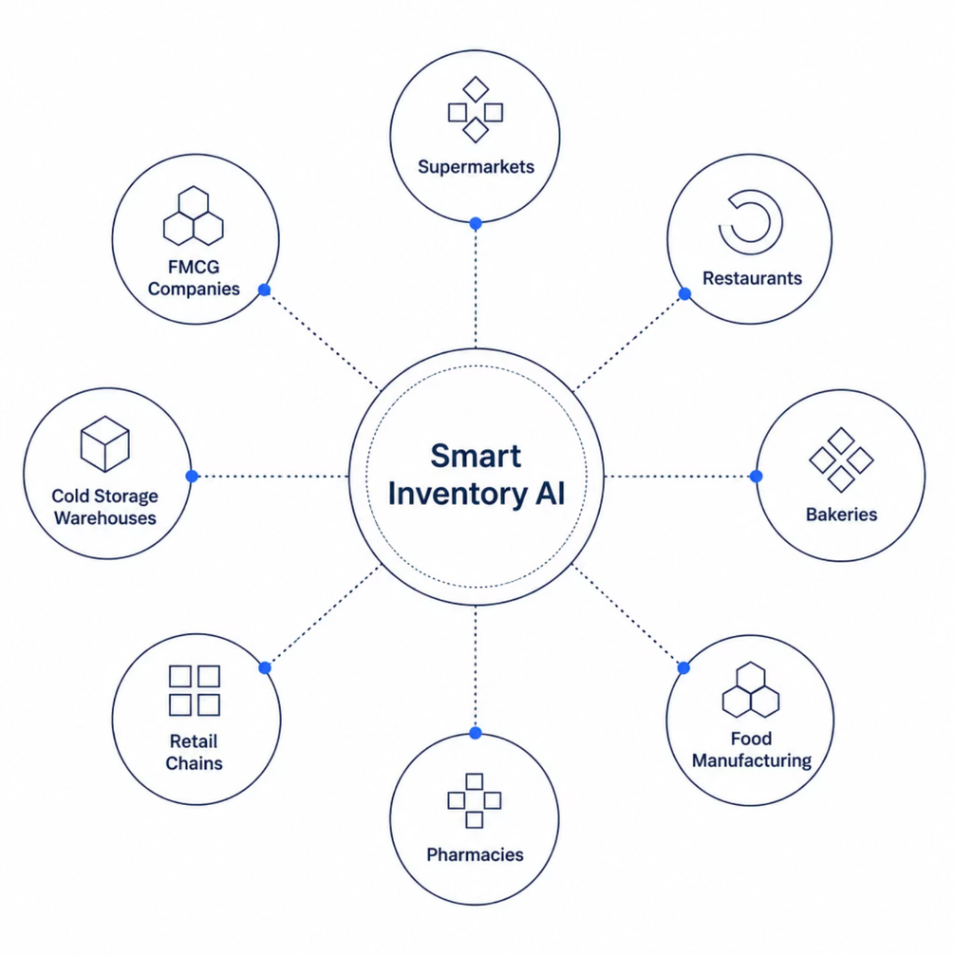
TARGET MARKET
Who We Serve
Smart Inventory AI is designed for any industry where product expiry, demand variability, and inventory waste directly impact profitability.
Food Manufacturing & FMCG
Pharmacies & Cold Storage
Notes:
4

Slide 5

TECHNOLOGY
Technology Stack
A modern, end-to-end stack built for scalability and real-time intelligence.
Layer
Technology
Data Collection
Excel
Database
MySQL / SQL Server
Backend
Python
Data Processing
Pandas, NumPy
Machine Learning
Scikit-learn, XGBoost
Dashboard
Power BI
Web Application
Streamlit
Version Control
Git & GitHub
Notes:
5

Slide 6

ARCHITECTURE
System Architecture & Workflow
The system follows a structured pipeline: data is collected via Excel, stored in SQL databases, processed with Python (Pandas, NumPy), analyzed using ML models (Scikit-learn, XGBoost), and visualized through Power BI dashboards and a Streamlit web application.
Ingest
ML Process
Predict
Dashboard
Input data includes inventory records, expiry dates, and sales history. The system outputs expiry risk scores, demand forecasts, revenue-at-risk estimates, smart discount recommendations, and stock transfer suggestions.
Notes:
6

Slide 7
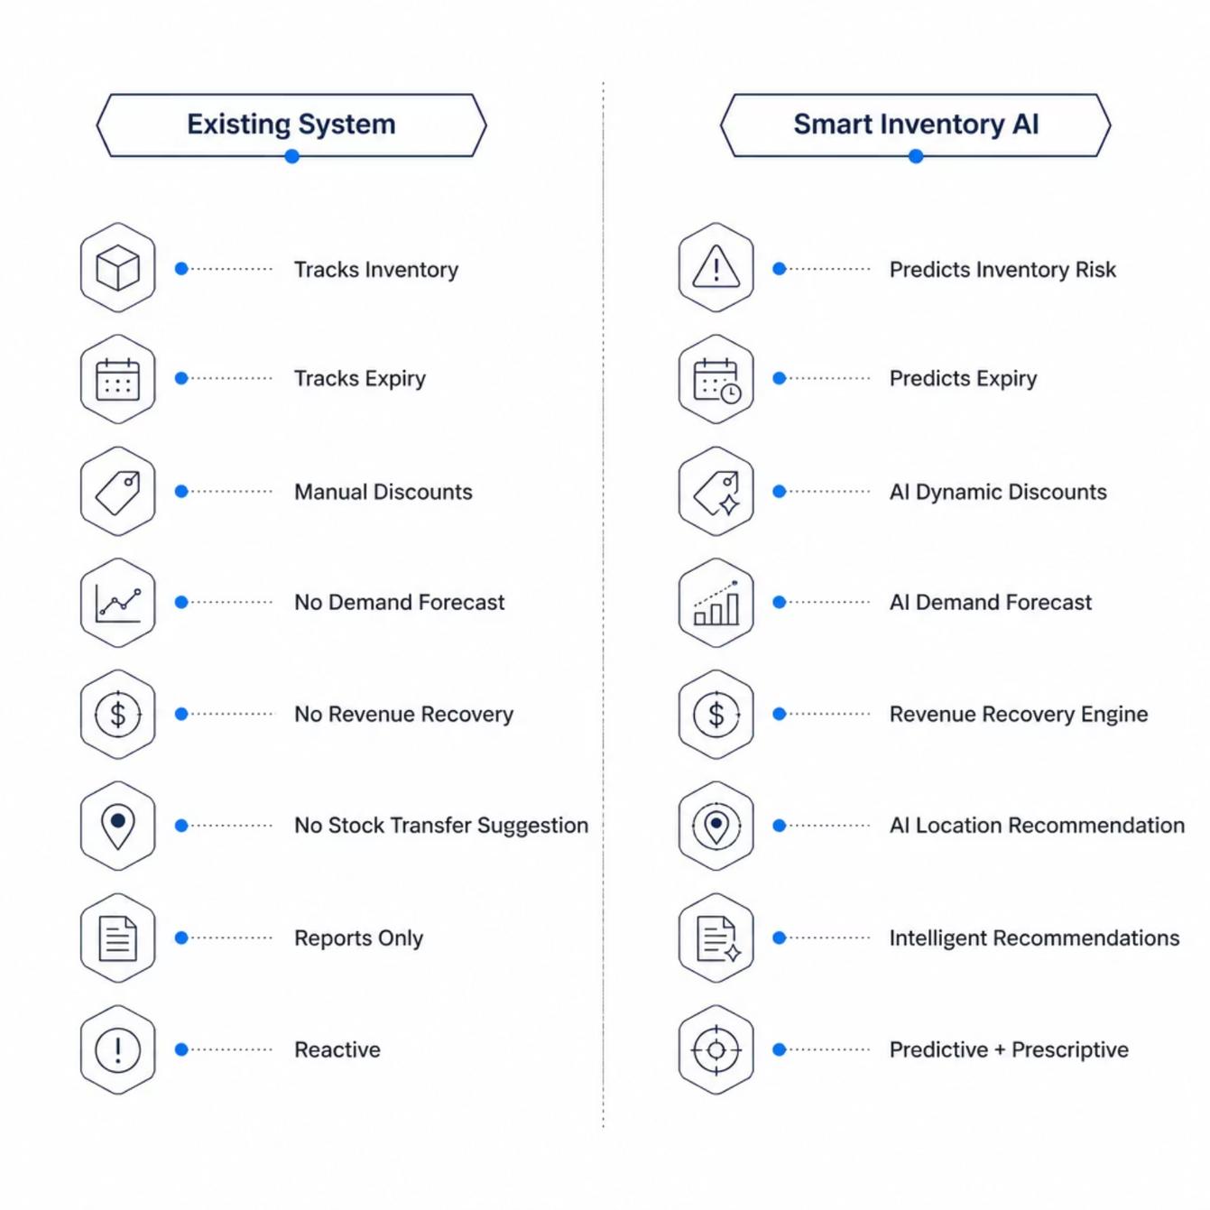
COMPARISON
Existing System vs. Smart Inventory AI
Traditional systems are reactive — they report what already happened. Smart Inventory AI is predictive and prescriptive — it tells businesses what will happen and what to do about it.
Notes:
7

Slide 8





MACHINE LEARNING
ML Models Powering the Platform
Expiry Prediction
Random Forest — Predicts which products are at risk of expiring unsold.
Demand Forecast
XGBoost — Accurate future demand prediction for smarter stocking.
Revenue Prediction
Linear Regression — Estimates potential revenue loss and recovery.
Product Segmentation
K-Means — Groups products by risk and behavior for targeted actions.
Recommendations
Rule-Based + ML — Generates smart discounts and stock transfer suggestions.
Notes:
8

Slide 9
DASHBOARD & BENEFITS
Power BI Dashboard & Expected Impact
Dashboard KPIs
Expected Business Benefits
Total Inventory & Revenue
Potential Loss & Revenue Recovery
Inventory Health & High-Risk Products
Branch Performance & Waste Analysis
40% Reduction
Higher Turnover
In expiry-related losses
Improved inventory utilization
Visual Charts
Less Waste
Sales & Expiry Trends
Demand Forecast & Heatmap
Revenue Recovery Tracking
Reduced food waste & better planning
Notes:
9

Slide 10
ROADMAP & CONCLUSION
Future Scope & Vision
Future Enhancements
Conclusion
01
Smart Inventory AI transforms traditional inventory management into an intelligent decision-making platform — predicting risks, minimizing expiry, recovering revenue, and enhancing profitability.
IoT Smart Shelf Monitoring
02
Thank You!
WhatsApp Alert System
03
"Predict Early. Recover Revenue. Maximize Profit."
GenAI Business Assistant
04
Questions and Answers???
Mobile App & Cloud Deployment
05
Blockchain Supply Chain Tracking
Notes:
10

