Slide 1


Department of
Computer Science & Engineering
Voice Agent Studio: A Local, Privacy-First, Quantum-Optimized AI Voice Assistant
Domain: Agentic AI
Amrita School of Computing
Amrita Vishwa Vidyapeetham, Chennai Campus
Student Members [BATCH ID: 72]
1: Mukesh Charan M– CH.SC.U4AIE23032
2: Sanjjey A – CH.SC.U4AIE23050
Guide Details
Dr. Sountharrajan S.
Associate professor,
Dept of CSE

Slide 2

Abstract
Abstract
Introduction
Literature Survey
Problem Statement
Research Gap
Architecture Diagram
Gantt Chart
References
We propose a browser-native, ultra-low-latency Voice Agent Studio for building real-time conversational AI without costly telephony or proprietary speech APIs.
Employ edge-based acoustic processing with adaptive VAD, noise-floor tracking, and seamless barge-in handling for natural conversations.
Leverage quantum-classical optimization using Qiskit QAOA/QUBO, combined with local RAG and intelligent tool orchestration for efficient intent routing and automated workflows.
Utilize asynchronous streaming and TTS prefetching to deliver low-latency, uninterrupted conversational responses.
Package each custom voice agent as a Docker image, enabling on-premises deployment while keeping sensitive client data within their own infrastructure through secure, isolated environments.

Slide 3
Introduction
Abstract
Introduction
Literature Survey
Problem Statement
Research Gap
Architecture Diagram
Gantt Chart
References
Recent advances in Large Language Models (LLMs) have enabled real-time voice-driven autonomous agents, but conventional systems still face high latency, recurring telephony costs, and dependence on centralized cloud services. This project introduces Voice Agent Studio, a modular platform that combines browser-side speech processing with asynchronous backend orchestration for responsive voice interactions. It integrates adaptive VAD, local BM25-based RAG, hybrid quantum-classical routing, and automated tool execution to streamline conversations. Each voice agent can be packaged as a Docker image and deployed on-premises, allowing organizations to keep sensitive data within their infrastructure while reducing dependence on external cloud services.

Slide 4
Literature Survey
Abstract
Introduction
Literature Survey
Problem Statement
Research Gap
Architecture Diagram
Gantt Chart
References
S.No | Authors & Year | Title | Journal Name | Methods Used | Key Findings | Research Gap Identified
1 | Bhatia & Khetarpaul (2025) | AI-enhanced bilingual banking assistant | Scientific Reports | Bilingual banking assistant with language detection and code-switching | 87% overall success; 93% language detection; 80% code-switching | Needs real-time ASR/TTS, more Indian languages, RAG, secure tools, larger testing
2 | Chowa et al. (2026) | LLM agents security duality: a comprehensive survey of self-evolving agents | Artificial Intelligence Review | Survey of LLM-agent capabilities, risks and security | Voice/multimodal agents introduce fraud, privacy and unauthorized-action risks | Needs practical security for authentication, consent, prompt injection and tool use
3 | Furtado et al. (2025) | Assessing the User Experience of an LLM-Based Conversational Agent for Older Adults | Journal of Healthcare Informatics Research | LLM conversational agent evaluated with older adults | Usability, clarity and accessibility strongly affect adoption | Needs larger, longitudinal and voice-first evaluations
4 | Ray, Dhandhania, Barres & Narasimhan (2026) | τ-Voice: Benchmarking Full-Duplex Voice Agents on Real-World Domains | ICML | Full-duplex simulator with noise, accents, telephony and turn-taking | Voice agents retained only 30–45% of text capability. | Needs non-English, human, accessibility and tool-latency evaluation.
5 | Abbasian, Azimi, Rahmani & Jain (2025) | Conversational health agents: a personalized large language model-powered agent framework | JAMIA Open | OpenCHA multilingual/multimodal LLM-agent framework | Supports personalization and integrations; strong domain-specific results | Needs voice-first evaluation, low latency, interruption handling and Indian languages

Slide 5
Literature Survey
Abstract
Introduction
Literature Survey
Problem Statement
Research Gap
Architecture Diagram
Gantt Chart
References
S.No | Authors & Year | Title | Journal Name | Methods Used | Key Findings | Research Gap Identified
6 | Adams, Acosta & Rajpurkar (2025) | How generative AI voice agents will transform medicine | npj Digital Medicine | Review of generative voice agents in healthcare | Real-time voice agents can improve access and engagement | Limited evidence on safety, privacy, bias, outcomes and real-world deployment
7 | Lima et al. (2025) | Cultural Feasibility of Conversational Robots for Dementia Care: A Mixed Methods Study | Journal of Participatory Medicine | Mixed-method study of conversational robots for dementia care | Engagement depends on practical and cultural factors | Needs long-term, personalized, multilingual and reliable voice-agent studies
8 | Yu et al. (2025) | SALMONN-omni: A Standalone Speech LLM without Codec Injection for Full-duplex Conversation | NeurIPS | Unified streaming speech encoder, LLM and synthesizer | Improved accuracy by 35.9% with strong barge-in and echo cancellation. | Codec/multi-module approaches still face complexity and error propagation.
9 | Lu et al. (2025) | DuplexMamba: Enhancing Real-time Speech Conversations with Duplex and Streaming Capabilities | NLPCC | Mamba-based speech encoder, LLM and duplex decoding | Matched recent Transformer models while supporting streaming duplex dialogue. | Transformer-heavy systems remain costly for long conversations.

Slide 6
Literature Survey
Abstract
Introduction
Literature Survey
Problem Statement
Research Gap
Architecture Diagram
Gantt Chart
References
S.No | Authors & Year | Title | Journal Name | Methods Used | Key Findings | Research Gap Identified
10 | Casanova et al. (2025) | Open Full-duplex Voice Agent with Speech-to-Speech Language Model | IEEE ASRU | Data-efficient speech-to-speech conversion with optimized open-source inference | Enables low-latency voice agents without extensive speech-text pretraining. | Accessible open-source full-duplex pipelines remain limited.
11 | Keshireddy (2025) | Retrieval-Augmented Generation Techniques in Oracle APEX Improving Contextual Responses in AI Assistants | Archives for Technical Sciences | FAISS dense retrieval + BM25 hybrid RAG | Improved BLEU, ROUGE-L and user satisfaction while reducing token overhead. | Needs scalable and accurate enterprise grounding.
12 | Acikgoz et al. (2025) | Can a Single Model Master Both Multi-turn Conversations and Tool Use? CoALM: A Unified Conversational Agentic Language Model | ACL | Multi-task training for dialogue reasoning and API use | CoALM outperformed strong domain-specific models across benchmarks. | Existing systems struggle with new APIs and long-term user intent.
13 | Samal, Swain & Sahoo (2026) | Srota AI: A Voice-Controlled Intelligent Web Automation Platform Using Large Language Models and Multi-Agent Orchestration | International Journal of Economic Social Science and Management LAW | LangGraph agents, Deepgram, semantic DOM, FastAPI, React | Reduced task time and errors in enterprise workflows. | Rule-based automation remains brittle and inaccessible.

Slide 7
Literature Survey
Abstract
Introduction
Literature Survey
Problem Statement
Research Gap
Architecture Diagram
Gantt Chart
References
S.No | Authors & Year | Title | Journal Name | Methods Used | Key Findings | Research Gap Identified
14 | Zhang et al. (2025) | Artificial intelligence voice gender, gender role congruity, and trust in automated vehicles | Scientific Reports | Study of voice gender similarity and trust | Voice characteristics can influence cognitive and affective trust | Needs research on accent, emotion, age and personalization
15 | Mahajan et al. (2025) | Transforming healthcare delivery with conversational AI platforms | npj Digital Medicine | Review of conversational AI and voice-agent deployment in healthcare | Trust, governance, validation and interoperability are critical | Needs standardized frameworks, benchmarks and safety models
16 | Loughnane et al. (2025) | Systematic review exploring human, AI, and hybrid health coaching interventions for psychological well-being | Frontiers in Digital Health | Systematic review of human, AI and hybrid health coaching | AI and hybrid coaching can support psychological well-being | Needs standardized metrics, longer studies and voice/text comparisons
17 | Hong & Park (2025) | Developing user-centered system design guidelines for explainable AI: a systematic literature review | Artificial Intelligence Review | Systematic review of user-centered explainable-AI design | Explanations should match user needs and interaction context | Needs real-time voice-agent evaluation without disrupting conversation

Slide 8
Literature Survey
Abstract
Introduction
Literature Survey
Problem Statement
Research Gap
Architecture Diagram
Gantt Chart
References
S.No | Authors & Year | Title | Journal Name | Methods Used | Key Findings | Research Gap Identified
18 | Wang et al. (2024) | Double Decoder: Improving Latency for Streaming End-to-end ASR Models | ICNLSP | Double-decoder streaming ASR | Reduced latency without WER degradation. | Latency, stability and computational cost remain trade-offs.
19 | Vaswani et al. (2017) | Attention Is All You Need | Advances in Neural Information Processing Systems (NeurIPS) | Self-attention, multi-head attention, positional encoding, encoder-decoder Transformer | Introduced the Transformer, achieving strong translation performance with greater parallelization and reduced training time. | Quadratic attention cost limits scalability for long sequences; motivates efficient SSM and quantum-attention alternatives.
20 | Zardini, E., Blanzieri, E., & Pastorello, D. (2024) | A quantum k-nearest neighbors algorithm based on the Euclidean distance estimation | Quantum Machine Intelligence | Quantum distance estimation, quantum k-NN | Demonstrates quantum nearest-neighbor classification using distance estimation. | No large-scale vector retrieval or real-time RAG evaluation.
21 | Jäger, J., & Krems, R. V. (2023) | Universal expressiveness of variational quantum classifiers and quantum kernels for support vector machines | Nature Communications | Variational quantum classifiers, quantum kernels | Demonstrates strong expressive power of quantum kernels and VQCs. | No application to semantic vector retrieval or RAG.

Slide 9
Literature Survey
Abstract
Introduction
Literature Survey
Problem Statement
Research Gap
Architecture Diagram
Gantt Chart
References
S.No | Authors & Year | Title | Journal Name | Methods Used | Key Findings | Research Gap Identified
22 | S. Shi et al., 2026 | A quantum neural network with built-in self-attention mechanism | Neurocomputing | PQCs, quantum Q/K/V states, quantum self-attention | Implements self-attention using parameterized quantum circuits without QRAM. | Not validated for multimodal speech or full-duplex LLMs.
23 | K. Blekos et al., 2024 | A Review on Quantum Approximate Optimization Algorithm and its Variants | Physics Reports | QAOA, QUBO, variational quantum optimization | Reviews QAOA methods and their optimization potential. | No direct application to CTC/ASR beam decoding.
24 | J. Bausch et al., 2021 | A quantum search decoder for natural language processing | Quantum Machine Intelligence | Quantum search, amplitude amplification, beam search | Quantum search improves beam decoding speed and accuracy. | Not evaluated for modern streaming CTC-ASR or QAOA-based decoding.

Slide 10
Problem Statement
Abstract
Introduction
Literature Survey
Problem Statement
Research Gap
Architecture Diagram
Gantt Chart
References
Conversational voice agents continue to face high latency, operational costs, and dependency on cloud-based pipelines. Sequential ASR, LLM, and TTS processing introduces network delays and unpredictable response times, while fixed-silence detection often causes poor turn-taking and speech overlap. Existing systems also struggle with dynamic intent routing, state management, and real-time barge-in handling when multiple knowledge sources and tools are involved. This creates a need for an open, edge-assisted voice agent framework that enables low-latency interaction, seamless interruption, optimized context routing, and reliable tool execution without dependence on costly proprietary infrastructure.

Slide 11
Research Gaps
Abstract
Introduction
Literature Survey
Problem Statement
Research Gap
Architecture Diagram
Gantt Chart
References
Lack of Edge-Based Audio Processing: Existing voice agents depend heavily on paid cloud speech services, with limited use of browser-side audio processing and VAD to reduce latency and operational costs.
Limited Optimization for Real-Time Intent Routing: Current systems rely on rule-based logic or additional LLM calls, increasing inference latency and leaving combinatorial prompt-routing optimization largely unexplored.
Inefficient Turn-Taking and Barge-In Handling: Conventional pipelines struggle to distinguish intentional interruptions from background noise, resulting in delayed responses, premature cut-offs, or overlapping speech.
High Infrastructure Requirements for Contextual Retrieval: Enterprise voice agents often depend on hosted vector databases, creating a need for lightweight retrieval approaches such as local BM25-based RAG.
Limited Integration of Retrieval and Tool Execution: Knowledge retrieval, transactional tools, and audio streaming are often handled as separate processes, introducing additional latency in real-time conversational workflows.

Slide 12
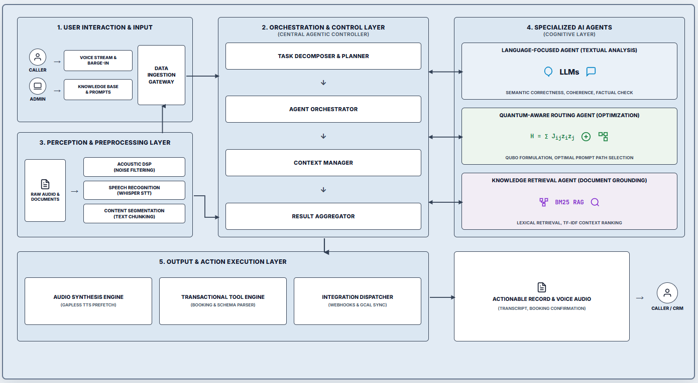
Architecture Diagram
Abstract
Introduction
Literature Survey
Problem Statement
Research Gap
Architecture Diagram
Gantt Chart
References

Slide 13
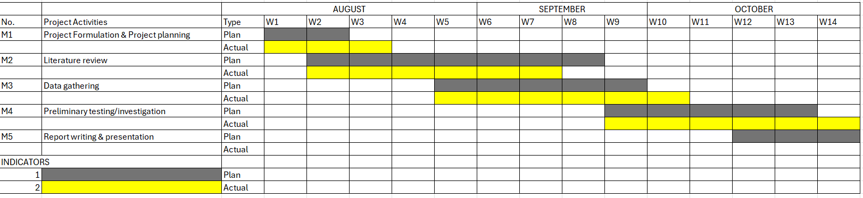
Gantt Chart
Abstract
Introduction
Literature Survey
Problem Statement
Research Gap
Architecture Diagram
Gantt Chart
References
Proposed Time Line For the Events in Project Phase 1

Slide 14
Reference
Abstract
Introduction
Literature Survey
Problem Statement
Research Gap
Architecture Diagram
Gantt Chart
References
Abbasian, M., Azimi, I., Rahmani, A. M., & Jain, R. (2025). Conversational health agents: A personalized large language model-powered agent framework. JAMIA Open, 8(4), ooaf067. https://doi.org/10.1093/jamiaopen/ooaf067
Xu, Y., Zhuang, Y., Liu, X., Zhang, T., Xiao, B., Xu, X., Jiang, D., Wang, J., & Hu, H. (2026). LLM agents security duality: A comprehensive survey of self-security and empowered cybersecurity. Artificial Intelligence Review, 59(8), Article 174. https://doi.org/10.1007/s10462-026-11563-0
Furtado, L., et al. (2025). Assessing the user experience of an LLM-based conversational agent for older adults. Journal of Healthcare Informatics Research, 10(1), 116–153. https://doi.org/10.1007/s41666-025-00217-5
Ray, S., Dhandhania, K., Barres, V., & Narasimhan, K. (2026). τ-Voice: Benchmarking full-duplex voice agents on real-world domains. ArXiv, abs/2603.13686. https://doi.org/10.48550/arxiv.2603.13686
Bhatia, M. S., & Khetarpaul, S. (2025). AI-enhanced bilingual banking assistant. Scientific Reports, 15, 37526. https://doi.org/10.1038/s41598-025-22569-z
Adams, S. J., Acosta, J. N., & Rajpurkar, P. (2025). How generative AI voice agents will transform medicine. npj Digital Medicine, 8, Article 353. https://doi.org/10.1038/s41746-025-01776-y
Lu, S., Tang, Y., Yan, S., Xiong, Y., & Xia, W. (2024). A Full-duplex Speech Dialogue Scheme Based On Large Language Models. ArXiv, abs/2405.19487. https://doi.org/10.48550/arxiv.2405.19487
Yu, W., Wang, S., Yang, X., Chen, X., Tian, X., Zhang, J., Sun, G., Lu, L., Wang, Y., & Zhang, C. (2025). SALMONN-omni: A Standalone Speech LLM without Codec Injection for Full-duplex Conversation. ArXiv, abs/2505.17060. https://doi.org/10.48550/arxiv.2505.17060

Slide 15
Reference
Abstract
Introduction
Literature Survey
Problem Statement
Research Gap
Architecture Diagram
Gantt Chart
References
Lu, X., Xu, W., Wang, H., Zhou, H., Zhao, H., Zhu, C., Zhao, T., & Yang, M. (2025). DuplexMamba: Enhancing Real-time Speech Conversations with Duplex and Streaming Capabilities. 62-74. https://doi.org/10.48550/arxiv.2502.11123
Casanova, E., Chen, C., Hu, K., Pasad, A., Rastorgueva, E., Narasimhan, S. L., Deng, S., Hosseini-Asl, E., Żelasko, P., Mendelev, V., Ghosh, S., Peng, Y., Chen, Z., Li, J., Balam, J., Lavrukhin, V., & Ginsburg, B. (2025). Open Full-duplex Voice Agent with Speech-to-Speech Language Model. 2025 IEEE Automatic Speech Recognition and Understanding Workshop (ASRU), 1-4. https://doi.org/10.1109/asru65441.2025.11434669
Keshireddy, S. R. (2025). Retrieval-Augmented Generation Techniques in Oracle APEX Improving Contextual Responses in AI Assistants. Archives for Technical Sciences. https://doi.org/10.70102/afts.2025.1833.253
Acikgoz, E. C., Greer, J., Datta, A., Yang, Z., Zeng, W., Elachqar, O., Koukoumidis, E., Hakkani-Tur, D., & Tur, G. (2025). Can a Single Model Master Both Multi-turn Conversations and Tool Use? CoALM: A Unified Conversational Agentic Language Model. 12370-12390. https://doi.org/10.48550/arxiv.2502.08820
Samal, M. S., Swain, M. B., & Sahoo, P. B. (2026). Srota AI: A Voice-Controlled Intelligent Web Automation Platform Using Large Language Models and Multi-Agent Orchestration. International Journal of Economic Social Science and Management LAW. https://doi.org/ 10.64751/vyfrez55
Kaewtawee, K., Modecrua, W., Pachtrachai, K., & Kraisingkorn, T. (2025). Cloning a Conversational Voice AI Agent from Call Recording Datasets for Telesales. ArXiv, abs/ 2509.04871. https://doi.org/10.48550/arxiv.2509.04871
Ji, S., Chen, Y., Fang, M., Zuo, J., Lu, J., Wang, H., Jiang, Z., Zhou, L., Liu, S., Cheng, X., Yang, X., Wang, Z., Yang, Q., Li, J., Jiang, Y., He, J., Chu, Y., Xu, J., & Zhao, Z. (2024). WavChat: A Survey of Spoken Dialogue Models. ArXiv, abs/2411.13577. https://doi.org/ 10.48550/arxiv.2411.13577

Slide 16
Reference
Abstract
Introduction
Literature Survey
Problem Statement
Research Gap
Architecture Diagram
Gantt Chart
References
Guo, H., Zhang, S., Soong, F., He, L., & Xie, L. (2021). Conversational End-to-End TTS for Voice Agents. 2021 IEEE Spoken Language Technology Workshop (SLT), 403-409. https://doi.org/10.1109/slt48900.2021.938346
Naveed, H., Khan, A., Qiu, S., Saqib, M., Anwar, S., Usman, M., Barnes, N., & Mian, A. S. (2023). A Comprehensive Overview of Large Language Models. ACM Transactions on Intelligent Systems and Technology, 16, 1 - 72. https://doi.org/10.1145/3744746
Wang, R., Nadig, S., Kulko, D., Vandieken, S., Chang, C.-T., Sarfjoo, S. S., & Robertson, J. (2024). Double Decoder: Improving latency for Streaming End-to-end ASR Models. 83-91 https://aclanthology.org/2024.icnlsp-1.10/
Vaswani, A., Shazeer, N., Parmar, N., Uszkoreit, J., Jones, L., Gomez, A. N., Kaiser, Ł., & Polosukhin, I. (2017). Attention is all you need. Advances in Neural Information Processing Systems, 30. https://doi.org/10.48550/arXiv.1706.03762
Zardini, E., Blanzieri, E., & Pastorello, D. (2024). A quantum k-nearest neighbors algorithm based on the Euclidean distance estimation. Quantum Machine Intelligence, 6(1), 23. https://doi.org/10.1007/s42484-024-00155-2
Jäger, J., & Krems, R. V. (2023). Universal expressiveness of variational quantum classifiers and quantum kernels for support vector machines. Nature Communications, 14(1), 576. https://doi.org/10.1038/s41467-023-36144-5
Shi, S., Wang, Z., Li, J., Li, Y., Shang, R., Zheng, H., Zhong, G., Gu, Y., & Huang, X. (2026). A quantum neural network with built-in self-attention mechanism. Neurocomputing, 674, 132862. https://doi.org/10.1016/j.neucom.2026.132862
Blekos, K., Brand, D., Ceschini, A., Chou, C.-H., Li, R.-H., Pandya, K., & Summer, A. (2024). A review on Quantum Approximate Optimization Algorithm and its variants. Physics Reports, 1068, 1–66. https://doi.org/10.1016/j.physrep.2024.03.002
Bausch, J., Subramanian, S., & Piddock, S. (2021). A quantum search decoder for natural language processing. Quantum Machine Intelligence, 3(1), 16. https://doi.org/10.1007/s42484-021-00041-1

