Slide 1
Artificial Neural Network
Supervised Machine Learning
Classification/Regression Algorithm

Slide 2
Course Topics
What does ANN mean?
How ANN works?
Pros and Cons of ANN
Applications of ANN
Modeling ANN with Python

Slide 3
What is ANN?
Artificial Neural Networks are the biologically inspired simulations performed on the computer to perform certain specific tasks like clustering, classification, pattern recognition etc.

Slide 4
How ANN Works? - ANN Layers
Input layer — It contains those units (artificial neurons) which receive input from the outside world on which network will learn, recognize about or otherwise process.
Output layer — It contains units that respond to the information about how it’s learned any task.
Hidden layer — These units are in between input and output layers. The job of hidden layer is to transform the input into something that output unit can use in some way.
Most neural networks are fully connected that means to say each hidden neuron is fully connected to the every neuron in its previous layer(input) and to the next layer (output) layer.

Slide 5
How ANN Works?
X
Y
10
?
25
5
15
aX + b = Y
a 🡪 weight (w) , b 🡪 Bias (b)
a=1, b=1
1*10+1 = 11 (error :14)
1*5+1 = 6 (error :9)
a=2, b=2
2*10+2 = 22 (error :3)
2*5+2 = 12 (error :3)
a=3, b=3
3*10+3 = 33 (error : -8)
3*5+3 = 18 (error :-3)
a=2, b=5
2*10+5 = 25 (error :0)
2*5+5 = 15 (error :0)

Slide 6
How ANN works?
Hidden Layer
Y_{predict} =( X1*W11+X2*W21+B1) +
( X1*W12+X2*W22+B2) +
(X1*W13+X2*W23+B3)
Input Layer
W11
B1
X1
W12
Output Layer
W21
W22
error = Y_{p}*(1-Y_{p})*(Y_{a} - Y_{p})
W_{new} = W_{old} + l*(error)
B_{new} = B_{old} + l*(error)
B2
Y
X2
W13
W231
B3
X1 | X2 | Y
0.8 | 0.6 | 1
0.3 | 0.7 | 0
0.6 | 0.4 | 0
ANN : Loan Approval
Input Layers Output Layer
X1 🡪 Credit Score Y 🡪 Loan Approval
X2 🡪 Salary Level

Slide 7
Stopping Criteria
Max Iteration
Validation score not improving
Errors below threshold

Slide 8
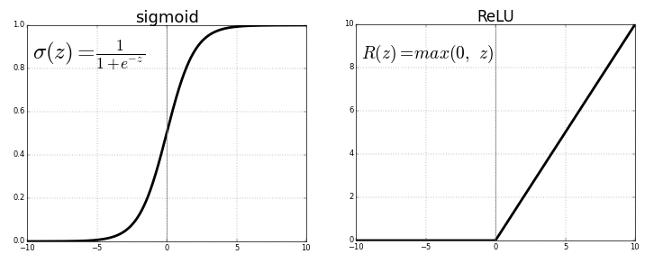
Hidden Layer Activation Functions

Slide 9
Output Layer Activation Functions
Classification
Softmax
Sigmoid
Regression
Linear

Slide 10
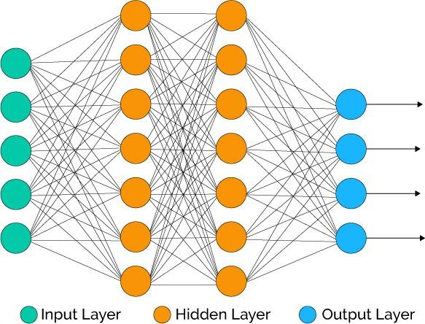
How ANN Works? -Typical ANN

Slide 11
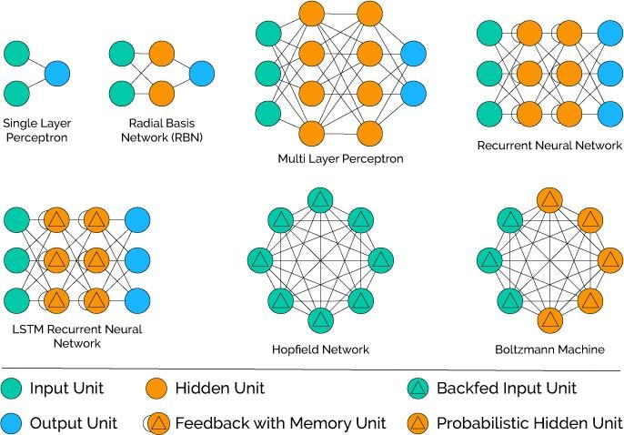
How ANN Works? - Types of ANN

Slide 12
Pros of ANN
Good to model the non-linear data with large number of input features
Widely used for high dimensionality data.
ANNs can generalize — After learning from the initial inputs and their relationships
ANN does not impose any restrictions on the input variables (like how they should be distributed)

Slide 13
Cons of ANN
NNs are useable only for numerical inputs, vectors with constant number of values, and datasets with non-missing data
ANNs are computationally expensive.
Black box, difficult to understand the modeling.
Multi-layer neural networks are usually hard to train.
Requires significant training data for model ANN compared to other ML algorithms.

Slide 14
Applications of ANN
Image Processing and Character recognition: Given ANNs ability to take in a lot of inputs, process them to infer hidden as well as complex, non-linear relationships, ANNs are playing a big role in image and character recognition
Forecasting: Forecasting is required extensively in everyday business decisions (e.g. sales, financial allocation between products, capacity utilization), in economic and monetary policy, in finance and stock market
Game-playing and decision making (backgammon, chess, poker)
Medical Diagnosis: Lung cancer, prostate cancer, colorectal cancer
To accelerate reliability analysis of infrastructures subject to natural disasters

Slide 15
Modeling ANN
MLP Classifier in action

