Slide 1
Decision Tree
Supervised Machine Learning
Classification/Regression Algorithm
© DataMites® and Skillogic® are part of Skillfloor Solutions Private Limited. All rights reserved

Slide 2
Course Topics
What is Decision Tree ?
Decision Tree Terminology
How Decision Tree works?
Entropy and information gain
Pros and Cons of Decision Tree
Applications of Decision Tree
Optimizing Decision Tree model performance
Modeling Decision Tree with Python

Slide 3
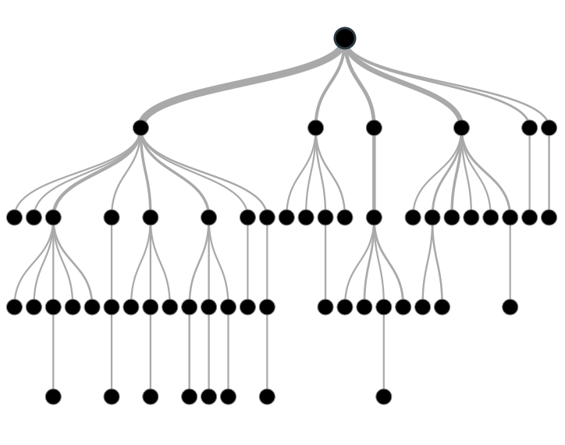
What is Decision Tree ?
Decision tree is a supervised machine learning algorithms.
It is use for both classification and regression problem.
Decision tree work on simple nested if else statement condition.

Slide 4
Types of Decision Trees
Types of decision tree is based on the type of target variable we have. It can be of two types:
Categorical Variable Decision Tree: Decision Tree which has a categorical variable as target.
Continuous Variable Decision Tree: Decision Tree which has a continuous variable as target.

Slide 5
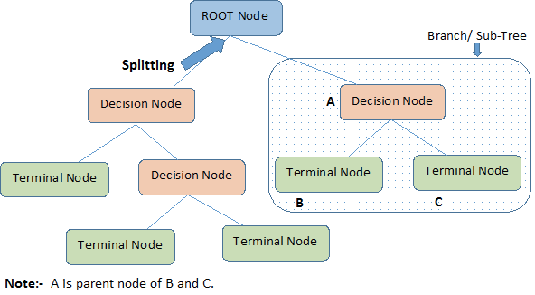
Decision Tree Terminology
Root Node: It represents entire population or sample and this further gets divided into two or more homogeneous sets.
Splitting: It is a process of dividing a node into two or more sub-nodes.
Decision Node: When a sub-node splits into further sub-nodes, then it is called decision node.
Leaf/ Terminal Node: Nodes with no children (no further split) is called Leaf or Terminal node.
Pruning: When we reduce the size of decision trees by removing nodes (opposite of Splitting), the process is called pruning.
Branch / Sub-Tree: A subsection of decision tree is called branch or sub-tree.
Parent and Child Node: A node, which is divided into sub-nodes is called parent node, where sub-nodes are the child of parent node.

Slide 6
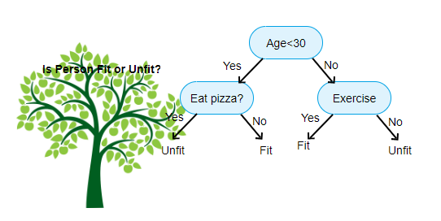
How Decision Tree works?
Decision tree work on simple nested if else statement condition. Decision tree break the dataset into smaller and smaller subset while at the same time it create a decision tree and result determine by leaf nodes.

Slide 7
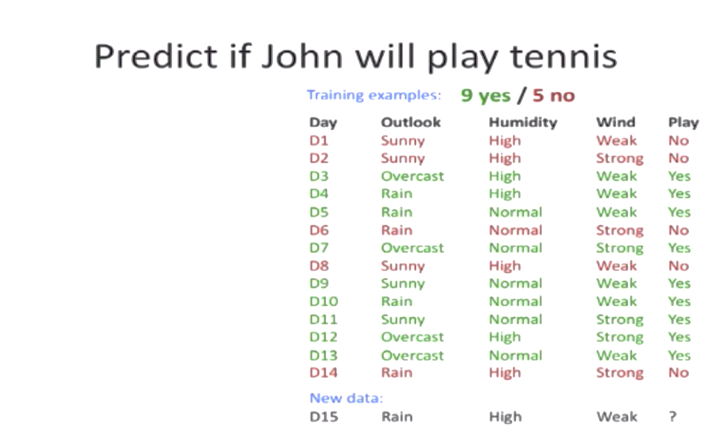
How Decision Tree works?
Let’s understand with examples:-

Slide 8
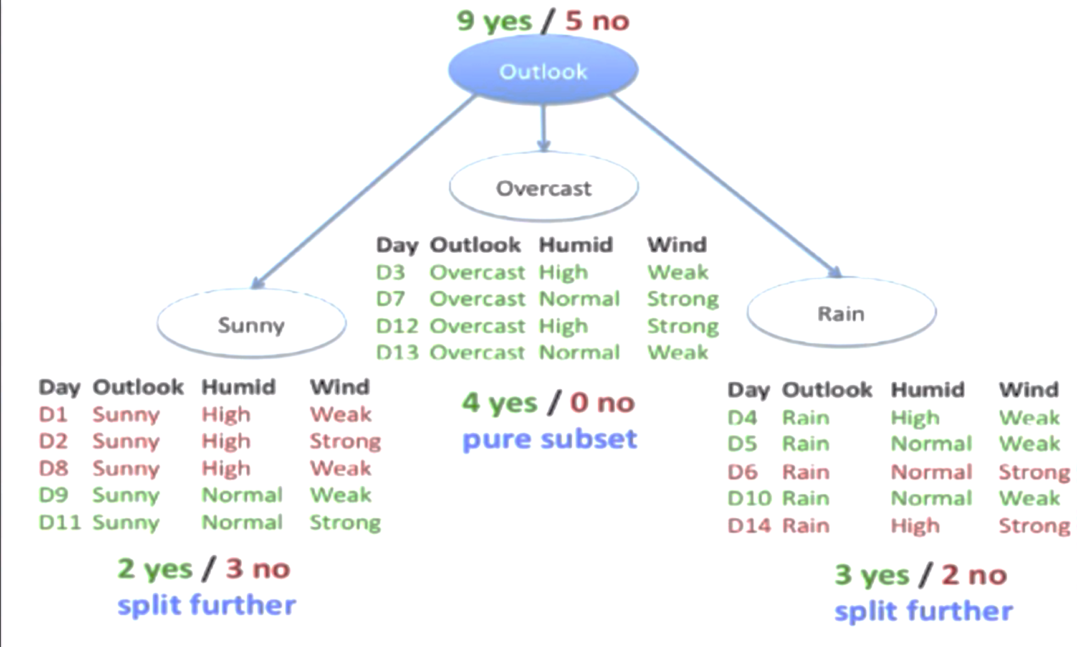
How Decision Tree works?
Let’s see what is the probability of yes and no.

Slide 9
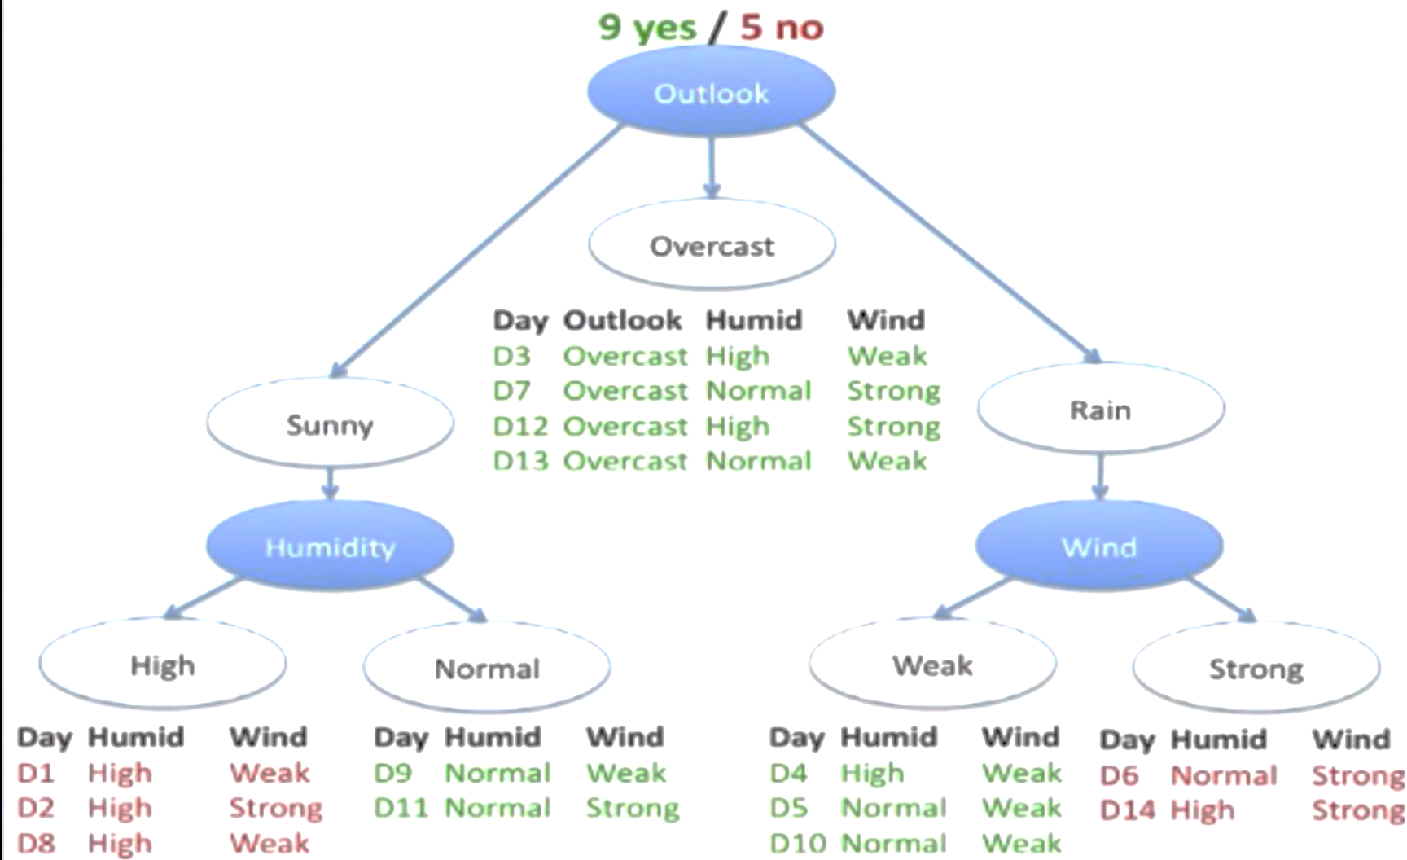
How Decision Tree works?

Slide 10
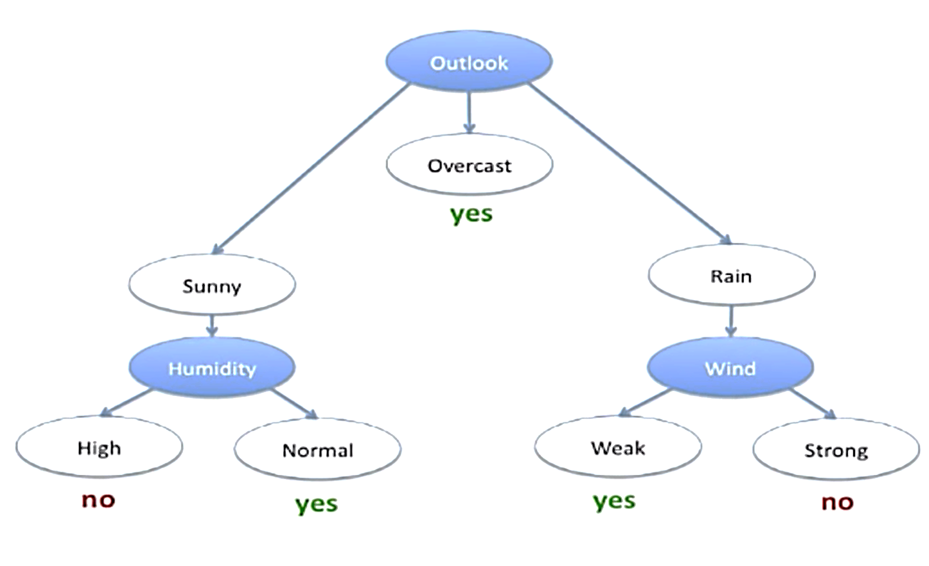
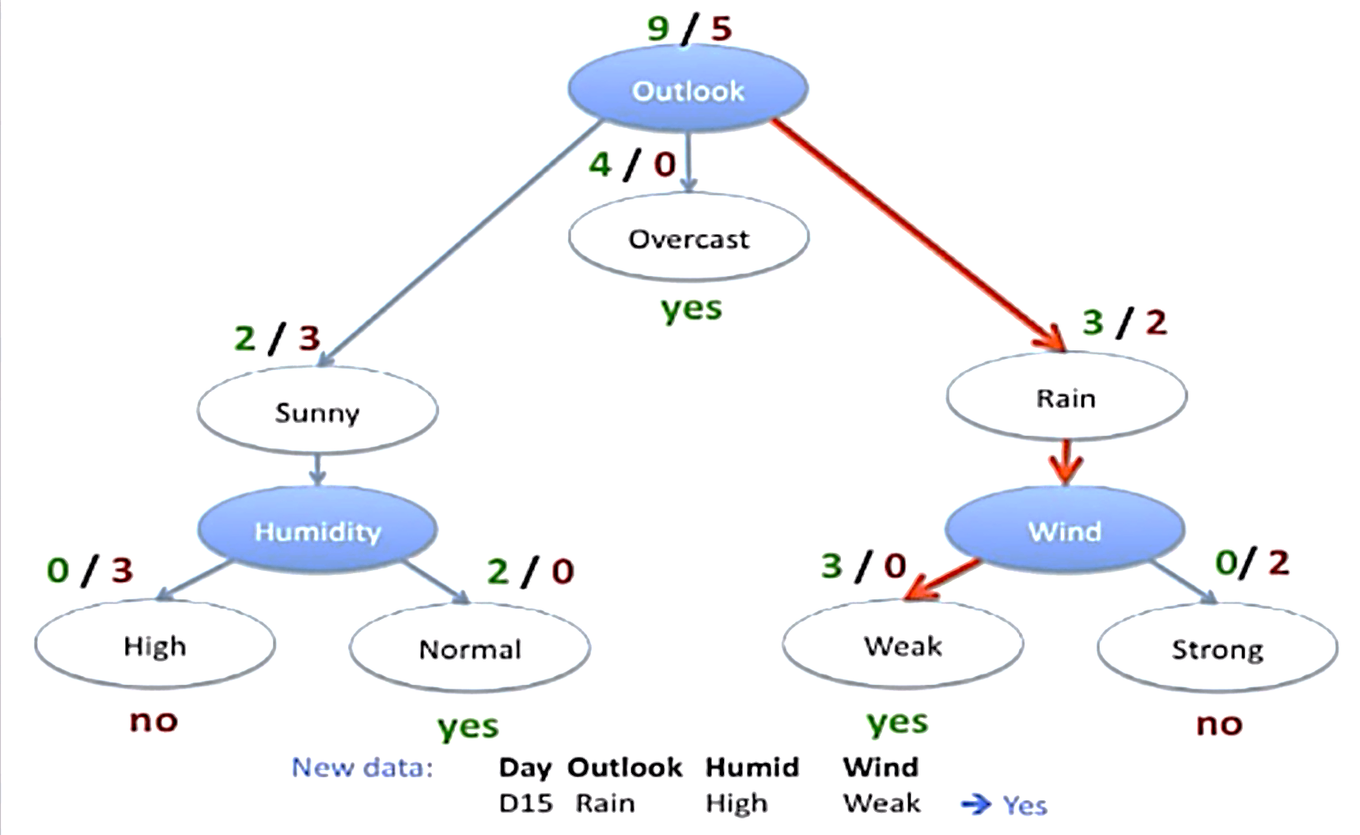
How Decision Tree works?

Slide 11
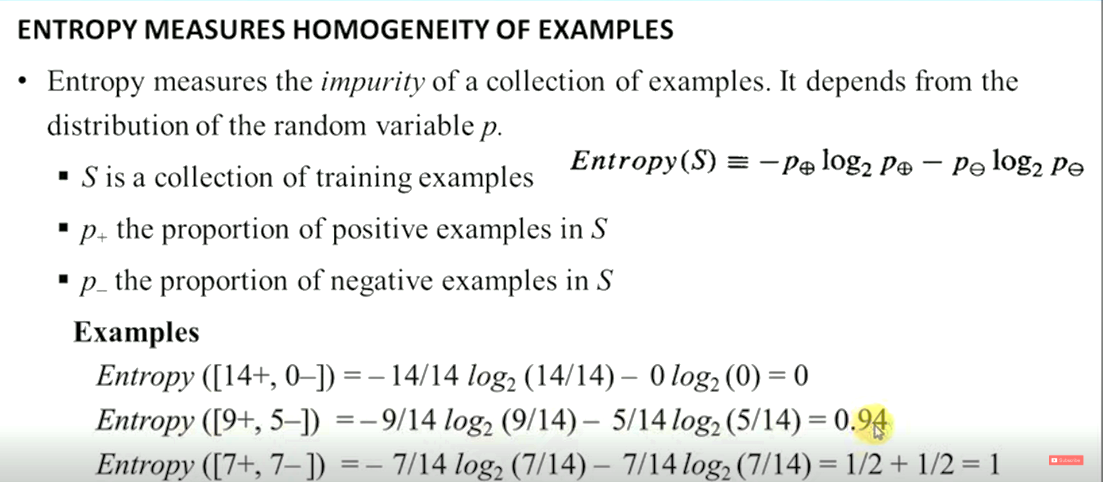
How to select the right feature?

Slide 12
Information Gain
Information Gain:
Information Gain is used to determine which feature/attribute gives us the maximum information about a class.
Information Gain is based on the concept of entropy, which is the degree of uncertainty, impurity or disorder.
Information Gain aims to reduce the level of entropy starting from the root node to the leave nodes.
The greater the reduction in the uncertainty, the more information is gained about Y from X.

Slide 13
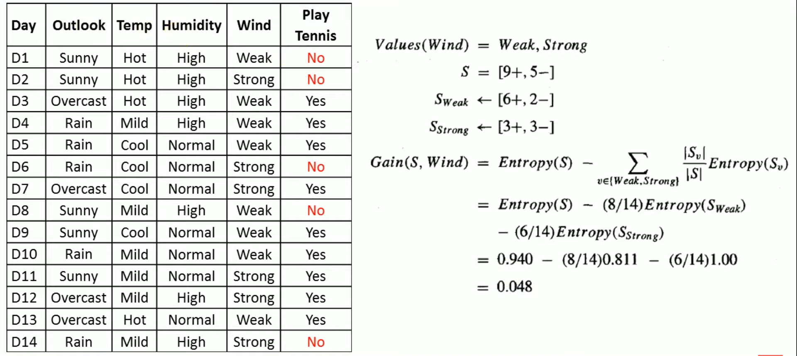
Entropy and Information Gain

Slide 14
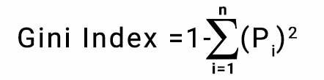
GINI INDEX
GINI INDEX
Gini index or Gini impurity measures the degree or probability of a particular variable.
4 records 🡪 2 yes, 2 No
Probability of +ve class = 2/4
Probability of –ve class = 2/4
Gini index = 1 – [ sq(p+) + sq(p-) ] = 1 – [ sq(2/4) + sq(2/4) ] = 0.50

Slide 15
Pros of Decision Tree
Easy to Understand: Decision tree output is very easy to understand even for people from non-analytical background. It does not require any statistical knowledge to read and interpret them.
Less data cleaning required: It requires less data cleaning compared to some other modeling techniques. It is not influenced by outliers and missing values to a fair degree.
Data type is not a constraint: It can handle both numerical and categorical variables.
Decision Tree Versatility : Decision trees can be customized for a variety for situations.

Slide 16
Cons of Decision Tree
Over fit : Over fitting is one of the most practical difficulty for decision tree models.
Low accuracy for continuous variables: While working with continuous numerical variables, decision tree loses information when it categorizes variables in different categories.
They are unstable, meaning that a small change in the data can lead to a large change in the structure of the optimal decision tree.

Slide 17
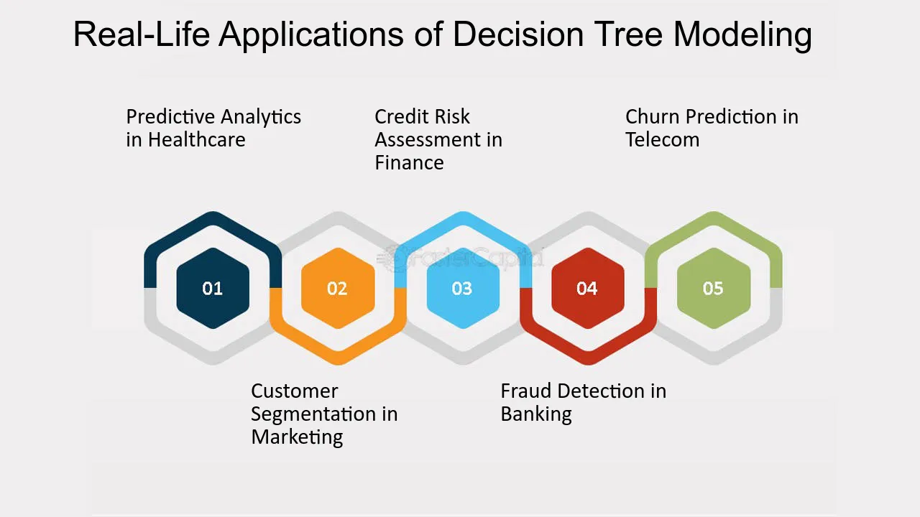
Applications of Decision Tree

Slide 18
Modeling Decision Tree
Decision Tree in action

