Slide 1
K-Nearest Neighbours
Supervised Machine Learning
Classification/Regression Algorithm

Slide 2
Course Topics
What is K-Nearest Neighbours?
How KNN works
KNN Assumptions
Pros and Cons
Applications of KNN
Modeling K-Nearest Neighbours

Slide 3
What is K-Nearest Neighbours algorithm?
K-Nearest Neighbors (KNN) is one of the fundamental algorithms for classification in Machine Learning. KNN need labeled data to learn and, so belongs to the supervised learning category.
KNN is widely disposable in real-life scenarios since it is non-parametric, meaning, it does not make any underlying assumptions about the distribution of data.

Slide 4
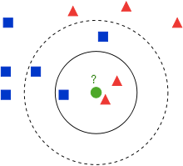
How K-Nearest Neighbours Works
KNN works based on minimum distance from the query instance to the training samples to determine the K-nearest neighbors.

Slide 5
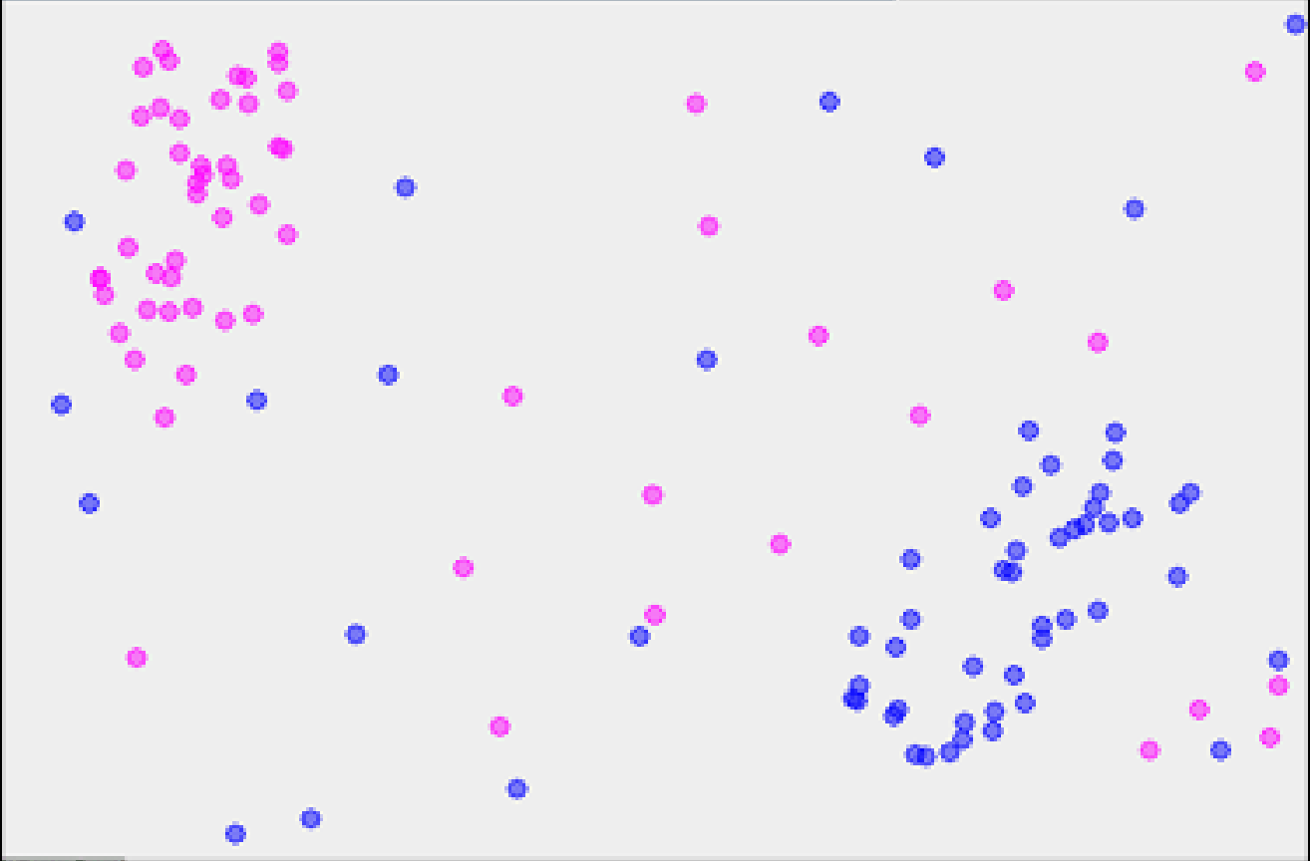
1-Nearest Neighbor
x

Slide 6
2-Nearest Neighbor
?

Slide 7
3-Nearest Neighbor
X

Slide 8
8-Nearest Neighbor
X

Slide 9
Pros of K-Nearest Neighbours
Simple to implement
Flexible to handle non-linearity
Naturally handles multi-class cases
Can do well in practice with enough representative data

Slide 10
Cons of K-Nearest Neighbour
Need to predefine value of parameter K (number of nearest neighbors)
Computation cost is quite high because we need to compute distance of each query instance to all training samples.
Storage of data
Must know we have a meaningful distance function

Slide 11
Popular Applications of KNN
Concept Search : Searching for semantically similar documents (i.e., documents containing similar topics)
Recommender Systems : If a customer likes a particular item, then you can recommend similar items for them. Also in Ads display etc.,
Facial recognition, Fingerprint detection

Slide 12
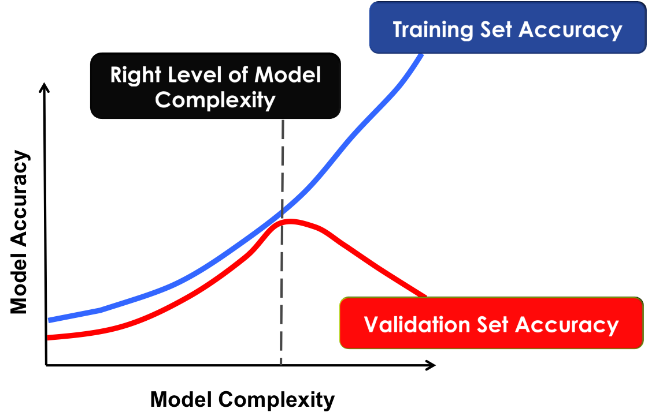
Controlling for Complexity in kNN

Slide 13
Modeling K-Nearest Neighbours
KNN in action

