Slide 1
K-Means
Unsupervised Machine Learning
Clustering Algorithm
© DataMites® and Skillogic® are part of Skillfloor Solutions Private Limited. All rights reserved

Slide 2
Course Topics
What is K-Means?
How the algorithm works
Pros and Cons
Applications
Modeling kmeans

Slide 3
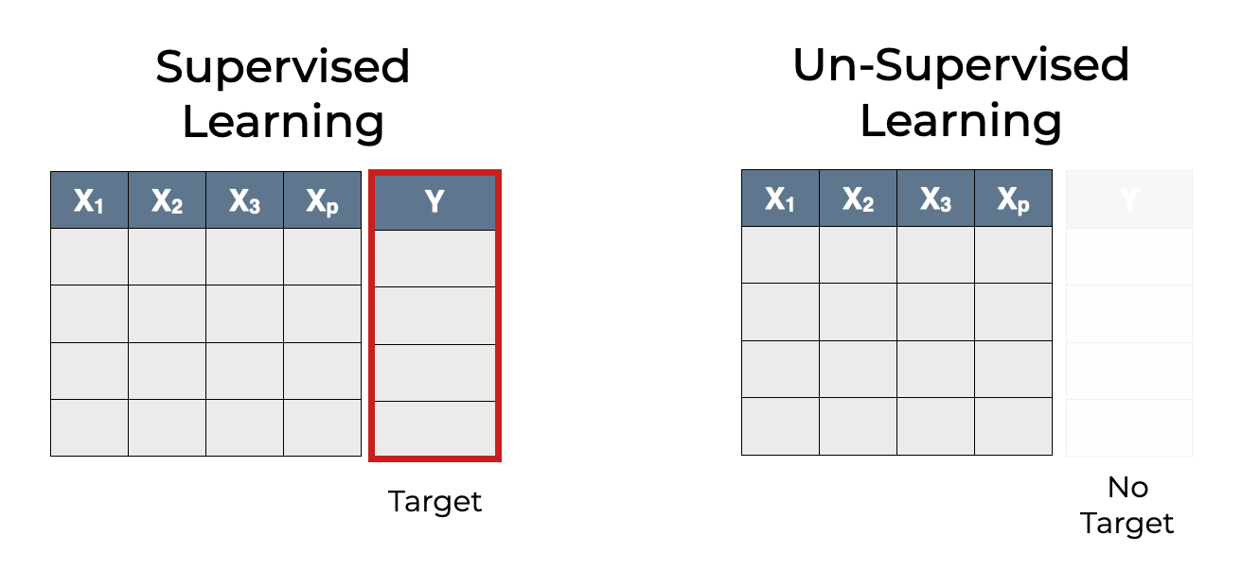
What is K-Means ?
K-means is a type of unsupervised machine learning algorithm
Used for clustering unlabelled data
Looks to find groups in the data by minimize the distance between the data points and their respective cluster centroid, with the number of groups represented by the variable K.
The algorithm works iteratively to assign each data point to one of K groups based on the features that are provided.
Data points are clustered based on feature similarity.

Slide 4
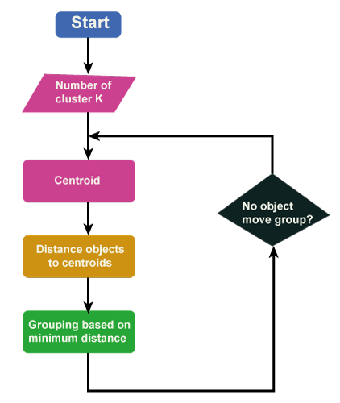
How K-Means works
Initialize no. of clusters (K).
Randomly assign k no. of centroids into a dataset.
Calculate the distance between each datapoint to all the centroids. Assign the datapoints to the nearest centroid so as to form k clusters.
Compute the new centroids of each cluster based on the data it contains, shifting from the older centroids.
Repeat steps 3 and 4 until the mean doesn't change.

Slide 5
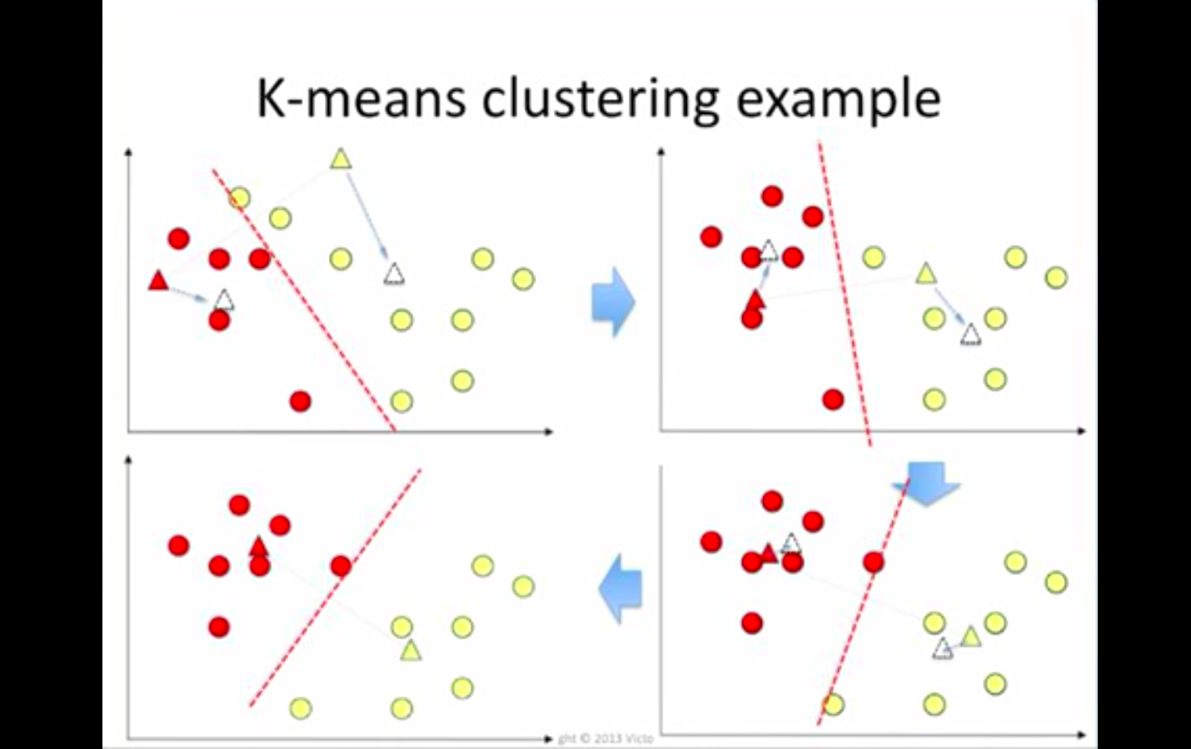
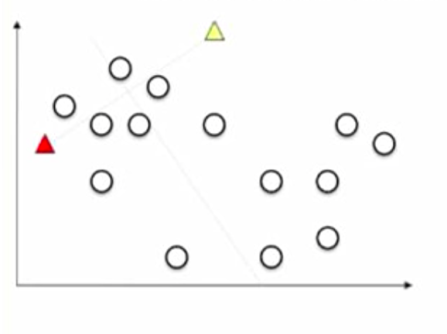
How K-Means works?

Slide 6
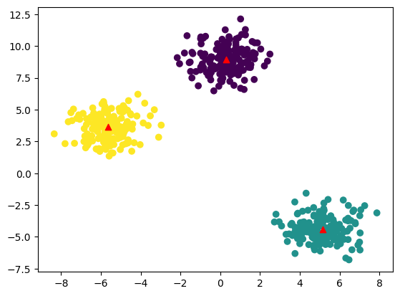
Pros of K-Means
Practically work well even if some assumptions are broken.
Simple, easy to implement.
Easy to interpret the clustering results.
Fast and efficient in terms of computational cost.

Slide 7
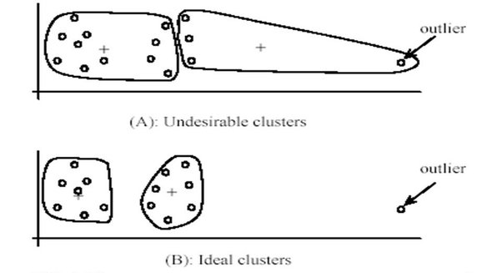
Cons of K-Means
Uniform effect: often produce clusters with relatively uniform size even if the input data have different cluster size.
Different densities: may work poorly with clusters with different densities but spherical shape.
Sensitive to outliers
K value needs to be known before K-means clustering

Slide 8
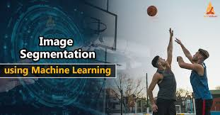


Applications of K-Means
Market segmentation
Computer vision
Agriculture
Feature learning
Recommendation Systems

Slide 9
Modeling K-Means
Clustering in action

