Slide 1
Support Vector Machine
Supervised Machine Learning
Regression/Classification Algorithm
© DataMites® and Skillogic® are part of Skillfloor Solutions Private Limited. All rights reserved

Slide 2
Course Topics
What is Support Vector Machine?
How SVM works
Pros and Cons
Applications
Optimizing model performance
Modeling Support Vector Machine

Slide 3
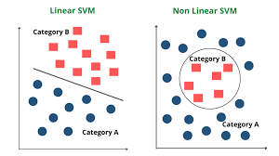
What is Support Vector Machine ?
Support Vector Machine” (SVM) is a supervised machine learning algorithm which can be used for both classification or regression challenges. However, it is mostly used in classification problems.
It use for Linearly separable data and Non-Linearly separable data.
SVM is a Non - probabilistic classifier.
SVM uses marginal distance unlike Logistic Regression or KNN.

Slide 4
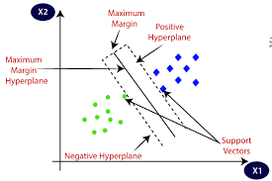
How Support Vector Machine works
Support vectors are identified through the data based on the task
Marginal lines pass through the support vectors to identify the boundary region
SVM maximises the marginal distance between hyperplane and support vectors

Slide 5
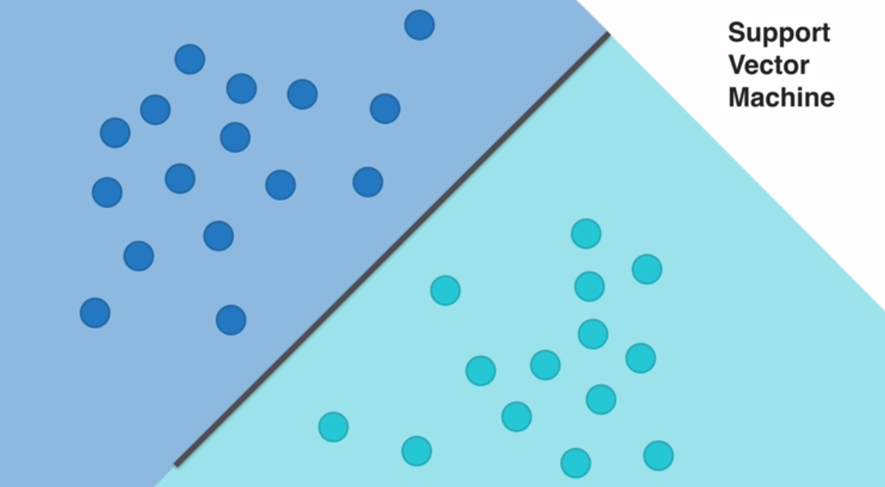
SVM: Hyperplane splitting Data

Slide 6
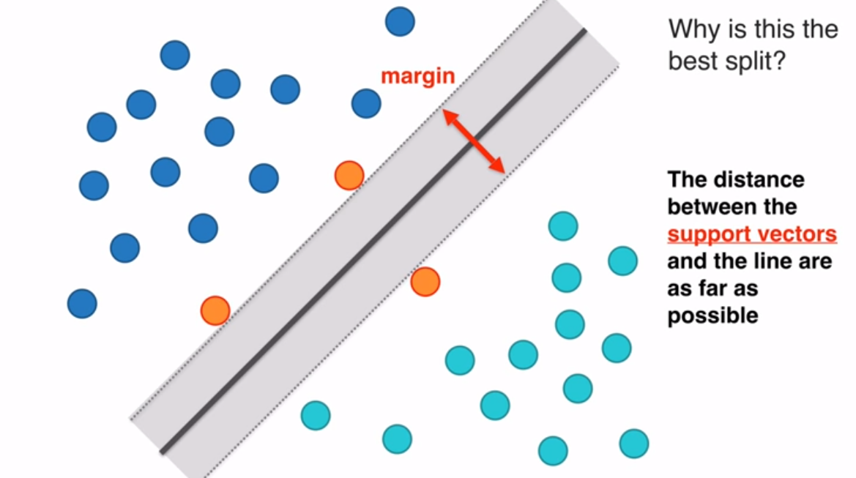
Marginal Distance

Slide 7
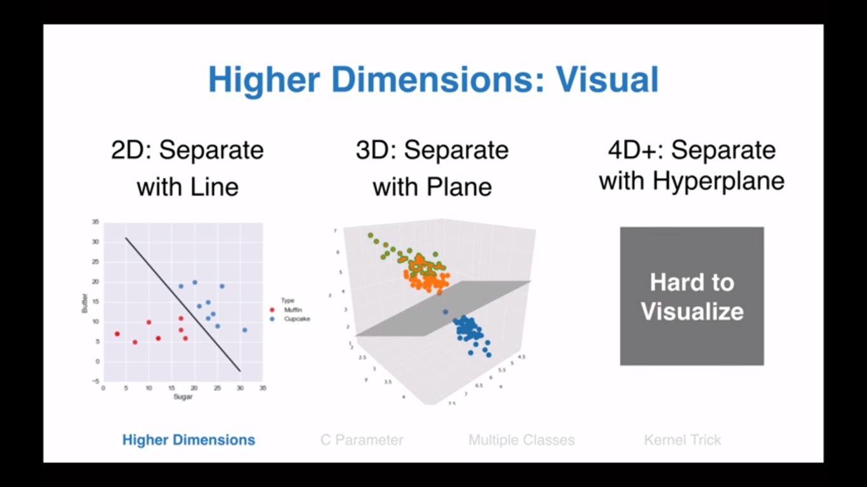
SVM Higher Dimensions Visual

Slide 8
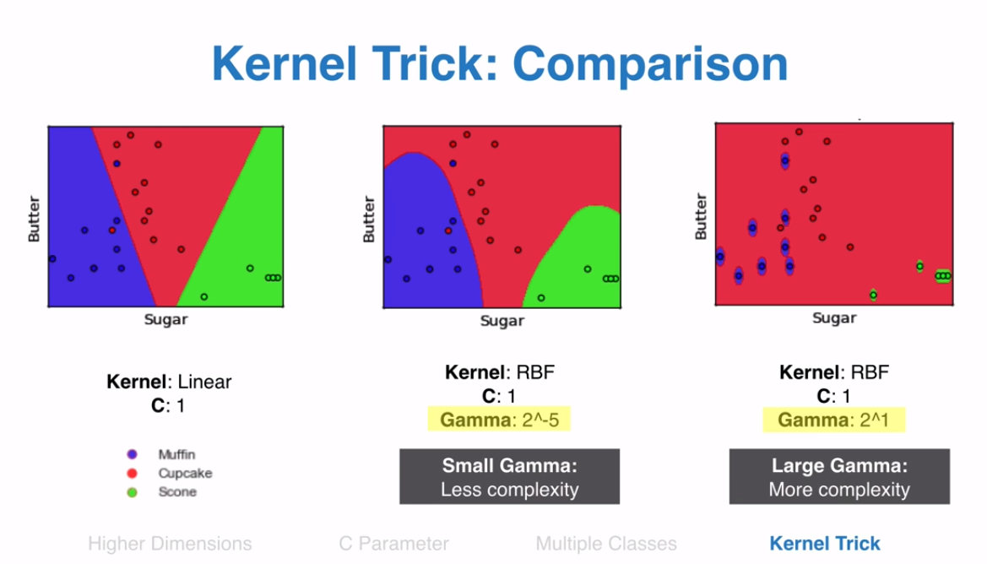
SVM Example: Kernel Trick

Slide 9
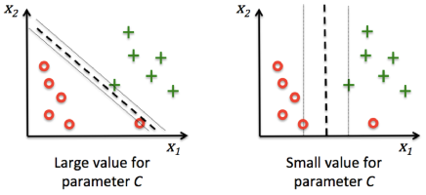
C Value

Slide 10
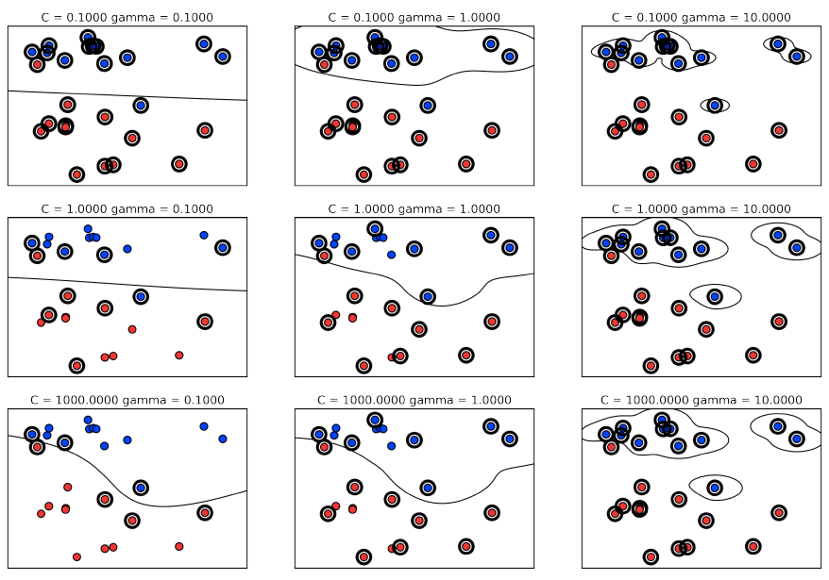
Gamma and C parameters

Slide 11
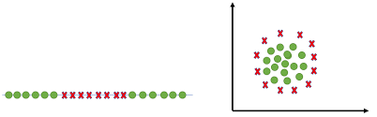
Pros of Support Vector Machine
Very good at dealing with higher dimensional data
Works well with smaller data set
Useful for both Linearly Separable (hard margin) and Non-linearly Separable (soft margin) data

Slide 12
Cons of Support Vector Machine
Picking right kernel and parameters can be computationally intensive.
In Natural Language Processing, structured representations of text yield better performances. Sadly, SVMs can not accommodate such structures (word embeddings).

Slide 13
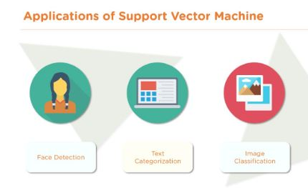
Applications of Support Vector Machine
Face Detection
Text Categorization
Image Classification

Slide 14
Modeling Support Vector Machine
Support Vector Classifier in action

