Slide 1
Linear Regression Supervised Machine Learning
MACHINE LEARNING EXPERT

Slide 2
Course Topics
What is Linear Regression?
How Linear Regression works?
Linear Regression Assumptions
Pros and Cons of Linear Regression
Applications of Linear Regression
Modeling Linear Regression with Python
MACHINE LEARNING EXPERT

Slide 3
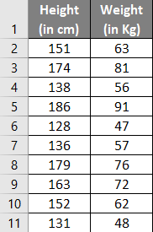
What is Linear Regression?
Linear Regression is a Supervised Machine Learning Algorithm.
Linear Regression is used to predict the continuous value.
Linear Regression is used to identify the linear relationship between dependent and independent variables.
MACHINE LEARNING EXPERT

Slide 4
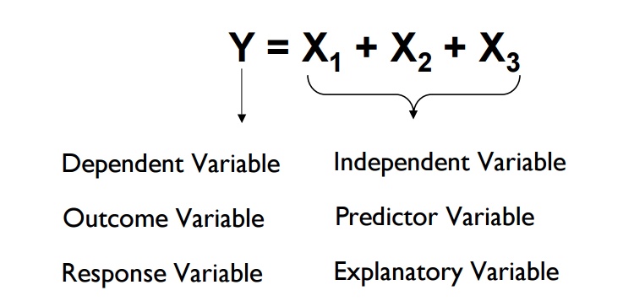
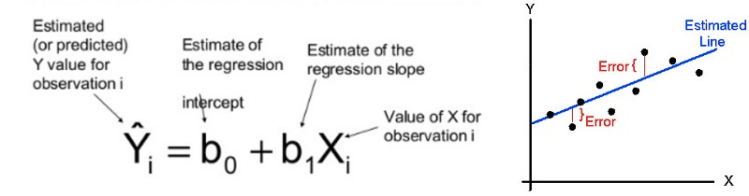
How Linear Regression works?
MACHINE LEARNING EXPERT

Slide 5
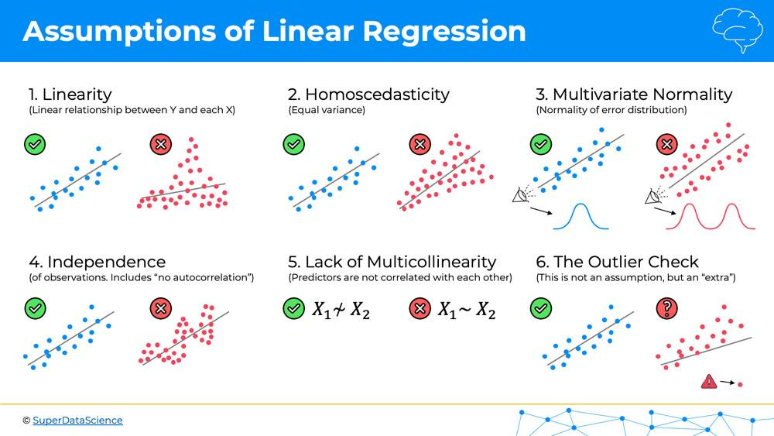
Assumptions of Linear Regression
Linear Relationship: There should be a linear relationship between dependent and independent variables.
Multivariate normality : Linear regression analysis requires all variables to be multivariate normal. Residual (Error) should be following normal distribution.
No or little collinearity: Linear regression assume that there is no multi-collinearity in the data.
MACHINE LEARNING EXPERT

Slide 6
Pros of Linear Regression
Linear regression is an extremely simple method. It is very easy and intuitive to use and understand.
Widely used, as many problems can be transformed into linear regression problems.
With regularization techniques, handling overfitting issue quite well.
MACHINE LEARNING EXPERT

Slide 7
Cons of Linear Regression
Assumes there is a straight-line (Linear) relationship between them. If your data are intrinsically nonlinear then linear regression may not yield best results.
Linear regression is very sensitive to the outliers in the data.
MACHINE LEARNING EXPERT

Slide 8

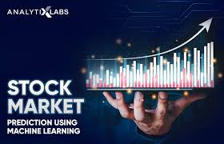
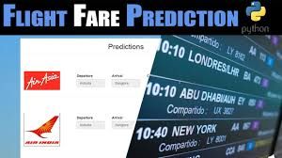
Applications of Linear Regression
Majority continuous variable predictions are through Linear Regression in business applications.
Here are some applications--
Stock Exchange – Price predictions
Weather forecast - temperatures
Flight price prediction
House price predictions
MACHINE LEARNING EXPERT

Slide 9
Modeling Linear Regression
Modeling with Jupyter Notebook
(attached in resource section of this module)
MACHINE LEARNING EXPERT

Slide 10

Questions?
Q&A Session
MACHINE LEARNING EXPERT

