Slide 1
My Friends Hobbies
-Mukesh Bit’ian

Slide 2
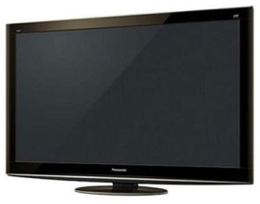


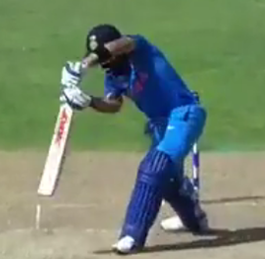

Mukilan’s Hobby
Watching Television
Performing @ Musically app
Reading story books
Playing Cricket
Watching Sci-Fi movies

Slide 3

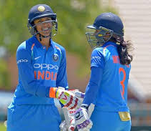
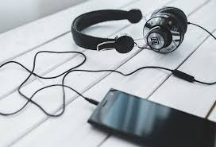

Gunalan’s Hobbies
Being Updated with NEWS
Watching All sort Cricket Matches
Listening to Yuvan’s Songs
Practicing for Athletic Event

Slide 4


