Slide 1
Biological Sequence Alignment using Dynamic programming
The sequence alignment problem
Mukesh Gautam
Roll No:- PAI2101

Slide 2

Introduction
Overview of the sequence alignment problem
Calculate the optimal global alignment
Characteristics of dynamic programming algorithms
Calculate the optimal local alignment
Notes:
Purpose: computational technique – iteration and recursion
Motivation: how does computer scientists think about computational problems

Slide 3
Sequence Alignment
Widely used in bio-informatics
Proteins and genes are of different lengths due to error in sequencing and genetic variation across species
Involves identifying evolutionary events: insertions, deletions, and substitutions
Goal is to “align” sequences such that number of mutations is minimized
Notes:
This talk will not necessarily make you a better BLAST user
See Dr. Buhler’s lecture notes on BLAST
Illustrates how to design a computational algorithm to solve a biological problem:
Generate an optimal alignment between two sequences

Slide 4
DNA Sequence Evolution
AAGACTT
-3 mil yrs
AAGGCTT
T_GACTT
-2 mil yrs
_GGGCTT
TAGACCTT
A_CACTT
-1 mil yrs
GGCTT
(Mouse)
TAGGCCTT
(Human)
TAGCCCTTA
(Monkey)
ACACTTC
(Lion)
ACCTT
(Cat)
today
Notes:
minimize the edit distance

Slide 5
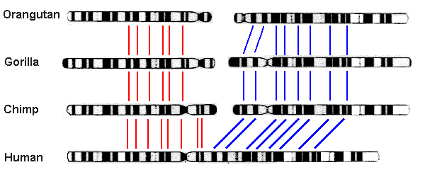
Visual inspection
Did you know that human DNA and chimp DNA areÂ 98.8%Â the same?Although this number may sound small, humans and chimps are very different when we go into our DNA. Out of the roughly three billion base pairs that make up our genetic code, 1.2% of them equates to over 35 million genetic differences.

Slide 6
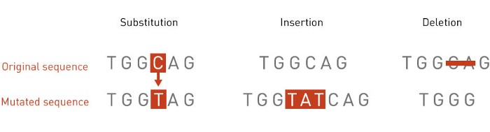
Reason of Evolution
Mutations can consist of insertions (adding of base pairs), deletions (removing of base pairs), and alterations (changing of base pairs).
When scaled to the billions of base pairs we have, the number becomes astronomical for the number of permutations that could’ve changed chimp DNA into human DNA
Notes:
Brute-force approach used to determine short passwords

Slide 7
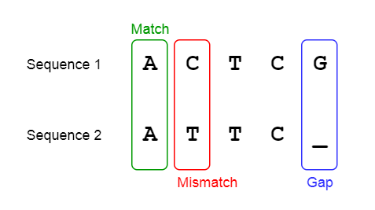
How to solved Problem
Sequence alignment has solved this problem by allowing us to compare two genetic strands and find the sequence of mutations that led from one to the other. The goal of sequence alignment is to find homologous/similar sequences in the genome, and then base mutations off of the gaps that emerge between these sequences
Homologous
Notes:
Most parsimonious alignment – minimize the number of gaps

Slide 8
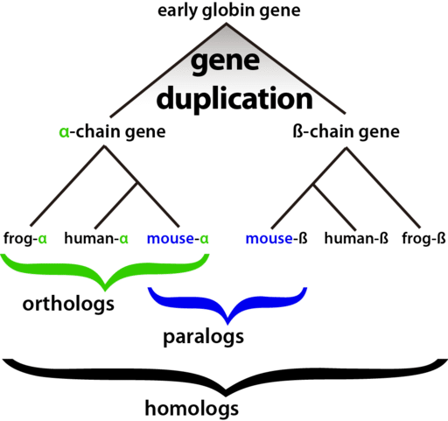
Terminology
Because of the number of different evolutionary events that are possible, common sequence alignment algorithms attempt to minimize the number of events to explain the differences between two genetic sequences.
Notes:
Do not have a time machine, but the alignment implies an evolutionary relationship
Most of the possibilities are caused by gaps

Slide 9
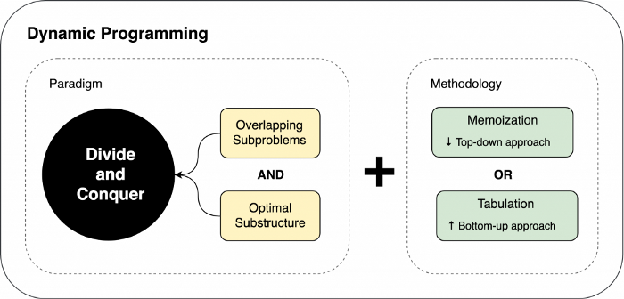
Dynamic Programming
Dynamic programming, which allows us to utilize overlapping sub-problems to solve a problem efficiently.

Slide 10
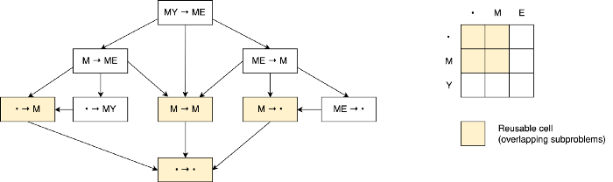
Condition for solving problem by Dynamic Programming
For a dynamic programming problem, there are two major things to check for:
Optimal Substructure: The optimal solution to a problem contains optimal solutions to subproblems of the problem.
Overlapping Subproblems: Subproblems are repeated many times, so storing the answers to these subproblems will reduce computational complexity when running the model.
Notes:
Dot plot: compare each base in the query against each base in the subject
Where does the alignment come from?

Slide 11
Needleman-Wunsch Algorithm
We now return back to the problem of the longest common subsequence between two sequences and how to reduce the time complexity from exponential to linear. Before doing, this a few variables need to be defined:
S = {S1, S2, …, Sm} and T = {T1, T2, … Tn}: the two sequences
d: the gap penalty cost (as explained above)
s(x; y): the score of aligning a base x from S and a base y from T
F: matrix where F (x, y) refers to the xth place in S and the yth place in T

Slide 12
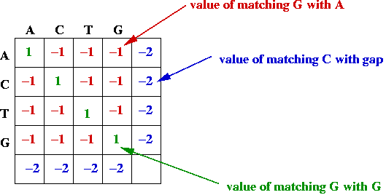
This algorithm attempts to use a key part of dynamic programming: that you can keep track of the optimized sub-problems to solve the problem of finding the best subsequence. If there is an optimal alignment from F(0, 0) to F(m, n) (or the optimal alignment across both substrings), then this means that there is an optimal alignment between F(0, 0) to F(i, j) and F(i+1, j+1) and F(m, n) for any i in [0, m) and j in [0, n).Â This shows that every subpath in an optimal path has to also be optimal.
Notes:
optimal substructure

Slide 13
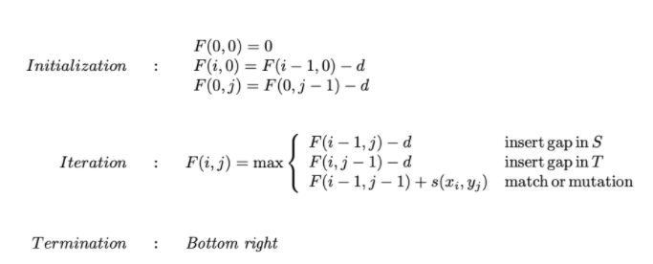
Filling the Matrix
The first step is toÂ initializeÂ some rows and columns so that the algorithm can systematically fill data into other cells in the matrix. F(0, 0) is initialized with 0, because no alignments have been made yet. F(i, 0) = F(i-1, 0)-d, because a state change from F(i-1, 0) to F(i, 0) means that Sequence T had a gap, which contributes to a gap error penalty. Similarly, F(0, j) = F(0, j-1)-d, because a state change from F(0, j-1) to F(0, j) means that Sequence S had a gap.

Slide 14
Three different ways to reach cell (i,j) in the alignment matrix
A
(i-1,j-1)
(i,j-1)
A
Align with subject
(i-1, j-1)
A
Gap in subject
(i-1, j)
A
Subject (y)
-
A
Gap in query
(i, j-1)
-
A
(i-1,j)
(i,j)
Query (x)
Arrow = alignment
Notes:
If cell (i,j) is part of the optimal path, identify the best path to reach cell (i,j)
Compare sequences of length 0 – algorithm will terminate

Slide 15
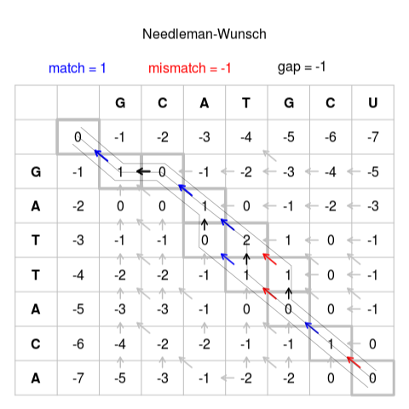
Traceback
After initializing the matrix, the final step is toÂ traceback through the matrix starting at the bottom right until you get to the top leftÂ (or from F(m, n) to F(0, 0)). This will provide the optimal alignment, and determining what the path means will give you the longest common substring.
Notes:
Protein sequences can use a more sophisticated scoring system (e.g. BLOSUM62)

Slide 16
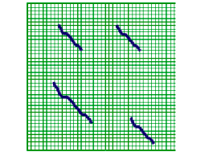
Local Alignment
In this algorithm, we were considering how two sequences can have the longest common subsequence.
This assumes that nucleotide groupings don’t switch places between mutations, and this can end up causing a huge number of mutations, when the actual result is much smaller
As shown above, sequences of nucleotides in S and T can be switched around, even if there has been little to no mutations in between these two sequences. To code this up is relatively similar to the Needleman-Wunsch algorithm for global alignmen
Notes:
prove by contradiction: only the best alignment at cell i,j could be part of the final optimal alignment

Slide 17
The initialization, iteration, and termination process are slightly altered
Initialization:Â Rather than saying F(i, 0) = F(i-1, 0)-d, F(i, 0) = 0 because note that local alignment states that there can be a switch in nucleotide sequences at any point in S or T. The applies to F(j, 0), which is also initialized to 0.
Termination:Â Termination can now occur anywhere, as shown in the diagram above.
Iteration:Â Because termination can now occur anywhere, we want to penalize negative scores heavily. Therefore, we now add a new constraint, where if the maximum is negative, then we make F(i, j) = 0.
?
Subject
Notes:
Prove by contradiction: only the best alignment at cell i,j could be part of the final optimal alignment
Turns out we do not actually need to know the optimal alignment
- One of the alignments in the DP matrix will be the optimal alignment (i.e. has the highest score)

Slide 18
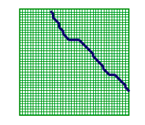
Semi-Global Alignment
Semi-global looks at anÂ alignment of a substring s of sequence S with a substring of t of sequence T
Notes:
We can eliminate entire branch of alignments because, by definition, there is a better alternative alignment
Score encapsulates the history of all the decisions made up to cell (i,j)

Slide 19
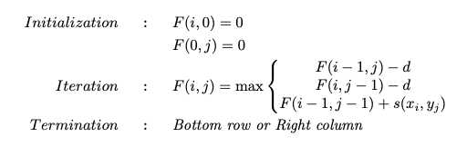
Similar to local alignment, there’s slight changes with the code from the Needleman-Wunsch algorithm that allow for this semi-global alignment:
Initialization: Same as local alignment
Termination: Termination can happen on anything in the bottom row or the right column. This is because these are the places where one of the sequences, S or T, stops. Since we are looking for semi-global alignment, once the sequence stops, there’s no way to go further, similar to global alignment.

Slide 20
Conclusion

Slide 21
References
https://www.linkedin.com/pulse/sequence-alignment-dynamic-programming-application-algorithms-aydin
https://medium.com/analytics-vidhya/sequence-alignment-and-the-needleman-wunsch-algorithm-710c7b1a23a4
https://www.singerinstruments.com/resource/what-are-genetic-mutation/
https://www.mun.ca/biology/scarr/Human_Ape_chromosomes.htm
Notes:
Alignment matrix corresponds to the decision tree

