Slide 1

EDU-VERSE "Revolutionizing Learning with AI-Powered Tools"

Slide 2
Features:
Web Search and Summarizer: Get summaries of educational websites quickly for easy comprehension
Latest Education News: Stay informed with summarized updates on educational trends.
YouTube Video Summarizer: Extract key points from educational videos for efficient learning.
Exam App: Prepare for exams with interactive tests and study materials.
Project Creator Mode: Build webpages easily with AI-generated HTML, CSS, JS.
Real-time-lecture-transcription: Efficiently transcribe and summarize class lectures for better note-taking.
Education Chat Bot: Get personalized assistance and learning recommendations from an AI chatbot.
Scan and Get Answer: Instantly scan educational materials for answers and insights.
AI Writer: Generate high-quality educational content effortlessly with AI assistance emails,letters,rearchpaper.
Roadmap: educational goals and milestones for motivation.
Notes Summarizer: Quickly summarize lengthy study materials for better understanding.

Slide 3

Web Search and Summarizer
This feature enables users to quickly obtain summaries of educational websites, saving time and effort in research.
By condensing online research into digestible summaries, students can easily grasp key information and concepts.
Enhances learning by providing concise summaries that aid in understanding complex topics and improving academic performance.

Slide 4
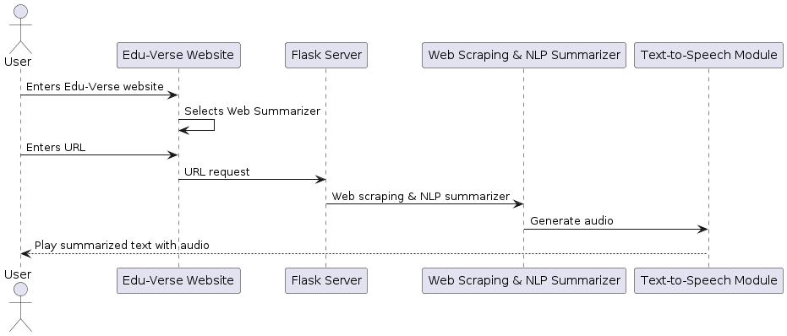
WorkFlow

Slide 5

Latest Education News
Stay up-to-date with the latest developments and trends in the education sector through summarized news updates.
Helps users stay informed about policy changes, advancements, and emerging trends, fostering a deeper understanding of the educational landscape.
Enables students to stay ahead in their studies and make informed decisions regarding their education and career paths.

Slide 6
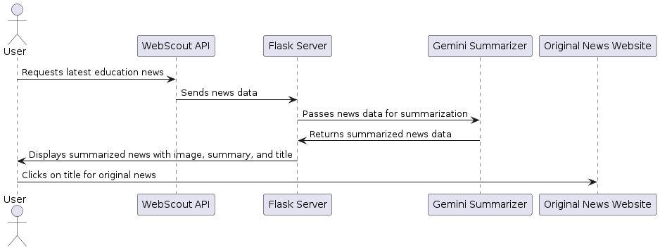
WORKFLOW

Slide 7

YouTube Video Summarizer
Extracts key points and essential information from educational videos, facilitating efficient learning.
Allows users to quickly identify relevant information without watching lengthy videos in their entirety.
Enhances learning by providing concise summaries that aid in retaining information and reinforcing understanding of educational concepts.

Slide 8
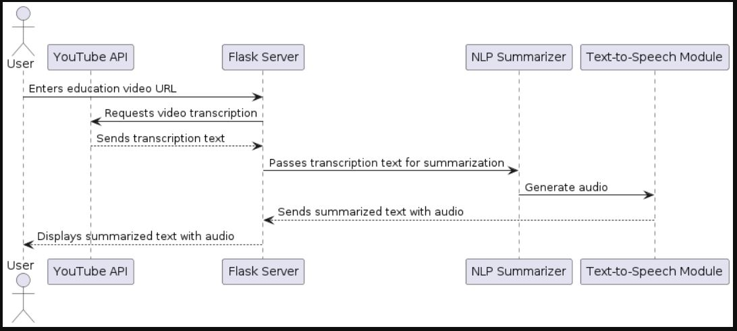
WORKFLOW

Slide 9

Exam App
Provides interactive tests, quizzes, and study materials to help students prepare for exams effectively.
Allows students to assess their knowledge, identify areas for improvement, and track their progress over time.
Enhances exam preparation by providing structured study materials and practice tests tailored to students' educational needs.

Slide 10
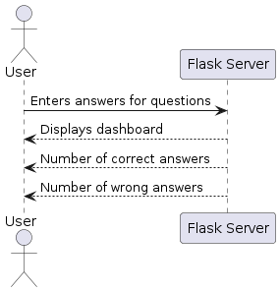
WORKFLOW

Slide 11

Project Creator Mode
Empowers users to develop web projects with minimal coding knowledge, fostering creativity and innovation in website development.
Streamlines the website development process by automatically generating HTML, CSS, and JS code.
Enhances students' web development skills and enables them to create professional-looking webpages for various educational projects.

Slide 12
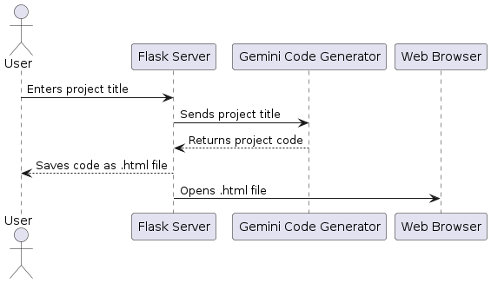
WORKFLOW

Slide 13

Real-time Lecture Transcription
Facilitates efficient note-taking by transcribing and summarizing class lectures in real-time.
Helps students capture and retain important information during lectures, enhancing their learning experience and academic performance.
Enables students to focus on understanding lecture content rather than worrying about taking detailed notes.

Slide 14
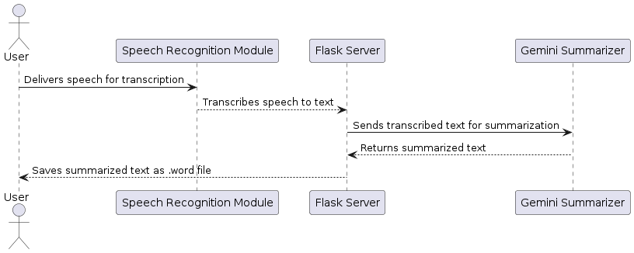
WORKFLOW

Slide 15

Education Chat Bot
Provides personalized assistance and learning recommendations to students through an AI-powered chatbot.
Guides students through their learning journey, answers questions, and provides tailored learning resources.
Enhances learning by offering immediate support and guidance, promoting engagement and knowledge retention.

Slide 16
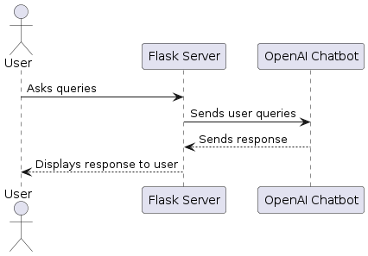
WORKFLOW

Slide 17

Scan and Get Answer
Allows users to instantly scan educational materials, such as textbooks or handwritten notes, to obtain answers and insights.
Provides a convenient way for students to access information from printed materials, enhancing their learning experience.
Enables students to quickly find answers to their questions and deepen their understanding of educational content.

Slide 18
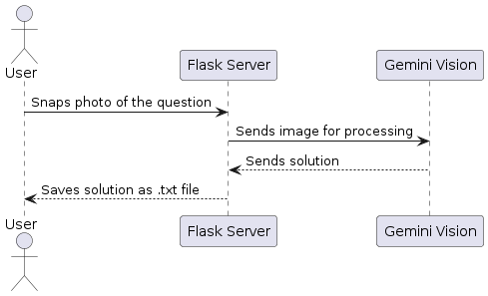
WORKFLOW

Slide 19

AI Writer
Assists users in generating high-quality educational content, such as essays, letters, reports, and emails, effortlessly.
Enhances students' writing skills and productivity by providing AI-powered assistance in content creation.
Enables students to produce well-written educational content efficiently, saving time and effort in writing assignments.

Slide 20
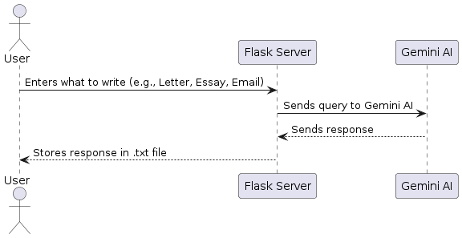
WORKFLOW

Slide 21

Roadmap
Helps users visualize their educational journey by creating a roadmap of educational goals and milestones.
Assists students in setting clear objectives, tracking their progress, and staying motivated towards achieving their educational aspirations.
Enhances students' focus and determination by providing a clear path to their educational goals and milestones.

Slide 22
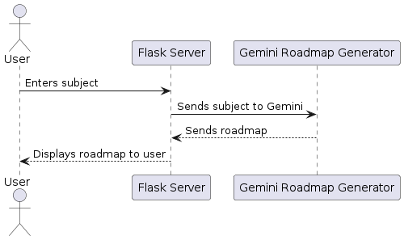
WORKFLOW

Slide 23

Notes Summarizer
Automatically summarizes lengthy study materials, such as notes and study guides, to help users grasp key concepts more efficiently.
Simplifies the process of reviewing and understanding complex study materials, enabling students to focus on essential information.
Enhances learning outcomes by providing concise summaries that aid in retaining information and improving comprehension.

Slide 24
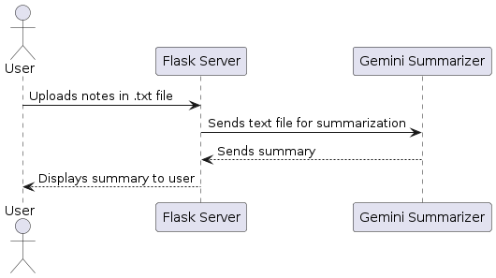
WORKFLOW

Slide 25
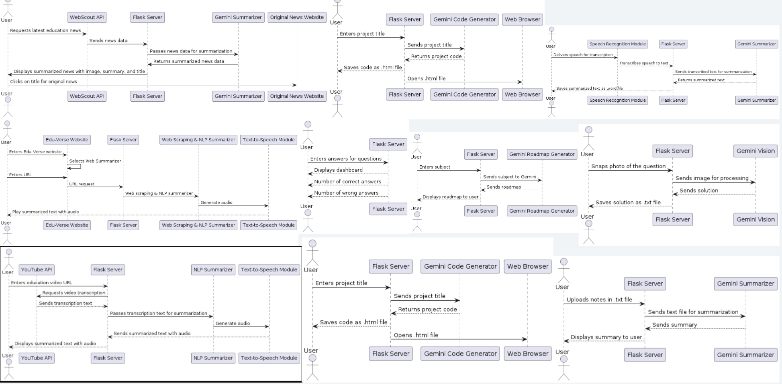

Slide 26
THANK YOU

