Slide 1

Real-time Business Monitoring System for Corporates to Identify Key Performance Indicators (KPI’s) of the Employees to Predict future Employee’s Promotions.
Team – 14
Dhruv Parmar
Kathan Patel
Mukesh Chadaram
Karthik Urala

Slide 2
PROMOTIONS!!!
PROMOTIONS!!!
PROMOTIONS!!!

Slide 3

PROBLEM STATEMENT
Who should we promote unbiased in the Upcoming promotion cycle?

Slide 4
Objective:
In a service-based company, the HR department aims to enhance its promotion strategy by using Previous Promotion Cycle’s Data to identify the most suitable candidates for promotion for the upcoming Promotion Cycle.
SOLUTION:
The best solution would be to use a predictive model to Analyze the Data to make Promotion-based Decisions easier and much more holistic keeping in mind both the Company’s Business and at the same time rewarding Employee’s Efforts.
Challenge:
The challenge lies in developing an efficient predictive model that analyzes various parameters and employee attributes to forecast potential promotions accurately.

Slide 5
Expected Outcomes:
Improved decision-making capabilities for HR personnel to identify and support employees most likely to succeed in higher roles.
Enhanced transparency in the promotion process, fostering a fair and merit-based environment within the organization.
Also gain several Insights about various Factors affecting the Organizational Performance in different Divisions.
By addressing this problem statement, the company aims to optimize its promotion strategy, ensuring that deserving candidates are identified promptly and provided with growth opportunities while maximizing overall Organizational Performance and Employee satisfaction.

Slide 6
DATA COLLECTION & PREPARATION
The dataset we used for this project was found in Kaggle.com
The dataset was cleaned using the Tableau Prep tool. We found null values present in the dataset under the Previous Year Rating Attribute. Which isn’t an Outlier. So, We changed it to ZERO.
There are 54808 records in the dataset.​
For prediction modelling, we edited some attributes like removing and modifying the data from the dataset (Data Transformation).
Kaggle.com - - https://www.kaggle.com/datasets/bhrt97/hr-analytics-classification

Slide 7
ATTRIBUTE | DESCRIPTION
Employee_id | Unique identifier to recognize the Employee (numeric)
Department | A category to which the employee belongs to (string)
Region | A place from which the Employee belongs to (alphanumeric)
Education | Employee’s educational background (string)
Gender | Gender of the Employee (string)
Recruitment_channel | Source where the employee gets hired (string)
No_of_trainings | Number of trainings an employee goes through (string)
Age | Age of the Employee (numeric)
Previous_year_rating | Employee’s previous year rating (numeric)
No_of_trainings | Number of years employee has been with the company (numeric)
KPIs_met >80% | Role-based KPI, A target/goals achieved where an employee’s performance in a role is calculated which should be >= 80% (boolean)
Awards_won | Awards handed out to the employee (numeric)
Avg_training_score | The mean score of an employee (numeric)
Is_promoted | The outcome of whether an Employee is promoted (Boolean)

Slide 8
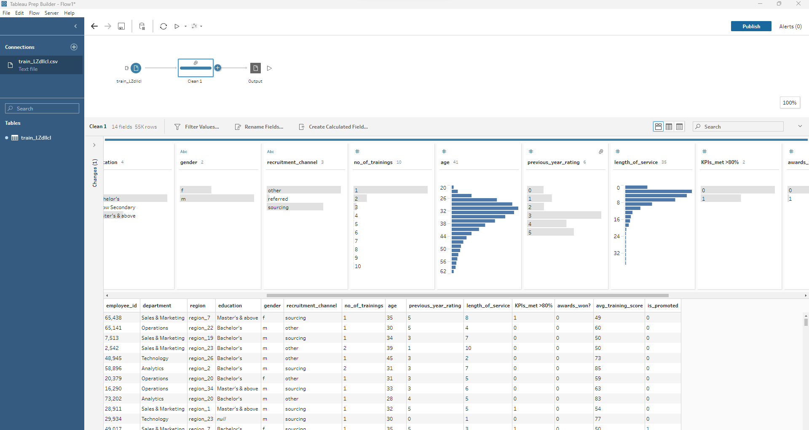

Slide 9
We used EDA (Exploratory Data Analysis) to understand the Data and gain some Insights.
There are 54808 records in the dataset.​
There are missing/null values present in the dataset.​ (In Previous Year Rating and Education)
Out of all the records present in the dataset, 4668(~8.5%) of the employees are promoted. ​
DATA ANALYSIS

Slide 10
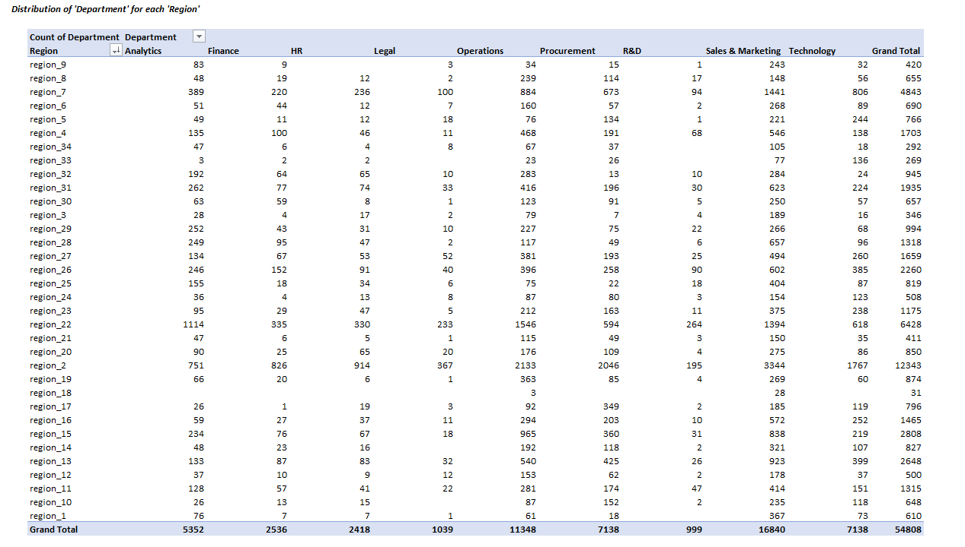

Slide 11
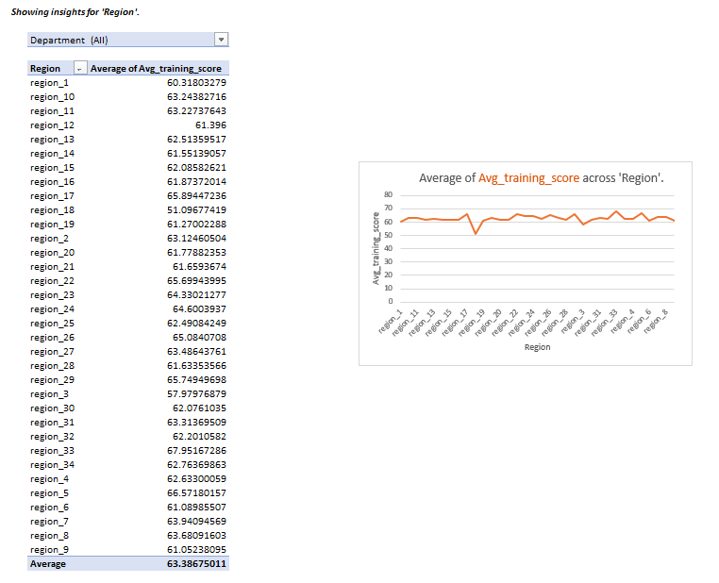

Slide 12
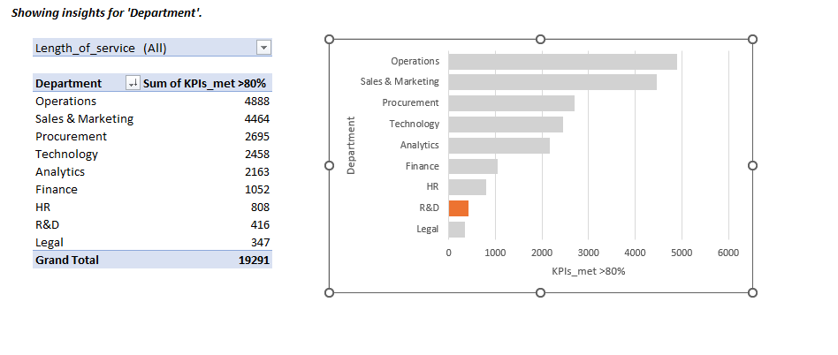

Slide 13
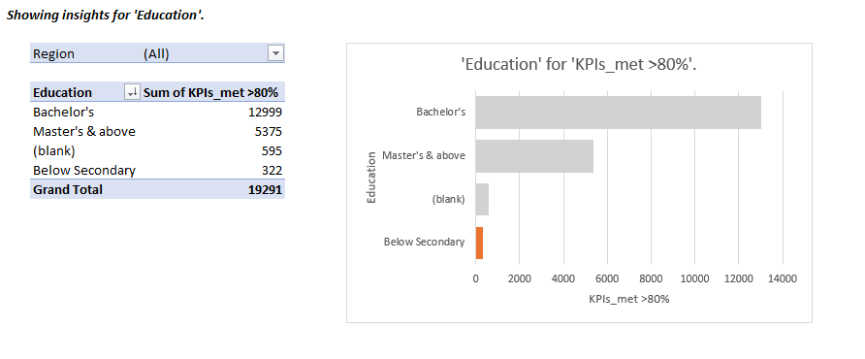

Slide 14
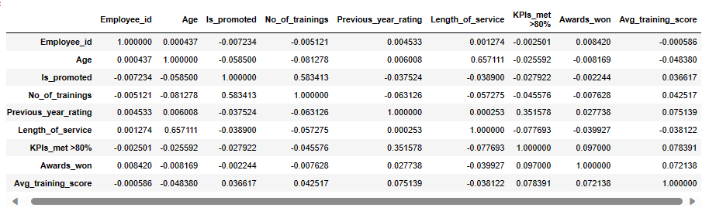
CORRELATION MATRIX

Slide 15
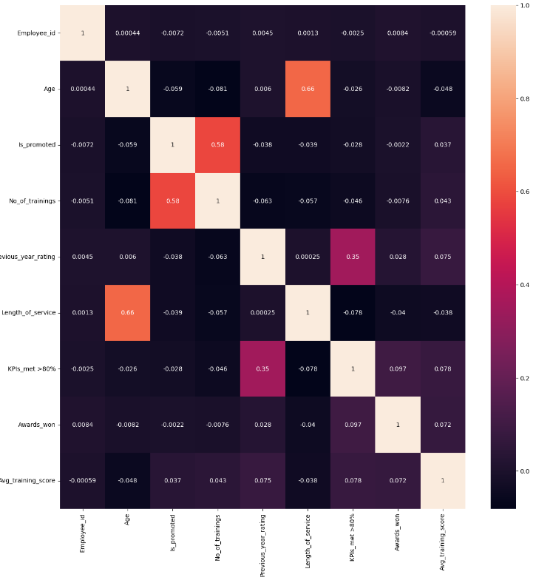
HEAT MAP

Slide 16
Insights on PROMOTIONS:​
For instance, in the attribute "Recruitment channel" the No. Of Employees promoted are:​
In Referred, 92 employees are promoted i.e., 1.97% of employees that are promoted.​
In Others, 2651 employees are promoted i.e., 56.79% that are promoted.​
In Sourced, 1925 employees are promoted i.e, 41.238% that are promoted.​
DATA ANALYSIS

Slide 17
DATA CLASSIFICATAION
No. Of Trainings | Total No. Of Promotions
1 | 3910 (83.76%)
2 | 605 (12.96%)
3 | 122 (2.6%)
4 or More | 31 (0.68%)
Role Based KPI (>=80%) | Total No. Of Promotions
Yes | 3262 (69.88%)
No | 1406 (30.12%)

Slide 18
DATA CLASSIFICATAION
Age | Total No. Of Promotions
20 Yrs to 30 Yrs | 1487 (31.855%)
30 Yrs to 40 Yrs | 2436 (52.185%)
40 Yrs to 50 Yrs | 575 (12.317%)
More than 50 yrs | 170 (3.641%)
Length of Service | Total No. Of Promotions
Less than 5 Yrs | 2654 (56.85%)
5 Yrs to 10 Yrs | 1567 (33.569%)
10 Yrs to 15 Yrs | 287 (6.14%)
More than 15 Yrs | 162 (3.47%)

Slide 19
DATA CLASSIFICATAION
Average Training Score | Total No. Of Promotions
Less than 60 | 1980 (42.416%)
60 to 70 | 861 (18.445%)
70 to 80 | 693 (14.845%)
80 to 90 | 1055 (22.6%)
More than 90 | 79 (1.692%)

Slide 20
DATA CORRELATION
You can say “Age” is sort of INVERSELY proportional to "promotion" as most of the young employees get promoted in the dataset.
"No of Trainings" is INVERSELY proportional to "promotion" i.e, less no. of trainings << the higher chance of an Employee getting promoted.
"Length of service" does play an important role. As per the Data to getting promoted as one thinks but you can say it is almost INVERSELY proportional to promotion.
"Training score" is INVERSELY proportional to "promotion".
"KPI’s met" is Directly proportional to "promotion" as the employee has to reach the criterion of >= 80% to get a promotion.
"Awards won" is INVERSELY proportional to "promotion" as more the awards <<< the higher chance of an employee getting promoted.

Slide 21
DATA VISUALISATION

Slide 22
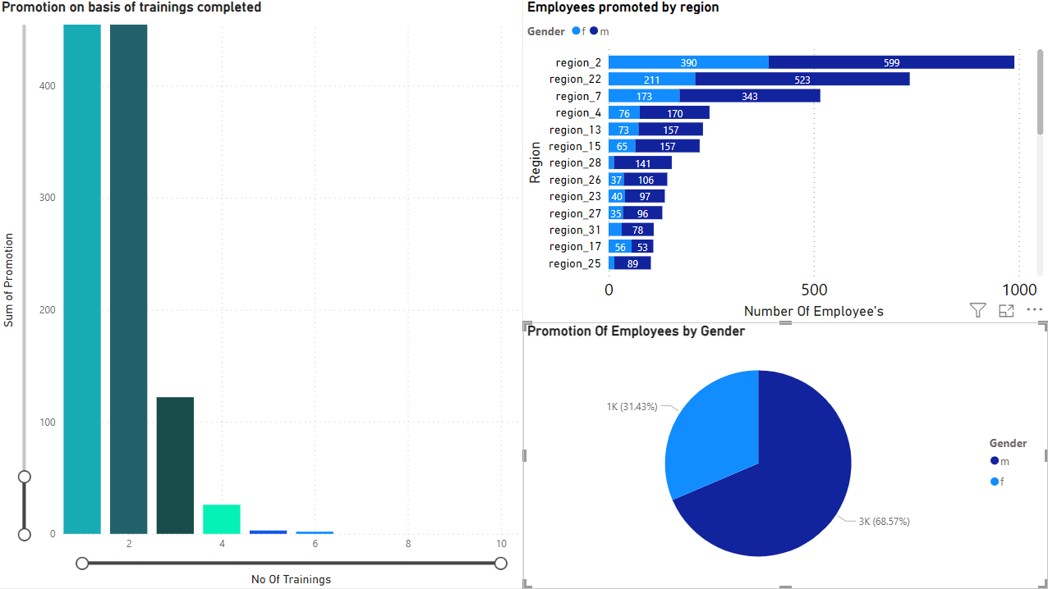
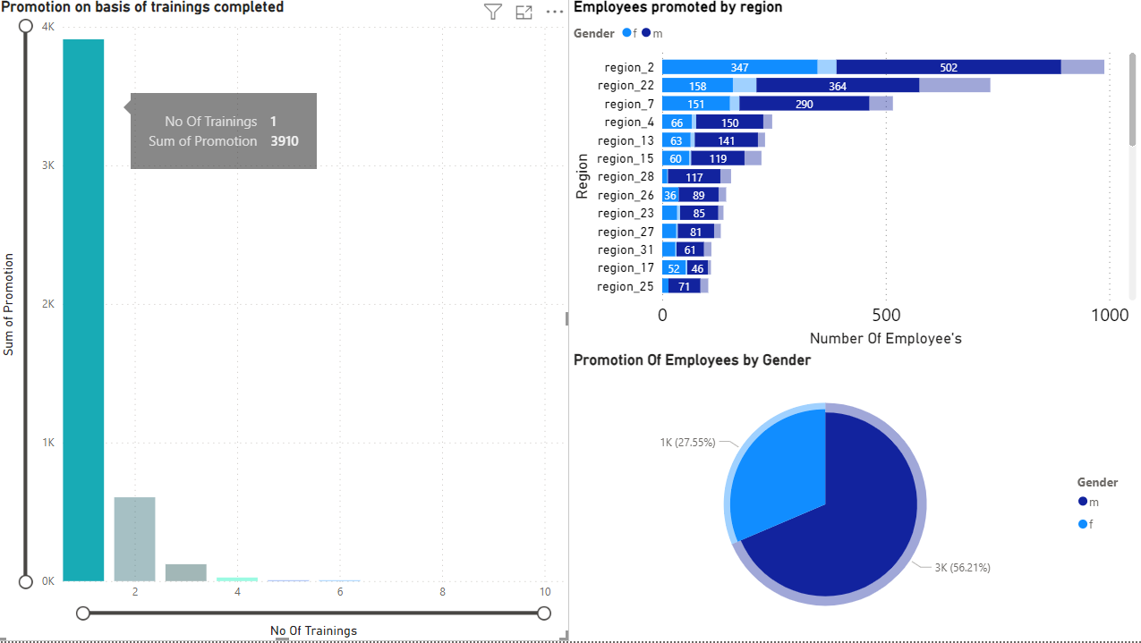
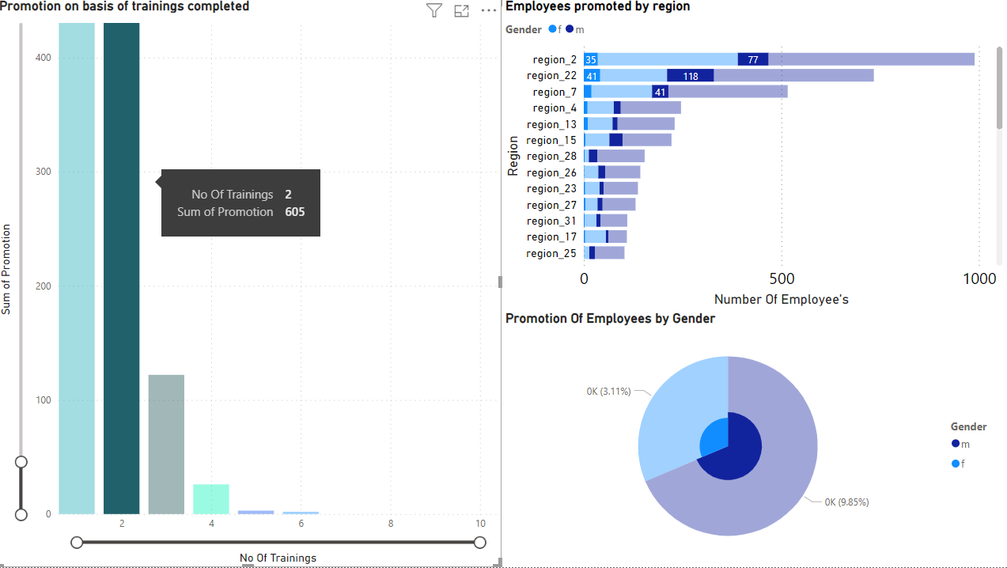
This dashboard shows the promotion of the employee’s based on the number of trainings taken in different regions with male to female ratio
Total Male Employees: 38496
Total Female Employees: 16312
Total Employees Promoted: 4668
Success Ratio Of Promotion (M:F) –
8.3 : 9
Employee’s with 1 training have been promoted the most and then it gradually decreases as the number of training increases which is one of the major KPI’S noted. Throughout, more number of male employees have been promoted over female

Slide 23
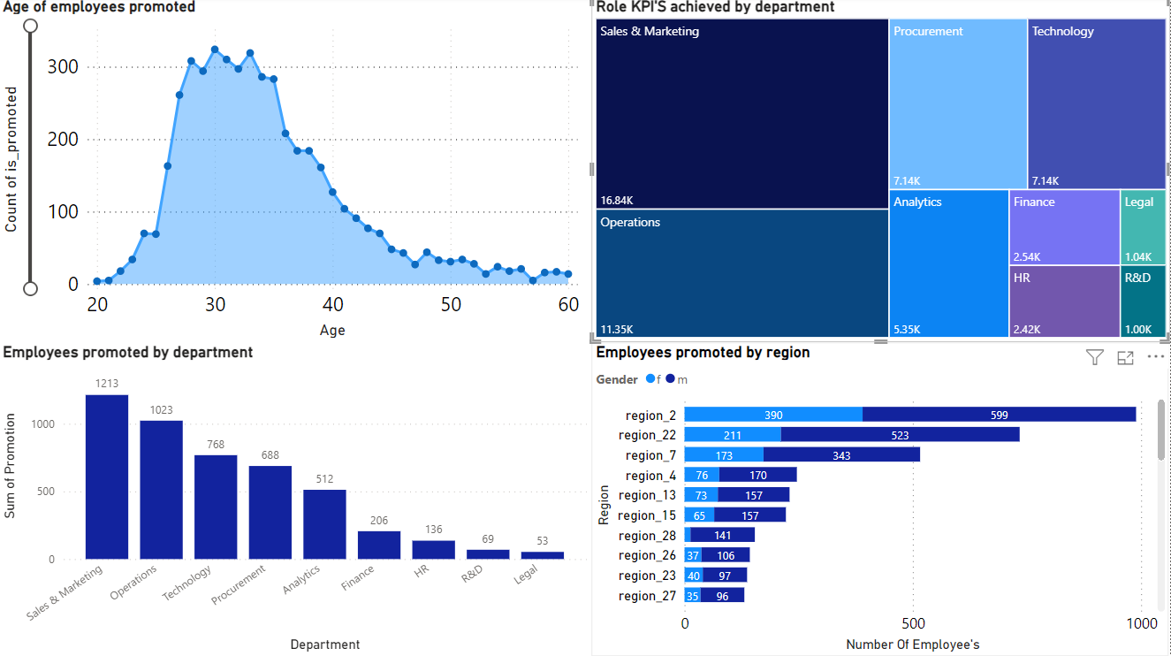
Interactive Dashboard with different parameters / variables to gain insights on employees promoted and nature of variables affecting each other
Age Of Employees Promoted
Role based KPI’S achieved By Department
Employees Promoted By Department
Employees Promoted By Region

Slide 24
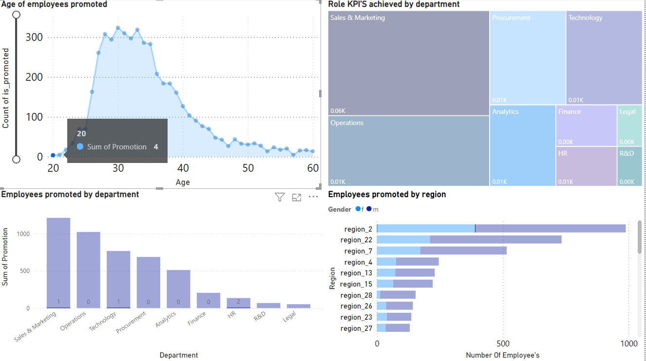
The following dashboard displays the least number of promotions for the Age: 20 which is the lowest as the employee is most likely a new joiner. It also shows the 4 employee’s who have been promoted across different departments.

Slide 25
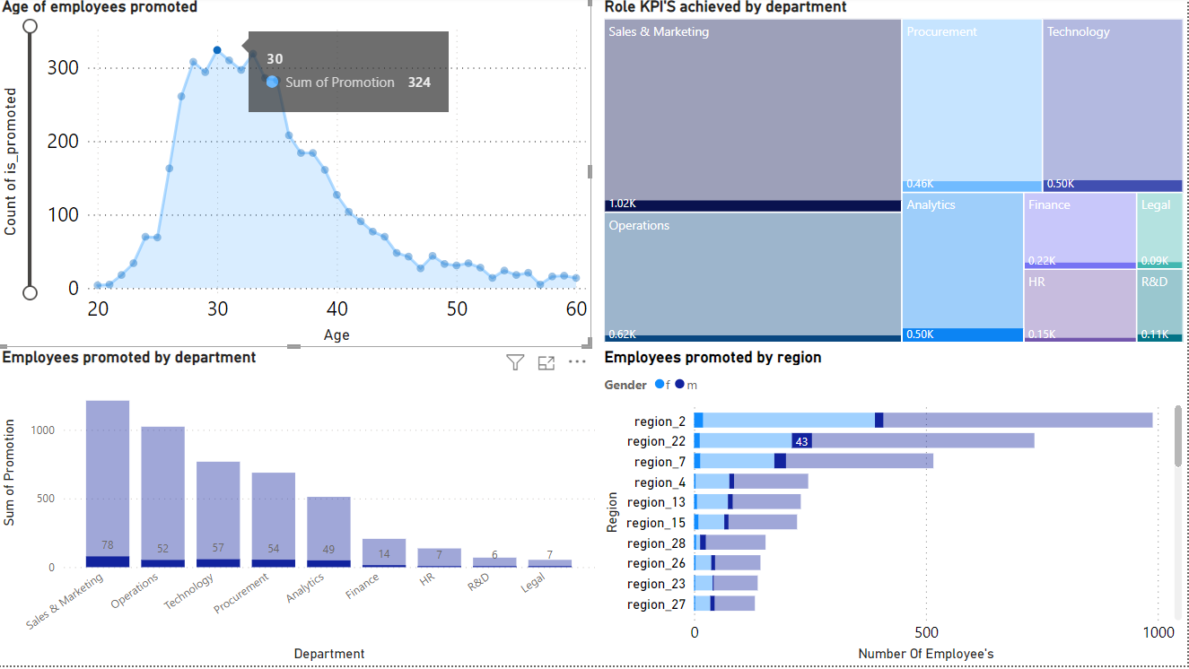
The above visual displays the highest number of promotions for the Age: 30 which is the highest as the employee is most likely at peak of his career or the. It also shows all the 324 employee’s who have been promoted across different departments and employees those who have achieved their KPI’S across different regions.

Slide 26
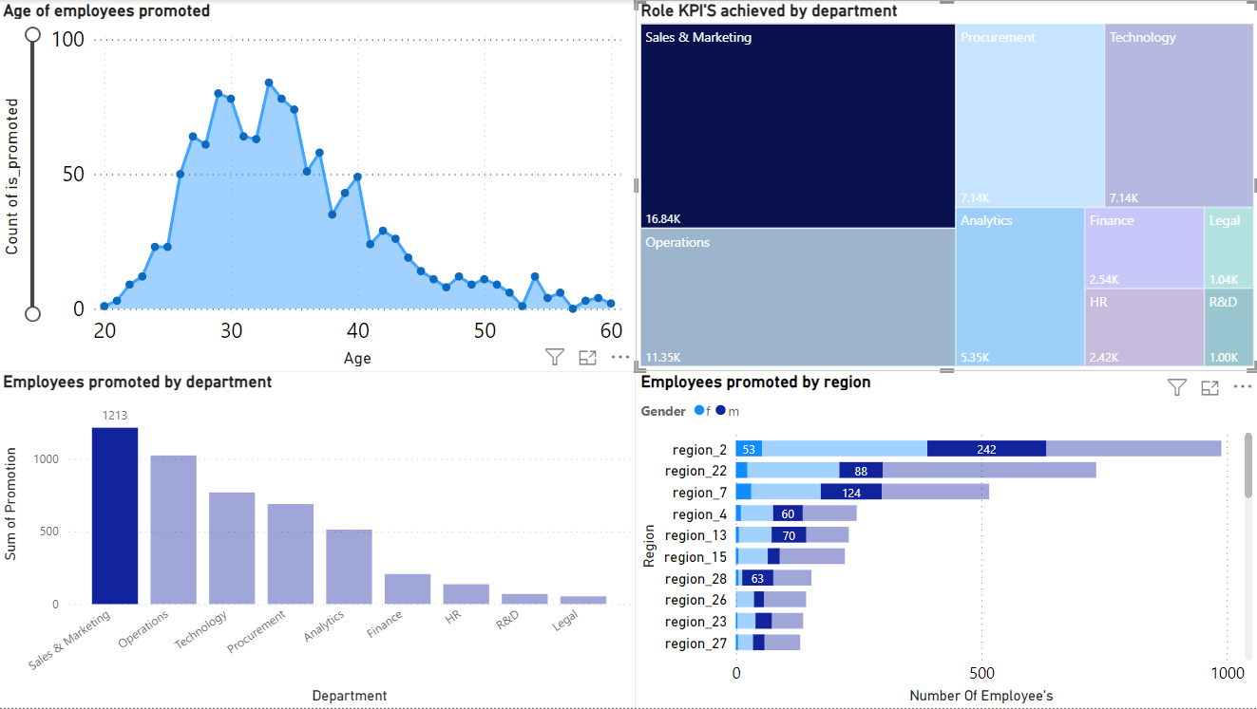
The above visual depicts the total number of employees achieved KPI>80% across various departments and the total number of employees promoted in a particular department across various regions with F:M ratio.

Slide 27
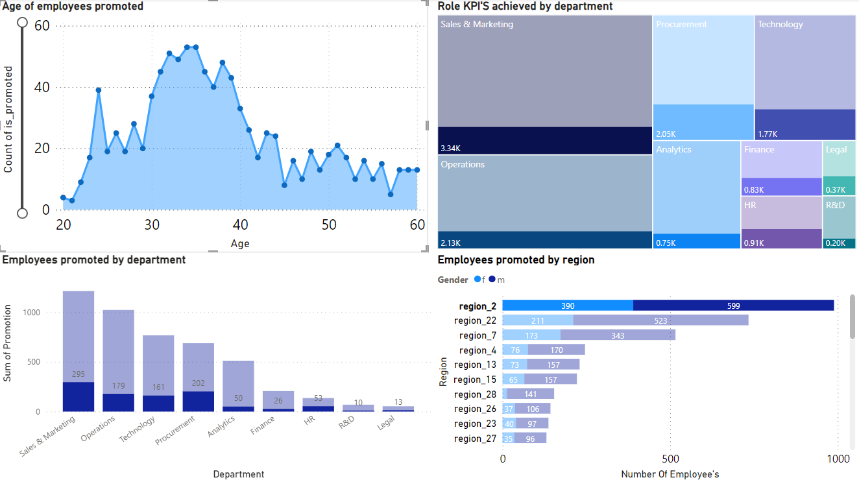
The following dashboard shows employees promoted in region 2 in different departments and people who have achieved KPI’S>80%.

Slide 28
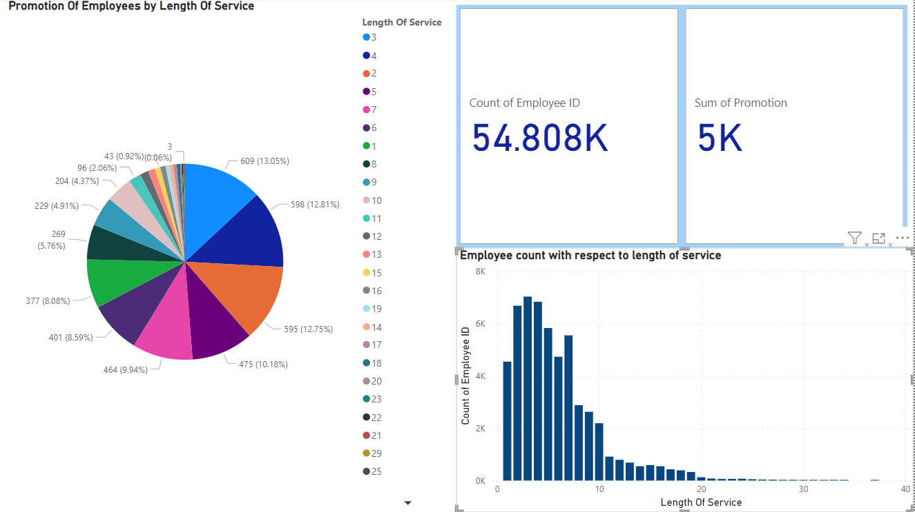

Slide 29
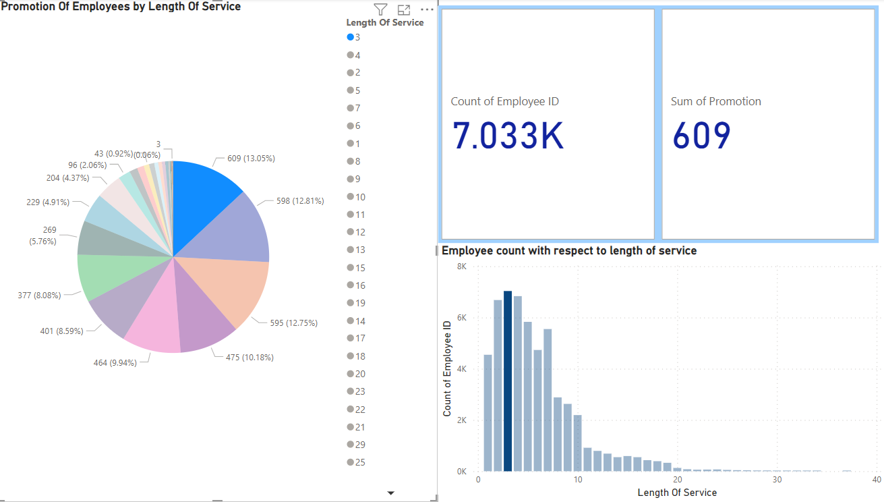

Slide 30
PREDICTION MODELLING

Slide 31
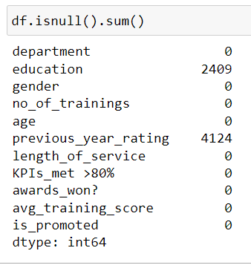
Data Preparation for Prediction Model
What’s the significance of the Data Prep?​
Null Values​
Dropped Features?​
EmployeeID
Region
Recruitment_Channel

Slide 32
Data Preparation for Prediction Model
Categorizing features into categories
Age | Class
20 Yrs to 30 Yrs | Early Career
30 Yrs to 40 Yrs | Mid Career
40 Yrs to 50 Yrs | Established Professional
More than 50 Yrs | Experienced Leaders
Average Training Score | Class
Less than 60 | Poor
60 to 70 | Below Average
70 to 80 | Average
80 to 90 | Above Average
More than 90 | Excellent
Length of Service | Class
Less than 5 Yrs | Novice
5 Yrs to 10 Yrs | Intermediate
10 Yrs to 15 Yrs | Advanced
More than 15 Yrs | Expert

Slide 33
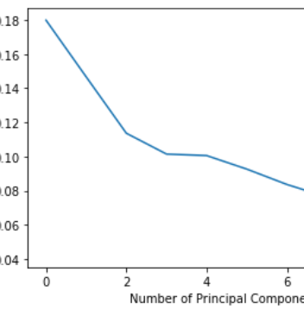
Data Preparation for Prediction Model
Standardization
Mean = 0 & STD = 1
PCA
Principal Component Analysis
LDA
Linear Discriminant Analysis

Slide 34
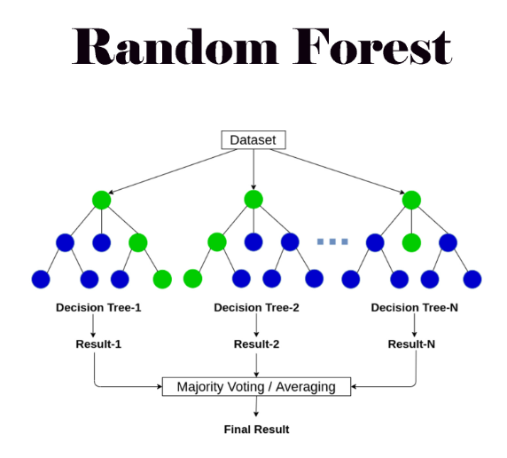
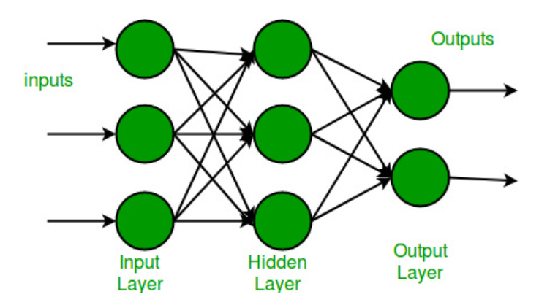
Data Modelling
Multilayer Perceptron

Slide 35
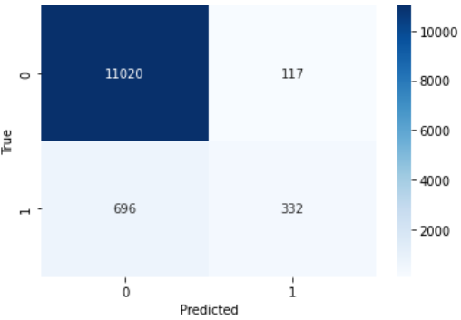
Model Evaluation
Model / Data | Standardize Data | PCA | LDA
Random Forest | 93.31% | 87.92% | 85.60%
MLP | 92.49% | 89.66% | 91.52%

Slide 36

Conclusion
We can say that No. Of Trainings and Role Based KPI’s met are the most important factors in determining the chances of Promotion.
Age also plays an Important role, As per the Analysis an Employee should be Upskilled upto a certain extent to Improve their chances of promotion. The most chances for a Promotion is for Employees between 25 to 35 Yearsof Age.
The Best Predictive Model upon analysis is found to be Random Forest Model with 93.31%.
Awards Won by Employees didn’t account to much of Promotions. We could almost say that they are Consolation Prizes.

Slide 37


THANK YOU

