Slide 1
Unlocking the World Of Banking: Understanding Processes and Protocols
Team Members:
Srinivas Kurakula
Dhruv Parmar
Karthik Urala
Venkata Mukesh Chadaram
Shailesh Gupta

Slide 2
Business Processes
KYC
Transactions
Forex
Fraud Detection
Customer Relationship Management

Slide 3
Business Matrix
 | Location | Account | Transaction | Date | Is Forex | Is Fraud | Time | Currency | Complaint
KYC | X | X |  | X
Transaction |  | X | X | X | X |  | X
Forex |  | X | X | X | X |  | X | X
Fraud Detection |  | X | X | X | X | X | X
CRM |  | X | X | X |  |  |  |  | X

Slide 4
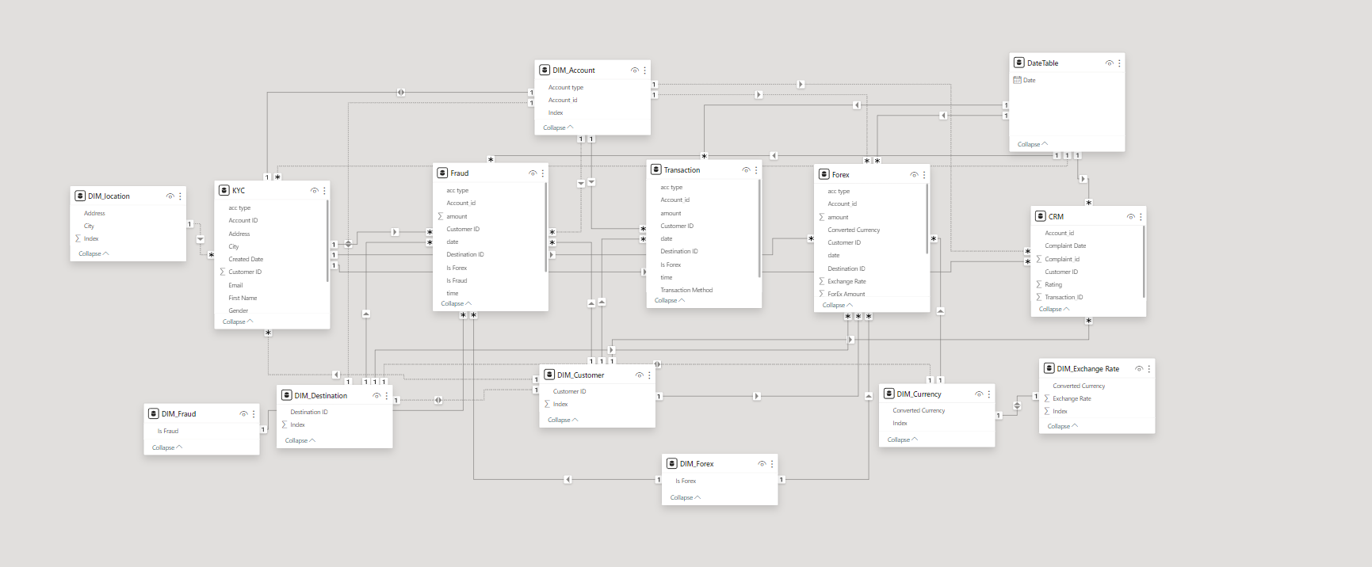
Consolidated Model

Slide 5
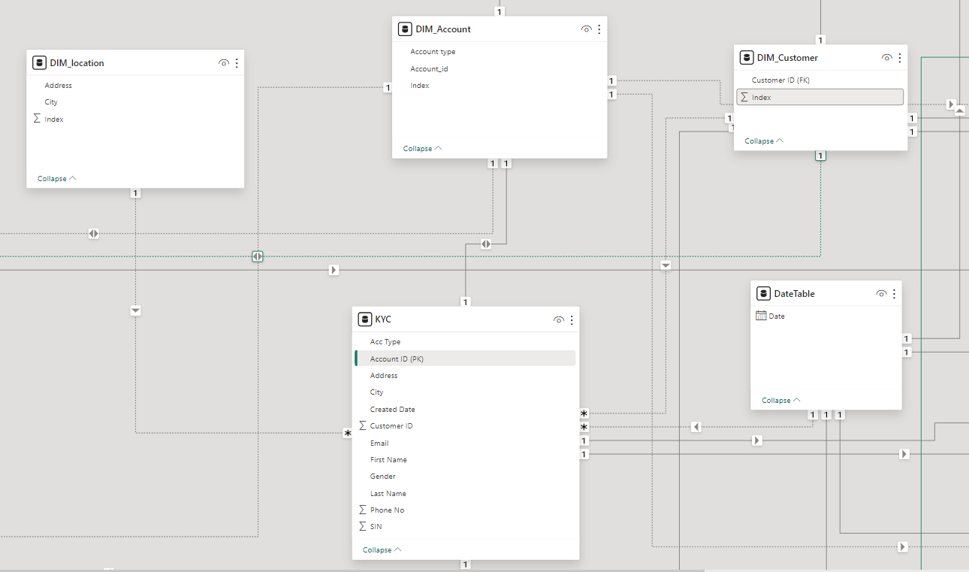
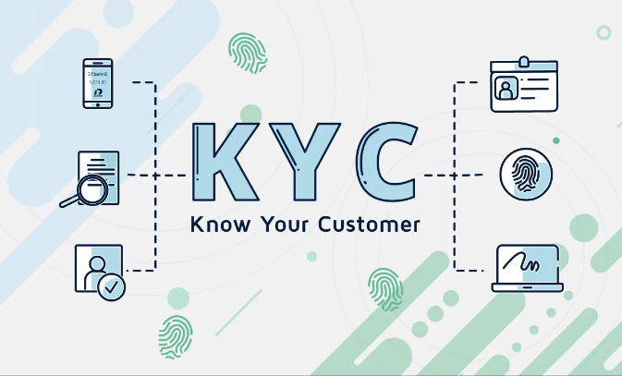
Know Your Customer (KYC)
KYC is a process used by banks to verify the identity of their clients, assess their risk levels, and ensure compliance with regulations, ultimately aiming to prevent money laundering, fraud, and other illicit activities.

Slide 6
Importance of KYC
Enhanced Security: KYC processes help banks mitigate fraud risks by verifying customer identities, ensuring secure transactions, and protecting against identity theft.
Regulatory Compliance: KYC is crucial for banks to comply with anti-money laundering (AML) regulations and counterterrorism financing standards, avoiding hefty penalties.
Customer Trust: Implementing rigorous KYC measures builds customer trust, as it demonstrates a bank’s commitment to safeguarding personal and financial information.
Operational Efficiency: Effective KYC procedures streamline customer onboarding and transaction processes, leading to improved operational efficiency and customer satisfaction.
Risk Management: By knowing their customers, banks can better manage and mitigate risks associated with financial crimes, ensuring the stability and integrity of the banking systems.

Slide 7
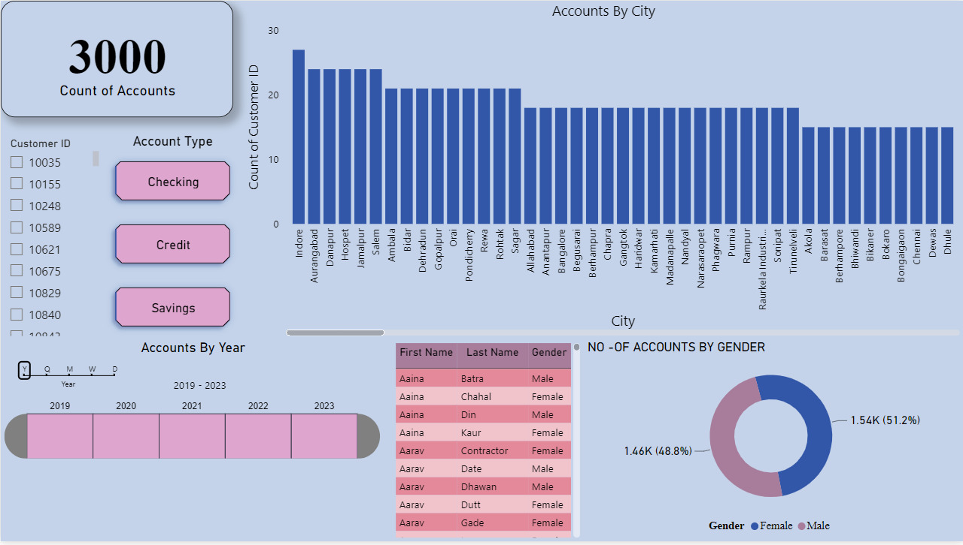

Slide 8
Observations
Total number of customers onboarded across 3 years (2019-2021) is 3000.
Total male-to-female ratio of customers is 1464:1536
Over the period, the highest number of accounts were created in Indore in 2019, while the lowest was in Sirsa.

Slide 9
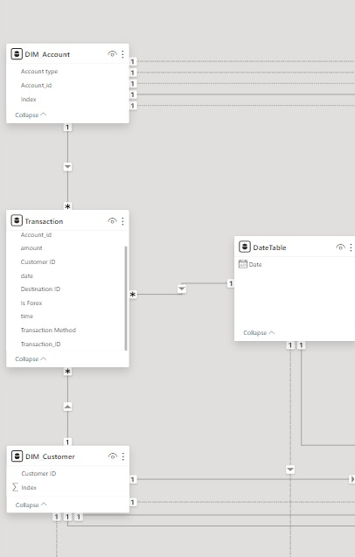
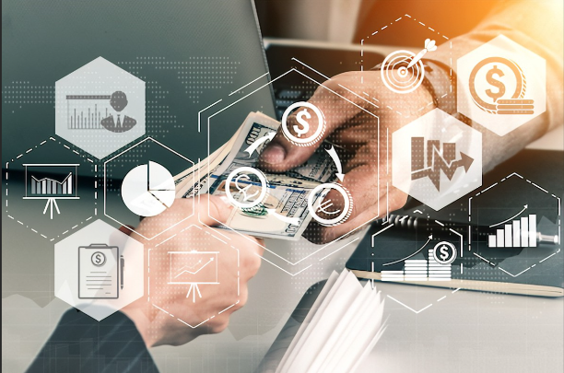
Transactions
A transaction refers to the exchange of funds or assets between two parties, typically involving the transfer of money from one account to another.

Slide 10
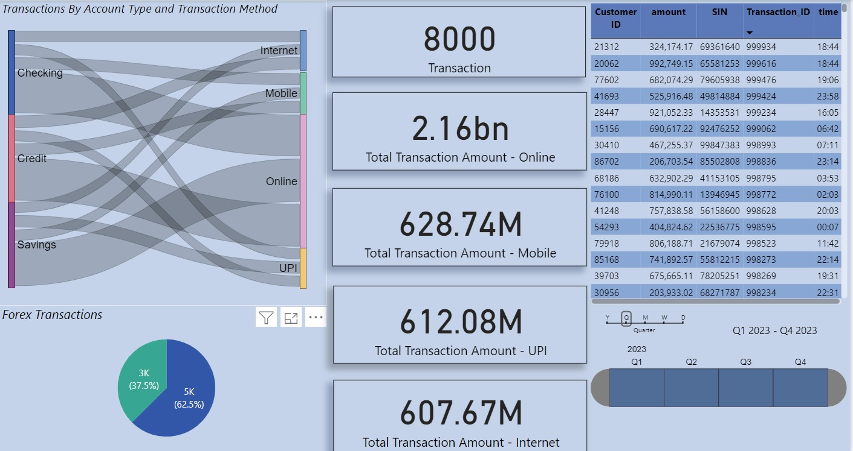

Slide 11
Insights / Observations
Total Transactions Amount via Online banking - 2.16 BN (There is a huge difference in total amount with respect to other banking methods due to Forex transactions being only done via Online Banking)
Total Transactions Amount via Mobile banking - 628.74
Total Transactions Amount via UPI banking - 612.08
Total Transactions Amount via internet banking - 607.67
Ratio % of Forex to Domestic transaction 37.5 : 62.5
Total amount of Forex transactions is: 1.49 BN across 3000 transaction IDs.

Slide 12
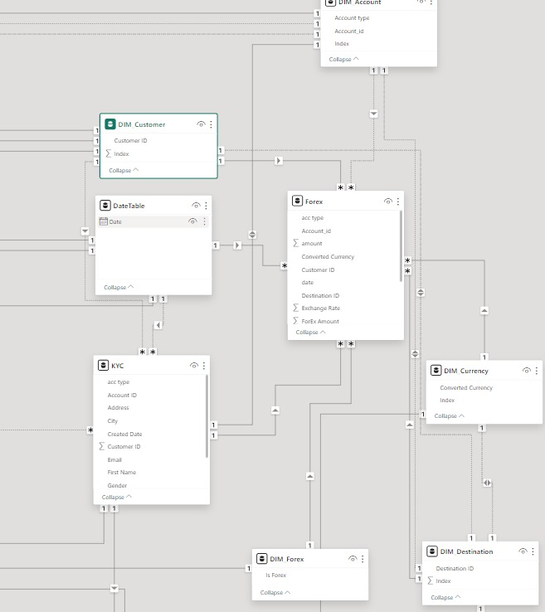

Forex
Forex is a global marketplace where currencies are traded. It’s the largest and most liquid financial market in the world, with an average daily trading volume exceeding trillions of dollars.

Slide 13
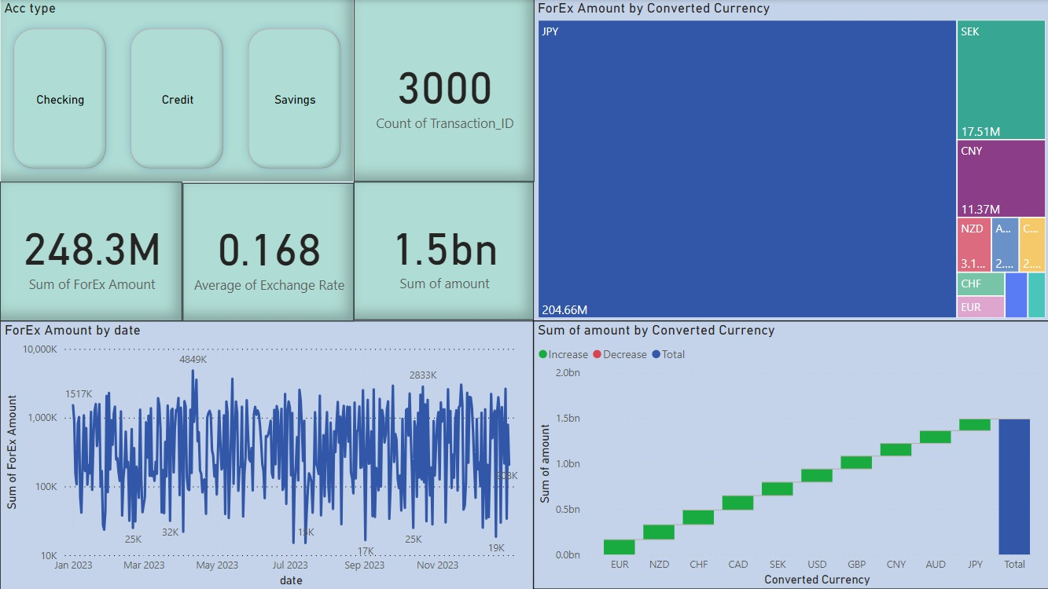

Slide 14
Insights / Observations
We can see the trend in the data that shows the movement of exchange rates to relatively higher and lower values over time.
The peak of transactional activity is observed on August , with subsequent surges continuing on November and January indicating noticeable periods of heightened market participation.
The cumulative trading volume reaches an impressive 1.5 billion across all currency pairs.
The aggregate sum of Forex transactions amounts to substantial 0.2 billion units, reflecting dynamic activity within the Forex market.
The Japanese Yen commands the highest trading volume while the Euro registers the lowest activity among currencies traded.

Slide 15
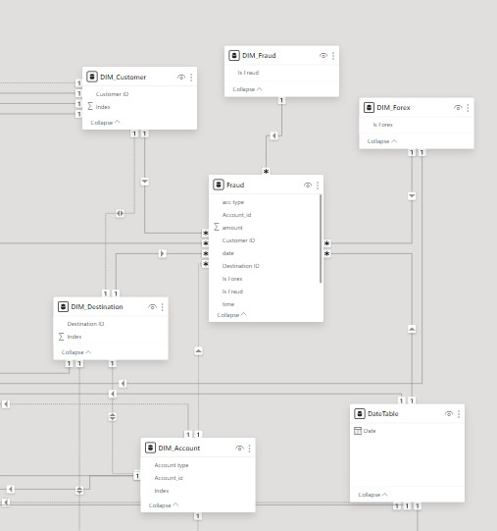
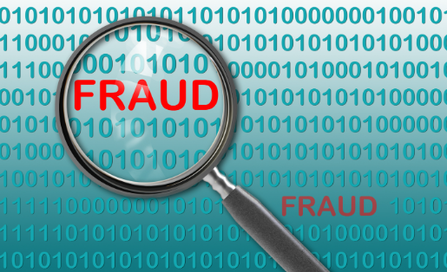
Fraud Detection
Fraud detection involves analyzing customer transactions and behaviors, and identifying and preventing fraudulent activities to safeguard the bank’s assets and maintain customer trust.

Slide 16
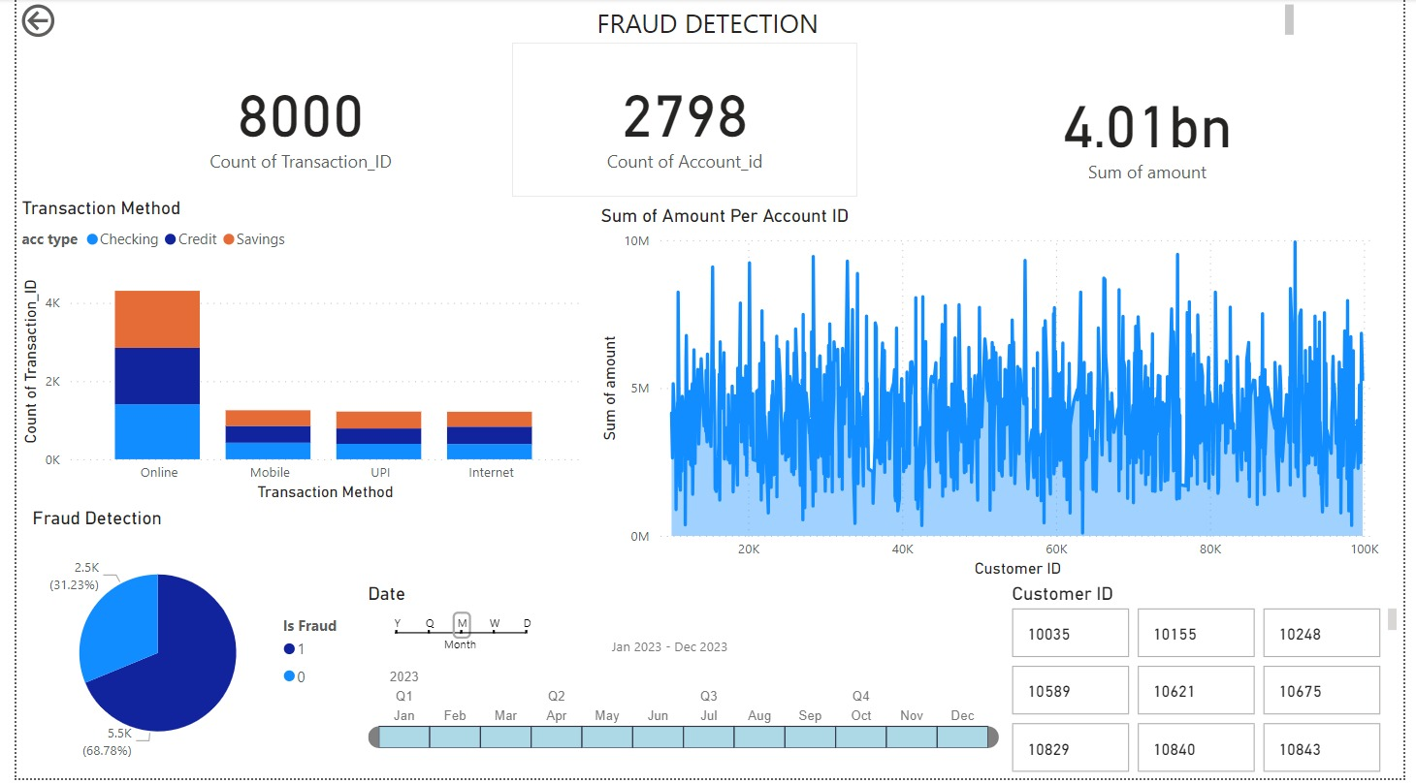

Slide 17
Insights/ Observations
Total Transactions: There were 8000 transactions, totaling 4.01 billion.
Fraudulent Transactions: 5502 transactions amounting to 2.76 billion.
Non-Fraudulent Transactions: 2498 transactions totaling 1.25 billion.
Payment Method Breakdown: Online Transactions: 4310 transactions accounted for 2.16 billion. UPI Transactions: 1220 transactions totaled 628.74 million. Internet Transactions: 1216 transactions amounted to 612.08 million. Mobile Transactions: 1254 transactions summed up to 607.67 million.
Distribution by Account Types: Savings Account Transactions: 2674 transactions totaled 1.34 billion. Credit Account Transactions: 2709 transactions amounted to 1.36 billion. Chequing Account Transactions: 2617 transactions summed up to 1.31 billion.

Slide 18
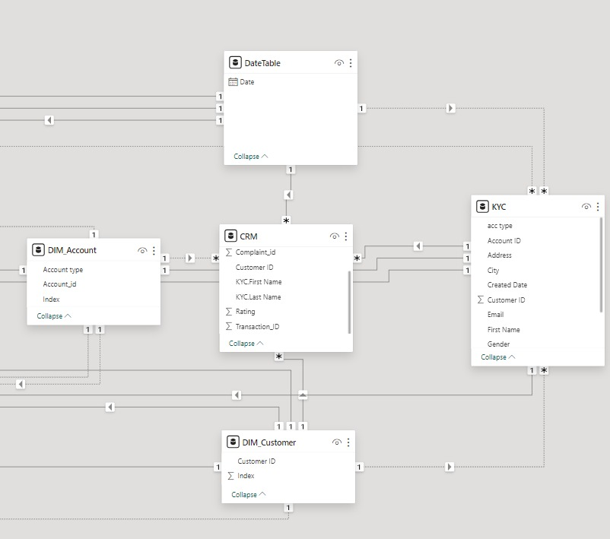
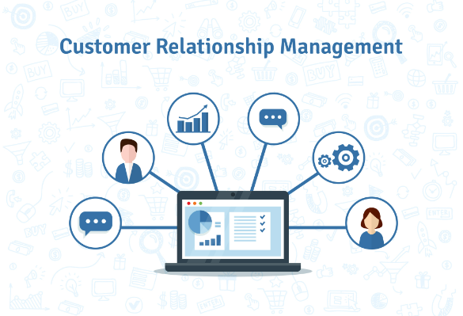
Customer Relationship Management (CRM)
CRM refers to strategies, processes, and technologies that banks use to manage and analyze interactions with their customers throughout entire customer lifecycle.

Slide 19
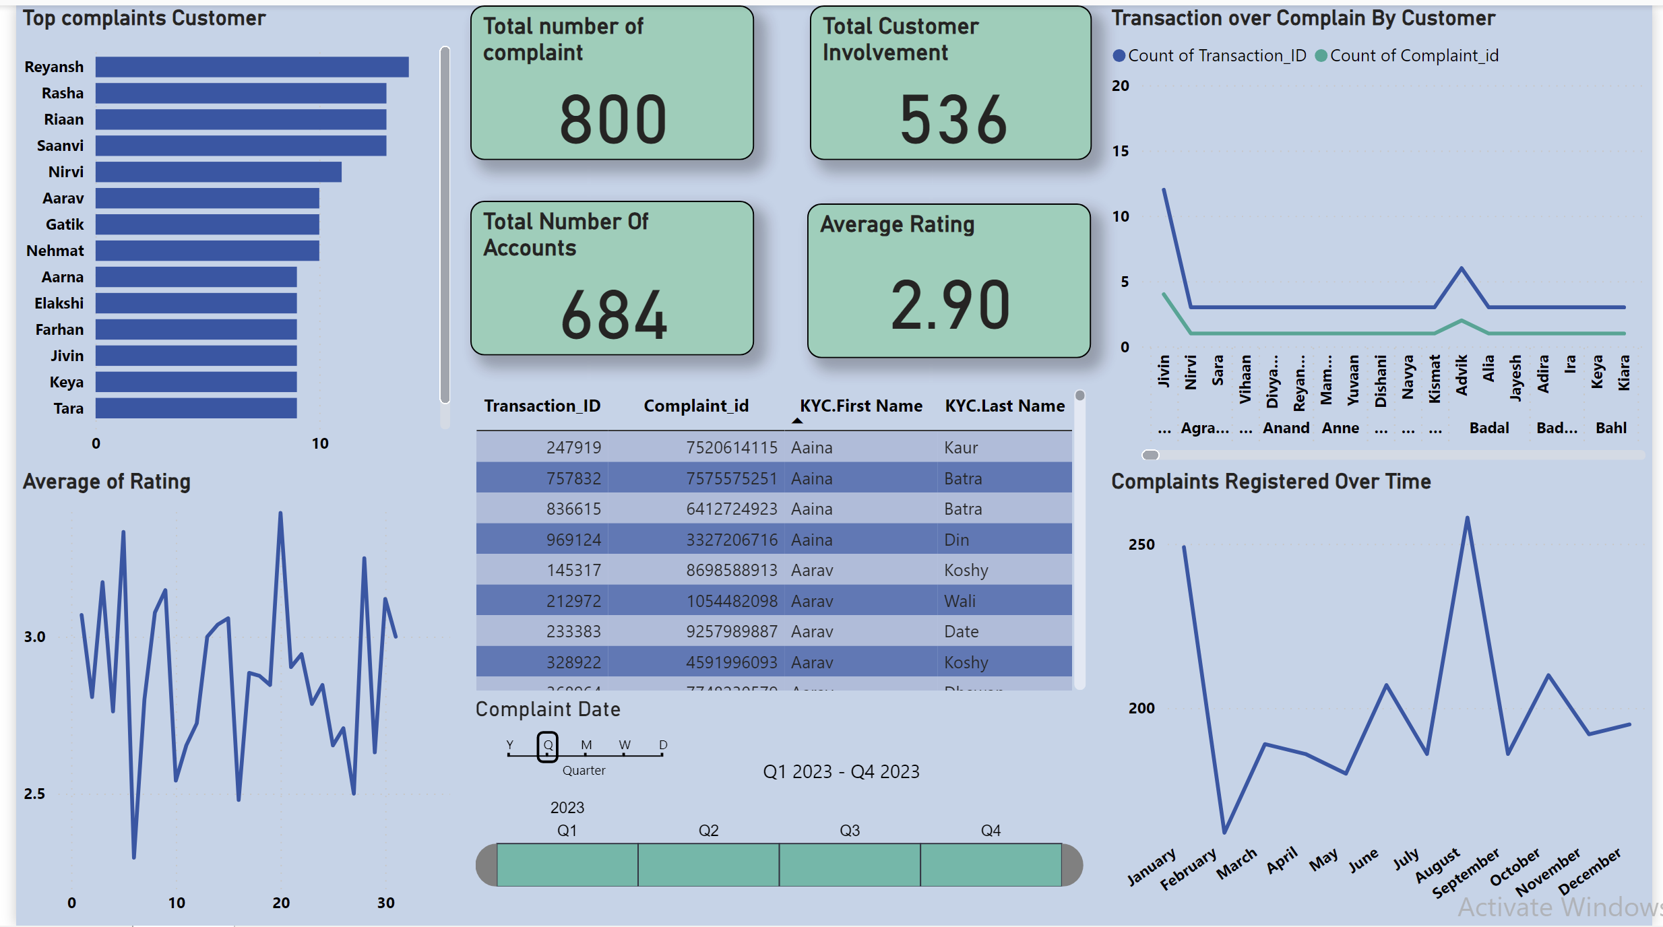

Slide 20
Insights / Observations
In September, we experienced the highest number of complaints, reflecting a notable spike in customer feedback during that period.
Reyansh lodged the highest number of complaints, whereas Tara filed comparatively fewer grievances, indicating different levels of feedback participation.
The average rating experiences a decline during the second week of the month, reaching its peak by the fourth week, demonstrating fluctuations in satisfaction levels over the course of the month.
Throughout the interactions, Jivin has engaged in nearly 15 transactions, and despite this significant activity, only around 5 instances have resulted in any complaints whereas Advik engaged in 8 transactions, but got around 3 complaints and the rest are stationary.

Slide 21







