Slide 1
Why Java 8 ?
Most popular and widely accepted language in the world.
Java creators wanted to introduce the Functional features such as:
Lambdas
Streams
Optional and etc.,
Technological advancements with the mobile/laptops/systems.
New Java 8 features simplify the concurrency operations.

Slide 2
Functional Programming:
Embraces creating Immutable objects.
More concise and readable code.
Using functions/methods as first class citizens.
Example:
Function<String,String> addSomeString = (name) -> name.toUpperCase().concat("default");
Write code using Declarative approach.

Slide 3
Imperative vs Declarative Programming

Slide 4
Imperative Style of Programming
Focuses on how to perform the operations.
Embraces Object mutability.
This style of programming lists the step by step of instructions on how to achieve an objective.
We write the code on what needs to be done in each step.
Imperative style is used with classic Object Oriented Programming.

Slide 5
Declarative Style of Programming
Focuses on what is the result you want.
Embraces Object immutability.
Analogous to SQL (Structured Query Languague).
Use the functions that are already part of the library to achieve an objective.
Functional Programming uses the concept of declarative programming.

Slide 6
Imperative vs Declarative Programming
Example 1
Sum of 100 numbers from 0 to 100

Slide 7
Imperative vs Declarative Programming
Example 2
Removing duplicates from a list of integers

Slide 8
What is Lambda Expression?
Lambda is equivalent to a function (method) without a name.
Lambda’s are also referred as Anonymous functions.
Method parameters
Method Body
Return Type
Lambdas are not tied to any class like a regular method.
Lambda can also be assigned to variable and passed around.

Slide 9
Syntax of the Lambda Expression
Lambda Expression:
( ) ->
{ }
Lambda Input Parameters
Arrow
Lambda Body

Slide 10
Usages of Lambda
Lambda is mainly used to implement Functional Interfaces(SAM).
@FunctionalInterface
public interface Comparator<T> {
int compare(T o1, T o2);
}
@FunctionalInterface
public interface Runnable { public abstract void run();
}

Slide 11
Lets code our first Lambda!
Implement Runnable using Lambda

Slide 12
Lambda in Practice ( Things to keep in Mind)
( ) -> Single Statement or Expression; // curly braces are not needed.
( )-> { <Multiple Statements> }; multiple
// curly braces are needed for
//statements

Slide 13
Lambdas vs Legacy Java(until Java7)
Legacy:
Runnable runnable = new Runnable() { @Override
public void run() { System.out.println("Inside Runnable 1");
}
};
Java 8:
Runnable runnableLambda = () -> {System.out.println("Inside Runnable 2");};

Slide 14
Functional Interfaces
Exists since Java 1.0
Definition:
A Functional Interface(SAM) is an interface that has exactly one abstract method.
@FunctionalInterface:
This annotation is introduced as part of the JDK 1.8.
Optional annotation to signify an interface as Functional Interface.

Slide 15
New Functional Interfaces in Java8
Consumer
Predicate
Function
Supplier

Slide 16
New Functional Interfaces in Java8
Consumer – BiConsumer
Predicate - BiPredicate
Function – BiFunction, UnaryOperator, BinaryOperator
Supplier

Slide 17
New Functional Interfaces in Java8
Consumer – IntConsumer, DoubleConsumer, LongConsumer
Predicate – IntPredicate, BiPredicate, LongPredicate
Function – IntFunction, DoubleFunction,
LongFunction,IntToDoubleFunction, IntoLongFunction,DoubletoIntFunction,
DoubletoLongFunction,LongtoIntFunction,
LongtoDoubleFunction,ToIntFunction, ToDoubleFunction,ToLongFunction
Supplier – IntSupplier, LongSupplier, DoubleSupplier, BooleanSupplier

Slide 18
Method Reference
Introduced as part of Java 8 and its purpose is to simplify the implementation Functional Interfaces.
Shortcut for writing the Lambda Expressions.
Refer a method in a class.

Slide 19
Syntax of Method Reference
ClassName::instance-methodName
ClassName::static-methodName Instance::methodName

Slide 20
Where to use Method Reference?
Lambda expressions referring to a method directly.
Using Lambda:
Function<String,String> toUpperCaseLambda = (s)->s.toUpperCase();
Using Method Reference:
Function<String,String> toUpperCaseMethodRefernce = String::toUpperCase;

Slide 21
Where Method Reference is not Applicable ?
Example:
Predicate<Student> predicateUsingLambda = (s) -> s.getGradeLevel()>=3;

Slide 22
Constructor Reference
Introduced as part of Java 1.8
Syntax:
Classname::new

Slide 23
Example:
Supplier<Student> studentSupplier = Student::new;
Invalid:
Student student = Student::new; // compilation issue

Slide 24
Lambdas and Local Variables
What is a Local variable ?
Any variable that is declared inside a method is called a local variable.
Lambdas have some restrictions on using local variables:
Not allowed to use the same the local variable name as
lambda parameters or inside the lambda body.
Not allowed re-assign a value to a local variable.
No restrictions on instance variables.

Slide 25
Local Variables – Not Allowed
Repeated Variable Name:
Variable i is declared in the same scope and used as a parameter in Lambda.
You cannot use the same variable as a lambda parameter or inside the lambda body.
Same Variable as Input:
int i=0; //Repeated varibale name not allowed
Consumer<Integer> c1 = (i) -> {
System.out.println(i+value);
};

Slide 26
Local Variables – Not Allowed
Same Variable as Lambda parameter:
int i=0;
Consumer<Integer> c1 = (i) -> { //Repeated variable name not allowed
System.out.println(i+value);
};
Same Variable in Lambda Body:
int i=0;
Consumer<Integer> c1 = (a) -> {
int i=0; //Repeated variable name not allowed
System.out.println(i+value);
};

Slide 27
Local Variables – Not Allowed
Not allowed to modify the value inside the lamda
int value =4; Consumer<Integer> c1 = (a) -> {
//value=6; //reassigning not allowed
// System.out.println(i+value);
};

Slide 28
Effectively Final
Lambda’s are allowed to use local variables but not allowed to
modify it even though they are not declared final. This concept is called Effectively Final.
Not allowed to modify the value inside the lamda
int value =4;
Consumer<Integer> c1 = (a) -> {
//value=6; //reassigning not allowed
// System.out.println(i+value);
};
Prior to Java 8 , any variable that’s used inside the anonymous class should be declared final.

Slide 29
Advantages of Effectively Final:
Easy to perform concurrency operations.
Promotes Functional Programming and demotes the Imperative style programming.

Slide 30
Introduction to Streams API:
Introduced as part of Java8
Main purpose is to perform some Operation on Collections.
Parallel operations are easy to perform with Streams API without having to spawn a multiple threads.
Streams API can be also used with arrays or any kind of I/O .

Slide 31
What is a Stream ?
Stream is a sequence of elements which can be created out of a collections such as List or Arrays or any kind of I/O resources and etc.,
List<String> names = Arrays.asList("adam","dan","jenny"); names.stream(); // creates a stream
Stream operations can be performed either sequentially or
parallel.
names.parallelStream(); // creates a parallel stream

Slide 32
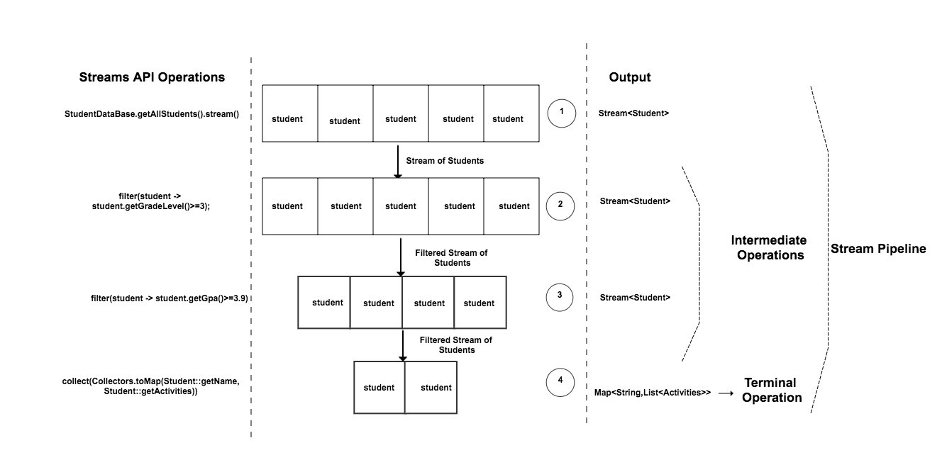
How Stream API Works ?

Slide 33
Collections and Streams
Collections | Streams
Can add or modify elements at any point of time. For Example: List -> list.add(<element>) | Cannot add or modify elements in the stream. It is a fixed data set.
Elements in the collection can be accessed in any order. Use appropriate methods based on the collection. For Example: List -> list.get(4); | Elements in the Stream can be accessed only in sequence.
Collection is eagerly constructed. | Streams are lazily constructed.

Slide 34
Collections and Streams
Collections | Streams
Collections can be traversed “n” number of times. | Streams can be traversed only once.
Performs External Iteration to iterate through the elements. | Performs Internal Iteration to iterate through the elements.

Slide 35
Stream API : map()
map : Convert(transform) one type to another.
Don’t get confused this with Map Collection.

Slide 36
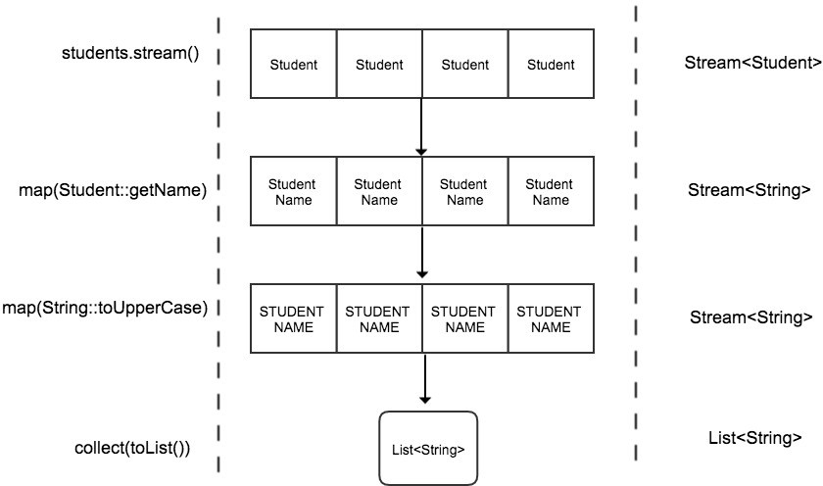

Slide 37
Stream API : flatMap()
flatMap : Converts(Transforms) one type to another as like map() method
Used in the context of Stream where each element in the stream represents multiple elements.
Example:
Each Stream element represents multiple elements.
Stream<List>
Steam<Arrays>

Slide 38
Stream API – distinct() , count() and sorted()
distinct – Returns a stream with unique elements
count – Returns a long with the total no of elements in the Stream.
sorted - Sort the elements in the stream

Slide 39
Stream API – filter()
filter – filters the elements in the stream.
Input to the filter is a Predicate Functional Interface.

Slide 40
Streams API - reduce()
reduce – This is a terminal operation. Used to reduce the contents of a stream to a single value.
It takes two parameters as an input.
First parameters – default or initial value
Second Parameter – BinaryOperator<T>

Slide 41
Stream API : Max/Min using reduce()
max -> Maximum(largest) element in the stream.
min -> Minimum(smallest) element in the stream.

Slide 42
Stream API : limit() and skip()
These two function helps to create a sub-stream.
limit(n) – limits the “n” numbers of elements to be processed in the stream.
skip(n) – skips the “n” number of elements from the stream.

Slide 43
Streams API : anyMatch(), allMatch() , noneMatch()
All these functions takes in a predicate as an input and returns a Boolean as an output.
anyMatch()- Returns true if any one of the element matches the predicate, otherwise false.
allMatch() - Returns true if all the element in the stream matches the predicate, otherwise false.
noneMatch() – Just opposite to allMatch(). Returns true if none of the element in the stream matches the predicate, otherwise false.

Slide 44
Streams API : findFirst() and findAny()
Used to find an element in the stream.
Both the functions returns the result of type Optional.
findFirst() – Returns first element in the stream.
findAny() – Returns the first encountered element in the stream.

Slide 45
Streams API - Short Circuiting

Slide 46
What is Short Circuiting ?
Examples of Short Circuiting:
Example 1:
if(boolean1 && boolean2){ //AND
//body
}
If the first expression evaluates to false then the second expression wont even execute.
Example 2:
if(boolean1 || boolean2){ //OR
//body
}
If the first expression evaluates to true then the second expression wont even execute.

Slide 47

Streams API Short Circuit functions
findFirst() findAny()
anyMatch() allMatch() noneMatch()
limit()
All these functions does not have to iterate the whole stream to evaluate the result.

Slide 48
Streams API : Stateful vs Stateless
Does Streams have an internal state?
Yes
Does all the Stream functions maintain an internal state ?
No

Slide 49
What is a State in Streams API ?
Converts a List<Student> to List<String>
private static List<String> namesUpperCase(List<Student> names){ List<String> namesUpperCase = names.stream()
.map(Student::getName)
.map(String::toUpperCase)
Pipeline)
.collect(toList());
(Stream State) (Stream
return namesUpperCase;
}

Slide 50
Intermediate Operations
Stateful functions
distinct()
sorted()
skip()
limit()
Stateless functions
map()
filter(), etc.,

Slide 51
Stateful functions:
Convert List<Student> to List<String>
public static List<String> printUniqueStudentActivities() { List<String> studentActivities = StudentDataBase.getAllStudents()
.stream()
.map(Student::getActivities)
.flatMap(List::stream)
.distinct() // needs the state of the previously processed elements
.sorted() // needs the state of the previously processed elements
.collect(toList());
return studentActivities;
}

Slide 52
Stateless Functions:
Convert List<Student> to List<String>
private static List<String> namesUpperCase(List<Student> names){ List<String> namesUpperCase = names.stream() //Stream<Student>
.map(Student::getName) //Stream<String> - stateless
.map(String::toUpperCase) // Stream<String> -> UpperCase -
stateless
.collect(toList()); // returns List - stateless
return namesUpperCase;
}

Slide 53
Streams API – Factory methods
Of()
generate()
iterate()

Slide 54
Streams API – of(), iterate() and generate()
Of() -> Creates a stream of certain values passed to this method.
Example:
Stream<String> stringStream = Stream.of(“adam”,”dan”,”Julie”);
iterate(), generate() -> Used to create infinite Streams.
Example:
Stream.iterate(1, x->x*2)
Example:
Stream.generate(<Supplier>)

Slide 55
Numeric Streams
Represents the primitive values in a Stream.
IntStream
LongStream
DoubleStream

Slide 56
Numeric Stream Ranges:
Int Stream:
IntStream.range(1,50) -> Returns an IntStream of 49 elements from 1 to 49.
IntStream.rangeClosed(1,50) -> Returns an IntStream of 50 elements from 1 to 50.
Long Stream:
LongStream.range(1,50) -> Returns a LongStream of 49 elements from 1 to 49.
LongStream.rangeClosed(1,50) -> Returns a LongStream of 50 elements from 1 to 50.
DoubleStream:
- It does not support the range ()and rangeClosed().

Slide 57
Numeric Stream – Aggregate Functions
sum()
max()
min()
average()

Slide 58
Numeric Streams : Boxing() and UnBoxing()
Boxing():
Converting a primitive type to Wrapper Class type
Example:
Converting an int (primitive) to Integer(wrapper).
UnBoxing():
Converting a Wrapper Class type to primitive type.
Example:
Converting an Integer(wrapper) to int(primitive).

Slide 59
Numeric Streams – mapToObj(), mapToLong(), mapToDouble()
mapToObj –> Convert a each element numeric stream to some Object.
mapToLong –> Convert a numeric stream to a Long Stream.
mapToDouble –> Convert a numeric stream to a Double Stream.

Slide 60
Stream Terminal Operations
Terminal Operations collects the data for you.
Terminal Operations starts the whole stream pipeline.
Terminal Operations:
forEach()
min()
max()
reduce()
collect() and etc.

Slide 61
Terminal Operation – collect()
The collect() method takes in an input of type Collector.
Produces the result as per the input passed to the collect() method.

Slide 62
Terminal Operations – joining()
joining() Collector performs the String concatenation on the elements in the stream.
joining() has three different overloaded versions.

Slide 63
Terminal Operations – counting()
counting() Collector returns the total number of elements as a result.

Slide 64
Terminal Operation – mapping()
mapping() collector applies a transformation function first and then collects the data in a collection( could be any type of collection)

Slide 65
Terminal Operations – maxBy() , minBy()
Comparator as an input parameter and Optional as an output.
maxBy()
This collector is used in conjunction with comparator. Returns the max element based on the property passed to the comparator.
minBy()
This collector is used in conjunction with comparator. Returns the smallest element based on the property passed to the comparator.

Slide 66
Terminal Operations – summingInt(), averagingInt()
summingInt() – this collector returns the sum as a result.
averagingInt() – this collector returns the average as a result.

Slide 67
Terminal Operations - groupingBy()
groupingBy() collector is equivalent to the groupBy() operation in SQL.
Used to group the elements based on a property.
The output of the groupingBy() is going to be a Map<K,V>
There are three different versions of groupingBy().
groupingBy(classifier)
groupingBy(classifier,downstream)
groupingBy(classifier,supplier,downstream)

Slide 68
Terminal Operations – partitioningBy()
partitioningBy() collector is also a kind of groupingBy().
paritioningBy() accepts a predicate as an input.
Return type of the collector is going to be Map<K,V>
The key of the return type is going to be a Boolean.
There are two different versions of partitioningBy()
partitioningBy(predicate)
partitioningBy(predicate,downstream) // downstream -> could be of any collector

Slide 69
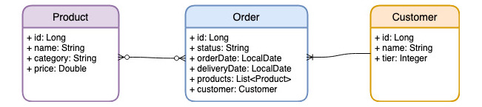
Stream Practice Problems
We are going to use following data structure for out stream workout.
To practice it, I have found some data and stored it in H2 DB.
Lets code some practice problems to cover all the theory that we have learnt till now, as per the following GitHub link :

Slide 70
Introduction to Parallel Streams

Slide 71
What is a Parallel Stream ?
Splits the source of data in to multiple parts.
Process them parallelly.
Combine the result.

Slide 72
How to Create a Parallel Stream ?
Sequential Stream:
IntStream.rangeClosed(1,1000)
.sum();
Parallel Stream:
IntStream.rangeClosed(1,1000)
.parallel()
.sum();

Slide 73
How Parallel Stream works ?
Parallel Stream uses the Fork/Join framework that got introduced in Java 7.
How many Threads are created ?
Number of threads created == number of processors available in the machine.

Slide 74
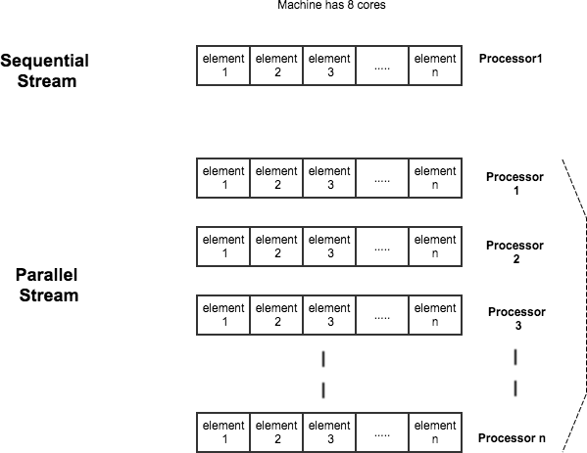

Slide 75
Introduction to Optional
Introduced as part of Java 8 to represent a Non-Null value
Avoids Null Pointer Exception and Unnecessary Null Checks.
Inspired from the new languages such as scala , groovy etc.,

Slide 76
Default and Static Methods in Interfaces

Slide 77
Interfaces in Java - Prior Java 8:
Define the contract.
Only allowed to declare the method. Not allowed to implement a method in Interface.
Implementation is only allowed in the Implementation class.
Not easy for an interface to evolve.

Slide 78
Default Methods – Java 8
default keyword is used to identify a default method in an interface.
Example from List Interface:
default void sort(Comparator<? super E> c) { Object[] a = this.toArray();
Arrays.sort(a, (Comparator) c); ListIterator<E> i = this.listIterator();
for (Object e : a) { i.next(); i.set((E) e);
}
}
Prior to Java 8 we normally use Collections.sort() to perform the similar operation.
Can be overridden in the Implementation class.
Used to evolve the Interfaces in Java.

Slide 79
Static Methods – Java 8
Similar to default methods.
This cannot be overridden by the implementation classes.

Slide 80
Abstract Classes vs Interfaces in Java 8
Instance variables are not allowed in Interfaces.
A class can extend only one class but a class can implement multiple interfaces.

Slide 81
Does this enable Multiple Inheritance in Java?
Yes
This was never possible before Java 8.

Slide 82
Introduction to New Date/Time Libraries
LocalDate, LocalTime and LocalDateTime and part of the java.time
package.
These new classes are created with the inspiration from the Joda- Time library.
All the new time libraries are Immutable.
Supporting classes like Instant, Duration,Period and etc.
Date, Calendar prior to Java 8.

Slide 83
LocalDate: Used to represent the date.
LocalTime: Used to represent the time.
LocalDateTime: Used to represent the date and time.

Slide 84
Period:
Period is a date-based representation of time in Days , Months and Years and is part of the java.time package.
Compatible with LocalDate.
It represents a Period of Time not just a specific date and time.
Example:
Period period1 = Period.ofDays(10); // represents a Period of 10 days
Period period2 = Period.ofYears(20); // represents a Period of 20 years

Slide 85
Period : Use-Case
Mainly used calculate the difference between the two dates.
Example:
LocalDate localDate = LocalDate.of(2018,01,01); LocalDate localDate1 = LocalDate.of(2018,01,31);
Period period = Period.between(localDate,localDate1); // calculates the difference between the two dates

Slide 86
Duration
A time based representation of time in hours , minutes, seconds and nanoseconds.
Compatible with LocalTime and LocalDateTime
It represents a duration of time not just a specific time.
Example:
Duration duration1 = Duration.ofHours(3);; // represents the duration of 3 hours
Duration duration1 = Duration. ofMinutes(3); // represents the duration of 3 minutes

Slide 87
Duration : Use-Case
It can be used to calculate the difference between the time objects such as LocalTime and LocalDateTime.
Example:
LocalTime localTime = LocalTime.of(7,20); LocalTime localTime1 = LocalTime.of(8,20);
Duration duration = Duration.between(localTime,localTime1);

Slide 88
Instant:
Represent the time in a machine readable format.
Example:
Instant ins = Instant.now();
- Represents the time in seconds from January 01,1970(EPOCH) to current time as a huge number.

Slide 89
Time Zones
ZonedDateTime, ZoneID, ZoneOffset
ZonedDateTime - Represents the date/time with its time zone.
Example:
2018-07-18T08:04:14.541-05:00[America/Chicago]
ZoneOffset-> -05:00
ZoneId -> America/Chicago

Slide 90
DateTimeFormatter
Introduced in Java 8 and part of the java.time.format
package.
Used to parse and format the LocalDate, LocalTime and
LocalDateTime.

Slide 91
Parse and Format
parse - Converting a String to a LocalDate/LocalTime/ LocalDateTime.
format - Converting a LocalDate/LocalTime/LocalDateTime to a String.

