Slide 1
What is Bootstrap ?
Responsive, Mobile First
Bootstrap Latest v4.1x
Currently v4.1.3
Previous Stable Version v3.3.7

Slide 2
About Bootstrap
Bootstrap is a free front-end framework for faster and easier web development
Bootstrap includes HTML and CSS based design templates for typography, forms, buttons, tables, navigation, modals, image carousels and many other, as well as optional JavaScript plugins
Bootstrap also gives you the ability to easily create responsive designs
What is Responsive Web Design? Responsive web design is about creating web sites which automatically adjust themselves to look good on all devices, from small phones to large desktops.
Bootstrap 4 is the newest version of Bootstrap; with new components, faster stylesheet and more responsiveness.
Bootstrap 4 supports the latest, stable releases of all major browsers and platforms. However, Internet Explorer 9 and down is not supported.
If you require IE8-9 support, use Bootstrap 3. It is the most stable version of Bootstrap, and it is still supported by the team for critical bug-fixes and documentation changes. However, new features will NOT be added to it.

Slide 3
Why use it ?
Advantages of Bootstrap:
Easy to use: Anybody with just basic knowledge of HTML and CSS can start using Bootstrap
Responsive features: Bootstrap's responsive CSS adjusts to phones, tablets, and desktops
Mobile-first approach: In Bootstrap, mobile-first styles are part of the core framework
Browser compatibility: Bootstrap 4 is compatible with all modern browsers (Chrome, Firefox, Internet Explorer 10+, Edge, Safari, and Opera)
Downloading Bootstrap 4 : We will Discuss this thing in our Upcoming Slides
There are two ways to start using Bootstrap 4 on your own web site.
You can:
Include Bootstrap 4 from a CDN
Download Bootstrap 4 from getbootstrap.com

Slide 4
Have a look at Acadview website on different devices

Slide 5

Desktop/laptop

Slide 6

Tablet/ipad

Slide 7
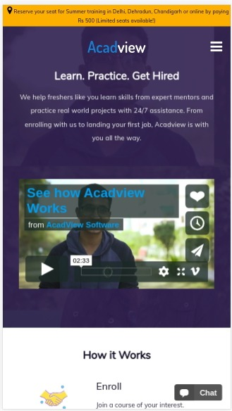
Mobile/smartphones

Slide 8
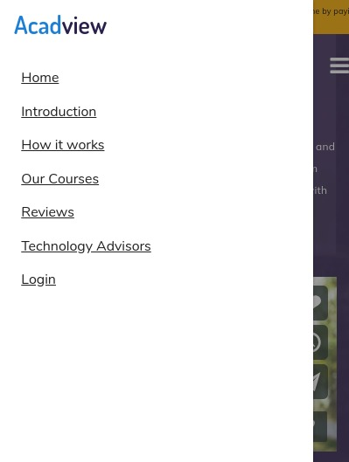
Mobile/smartphones with navbar open

Slide 9
This responsive web design can be done very easily with bootstrap library.

Slide 10
Bootstrap Features

Slide 11

Responsive

Slide 12
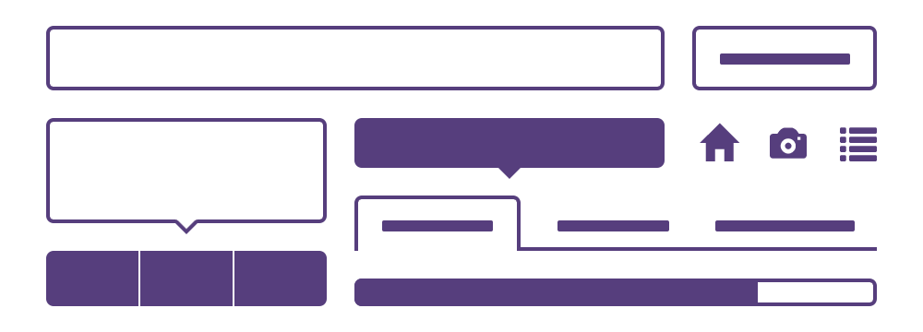
Components

Slide 13
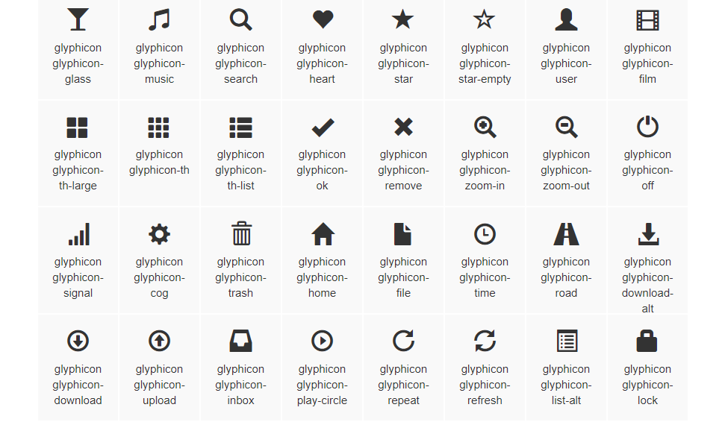
Glymphicons

Slide 14
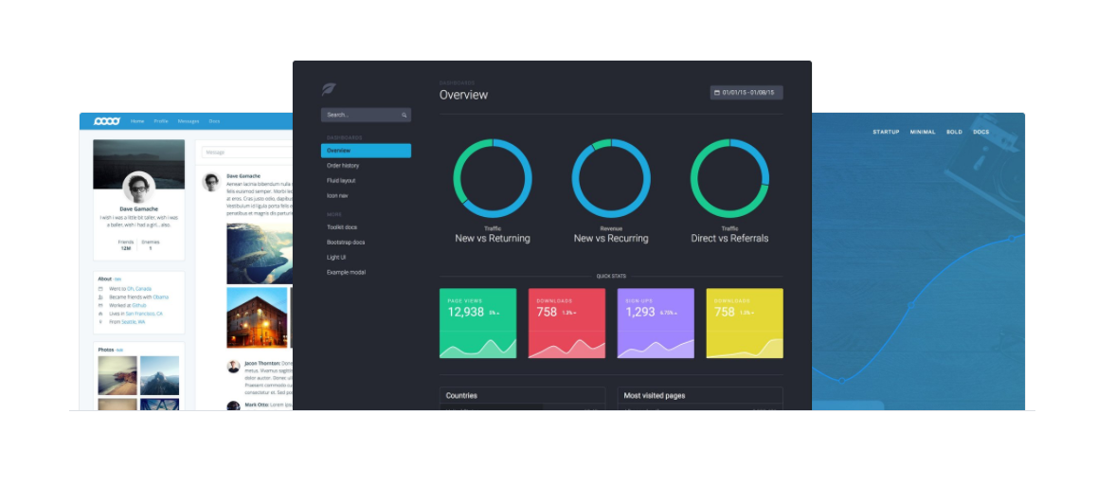
Theme Support

Slide 15
Theme Support
Responsive
Grid
Components
Navbar
Button
Progress bar
Dropdowns etc
Great Community Support

Slide 16
Installation

Slide 17
Go-to Official Website

Slide 18
Bootstrap Classes

Slide 19
Most everything that you want to add onto a page by using Bootstrap is done by adding classes and HTML to the page. There are numerous Bootstrap classes. Fortunately, you don't have to know or memorize all of them.

Slide 20
Many of the classes are related to one another, so learning the basic concepts of what makes up certain classes is all that's needed. There are many that are pretty straight forward, such as left, right, and Center which will do exactly what you expect.

Slide 21
The goal of this training is not to teach you every Bootstrap class that's available, but rather how to use Bootstrap in your applications.

Slide 22
Good News
Bootstrap uses CSS. This means you are free to customize all classes as needed by using standard CSS and cascading rules.

Slide 23
Starter Template
<!doctype html>
<html lang="en">
<head>
<!-- Required meta tags -->
<meta charset="utf-8">
<meta name="viewport" content="width=device-width, initial-scale=1, shrink-to-fit=no">
<!-- Bootstrap CSS -->
<link rel="stylesheet" href="https://stackpath.bootstrapcdn.com/bootstrap/4.1.3/css/bootstrap.min.css" integrity="sha384-MCw98/SFnGE8fJT3GXwEOngsV7Zt27NXFoaoApmYm81iuXoPkFOJwJ8ERdknLPMO" crossorigin="anonymous">
<title>Hello, Chitkra</title>
</head>
<body>
<h1>Hello,Chitkara!!!</h1>
<!-- Optional JavaScript -->
<!-- jQuery first, then Popper.js, then Bootstrap JS -->
<script src="https://code.jquery.com/jquery-3.3.1.slim.min.js" integrity="sha384-q8i/X+965DzO0rT7abK41JStQIAqVgRVzpbzo5smXKp4YfRvH+8abtTE1Pi6jizo" crossorigin="anonymous"></script>
<script src="https://cdnjs.cloudflare.com/ajax/libs/popper.js/1.14.3/umd/popper.min.js" integrity="sha384-ZMP7rVo3mIykV+2+9J3UJ46jBk0WLaUAdn689aCwoqbBJiSnjAK/l8WvCWPIPm49" crossorigin="anonymous"></script>
<script src="https://stackpath.bootstrapcdn.com/bootstrap/4.1.3/js/bootstrap.min.js" integrity="sha384-ChfqqxuZUCnJSK3+MXmPNIyE6ZbWh2IMqE241rYiqJxyMiZ6OW/JmZQ5stwEULTy" crossorigin="anonymous"></script>
</body>
</html>

Slide 24
Bootstrap Starting Classes
container
Creates a “fixed-width” container
container-fluid
Creates a “full-width” container in browser
Let’s Try this Out!
To Checkout Difference in Both You Guys Can refer:-
https://www.jquery-az.com/bootstrap-container-and-container-fluid-what-is-the-difference/

Slide 25
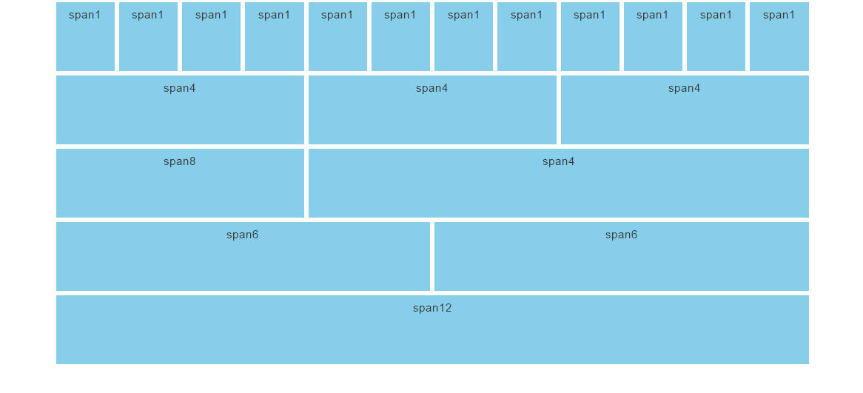
Bootstrap Grid System
In a Row There are Total 12 no of columns.

Slide 26
Bootstrap 4 Grid System
Bootstrap's grid system is built with flexbox and allows up to 12 columns across the page.
If you do not want to use all 12 columns individually, you can group the columns together to create wider columns:
The grid system is responsive, and the columns will re-arrange automatically depending on the screen size.
Make sure that the sum adds up to 12 or fewer (it is not required that you use all 12 available columns).
Grid Classes
The Bootstrap 4 grid system has five classes:
.col- (extra small devices - screen width less than 576px)
.col-sm- (small devices - screen width equal to or greater than 576px)
.col-md- (medium devices - screen width equal to or greater than 768px)
.col-lg- (large devices - screen width equal to or greater than 992px)
.col-xl- (xlarge devices - screen width equal to or greater than 1200px)
The classes above can be combined to create more dynamic and flexible layouts.

Slide 27
Basic Structure of a Bootstrap 4 Grid
<!-- Control the column width, and how they should appear on different devices --> <div class="row"> <div class="col-*-*"></div> <div class="col-*-*"></div> </div> <div class="row"> <div class="col-*-*"></div> <div class="col-*-*"></div> <div class="col-*-*"></div> </div>
<!-- Or let Bootstrap automatically handle the layout --> <div class="row"> <div class="col"></div> <div class="col"></div> <div class="col"></div> </div>
create a row (<div class="row">). Then, add the desired number of columns (tags with appropriate .col-*-* classes). The first star (*) represents the responsiveness: sm, md, lg or xl, while the second star represents a number, which should add up to 12 for each row.
instead of adding a number to each col, let bootstrap handle the layout, to create equal width columns: two "col" elements = 50% width to each col. three cols = 33.33% width to each col. four cols = 25% width, etc. You can also use .col-sm|md|lg|xl to make the columns responsive.
Visit Here :- https://www.w3schools.com/bootstrap4/bootstrap_grid_basic.asp

Slide 28



Popular

Slide 29
<div class="row"> <div class="col-xs-6"> <div class='row'> <div class="col-xs-6"> Col 1 </div> <div class="col-xs-6"> Col 2 </div> </div> </div> <div class="col-xs-6"> Col 3 </div> </div>

Slide 30
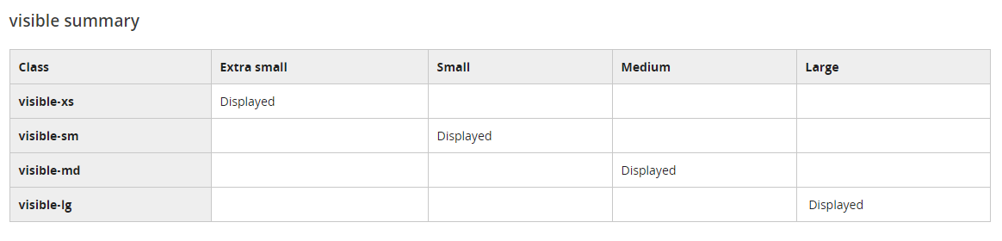
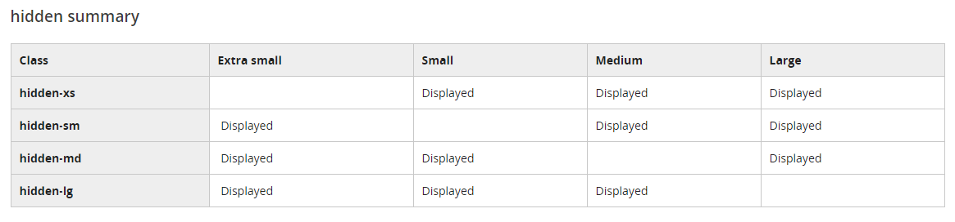
Bootstrap Visibility Classes

Slide 31
The Bootstrap grid behaves like a table. There are rows and columns. However, unlike tables, Bootstrap uses CSS to manage the layout of the pages. In addition, Bootstrap offers support for mobile browsers and different sized screens by providing different grids for different screen sizes

Slide 32
Typography Classes
https://www.w3schools.com/bootstrap4/bootstrap_typography.asp

Slide 33
Bootstrap Colors
Text Colors
Bootstrap 4 has some contextual classes that can be used to provide "meaning through colors".
The classes for text colors are: .text-muted, .text-primary, .text-success, .text-info, .text-warning, .text-danger, .text-secondary, .text-white,.text-dark, .text-body (default body color/often black) and .text-light:
Background Colors
The classes for background colors are: .bg-primary, .bg-success, .bg-info, .bg-warning, .bg-danger, .bg-secondary, .bg-dark and .bg-light.
Note that background colors do not set the text color, so in some cases you'll want to use them together with a .text-* class.
For Demo Visit Here:- https://www.w3schools.com/bootstrap4/bootstrap_colors.asp

Slide 34
Bootstrap tables:-
Bootstrap 4 Tables
Bootstrap 4 Basic Table (.table class)
Striped Rows (.table-striped class)
Bordered Table (.table-bordered class)
Hover Rows (.table-hover class)
Black/Dark Table (.table-dark class)
Dark Striped Table ( Combine table-dark table-striped together)
Hoverable Dark Table (.table-hover class)
Borderless Table
To find out More and to find demo visit here : - https://www.w3schools.com/bootstrap4/bootstrap_tables.asp
We are also using Bootstrap Tables in Our Projects.

Slide 35
Images, Jumbotron, Buttons
Images- Rounded Corners (.rounded), Circle (.rounded-circle), Thumbnail (.img-thumbnail) , Centered & Responsive
Jumbotron- Jumbotron (.jumbotron), Full Width Jumbotron (.jumbotron-fluid) and adjust the content using .container or .container-fluid inside of it:
Buttons- ButtonStyles(basic,Primary,secondary,success,info,warning,danger,link,dark,light) ,Button Outline(outline class will provide bordered outline), Button-Sizes(large,medium,small), Active/Disabled Buttons (.active, .disabled)
https://www.w3schools.com/bootstrap4/bootstrap_images.asp
https://www.w3schools.com/bootstrap4/bootstrap_jumbotron.asp
https://www.w3schools.com/bootstrap4/bootstrap_buttons.asp
https://www.w3schools.com/bootstrap4/bootstrap_images.asp

Slide 36
Bootstrap forms
Bootstrap 4 Form Layouts
Bootstrap provides two types of form layouts:
Stacked (full-width) form (the class .form-group, around each form control, is there to ensure proper margins)
Inline form ( in an inline form, all of the elements are inline and left-aligned.)
Note: This only applies to forms within viewports that are at least 576px wide. On screens smaller than 576px, it will stack horizontally.
(Additional rule for an inline form:,Add class .form-inline to the <form> element)
All textual <input>, <textarea>, and <select> elements with class .form-control have a width of 100%.
https://www.w3schools.com/bootstrap4/bootstrap_forms.asp
https://www.w3schools.com/bootstrap4/bootstrap_forms_inputs.asp

Slide 37
Navbar
Basic Navbar
Vertical Navbar
Centered Navbar
Colored Navbar
Brand / Logo
Collapsing The Navigation Bar
Navbar With Dropdown
Navbar Forms and Buttons
Navbar Text
Fixed Navigation Bar
Bottom Fixed Navbar
Sticky Navbar
For Demo Visit Here :- https://www.w3schools.com/bootstrap4/bootstrap_navbar.asp

Slide 38
navbar
Base class to create navbar

Slide 39
<navclass="navbar"> <!--Contents here--> </nav>

Slide 40
navbar-default
Class to define type of navbar

Slide 41
navbar-inverse
Class to define type of navbar

Slide 42
<nav class="navbar navbar-inverse"> <!--Contents here--> </nav>

Slide 43
Remember Page Layout Classes

Slide 44
container
Fixed width layout

Slide 45
container-fluid
Full width layout

Slide 46
<div class="container"> <!--Contents here--> </div>

Slide 47
Add Content To Navbar

Slide 48
navbar-brand
Styling website name or logo

Slide 49
<a class="navbar-brand" href="#"> Website Logo </a>

Slide 50
Login Form

Slide 51
navbar-form
Styling forms inside navbar

Slide 52
<form class="navbar-form"> <!--Form elements here--> </form>

Slide 53
form-group
Grouping form elements inside form.

Slide 54
<form class="navbar-form">
<div class="form-group"> <input type="text"> ... </div> </form>

Slide 55
form-control
Styling form elements inside form-group.

Slide 56
<form class="navbar-form">
<div class="form-group"> <input type="text" class="form-control"> </div> </form>

Slide 57
Make it Responsive

Slide 58
collapse
navbar-collapse

Slide 59
<div class="collapse navbar-collapse"> <!--Contents here--> </div>

Slide 60
Navbar Positioning

Slide 61
navbar-left
navbar-right

Slide 62
<form class="navbar-form navbar-right">
<div class="form-group"> <input type="text" class="form-control"> </div> </form>

Slide 63
Toggle Button

Slide 64
Footer

Slide 65
Acadview
Log In
Copyright 2017 Acadview Inc.

Slide 66
=
Acadview
Copyright 2017 Acadview Inc.

Slide 67
navbar-text
text-center

Slide 68
<footer> <!--navbar start--> <nav class="navbar navbar-inverse"> <!--fixed width navbar contents--> <div class="container"> <p class="navbar-text text-center"> Copyright &copy; 2017 Acadview Inc. </p> </div> <!--fixed width end--> </nav> <!--navbar end→
</footer>

Slide 69
Sign Up

Slide 70

Acadview
Log In
Acadview helps you connect and share with the people in your life.
Create an account
It's free and always will be.
Create an account
Copyright 2017 Acadview Inc.

Slide 71
=
Acadview
Acadview helps you connect and share with the people in your life.
Create an account
It's free and always will be.
Create an account
Copyright 2017 Acadview Inc.

Slide 72
Acadview
Log In
Acadview helps you connect and share with the people in your life.
Create an account
It's free and always will be.
Create an account
Copyright 2017 Acadview Inc.

Slide 73
=
Acadview
Acadview helps you connect and share with the people in your life.
Create an account
It's free and always will be.
Create an account
Copyright 2017 Acadview Inc.

Slide 74
Your Today’s Task
Design a Responsive Template By using Bootstrap which does the Following task.
Login/Sign-up Page (Contains Responsive Navbar and Footer )
Using bootstrap tables to show some static data

Slide 75
Free Bootstrap Themes
Official Themes-
https://themes.getbootstrap.com/
Sample Templates- https://startbootstrap.com/template-categories/all/

Slide 76
References
https://www.w3schools.com/bootstrap4/default.asp
https://getbootstrap.com/

Slide 77
Thank You !!!! That’s All For Today. See you in the next class

