Slide 1
Markdown & GitHub
Mukesh Dubey

Slide 2
Lecture Goals
To Present an introduction to Markdown and GitHub

Slide 3
Purpose: Getting Ready for the What To Learn
After the session make any Documentation that has to be uploaded to GitHub
Before Doing That you guys need to be comfortable with the following technologies
git --- Done ..
Markdown
GitHub
In we already Covered the introduction to git.
So Now, let’s continue and learn Markdown and GitHub

Slide 4
Markdown
Markdown is a mark-up language created by John Gruber in 2004.
He describes it like this:
Markdown is a text-to-HTML conversion tool for web writers. Markdown allows you to write using an easy-to-read, easy-to-write plain text format, then convert it to structurally valid XHTML (or HTML). You control the display of the document; formatting words as bold or italic, adding images, and creating lists are just a few of the things we can do with Markdown.
Thus, “Markdown” is two things:
A plain text formatting syntax; and …
The overriding design goal for Markdown’s formatting syntax is to make it as readable as possible. The idea is that a Markdown-formatted document should be publishable as-is, as plain text, without looking like it’s been marked up with tags or formatting instructions. While Markdown’s syntax has been influenced by several existing text-to-HTML filters, the single biggest source of inspiration for Markdown’s syntax is the format of plain text email.

Slide 5
Markdown is Everywhere
Markdown proved to be very popular
Support for it has popped up in all sorts of places
There are dedicated markdown editors; GitHub uses it extensively(Atom,Jupyter Notebook)
There are many blogging systems that will accept markdown-formatted articles and convert them to HTML automatically(Gitter)
Markdown is thus a project that “scratched an itch” for John Gruber. It is an example of “eating your own dog food”: using your own software daily.

Slide 6
Trying out the Examples
Note: You can try out any of the examples shown in this lecture
Head to <http://daringfireball.net/projects/markdown/dingus>
You can also go to GitHub
Create a new repo and ask that it have a README.md file created
Edit the README.md file to contain any Markdown you want
and then flip over to the “Preview changes” tab
Each time you switch to that tab, Github converts the Markdown that you wrote to HTML and displays the results

Slide 7
The Basics (I)
Paragraphs
A paragraph is one or more consecutive lines of text
To create a new paragraph, separate it from the previous paragraph with a blank line
<p>When converting to HTML, the paragraph is wrapped in a p tag</p>
Headings
You can specify headings in one of two ways; I’ll cover one of them
To specify that a line is a heading, start it with a hash mark (#)
A heading line can start with 1 to 6 hash marks, corresponding to HTML’s
h1, h2, h3, h4, h5, and h6 tags.

Slide 8
The Basics (II)
Blockquotes
If you need to indicate a quotation in your document, use the notation that has been used in plain-text e-mail since the dawn of time
that is, start each line with a “greater than” (>) symbol
Blockquotes can be nested and can contain other markdown elements
> # This is a heading inside of a blockquote.
>
> Here’s the text of paragraph 1 in the blockquote
>
> > Here’s a quote within a quote
>
> Here’s the text of paragraph 2 in the blockquote

Slide 9
The Basics (III)
Emphasis
To emphasize a phrase, surround it with asterisks or underscores
I *really* want you to be there
No, I _really_ do.
If you strongly want to emphasize something, then double the symbols
Listen, I **really** want you to be there
I’m not kidding.
In HTML, the former will be translated as an em tag; the latter as a strong tag
By convention, em tags appear in italics while strong tags appear in bold

Slide 10
The Basics (IV)
Lists
You can create two types of lists (just like in HTML)
Unordered lists: use *, +, or - followed by a space
Ordered lists: use numbers followed by periods and a space.
This is a list
Items can have
multiple paragraphs if you need them
just indent by four spaces
and have blank lines between items
Here's the end of the list
Here's the start of a new paragraph
Here's an ordered list that follows
with multiple items
as many as you need

Slide 11
The Basics (V)
Embedded Lists
You can embed one list inside another, as many levels deep as you need (within reason). Just prefix each level with four spaces in front of the list marker. Level 1 is a normal list. Level 2 lists have four spaces at the start of their lines. Level 3 lists have eight spaces at the start of their lines, etc.
This is a list
This is an embedded list
that is indicated by adding
four spaces in front of the list marker
Go as deep as you need.
This is the second item of the outer list
And this is the third item

Slide 12
The Basics (VI)
Code Elements and Code Blocks
You can have “code” elements either in-line or in a stand-alone block
In-line code is indicated by surrounding the word or phrase with backticks
Be sure to call the `init()` method before you call `doMyWorkForMe()`
Stand-alone code blocks are indicated by four spaces at the start of the line
def check(dir: Path) = { if (!exists(dir)) {
error(s"Directory: <$dir> does not exist.")
}
}

Slide 13
The Basics (VII)
Links
Markdown supports two styles of links. I’ll show you the most common one
To create a link, you indicate the text of the link, and then the link itself
The text goes in square brackets, the link goes in parentheses.
Check out [GitUp](http://gitup.co) for a cool way to view git repos.
You can add a link title if you want
Check out [GitUp](http://gitup.co "It's cool!") for a cool way to view git repos.
Link titles appear as a tool-tip in web browsers when you hover over a link.
They also increase the accessibility of your page as they can be processed by screen readers and other similar tools.

Slide 14
The Basics (VIII)
Images
Images have a similar syntax to links.
![alt text](href "title")
For example
![Kitties!](http://www.pluspets.net/wp-content/ uploads/2011/01/Best-Cats-Photos8.jpg "So cute!")

Slide 15


MARKDOWN SYNTAX
# This is an <h1> header format This Is an <h1> header format
## This is an <h2> header format This is an <h2> header format
### This is an <h6> header format This is an <h2> header format
*This text will be in italics* This text will be in italics
**This text will be in bold** This text will be in bold
**_This text will be in bold and italic_** This text will be in bold and italic
Unordered list:
-First
–Second
-Third
Ordered list:
1. First item
2 Second item
3. Third item
Links: [Google](http://www.google.com) Google
![alt text](href "title")
![Kitties!](https://www.google.co.in/url?sa=i&rct=j&q=&esrc=s&source=images&cd=&cad=rja&uact=8&
ved=2ahUKEwjv3aaytYbdAhXTeX0KHXzGDtAQjRx6BAgBEAU&url=https%3A%2F%2Ftwitter.com%2F
MukeshDubey1420%2Fstatus%2F980293391668756481&psig=AOvVaw0y6OAAyH6-GKLCPsg8wxvd&
ust=1535225110003352 “Team Decider!")
Unordered list:
First
Second
Third
Ordered list:
First
Second
Third

Slide 16
HTML Allowed (I)
Markdown’s reason for existence is to take text and convert it to HTML
As a result, if there is something that HTML allows but Markdown doesn’t support, just insert the HTML directly into the Markdown
This applies to block level and in-line elements of HTML
See <http://daringfireball.net/projects/markdown/syntax> for details
For instance, the oﬃcial version of Markdown does not support tables
Note: GitHub’s version (or “flavor”) of Markdown does
So, in the oﬃcial version of Markdown, if you need a table just add it
See example next slide

Slide 17
HTML Allowed (II)
This is a <a href=“http://daringfireball.net/projects/ markdown/">Markdown</a> paragraph
<table>
<tbody>
<tr>
<td>Row 1, Column 1</td>
<td>Row 1, Column 2</td>
</tr>
</tbody>
</table>
This is a second Markdown paragraph

Slide 18
Why?
Why did I present this information?
Because GitHub uses Markdown everywhere and even adds new features to Markdown
What does GitHub add to Markdown?
URL auto-linking
Strikethrough text
Fenced code blocks and syntax highlighting
Tables
Click on the link above for more information

Slide 19

GitHub

Slide 20
GitHub
GitHub is a Web-based repository hosting service for git
You can upload your repositories to it and then access/manipulate them with a nice Web-based interface for many of the most common commands
(as many public repositories as you want; you have to pay to keep your repositories private)
It then adds new services on top of git that are designed for collaboration
access control
issue tracking
notifications
pull requests

Slide 21

Brief Introduction to GitHub
I will not attempt to present a comprehensive introduction to GitHub
Features that I don’t cover can become the topic of YOUR essays 😃
Take a look at: <https://github.com/features> for more info
Instead, I’ll cover
how you can use GitHub as a remote copy of a local repository
This will allow us to explore the pull and push commands
how you can use GitHub to serve your essays to the world

Slide 22
Assumptions
I assume that you
have a GitHub account
you will need one for this class (so please create one, if needed)
have followed the “Set Up Git” instructions at GitHub Bootcamp
When you issue “git clone”, “git fetch”, “git pull”, and “git push” requests, GitHub will ask you for your password or passphrase
If you don’t want to type that each time, you will need to
a) create/upload your public key file to your GitHub profile, or
b) store your GitHub password in a credential helper

Slide 23
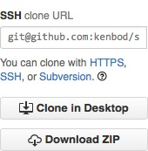
Linking Repositories (I)
The first thing that needs to happen to work with Github is linking a repository on your computer to one that exists on Github
There are two primary ways to do this
1. If the repo exists on GitHub and not on your computer
git clone <URI>
GitHub make this easy by letting you cut-and-paste the URI from the repo’s home page

Slide 24










Big Picture View (I)
HEAD
master
HEAD
master
0
1
2
5
0
1
2
5
3
4
bug-fix
3
4
bug-fix
Use “git clone” to copy a repo to your machine
git clone
HEAD
master
0
1
2
5
3
4
bug-fix

Slide 25
The Link
When you do this, git clone configures the repository to remember where it came from
You can verify this with the git remote command
For one of my GitHub-based repos, the git remote -v command lists
origin git@github.com:kenbod/icse2016.git (fetch)
origin git@github.com:kenbod/icse2016.git (push)
This says that my local repository is associated with a remote copy called “origin” (a standard convention) that is located on GitHub.
My repository can be associated with any number of other repositories
On a local-only repo, git remote -v produces no output

Slide 26

Linking Repositories (II)
Going back to linking repositories… the other primary way of doing this is:
2. If the repo exists on your computer but not on GitHub then
Create an empty repo on Github:
Fill out the resulting dialog (see next slide)

Slide 27
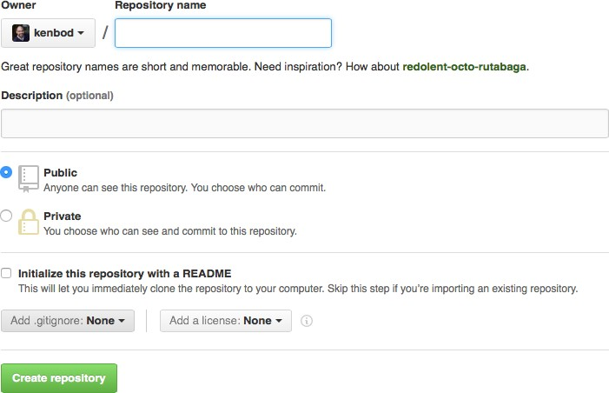
Repo name goes here

Slide 28
Linking Repositories (III)
After the empty repository has been created, GitHub provides helpful instructions on how to establish the link (see next slide)
As an example, I took the (very) simple repo I created in the Git lecture and uploaded it to GitHub
I named my new empty repo on GitHub “example_project” to match what I called the repo locally.

Slide 29
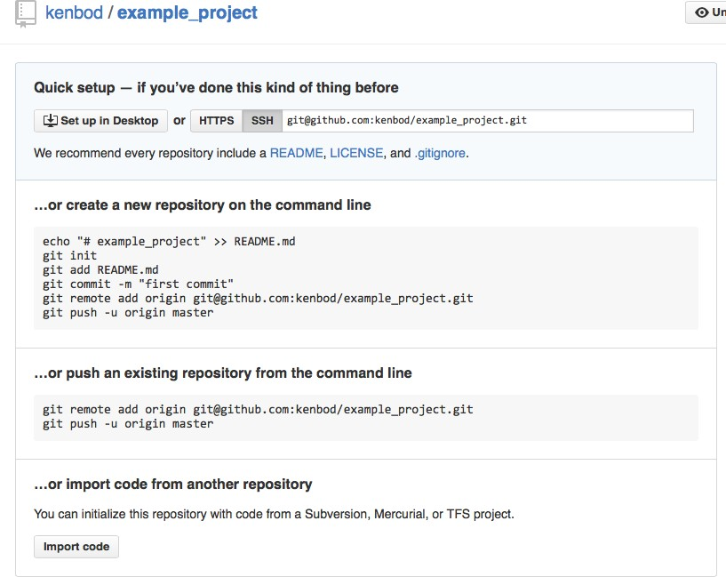

Slide 30
Things to note:
git remote command first used to add a remote repository, then used to list our local repository’s remotes.
git push is used to push the contents of our master branch to the remote repo and to configure the local branch to “track” the remote
git branch -a is used to list all branches including the ones on our remote We have a local branch called “bug-fix” that did NOT get copied to the remote

Slide 31
Establishing the link
git clone
When you clone a repository, it automatically creates a local branch for each remote branch and sets up a “tracking relationship” between them
A local branch that “tracks” a remote branch will allow “git pull” commands to copy commits from the remote branch that were added in some way (typically pushed to that branch by one of your collaborators)
git push -u <repo> <refspec>
This is the other way to establish a link between a local branch and a remote one; in this case, you’re simultaneously pushing the contents of a local branch (thus creating the branch on the remote repository) and setting up the tracking relationship

Slide 32
git push (I)
We are just scraping the surface of the “git push” command
The generic form of the command is:
git push <options> <repo> <refspec>
The <repo> argument ALWAYS refers to a remote repository
If you don’t specify it, then ‘origin’ is assumed
<refspec> is a placeholder for this beast: (+)<src_ref>:<dst_ref>
src_ref is a refspec that references your local repo; dst_ref is for the remote
If you just list a single branch name (like we did), it is short for
<src_branch>:<dst_branch> or, in our case, master:master
If you don’t specify the <refspec>, your current branch is assumed

Slide 33
git push (II)
Putting it all together
git push -u origin master
means: push the contents of the master branch of MY repository to the master branch of the REMOTE repository (creating the branch, if needed) AND set up a tracking relationship between them
After we set-up the tracking relationship, we can push new commits to master to the remote copy of master using ANY of these commands
git push origin master:master
git push origin master
git push (assuming that master is your current branch)

Slide 34
Pull before you Push (I)
If you have new commits that you want to push to the remote but someone else already pushed THEIR new commits to the remote, you will need to pull them in first using ANY of these commands
git pull origin master
git pull
git pull is a “short cut” in that it does the following thing
git fetch <args>: pulling down the latest info about the remote
git merge <remote-branch>: this merges the changes of the remote branch into your current local branch
Note: you can just do “git fetch” and then do the merge yourself if you want

Slide 35
Pull before you Push (II)
Regardless, once you have pulled, you can resolve any conflicts that might have popped up and then you can push your own commits to the remote branch
Finally, going back to our example, if we want our “bug-fix” branch from our local repository to be stored on the remote, then we can just push it using the same command that we did before
Here’s how
git checkout bug-fix
git push <== fails, because remote branch doesn’t exist yet
git push -u origin bug-fix <== works!

Slide 36
Using GitHub for our Essays

Slide 37
Using GitHub's Wiki Feature
For week 3, we are going to use GitHub's Wiki Feature to submit our essays
See https://github.com/kenbod/5828_F16/wiki/ for details
Overview
Pick a software engineering topic, technique, framework, person, etc. and write a short essay on that topic (2 to 4 paragraphs)
Go to the wiki, create a page (named after your topic), and use Markdown to enter information, links, code, images, etc.
Essays are due on Wednesday by 11:59 PM
On Thursday, find three essays from other students and add a review
Reviews are due on Sunday by 11:59 PM

