Slide 1
Most Expensive Weather and Climate Disasters in USA
Mukesh Rajmohan
G01456275

Slide 2
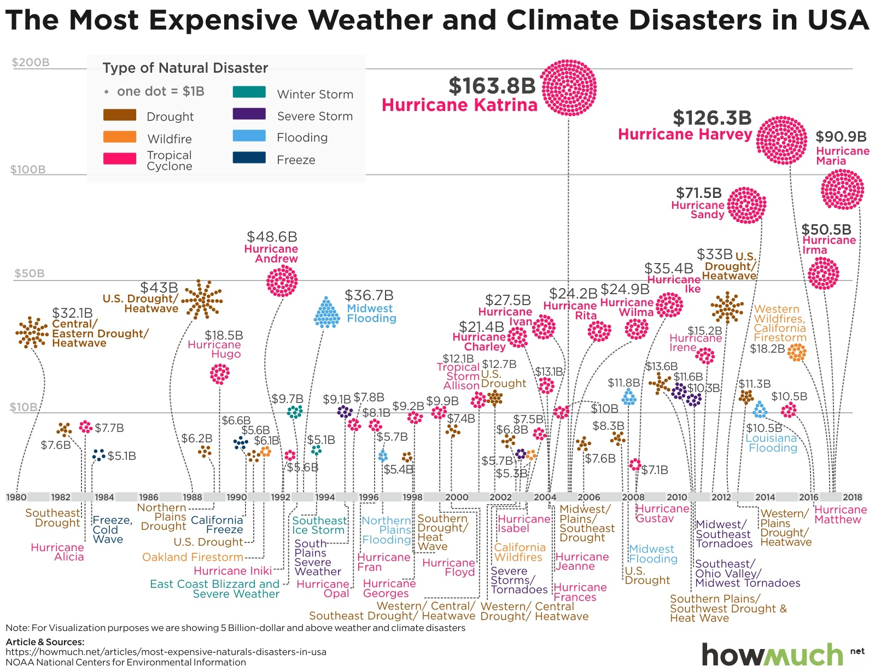
Bad Graph

Slide 3
The Graph attempts to handle all the disasters from 1980 to 2020.
Depiction of one dot = $1B is not necessary since the cost is shown.
No information on what type of disaster cost the most in each region.
The names of the disaster are not clear for human view.
The Y-axis information doesn’t provide accurate info on which year it happened.
The X-axis intervals are also too far to match the cost with the disaster.
The information is not grouped properly to find the most expensive natural disasters.

Slide 4
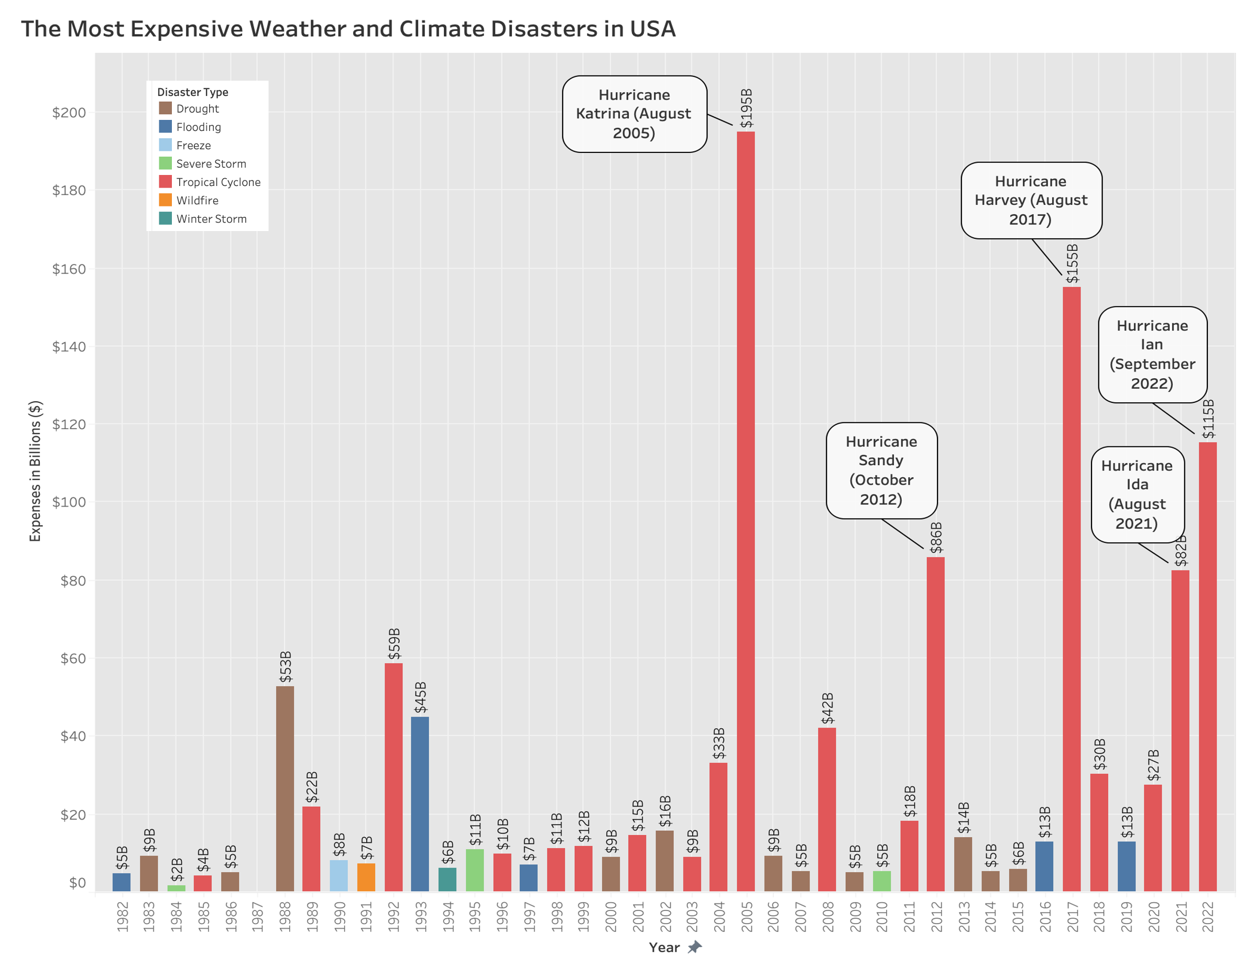
Redesigned Graph

Slide 5
Data Source
National Centers for Environmental Information.
Data of all natural disasters that happened between 1982 – 2022.
Data of the total cost of each disaster type in each state.
Software Solution
R –> Pre-processing of the data source to get usable data for visualization.
Tableau –> To visualize the graphs and create dashboards.

Slide 6
Improvements
Display of highest costing disaster each year.
Clear distinction between the different disaster types.
Labelling of the expenses stemming from each disaster.
Marking of the 5 highest costing disasters over time.
Possible Additional Approach
Order the disaster based on expenses.
Show a map with high costing disaster types respective to each state.
Label the expenses of the highest costing states.
Mark the highest costing disaster of each type.

Slide 7
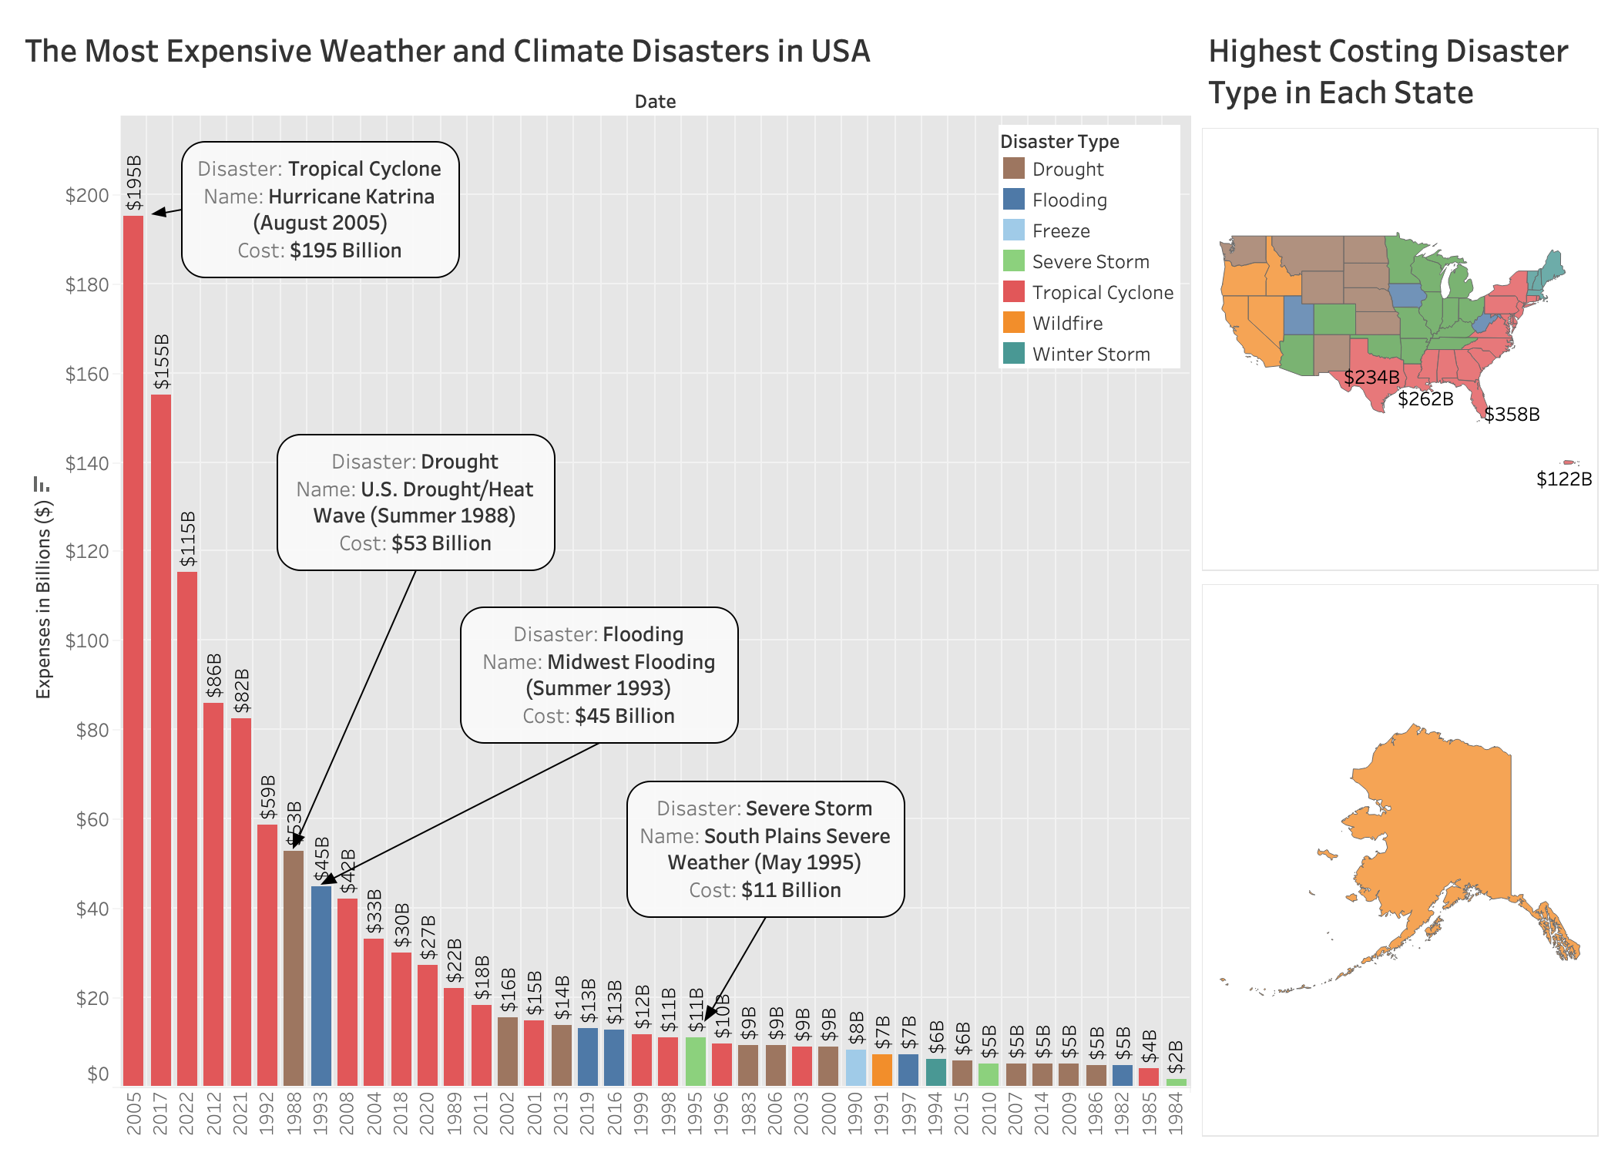
Redesigned Graph

