Slide 1
RESUME PARSING AND ANALYSIS USING NLP TECHNIQUES

Slide 2
Team
Akhil Bhimarasetty
Phani Venkata Krishna Varun Vegi Sai Raghavendra
Mukesh Rajmohan
Bhuvan Sai Thatthari

Slide 3
Introduction
The recruitment industry faces the challenge of processing hundreds of resumes per job posting. This project introduces an NLP-driven solution that automates the extraction and analysis of key information from resumes, significantly enhancing the efficiency and objectivity of the recruitment process.
Notes:
Every industry faces multiple challenges during recruitment,
Major challenge is to process hundreds of resumes per a job posting
This project introduces an NLP-driven solution that automates the extraction and analysis of key information from resumes, significantly enhancing the efficiency of the recruitment process

Slide 4
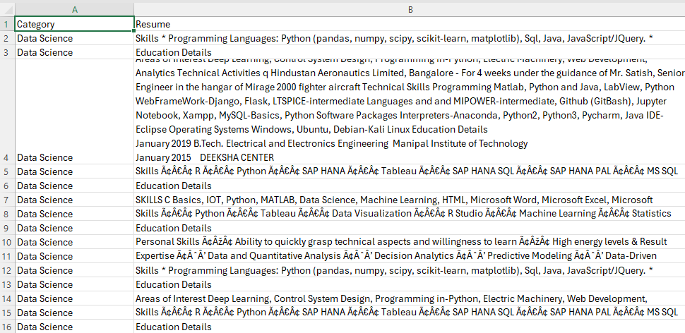
Dataset
https://www.kaggle.com/datasets/gauravduttakiit/resume-dataset?select=UpdatedResumeDataSet.csv
Notes:
The dataset consist of 25 different categories here is the example of 15 data science categories each consist of different resumes
The dataset has around 1000 resumes, sourced from online job portals and recruitment databases. It includes diverse fields like education, work history, skills, and certifications.
Data preprocessing steps involved cleaning textual data, normalizing job titles, and categorizing skills and educational qualifications to standardize entries across the dataset.

Slide 5
Objectives
Identification and extraction of essential data
Improve the precision in matching candidates with job requirements
Reduce the time spent on manual resume screening
Notes:
To develop an NLP system that automates the identification and extraction of essential data from resumes such as skills, educational background, and professional experience.
To improve the precision in matching candidates with job requirements, thereby enhancing the effectiveness of the recruitment process.
To reduce the time HR professionals spend on manual resume screening, allowing them to focus on more value-adding activities.

Slide 6
System Architecture
Data ingestion module.
Preprocessing unit.
NLP processing engine.
Decision support system that ranks candidates.
Notes:
Data Ingestion Module:
It handles the collection and initial storage of resume data, which can come from various sources such as online job portals, email attachments, or directly uploaded files.
It reads different file formats like pdf, docx, txt
It organizes data into a structured format for further processing.
Preprocessing Unit:
This unit cleans and normalizes the data
It does so by converting all the text to lowercase
Removing special characters and irrelevant information like headers and footers and graphical elements
Correcting typos
Tokenization of text and removal of common words like the and
NLP Engine: Performs feature extraction using TF-IDF to convert text data into numerical format for the ML models to understand.
Entity Recognition to identify and categorize key pieces of information like names, companies, job titles, skills and educational qualifications
Decision Support System:
This uses processed data to make informed decisions like ranking the candidates based on how well their qualifications match the job criteria.

Slide 7
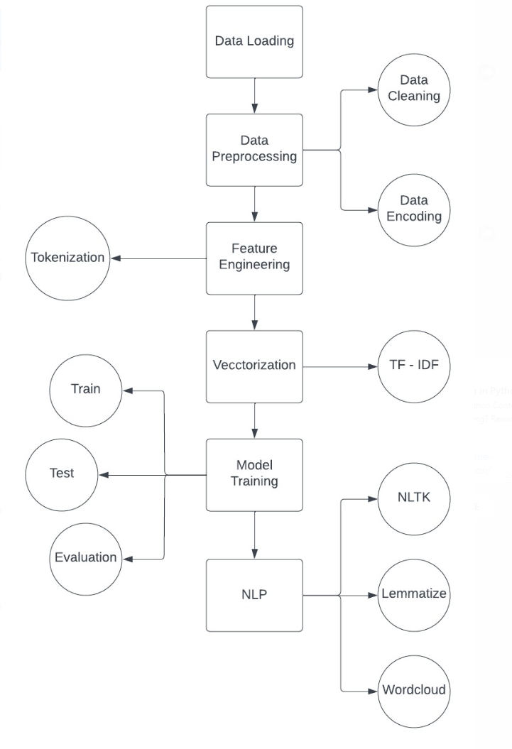
Flowchart

Slide 8
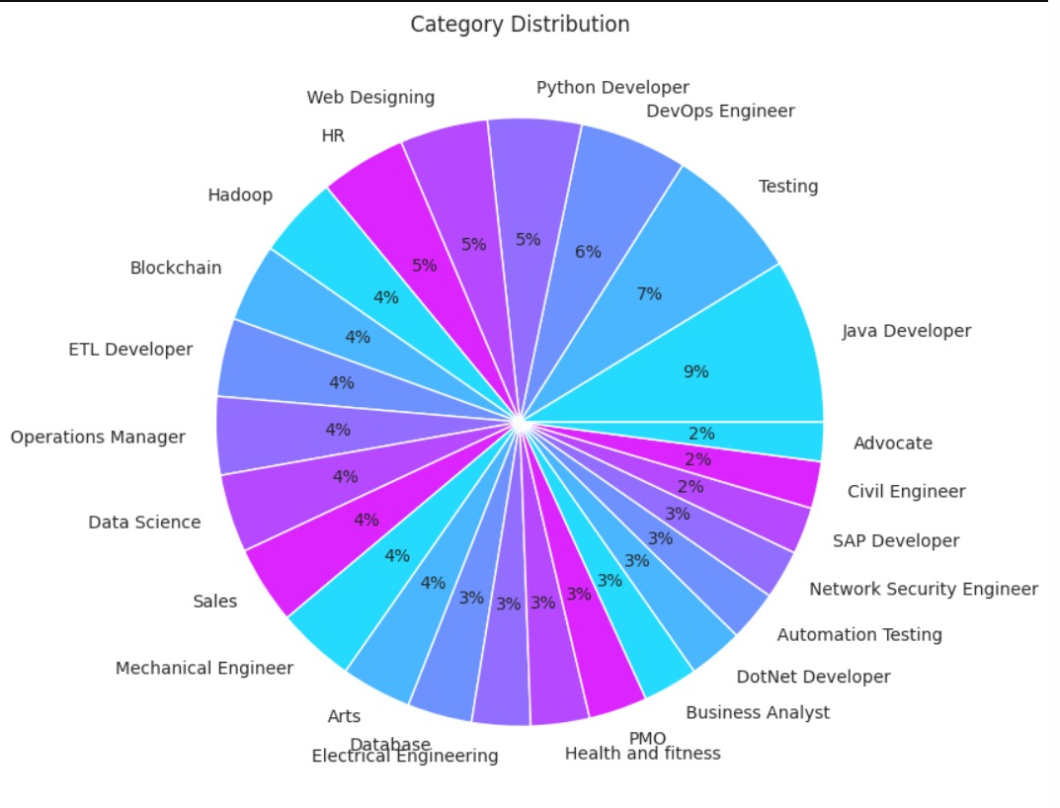
EDA of Dataset

Slide 9
NLP and/or Data Analytics Approaches:
Tokenization
TF-IDF for feature extraction
Entity recognition
Notes:
Tokenization is used to split resume content into words.
This allows the system to individually analyze each word for further processing steps such as stop word removal, normalization, and feature extraction.
TF-IDF:
It is a statistical measure used to evaluate the importance of a word to a document in a collection or corpus.
TF: Term Frequency is used to measure the importance of a word in a document.
IDF: Inverse Document Frequency is used to measure the importance of a word across documents. Highter the frequency, lower is the IDF score.
This is used to check for words like skills and experiences that a re relevant to specific job descriptions.
Helps to better match candidates and job postings
Named Entity Recognition:
NER is a process when an NLP model identifies and classifies proper nouns in text into predefined categories such as names, companies, job titles, skills, educational institutes, etc. so that it becomes easy for us to match the skills required for that set job description.

Slide 10

Experimental Results and Analysis Accuracy of the Results

Slide 11
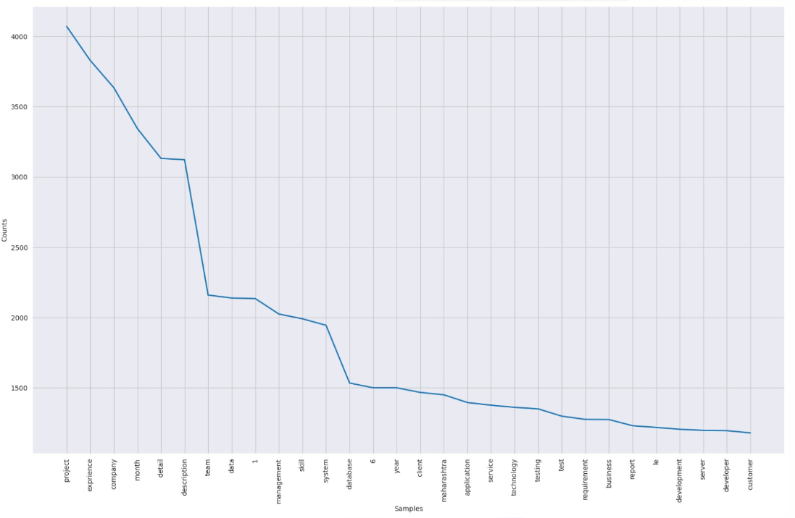
Token Frequency

Slide 12
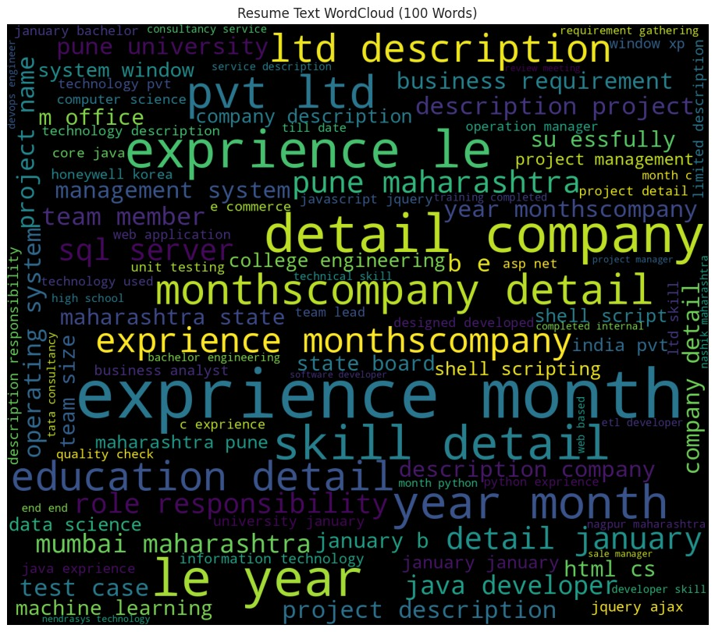
Word Cloud (100 words)

Slide 13
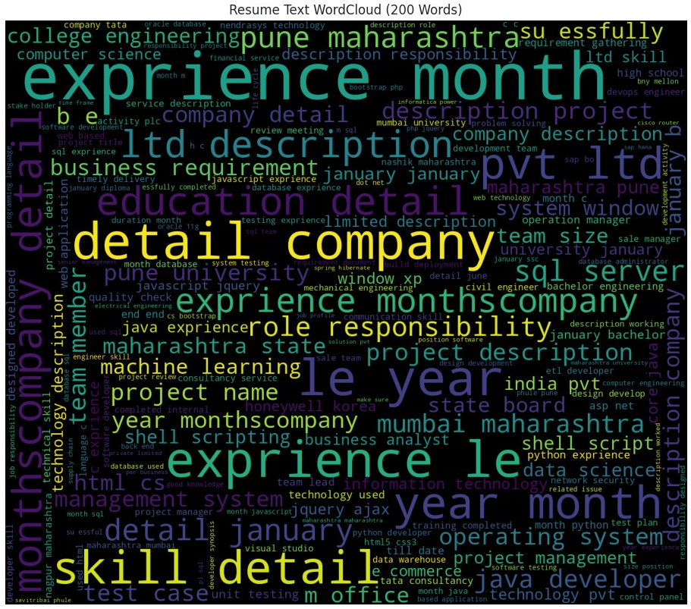
Word Cloud (200 words)

Slide 14
Explain how your proposed solution succeeded
Successful automated significant parts of resume screening.
Categorize candidates according to job description.
Improvements needed to handle creative and diverse resumes.

Slide 15
Future Works
Firstly, we would spend more time on research and understanding the ever-evolving metrics of resumes and data extraction.
We plan to work with larger datasets encompassing a wider variety of categories.
We intend to employ advanced NLP techniques like BERT on our data and build a novel model.
We look to implement this model as an interactive GUI in the form of a web/mobile app for commercial use.
Notes:
1 with every passing year the format of making resumes and editing it has been constantly leveling up and nowadays resumes come in various formats and styles, sometimes making it difficult for the machine to directly understand it just from raw input.
2 this will enable us to expand and test the caliber of the model when using a larger set of values and data

Slide 16
Conclusion
In this project, we achieved classification of almost 1000 resumes into their respective categories with 99% accuracy.
We demonstrated how machine learning and Natural Language Processing can be applied to improve our day-to-day life through the example of this Resume Screening project.

Slide 17
Thank you

