Slide 1
DataCamp case study project
Rental price predictor application for San Francisco

Slide 2
FACTS
Rents dropped 12% year over year during the summer of 2020 and were up 79% in first half of 2021 compared to the first half of 2020.
Renter-occupied households account for 188,696 (or 52%) of San Francisco households, while owner-occupied households account for 173,658 (or 47%).
San Francisco has a very large rental market just falling behind New York.
The average rent for an apartment in San Francisco is $3,102 is lot less compared to 2018.

Slide 3
CASE STUDY
A housing rental company has hired you for a new project. They are interested in developing an application to help people estimate the money they could earn renting out their living space.
The company has provided you with a dataset that includes details about each property rented, as well as the price charged per night. They want to avoid estimating prices that are more than 25 dollars off of the actual price, as this may discourage people.

Slide 4
METHODOLOGY
There is a lot of features in the data which is unnecessary for our use case which is provided by the organization. We removed all unwanted data.
After cleaning the data, it finally has 2496 rows and 10 columns.
Different machine learning techniques were applied on the data to predict the rental price.
The final model comes within $23 of the real price. With the ability to explain 50% of the price variation.

Slide 5
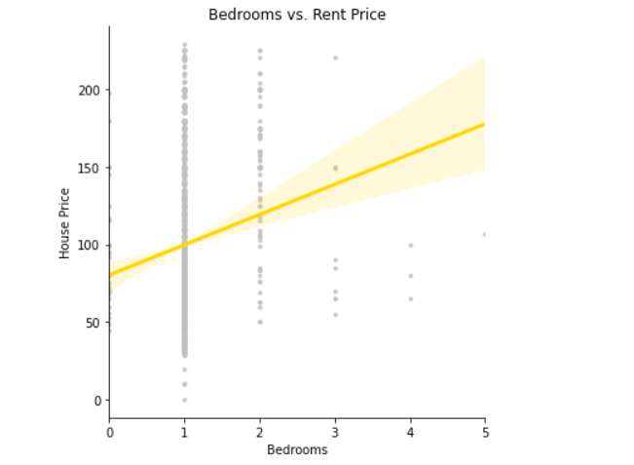
No. of Bedrooms and their prices
The most common type of rental is single bedroom.
There are very less more than 3 bedroom houses.
The increase in bedrooms is increase in rental price.
The 2 bedroom houses has a minimum rental price (50$) and gradually increases.

Slide 6
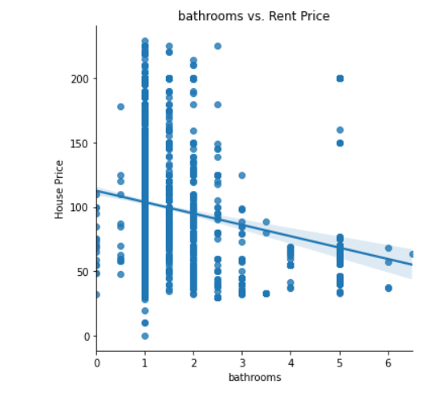
No. of Bathrooms and their prices
Here the greater number of bathrooms doesn’t really increase the price.
Because it might be a sharing room and people need to share those Bathrooms.
Again, the most common type is having 1 bathroom.

Slide 7
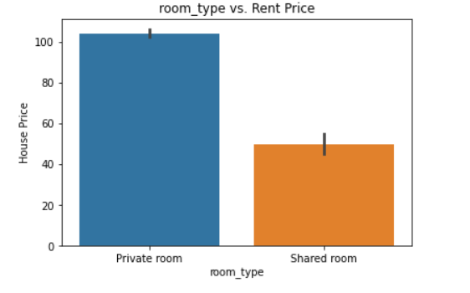
Type of Rooms and their prices
We can clearly say that private room is more costly than shared rooms.
Shared room maximum price is nearly half compared to private room.

Slide 8
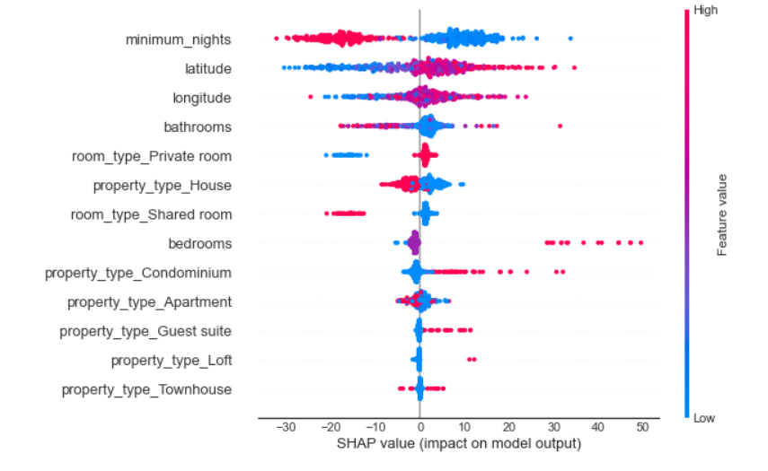
FINAL RESULTS
When a property is rented for a short period of time, the rental revenue is higher.
Closer proximity to the city center guarantees more rental income.
Short-term rentals are more profitable.
The rent for a listing with a large number of bedrooms is greater.
Surprisingly, shared rooms are more expensive, possibly due to the rental quality.
The most expensive sort of renting is a condominium.

Slide 9
CONCLUSION
The location of your property does have an impact on rental income.
In the near run, location is the most important factor in determining rental pricing.
Condo owners might anticipate a boost in rental income.
If your property is closer to the city's center, you can charge more.

Slide 10

THANK YOU

